Slide 1

The Gospel as Apologetic:
Why the message of salvation shows that Christianity is true
Dr. Neil Shenvi
Fairview Baptist Church
September 12, 2026

Slide 2
Outline
Motivation
Unique truths = Uniquely true religion
Christianity makes unique claims about sin and salvation
Christianity’s claims about sin are true
Christianity claims about salvation are true
Conclusions

Slide 3
Why do we need the Argument from the Gospel?
The problem of justification
Existential weight
Evangelistic simplicity

Slide 4


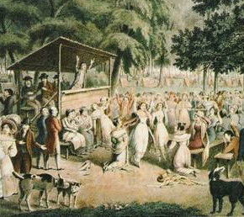

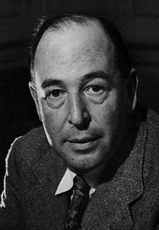

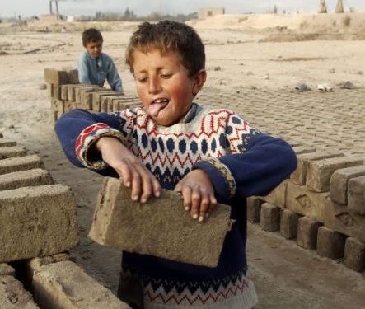

How do we bridge the gap between available evidence and typical Christian experience?
Available resources
Real-life

Slide 5

How do we withstand dark nights of the soul?

Slide 6

How do we incorporate apologetics into evangelism?

Slide 7
The Argument from the Gospel
Unique truths = Uniquely true religion.
Christianity makes unique claims about sin and salvation.
Christianity’s claims about sin are true.
Christianity’s claims about salvation are true.
Therefore, Christianity is uniquely true.

Slide 8

Unique truths = uniquely true religion

Slide 9
The Argument from the Gospel
Unique truths = Uniquely true religion.
Christianity makes unique claims about sin and salvation.
Christianity’s claims about sin are true.
Christianity’s claims about salvation are true.
Therefore, Christianity is uniquely true.

Slide 10


Comparative religion and religious hatred

Slide 11

Comparative religion and religious hatred
Religious differences do not necessarily imply superiority or inferiority
Some religious differences are matters of empirical fact
The uniqueness of Christianity does not necessarily imply the truth of Christianity

Slide 12
The uniqueness of the gospel
Christianity on sin and rescue
  Catholicism
  Eastern Orthodoxy
  Protestantism
Other major religions on sin and rescue
  Buddhism
  Hinduism
  Islam
  Judaism

Slide 13
Catholicism on sin and rescue
386 Sin is “humanity's rejection of God and opposition to him.”
403 “the overwhelming misery which oppresses men and their inclination towards evil and death” is based on “a sin with which we are all born afflicted, a sin which is the ‘death of the soul’”
430 “Since God alone can forgive sins, it is God who, in Jesus his eternal Son made man, ‘will save his people from their sins.’”
457 “The Word became flesh for us in order to save us by reconciling us with God, who ‘loved us and sent his Son to be the expiation for our sins’”¹
¹Catechism of the Catholic Church, 2nd ed., Libreria Editrice Vaticana, Citta del Vaticano

Slide 14
Orthodoxy on sin and rescue
“God has made man, and willed that he should abide in incorruption; but men, having despised and rejected the contemplation of God, and devised and contrived evil for themselves … received the condemnation of death … [they were] corrupted according to their devices; and death had the mastery over them as king.”
“seeing the race of rational creatures in the way to perish, and death reigning over them by corruption [Jesus] gave [his body] over to death in the stead of all” and that Jesus sacrificed himself because “no otherwise could the corruption of men be undone save by death as a necessary condition.”¹
¹Athanasius of Alexandria, On the Incarnation of the Word, Chapters 8-9.

Slide 15
Protestantism on sin and rescue
“Q. Can you live up to [God’s law] perfectly?
A. No. I have a natural tendency to hate God and my
neighbor.”¹
Jesus perfectly obeyed God’s law and then “underwent the punishment due to us, which we should have borne and suffered, being made sin and a curse for us” so that “by his perfect obedience and sacrifice of himself … [He] hath fully satisfied the justice of God, procured reconciliation, and purchased an everlasting inheritance in the kingdom of heaven.”²
¹ Heidelberg Catechism, Question 5.
² LBC 1689, Chapter 8

Slide 16
Buddhism on sin and rescue
The Four Noble truths identify not sin, but suffering as our fundamental problem
The goal of Buddhism is the attainment of nirvana, a state of eternal bliss and liberation from desire
Buddha taught that “the way to overcome self-seeking is through the Eightfold Path [which is] a course of treatment… It is not treatment by pills, or rituals, or grace [but] by training.”¹
Mahayana Buddhism includes a concept of ‘savior’ but the salvation is from suffering, not sin
¹Smith, H. The World’s Religions, Harper Collins, New York, 1991, p. 104.

Slide 17
Hinduism on sin and rescue
Hinduism identifies our fundamental problem as samsara, the cycle of reincarnation
The goal is moksha, liberation from reincarnation, which can be achieved through following the way of knowledge, the way of works, or the way of devotion
The way of devotion shares some similarities with the Christian conception of grace, but the gift sought is not necessarily forgiveness or reconciliation. Moreover, it is only one way among many.

Slide 18
Islam on sin and rescue
Islam recognizes that sin is an offense against God, but denies that we are innately or radically sinful and that we need a Savior
“Sin is not a state of being; it is the result of an act of disobedience, failure to do or not to do what God commands or prohibits. Human beings are not sinful by nature.”¹
Muslim Suzanne Haneef writes “there is no need for a Savior, and in any case God Most High alone can save.”²
¹Esposito, J.L. Islam: The Straight Path, 3rd edition, Oxford University Press, Oxford, 1988, p. 27
²Haneef, S. What Everyone Should Know About Islam and Muslims, 11th ed., Kazi Publications, Inc., Chicago, 1993, p. 182

Slide 19
Judaism on sin and rescue
Modern Judaism grew out of rabbinic Judaism, which emerged after the destruction of the Temple in 70AD
“Judaism teaches that human beings are not basically sinful. We come into the world neither carrying the burden of sin committed by our ancestors nor tainted by it.”¹
“Through devoted obedience to the prescriptions of Torah [God’s law] and its rabbinic elaborations, Judaism has taught that one might lead a life of divinely guided sanctity and ascend along just this path to religious perfection and communion with God.”²
¹Hammer, R. Entering the High Holy Days, The Jewish Publication Society, Philadelphia, 2005, p. 30.
²Fishbane, Michael A. Judaism, Harper and Row, San Franciso, 1987, p. 15-16.

Slide 20
The uniqueness of Christianity
Prof. Stephen Prothero’s classification of world religions:
Religion | The problem is… | The solution is…
Buddhism | Suffering | Awakening
Hinduism | Samsara (“wandering”) | Moksha (“release”)
Islam | Pride | Submission
Judaism | Exile | Return to God
Christianity | Sin | Salvation
¹Prothero, S. God is Not One, Harper Collins Publishers, New York, 2012

Slide 21

The uniqueness of Christianity
“[W]hile it may seem to be an act of generosity to state that Confucians and Buddhists and Muslims and Jews can also be saved, this statement is actually an act of obfuscation. Only Christians seek salvation…
[J]ust as hitting home runs is the monopoly of one sport, salvation is the monopoly of one religion. If you see sin as the human predicament and salvation as the solution, then it makes sense to come to Christ.”¹
¹Prothero, S. God is Not One, Harper Collins Publishers, New York, 2012, p. 22-23.

Slide 22
The Argument from the Gospel
Unique truths = Uniquely true religion.
Christianity makes unique claims about sin and salvation.
Christianity’s claims about sin are true.
Christianity’s claims about salvation are true.
Therefore, Christianity is uniquely true.

Slide 23

The Bible on sin
"The LORD saw that the wickedness of man was great in the earth, and that every intention of the thoughts of his heart was only evil continually." - Gen. 6:5
"Against you, you only, have I sinned and done what is evil in your sight... Behold, I was brought forth in iniquity, and in sin did my mother conceive me."
- Psalm 51:4-5
"None is righteous, no, not one; no one understands; no one seeks for God. All have turned aside; together they have become worthless; no one does good, not even one." - Rom. 3:10-12

Slide 24
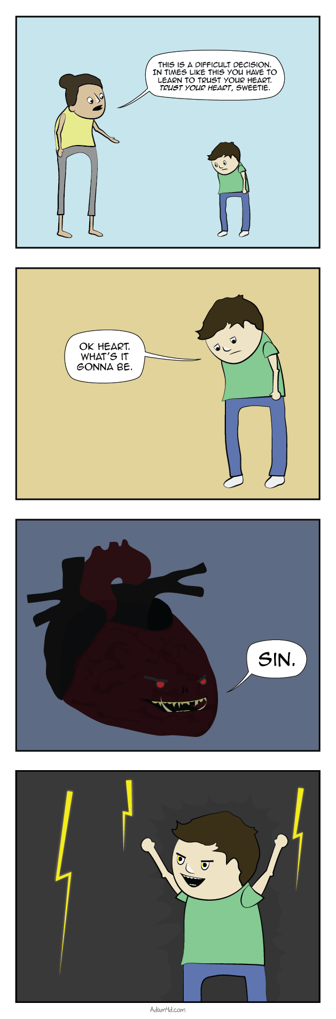
The Bible on sin
THIS IS A DIFFICULT DECISION. IN TIMES LIKE THIS YOU HAVE TO LEARN TO TRUST YOUR HEART. TRUST YOUR HEART, SWEETIE.
OK HEART, WHAT’S IT GONNA BE.

Slide 25
The depth and ubiquity of evil
“In the majority of massacres there is evidence of multiple acts of savagery, which preceded, accompanies or occurred after the deaths of victims. Acts such as killing defenseless children, often by beating them against walls or throwing them alive into pits where the corpses of adults were later thrown; the amputation of limbs; the impaling of victims; the killing of persons by covering them in petrol and burning them alive; the extraction, in the presence of others, of the viscera of the victims who were still alive… the opening of wombs of pregnant women, and other similarly atrocious acts.” – The Commission on Historical Clarification, describing Guatemalan atrocities against the Mayans
Naimark, N.M., Genocide: A World History Oxford University Press, New York, 2017, p. 109

Slide 26
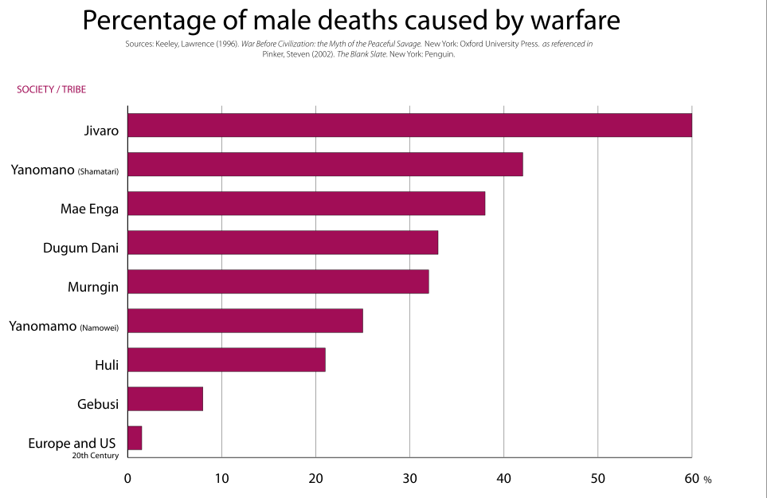
The depth and ubiquity of evil
Pinker, S. The Blank Slate, Penguin, New York, 2002, p. 57

Slide 27

The depth and ubiquity of evil
“the psychological toll of this work is immense. A lot of the job involves taking down pornography, of course, but a lot of it is taking down hateful, sadistic, and terrifying stuff. (There's also a lot of overlap.) ‘The worst was the gore: brutal street fights, animal torture, suicide bombings, decapitations, and horrific traffic accidents,’… One woman in particular is ‘especially haunted’ by a video she took down, about half an hour long, that appeared to be of a [CENSORED] Seeing that just once would be hard to get over, but having to deal with that stuff daily seems impossible to fathom.”
“The army of content moderators is huge, ‘well over 100,000,’”
Marcotte, A. “An Army of Workers Overseas Suffer the Worst of the Internet So You Don’t Have To,” Slate, Oct. 27, 2014.

Slide 28
Milgram experiments
Yale professor Stanley Milgram recruited ‘teachers’ to subject ‘learners’ to electric shocks
Under the supervision of a ‘scientist’ 65% of the ‘teachers’ were willing to administer lethal voltages to the ‘learners’
A 2006 experiment replicated the results
Burger, J. M. American Psychologist. Vol. 64, No. 1, p. 1–11.

Slide 29
The radical nature of sin
“You have heard that it was said to those of old, ‘You shall not murder; and whoever murders will be liable to judgment.’ But I say to you that everyone who is angry with his brother will be liable to judgment; whoever insults his brother will be liable to the council; and whoever says, ‘You fool!’ will be liable to the hell of fire.” – Matt. 5:21-22
“You have heard that it was said, ‘You shall not commit adultery.’ But I say to you that everyone who looks at a woman with lustful intent has already committed adultery with her in his heart.” – Matt. 5:27-28

Slide 30
The Argument from the Gospel
Unique truths = Uniquely true religion.
Christianity makes unique claims about sin and salvation.
Christianity’s claims about sin are true.
Christianity’s claims about salvation are true.
Therefore, Christianity is uniquely true.

Slide 31

The Bible on rescue
"God shows his love for us in that while we were still sinners, Christ died for us." - Rom. 5:8
"But God, being rich in mercy, because of the great love with which he loved us, even when we were dead in our trespasses, made us alive together with Christ—by grace you have been saved” - Eph. 2:4-5
"For the Son of Man came to seek and to save the lost.”- Luke 19:10

Slide 32
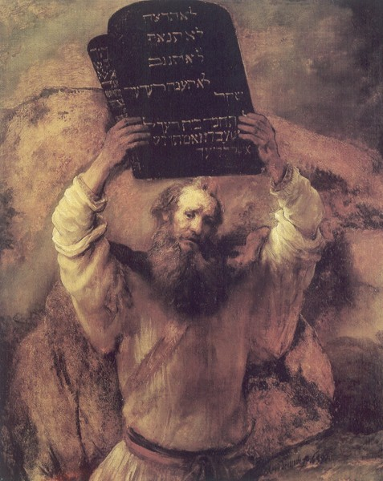
Sin as transgression
“But if you will not obey the voice of the Lord your God or be careful to do all his commandments and his statutes that I command you today, then all these curses shall come upon you and overtake you…The Lord will send on you curses, confusion, and frustration in all that you undertake to do, until you are destroyed and perish quickly on account of the evil of your deeds, because you have forsaken me.” – Deut. 28:15-20
“[God] will render to each one according to his works…For all who have sinned without the law will also perish without the law, and all who have sinned under the law will be judged by the law. For it is not the hearers of the law who are righteous before God, but the doers of the law who will be justified.” – Rom. 2:6-13

Slide 33

Sin as transgression

Slide 34

Sin as slavery
“Do you not know that if you present yourselves to anyone as obedient slaves, you are slaves of the one whom you obey, either of sin, which leads to death, or of obedience, which leads to righteousness?” - Romans. 6:16
“Truly, truly, I say to you, everyone who practices sin is a slave to sin. The slave does not remain in the house forever; the son remains forever. So if the Son sets you free, you will be free indeed” - John 8:34-36

Slide 35
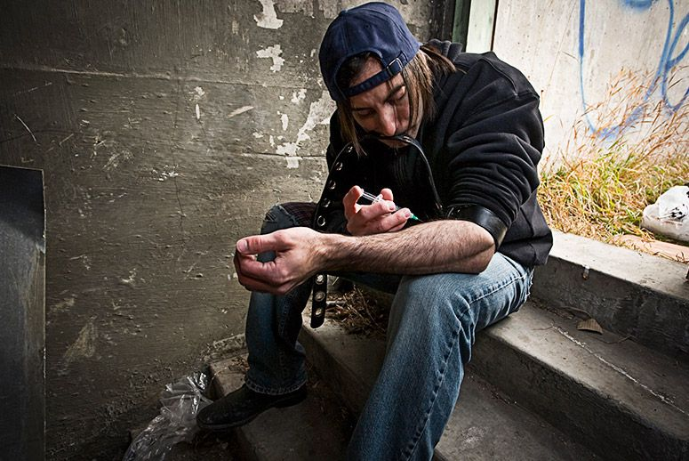
Sin as slavery

Slide 36
Outline
Motivation
Unique truths = Uniquely true religion
Christianity makes unique claims about sin and salvation
Christianity’s claims about sin are true
Christianity claims about salvation are true
Conclusions

Slide 37

The offense of the gospel

Slide 38
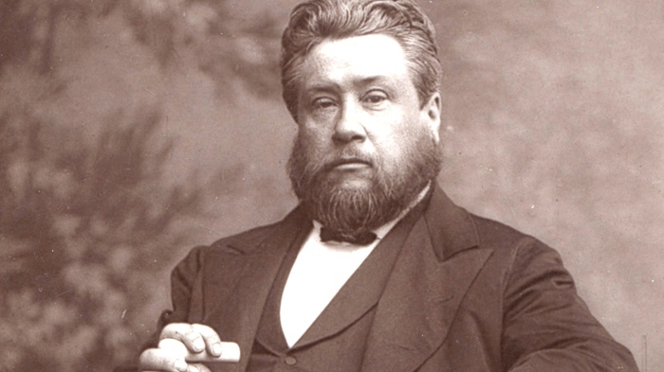
The sufficiency of the gospel

Slide 39
Why do we need the Argument from the Gospel?
The problem of justification
Existential weight
Evangelistic simplicity

Slide 40

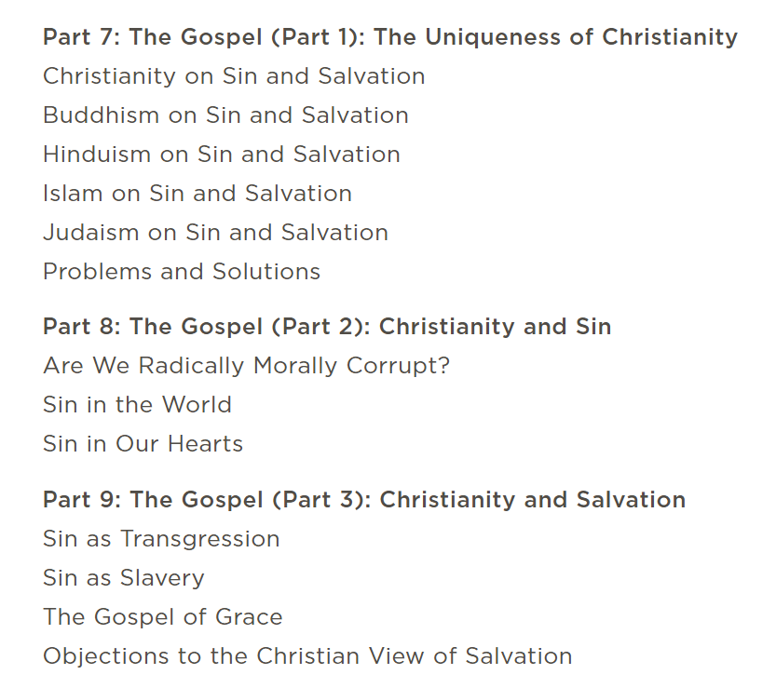
Neil Shenvi, Why Believe? Chapters 7-9

Slide 41


Acknowledgements
Dr. Christina Shenvi
Dr. Pat Sawyer
shenviapologetics.com/slides/
Twitter @NeilShenvi

