Slide 1
Critical Theory and Christianity: Are They Compatible?
Dr. Neil Shenvi
Tiny Heartbeat Ministries
July 24, 2026

Slide 2





This talk is not about Trump

Slide 3
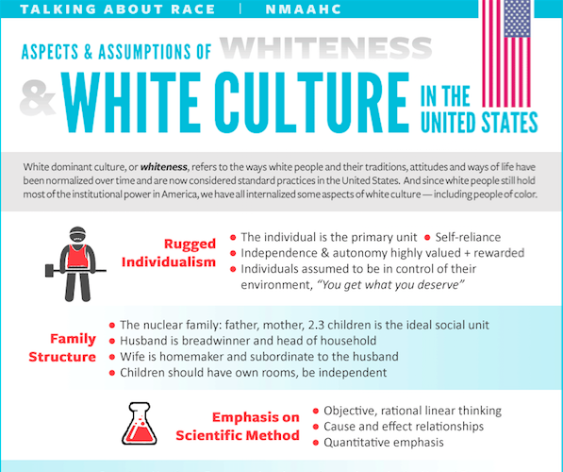
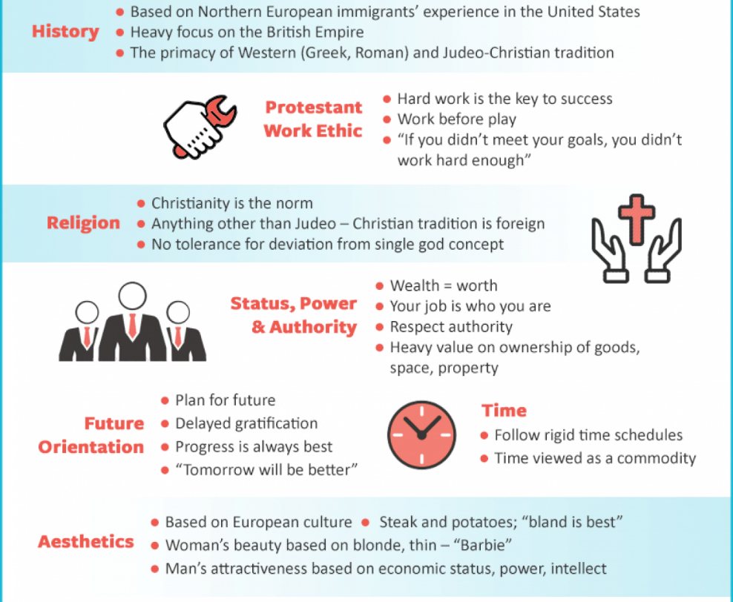
Smithsonian NMAAHC
“Whiteness and white racialized identity refer to the way that white people, their customs, culture, and beliefs operate as the standard by which all other groups of are compared.”

Slide 4

Blue’s Clues Pride Month Cartoon
“Families marching one-by-one
Hurrah, hurrah
Families marching one-by-one
Hurrah, hurrah
This family has two mommies
They love each other so proudly
And they all go marching in the Big Parade…
These babas are non-binary
They love each other so proudly…
Ace, bi and pan grown-ups you see can love each other so proudly
And they all go marching in the Big Parade"

Slide 5
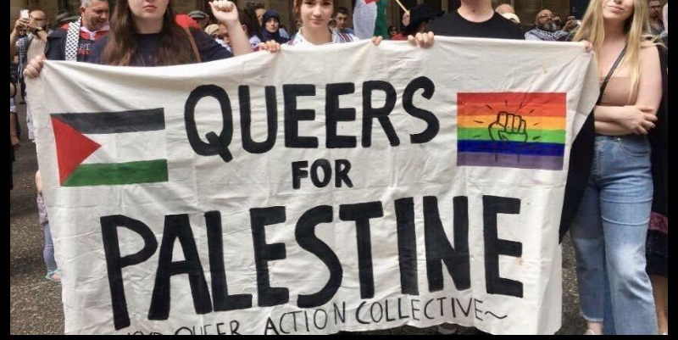
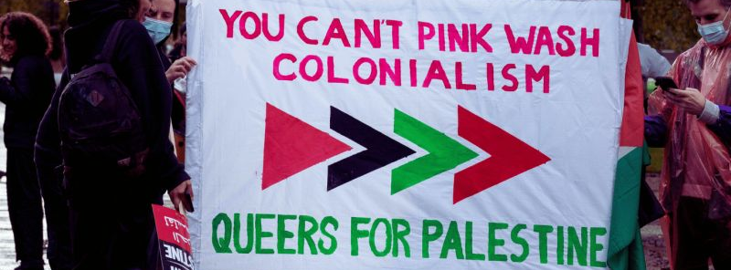
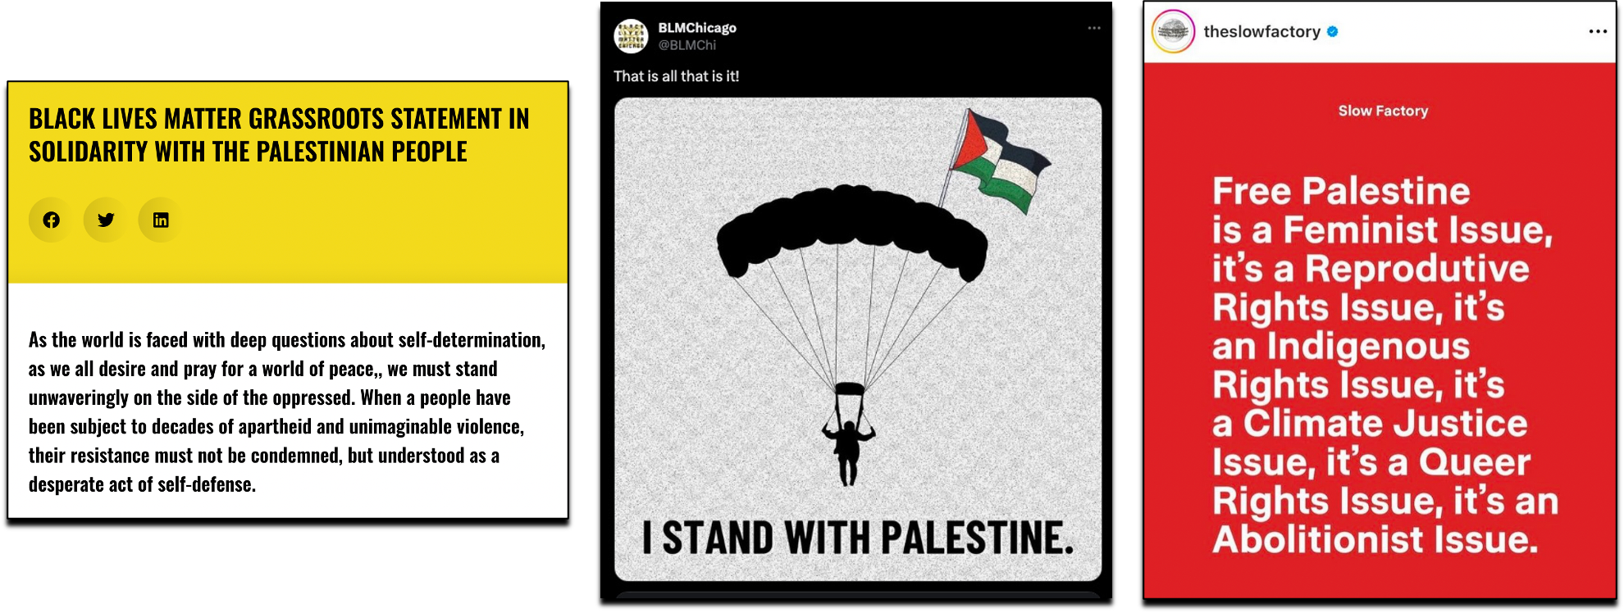
Queers for Palestine

Slide 6

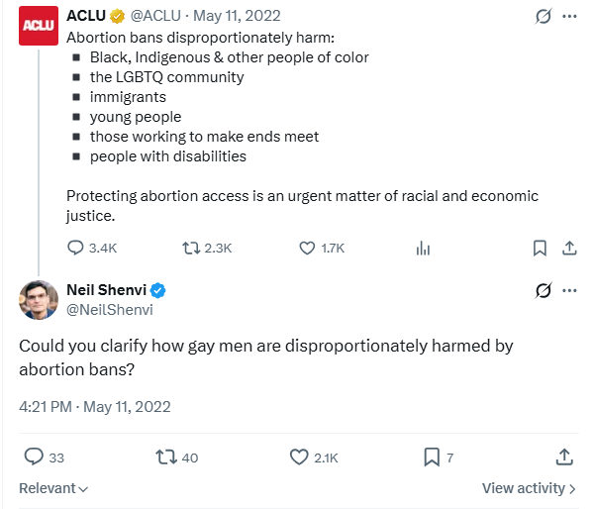
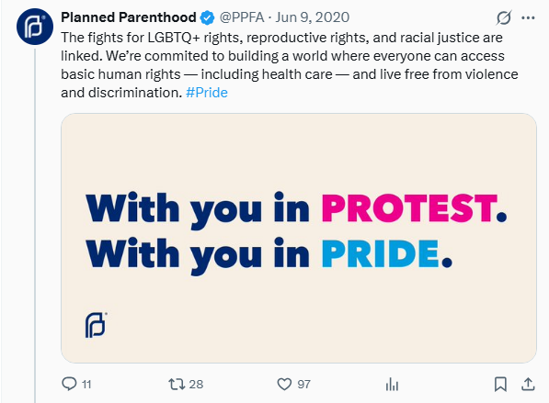
Abortion

Slide 7
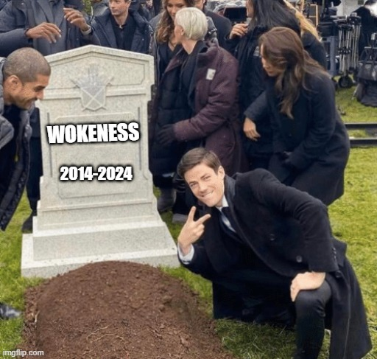

Is wokeness dead?

Slide 8
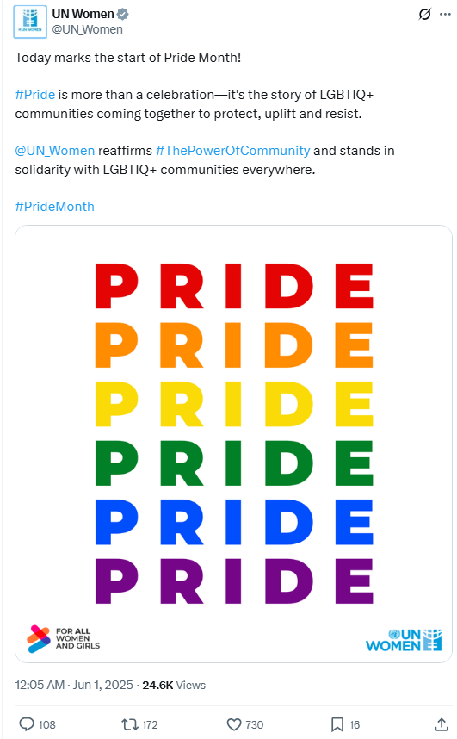
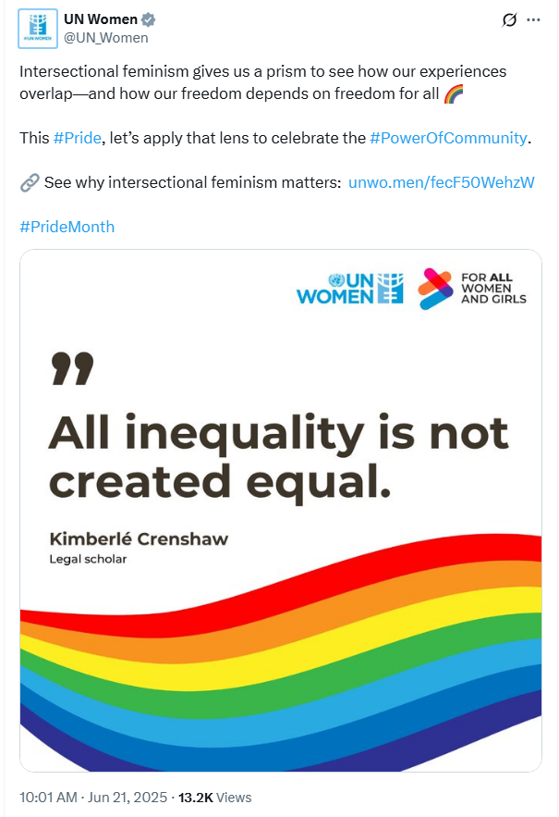
Wokeness is not dead

Slide 9
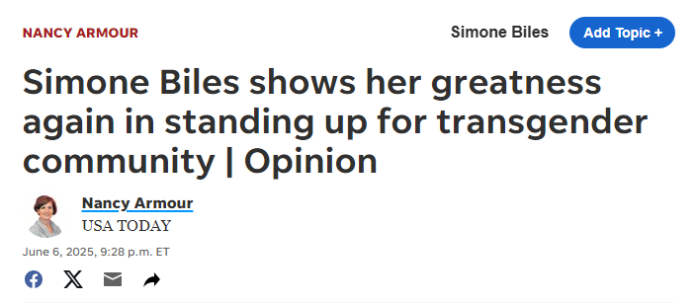
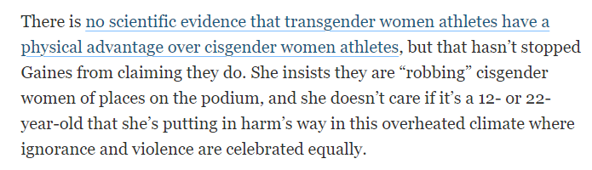
Wokeness is not dead

Slide 10
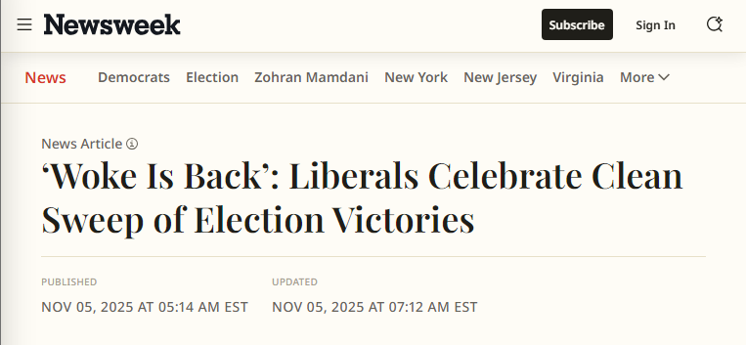

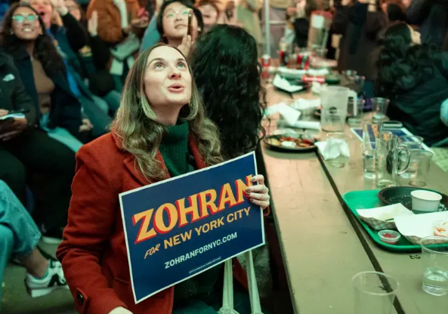
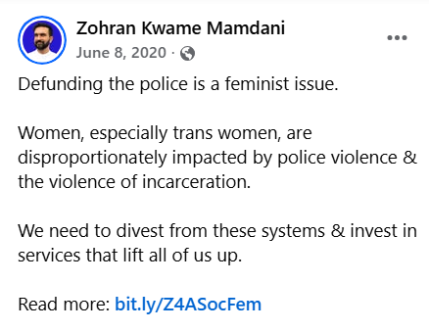
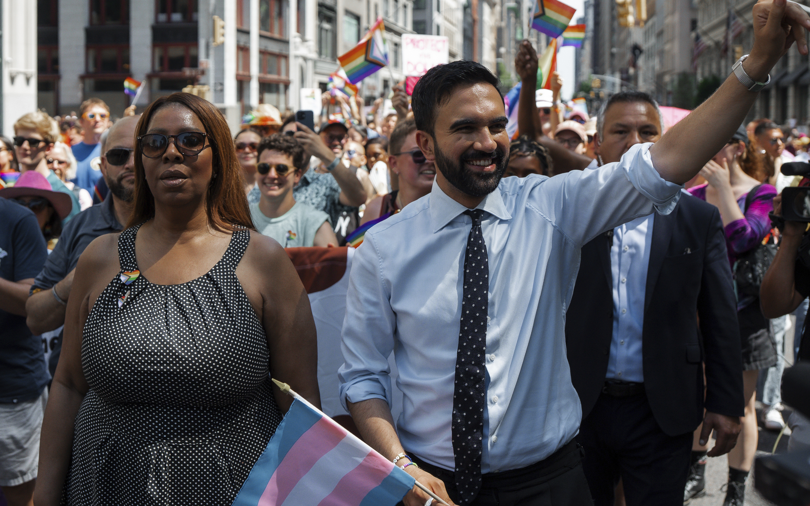
Wokeness is not dead

Slide 11
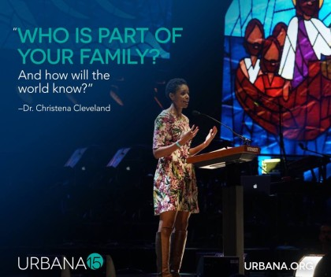
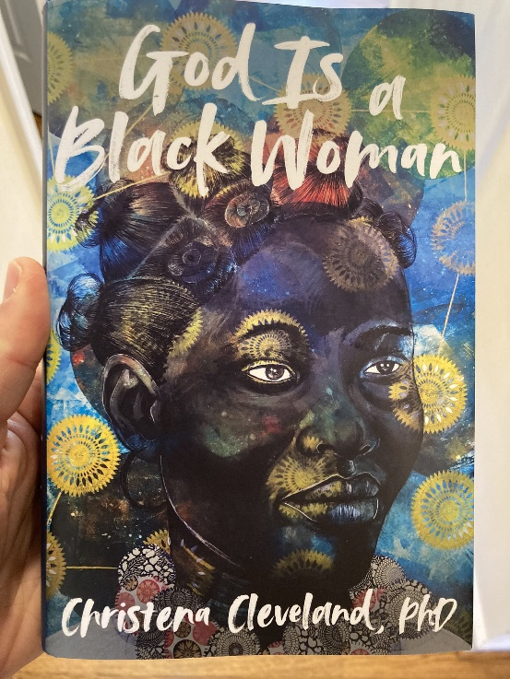

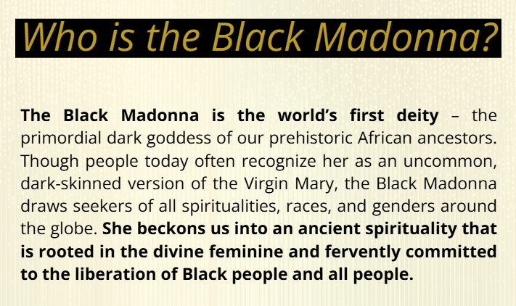
Why should we care?
2015
2022
2026
“Paul, Peter, Luke, John, James, and the writer of Hebrews repeatedly and emphatically make the same point: the unified church is the vehicle through which the kingdom of God is powerfully communicated to the world” – Cleveland, Disunity in Christ, p. 37-38 (2013)
"More than anything, we must eradicate the transphobia within ourselves and our communities. For if God is a Black woman, then She's a Black trans woman. Obviously" - Cleveland, God is a Black Woman, p. 232 (2022)

Slide 12
Outline
Contemporary Critical Theory
  Social Binary
  Hegemonic Power
  Lived Experience
  Social Justice
Contemporary Critical Theory vs. Christianity
  A False Worldview
  A False Understanding of Oppression
  A False Identity
  A False Epistemology
  A False Salvation
  Pro-life Implications
Conclusions

Slide 13
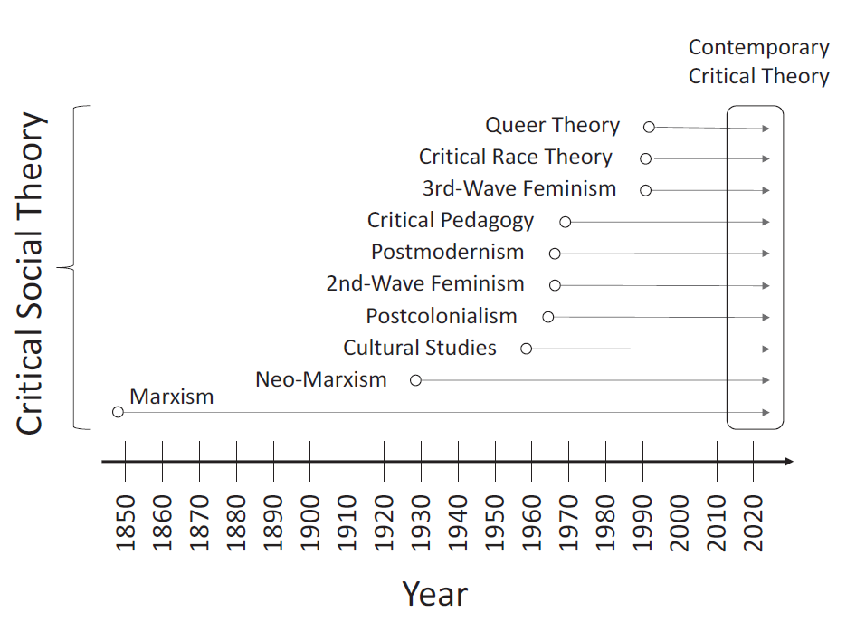
The history of contemporary critical theory
Shenvi and Sawyer, Critical Dilemma, p. 64

Slide 14
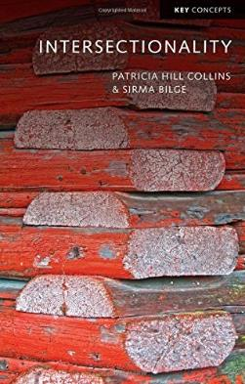
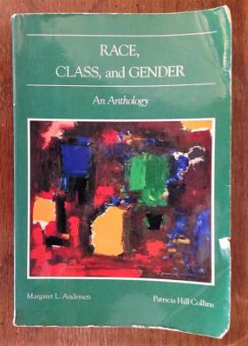
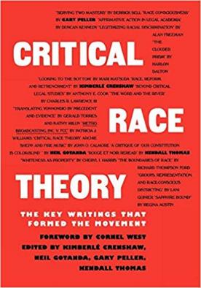
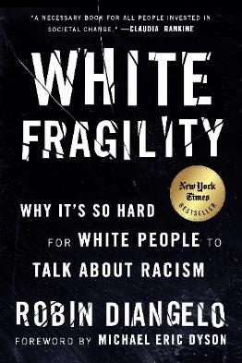
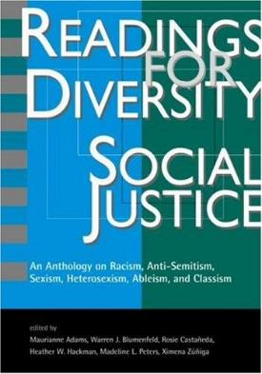
The central ideas of contemporary CT
Idea 1: Social binary
Idea 2: Oppression through ideology
Idea 3: Lived experience
Idea 4: Social justice

Slide 15
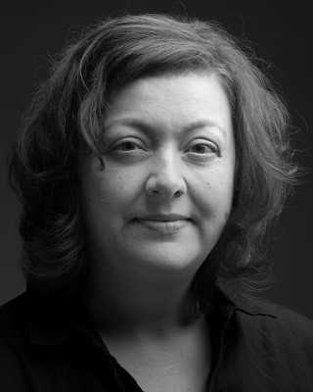
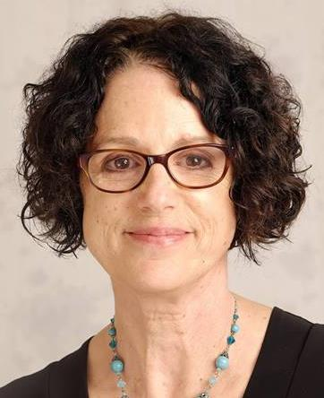
Idea #1: Society is divided into oppressed and oppressor groups
“For every social group, there is an opposite group… the primary groups that we name here are: race, class, gender, sexuality, ability status/exceptionality, religion, and nationality”
“Oppression describes a set of policies, practices, traditions, norms, definitions, and explanations (discourses), which function to systematically exploit one social group to the benefit of another social group. The group that benefits from this exploitation is termed the dominant (or agent) group, and the group that is exploited is termed the minoritized (or target) group…. Sexism, racism, classism, ableism, and heterosexism are specific forms of oppression” – Sensoy and DiAngelo, Is Everyone Really Equal? p. 44, 61

Slide 16
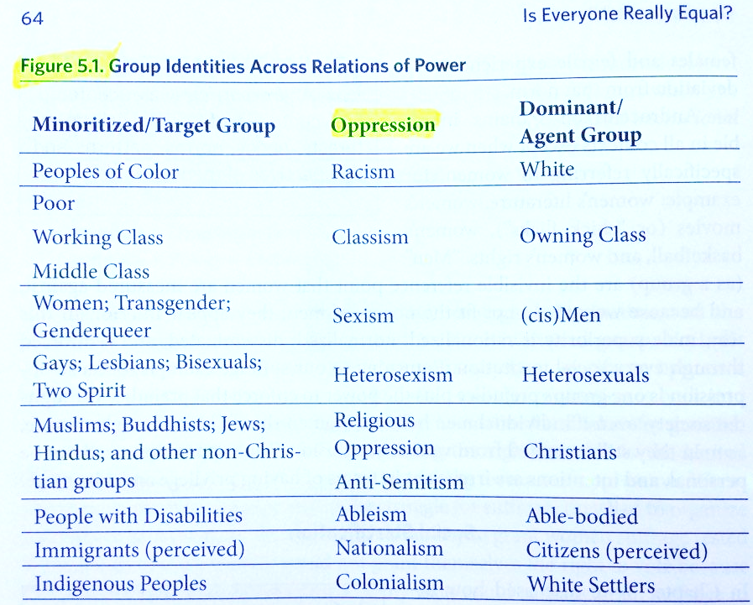
Idea #1: Society is divided into oppressed and oppressor groups
Sensoy and DiAngelo, Is Everyone Really Equal, p. 64

Slide 17
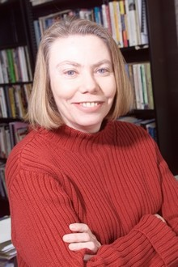
Idea #2: Oppression occurs through hegemonic power
“oppression also traditionally carries a strong connotation of conquest and colonial domination… New left social movements of the 1960s and 1970s, however, shifted the meaning of the concept of oppression. In its new usage, oppression designates the disadvantage and injustice some people suffer not because a tyrannical power coerces them, but because of the everyday practices of a well-intentioned liberal society… Oppression in this sense is structural, rather than the result of a few people’s choices or policies. Its causes are embedded in unquestioned norms, habits, and symbols.” – Iris Young, “Five Faces of Oppression,” Readings for Diversity and Social Justice, p. 36

Slide 18
Idea #2: Oppression occurs through hegemonic power
“Hegemony refers to the control of the ideology of society. The dominant group maintains power by imposing their ideology on everyone.”
“From a critical social justice perspective, privilege is defined as systemically conferred dominance and the institutional processes by which the beliefs and values of the dominant group are ‘made normal’ and universal.” – Sensoy and DiAngelo, Is Everyone Really Equal? p. 73, 80

Slide 19
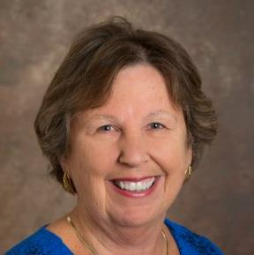
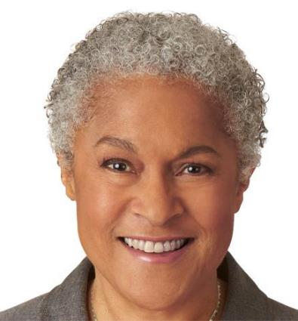
Idea #3: ‘Lived experience’ gives oppressed groups privileged access to truth
“The idea that objectivity is best reached only through rational thought is a specifically Western and masculine way of thinking – one that we will challenge throughout this book.” – Margaret L. Andersen and Patricia Hill Collins, “Reconstructing Knowledge,” in Anderson and Collins, Race, Class, and Gender, p. 4-5

Slide 20
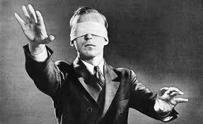
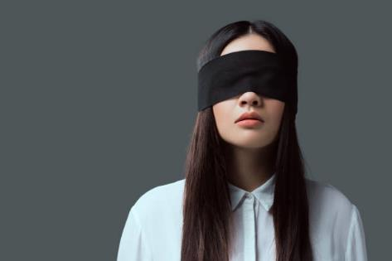

Idea #3: ‘Lived experience’ gives oppressed groups privileged access to truth
Oppression and epistemology:
Privilege
Lived
experience
Internalized oppression
Liberatory consciousness

Slide 21

Idea #4: Social justice demands the liberation of oppressed groups
Definition of social justice:
“Prior to celebrating diversity, we must first eliminate intolerance. No matter what form it takes or who does it, we must all take action to stop intolerance when it happens. Working towards a celebration of diversity implies working for social justice – the elimination of all forms of social oppression… Social injustice takes many forms. It can be injustice based on a person’s gender, race, ethnicity, religion, sexual orientation, physical or mental ability, or economic class.” – Mary McClintock, “How to Interrupt Oppressive Behavior,” Readings for Diversity and Social Justice, p. 483

Slide 22

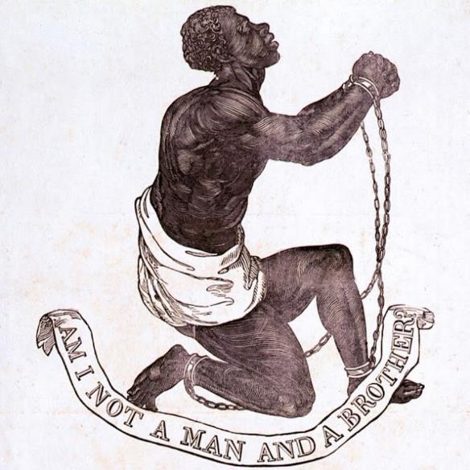

Positives of contemporary critical theory
Emphasis on sinfulness of oppression
Focus on structure, systems, and norms
Recognition of hegemonic power

Slide 23
Outline
Contemporary Critical Theory
  Social Binary
  Hegemonic Power
  Lived Experience
  Social Justice
Contemporary Critical Theory vs. Christianity
  A False Worldview
  A False Understanding of Oppression
  A False Identity
  A False Epistemology
  A False Salvation
  Pro-life Implications
Conclusions

Slide 24
Christianity and contemporary critical theory are competing worldviews
 | Christianity | Contemporary critical theory
Who are we? | God’s creatures | Members of various groups
How do we know truth? | Scripture and reason | Lived experience and embodied knowledge
What is our problem? | Sin | Oppression
What is the solution? | Jesus | Liberation
What is our duty? | Loving God | Liberating the oppressed
What is our purpose? | Glorifying God | Working for liberation

Slide 25
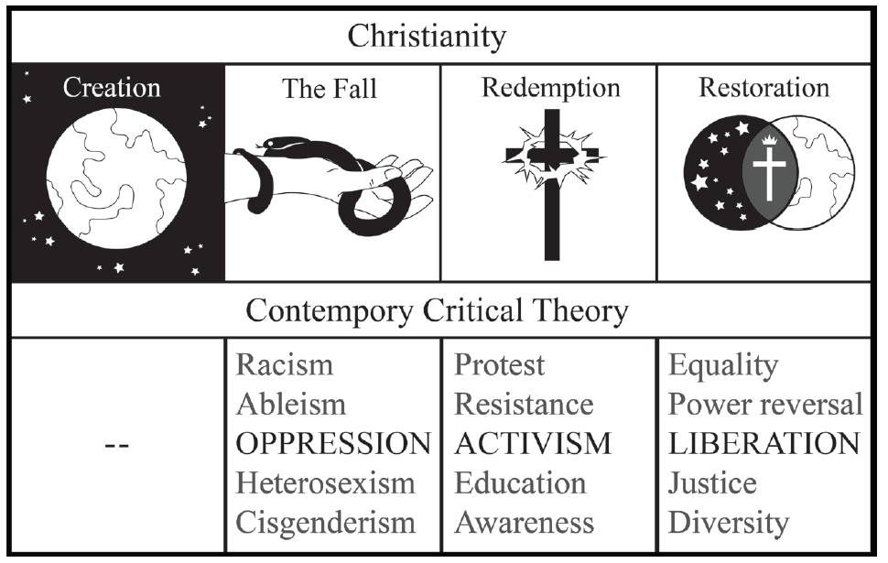
Christianity and contemporary critical theory are competing worldviews
Shenvi and Sawyer, Critical Dilemma, p. 284

Slide 26
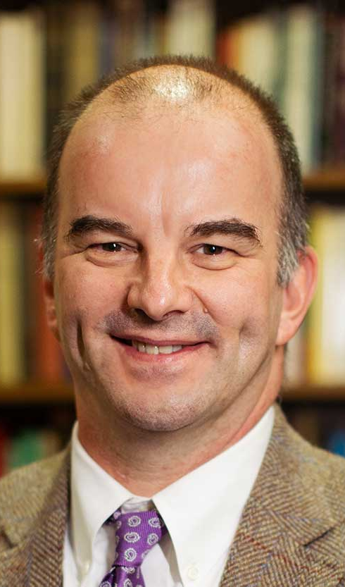
Unifying themes of critical theory
“the cluster of philosophical approaches to [issues of identity is] known by the umbrella term critical theory. Critical theory is today a diverse phenomenon that draws deeply and variously on strands of Marxist thought, psychoanalysis, feminist theory, postcolonialism, poststructuralism, queer theory, and deconstruction… at the core of the various approaches of critical theorists lies a relatively simple set of convictions: the world is to be divided up between those who have power and those who do not; the dominant Western narrative of truth is really an ideological construct designed to preserve the power structure of the status quo; and the goal of critical theory is therefore to destabilize this power structure by destabilizing the dominant narratives that are used to justify –to ‘naturalize’– it” - Trueman
Trueman, The Rise and Triumph of the Modern Self, p. 225-226

Slide 27
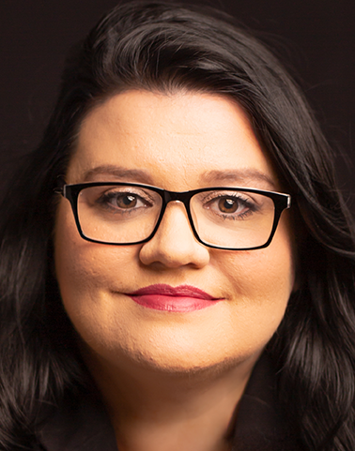
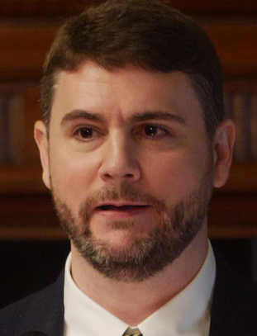
Critical theory as worldview
“we now have Social Justice texts--forming a kind of Gospel of Social Justice--that express, with absolute certainty, that all white people are racist, all men are sexist, racism and sexism are systems that can exist and oppress absent even a single person with racist or sexist intentions or beliefs..., sex is not biological and exists on a spectrum, language can be literal violence, denial of gender identity is killing people, the wish to remedy disability and obesity is hateful, and everything needs to be decolonized.
Does this sound like a metanarrative? That's because it is. Social Justice scholarship and its educators and activists see these principles and conclusions as The Truth According to Social Justice--and they treat it as though they have discovered the analogue of the germ theory of disease, but for bigotry and oppression”
-Pluckrose and Lindsay, Cynical Theories, p. 182-183

Slide 28
Outline
Contemporary Critical Theory
  Social Binary
  Hegemonic Power
  Lived Experience
  Social Justice
Contemporary Critical Theory vs. Christianity
  A False Worldview
  A False Understanding of Oppression
  A False Identity
  A False Epistemology
  A False Salvation
  Pro-life Implications
Conclusions

Slide 29
Idea #1: Society is divided into oppressed and oppressor groups
Sensoy and DiAngelo, Is Everyone Really Equal, p. 64

Slide 30


Redefining oppression
Oppression = Unjust, tyrannical treatment
Oppression = Hegemonic norms
Whiteness = oppression
Gender roles = oppression
Heterosexism = oppression
Cisgenderism = oppression
Adultism = oppression

Slide 31
Outline
Contemporary Critical Theory
  Social Binary
  Hegemonic Power
  Lived Experience
  Social Justice
Contemporary Critical Theory vs. Christianity
  A False Worldview
  A False Understanding of Oppression
  A False Identity
  A False Epistemology
  A False Salvation
  Pro-life Implications
Conclusions

Slide 32


Adversarial identities
White
Male
Rich
Heterosexual
Cisgender
Christian
Able-bodied
Non-white
Female
Poor
Homosexual
Transgender
Non-Christian
Disabled

Slide 33
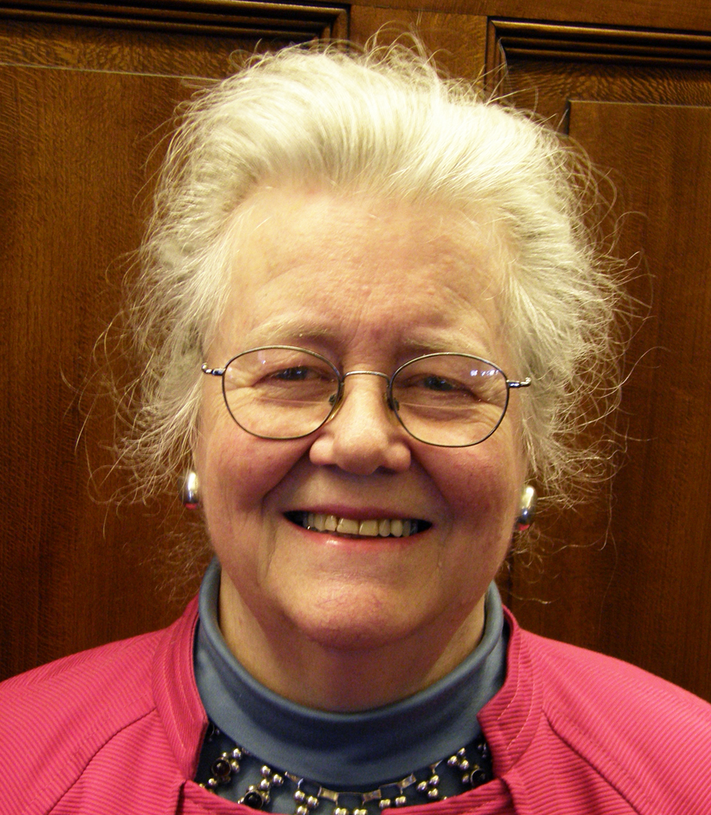
Adversarial identities
“I began to understand why we [White women] are justly seen as oppressive, even when we don't see ourselves that way. I began to count the ways in which I enjoy unearned skin privilege and have been conditioned into oblivion about its existence.
My schooling gave me no training in seeing myself as an oppressor, as an unfairly advantaged person, or as a participant in a damaged culture. I was taught to see myself as an individual whose moral state depended on her individual moral will.”
– Peggy McIntosh, “White Privilege and Male Privilege,” in Race, Class, and Gender, 72

Slide 34
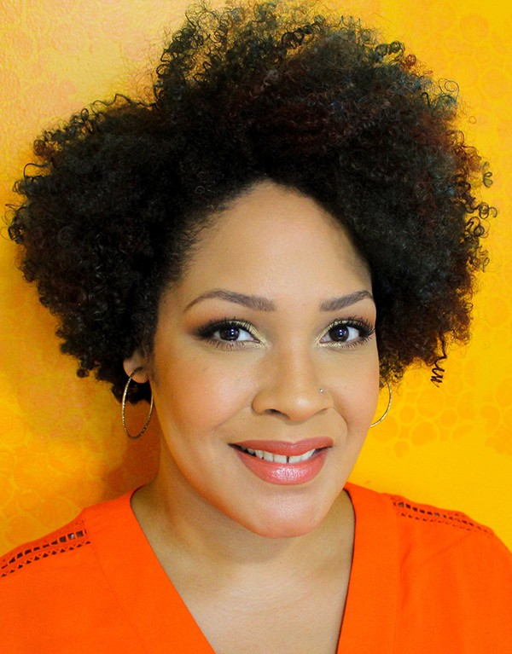
Adversarial identities
“if you are white in a white supremacist society, you are racist. If you are male in a patriarchy, you are sexist. If you are able-bodied, you are ableist. If you are anything above poverty in a capitalist society, you are classist. You can sometimes be all of these things at once.”
– Ijeoma Oluo, So You Want to Talk About Race?, 220-221

Slide 35
Identity and solidarity
Creation
Sin
Redemption

Slide 36
Outline
Contemporary Critical Theory
  Social Binary
  Hegemonic Power
  Lived Experience
  Social Justice
Contemporary Critical Theory vs. Christianity
  A False Worldview
  A False Understanding of Oppression
  A False Identity
  A False Epistemology
  A False Salvation
  Pro-life Implications
Conclusions

Slide 37
Idea #3: ‘Lived experience’ gives oppressed groups privileged access to truth
Oppression and epistemology:
Privilege
Lived
experience
Internalized oppression
Liberatory consciousness

Slide 38
Deferring to lived experience
“It is about race if a person of color thinks it’s about race. This may sound at first like I’m asking you to just take every person of color’s word for it, as if they are infallible… But the truth is, whether or not someone is fallible is beside the point. We are, each and every one of us, a collection of our lived experiences… And our experiences are valid…And so, if a person of color says that something is about race, it is— because regardless of the details, regardless of whether or not you can connect the dots from the outside, their racial identity is a part of them, and it is interacting with the situation.”
–Oluo, So You Want to Talk About Race? 15

Slide 39

Should we defer to lived experience?
“As a woman, I know that our society is deeply sexist.”
“As a Black man, I know that our society is deeply racist.”
“As a lesbian, I know that sexual orientation is fixed from birth.”
“As a Sufi Muslim, I know that Islam is true.”
“As a polyamorous man, I know that sex outside of marriage is okay.”
“As a Hindu, I know that all paths lead to God.”

Slide 40
Outline
Contemporary Critical Theory
  Social Binary
  Hegemonic Power
  Lived Experience
  Social Justice
Contemporary Critical Theory vs. Christianity
  A False Worldview
  A False Understanding of Oppression
  A False Identity
  A False Epistemology
  A False Salvation
  Pro-life Implications
Conclusions

Slide 41
Conflicting Soteriology
 | Christianity | Contemporary Critical Theory
Sin | Rebellion: breaking God’s commandments | Privilege: whiteness, patriarchy, classism, heterosexism, ableism, cisgenderism
Salvation | Redemption: repent and believe the gospel | Activism: confess your privilege, divest from privilege, do the work, center marginalized voices, stop taking up space

Slide 42
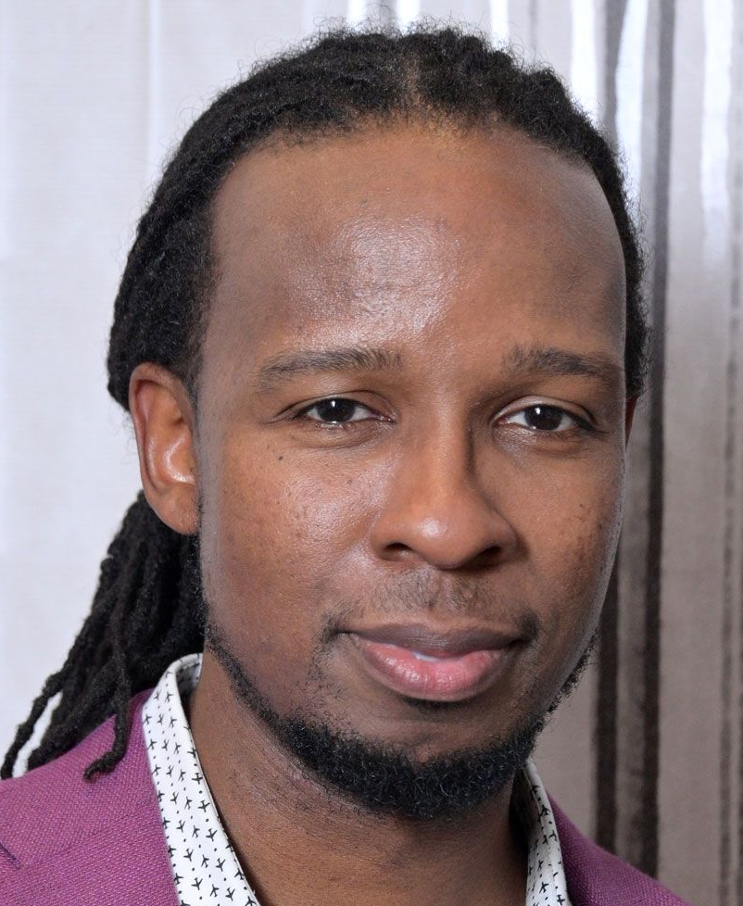
The Sin of Privilege
“Antiracist policies cannot eliminate class racism without anticapitalism policies. Anticapitalism cannot eliminate class racism without antiracism.”
“To truly be antiracist is to be feminist. To truly be feminist is to be antiracist.”
“We cannot be antiracist if we are homophobic or transphobic… To be queer antiracist is to understand the privileges of my cisgender, of my masculinity, of my heterosexuality, of their intersections.”
– Kendi, How to Be Antiracist, 159, 189, 197.

Slide 43

The Sin of Privilege
“it is not possible for your parents to have taught you not to be racist, or for your parents to have been free of racism themselves. This is not possible because racism is a social system embedded in our culture and its institutions.”
“From an antiracist perspective, the question is not, ‘Did racism take place’ but ‘How was racism taking place’ because the assumption is that racism is always at play, always operating”
– DiAngelo, What Does It Mean to Be White?, 265, 330.

Slide 44
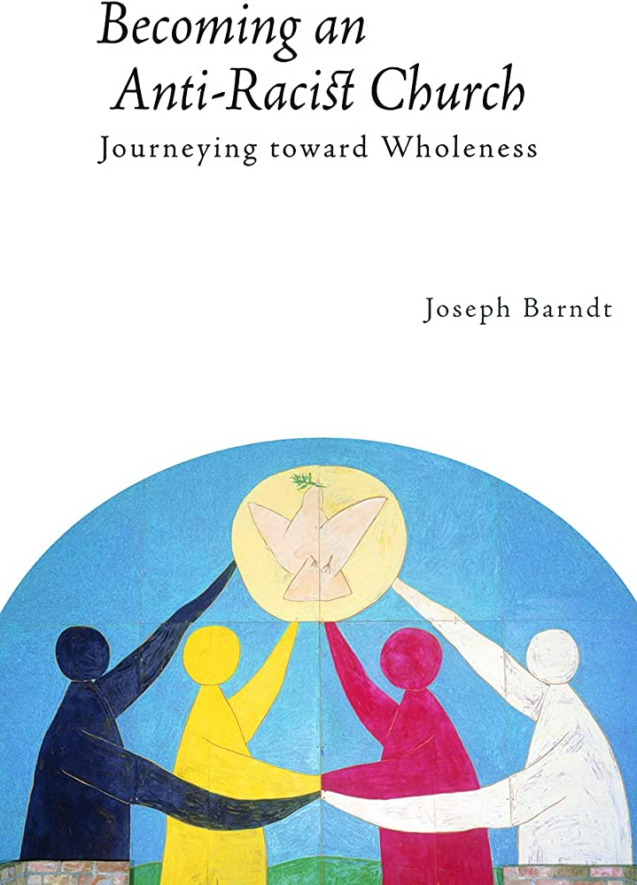
Doing the Work of Salvation
“The first and most important task in shaping an anti-racist church is to give birth to an anti-racist Christian identity… Taking this birthing metaphor one step further to the biblical imagery of rebirth, this identity-transforming process can be understood in no less powerful terms than what Jesus described as being ‘born again’--a complete spiritual transformation.”– Joseph Barndt, Becoming an Antiracist Church, 153.

Slide 45
Doing the Work of Salvation
“a positive white identity is an impossible goal. White identity is inherently racist; white people do not exist outside the system of white supremacy. This does not mean that we should stop identifying as white and start claiming only to be Italian or Irish. To do so is to deny the reality of racism in the here and now, and this denial would simply be color-blind racism. Rather, I strive to be ‘less white.’ To be less white is to be less racially oppressive.”
– DiAngelo, White Fragility, 149-150.

Slide 46

Doing the Work of Salvation
“Antiracism work is not a twenty-eight-day journey. It is a lifelong practice. It requires your lifelong commitment to antioppression… There is no feel-good reward at the end other than the knowledge that you are doing this because it’s the right thing to do.” – Layla Saad, Me and White Supremacy, 25.

Slide 47
Outline
Contemporary Critical Theory
  Social Binary
  Hegemonic Power
  Lived Experience
  Social Justice
Contemporary Critical Theory vs. Christianity
  A False Worldview
  A False Understanding of Oppression
  A False Identity
  A False Epistemology
  A False Salvation
  Pro-life Implications
Conclusions

Slide 48
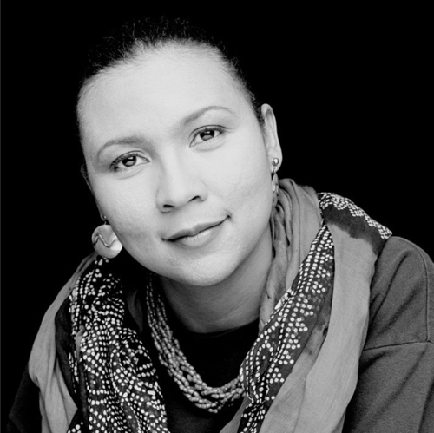
Pro-life Implications
“If feminism is a movement to end sexist oppression, and depriving females of reproductive rights is a form of sexist oppression, then one cannot be anti-choice and be feminist. A woman… cannot be anti-abortion and an advocate of feminism.”
“there [can be] no genuine sexual liberation for women and men without better, safer contraceptives — without the right to a safe, legal abortion.”
“[Power feminists] were the group that began to suggest that one could be feminist and anti-abortion. This is another misguided notion. Granting women the civil right to have control over our bodies is a basic feminist principle… it is a feminist principle that women should have the right to choose.”
bell hooks, Feminism is for Everybody, p. 6, 26, 114

Slide 49
Outline
Contemporary Critical Theory
  Social Binary
  Hegemonic Power
  Lived Experience
  Social Justice
Contemporary Critical Theory vs. Christianity
  A False Worldview
  A False Understanding of Oppression
  A False Identity
  A False Epistemology
  A False Salvation
  Pro-life Implications
Conclusions

Slide 50
Christianity and contemporary critical theory are competing worldviews
Shenvi and Sawyer, Critical Dilemma, p. 284

Slide 51
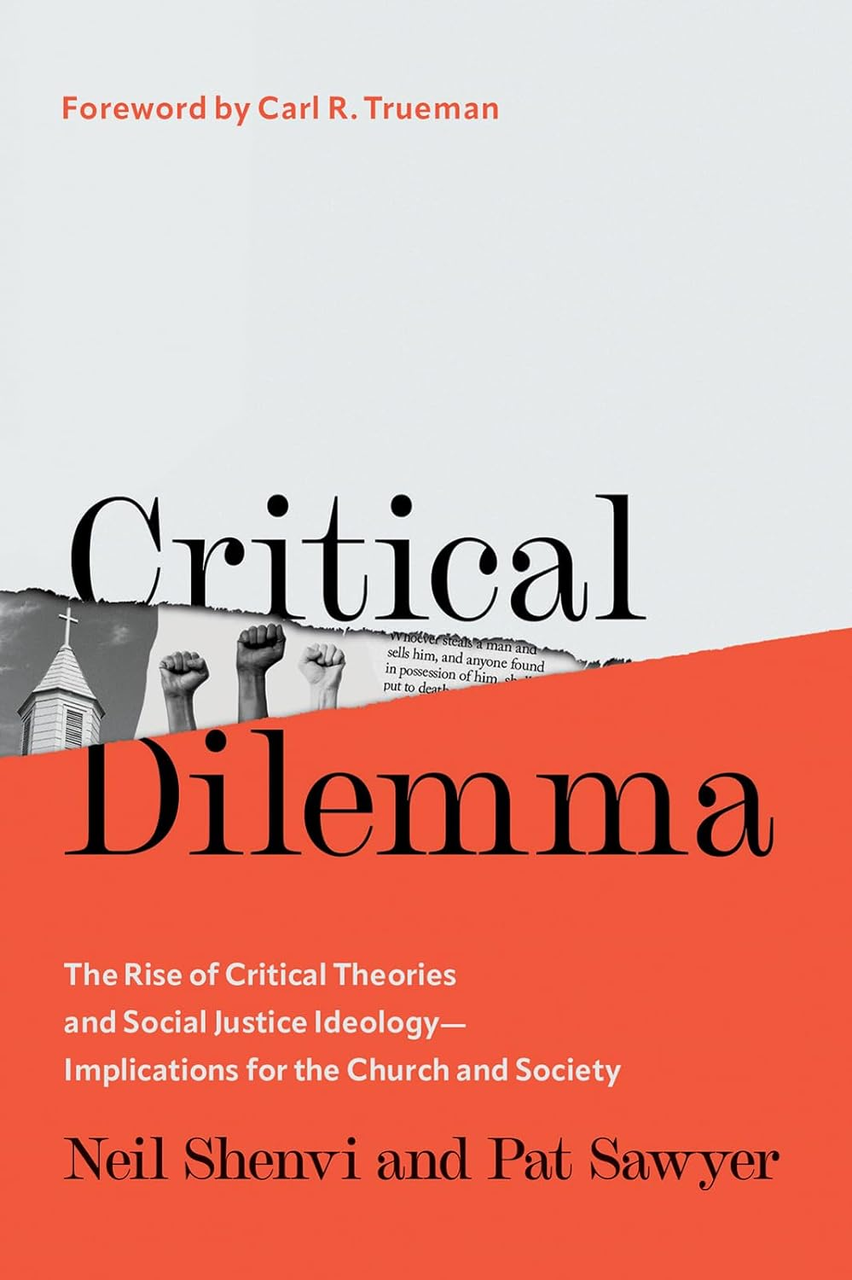
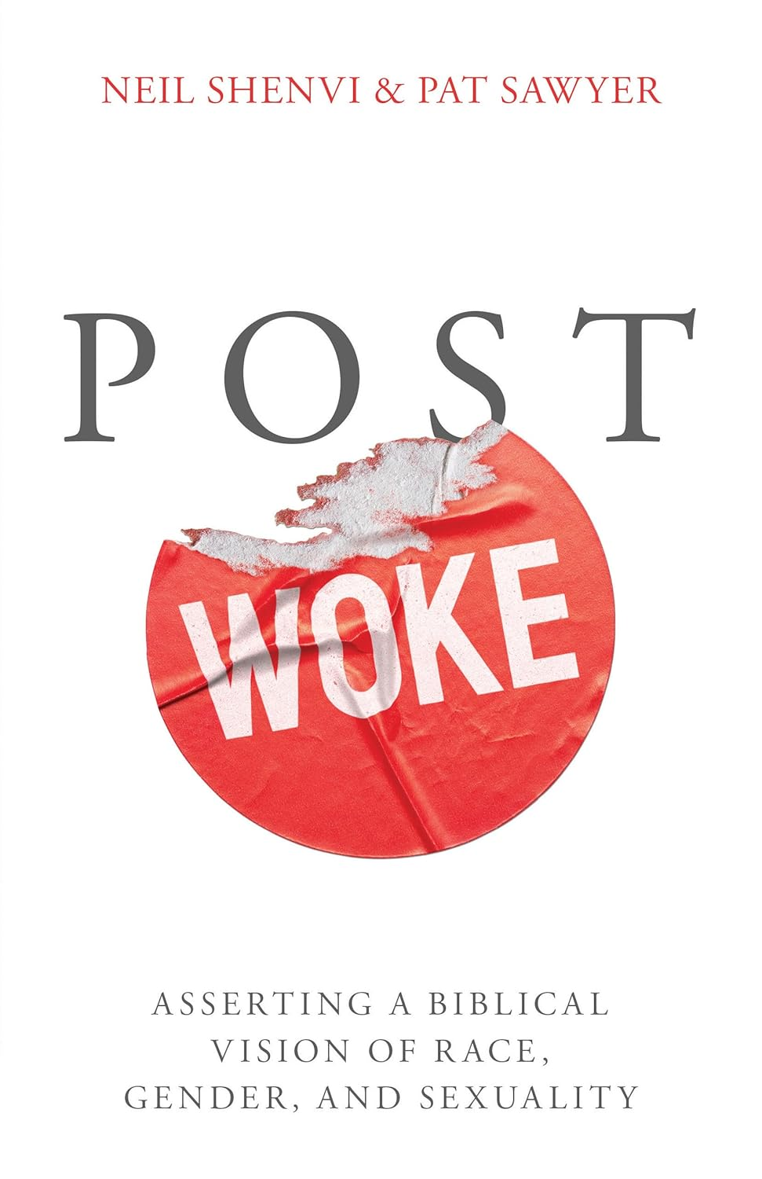
Additional resources
Neil Shenvi and Pat Sawyer, Critical Dilemma (2023)
Neil Shenvi and Pat Sawyer, Post Woke (2026)

Slide 52

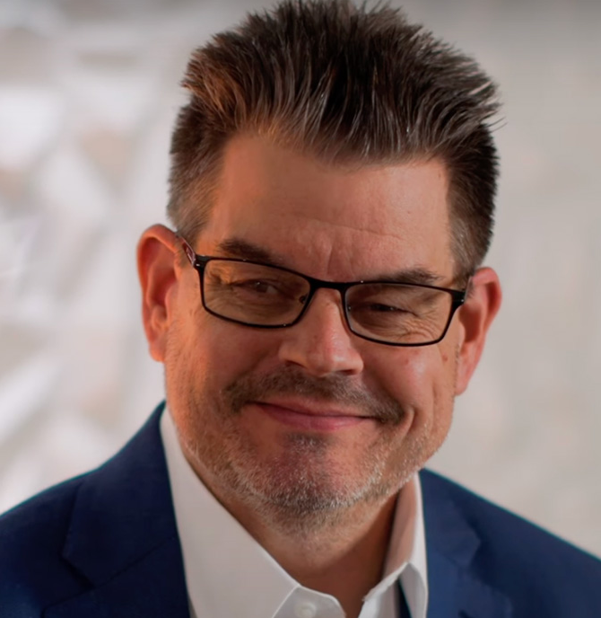
Acknowledgements
Dr. Christina Shenvi
Dr. Pat Sawyer
shenviapologetics.com/slides/
criticaldilemma.com/
Twitter @NeilShenvi

