Slide 1
WHY
BELIEVE?
June 19-22, 2026
NEIL SHENVI

Slide 2

Personal Info

Slide 3
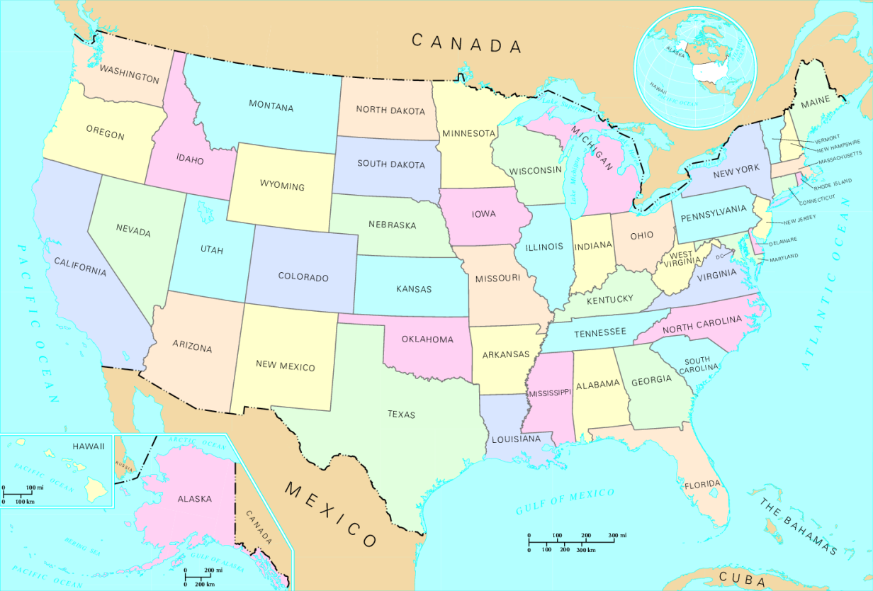
Personal Info

Slide 4
Outline
Introduction
Trilemma
Moral Argument
Argument from the Gospel
Conclusion

Slide 5
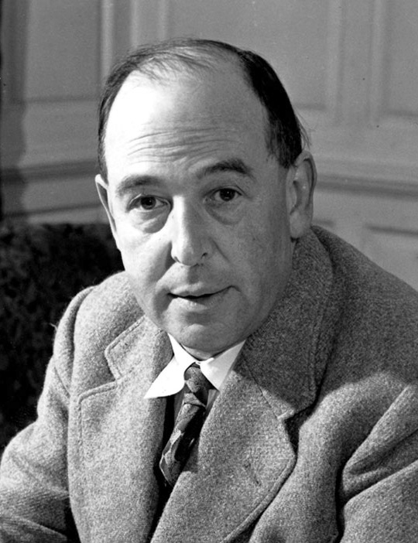
Liar, Lunatic, or Lord
I am trying here to prevent anyone saying the really foolish thing that people often say about Him: “I’m ready to accept Jesus as a great moral teacher, but I don’t accept his claim to be God.” That is the one thing we must not say. A man who was merely a man and said the sort of things Jesus said would not be a great moral teacher. He would either be a lunatic—on a level with the man who says he is a poached egg—or else he would be the Devil of Hell. You must make your choice. Either this man was, and is, the Son of God, or else a madman or something worse. You can shut Him up for a fool, you can spit at Him and kill Him as a demon or you can fall at His feet and call Him Lord and God. But let us not come with any patronizing nonsense about His being a great human teacher. He has not left that open to us. He did not intend to. - C. S. Lewis, Mere Christianity, 55–56

Slide 6
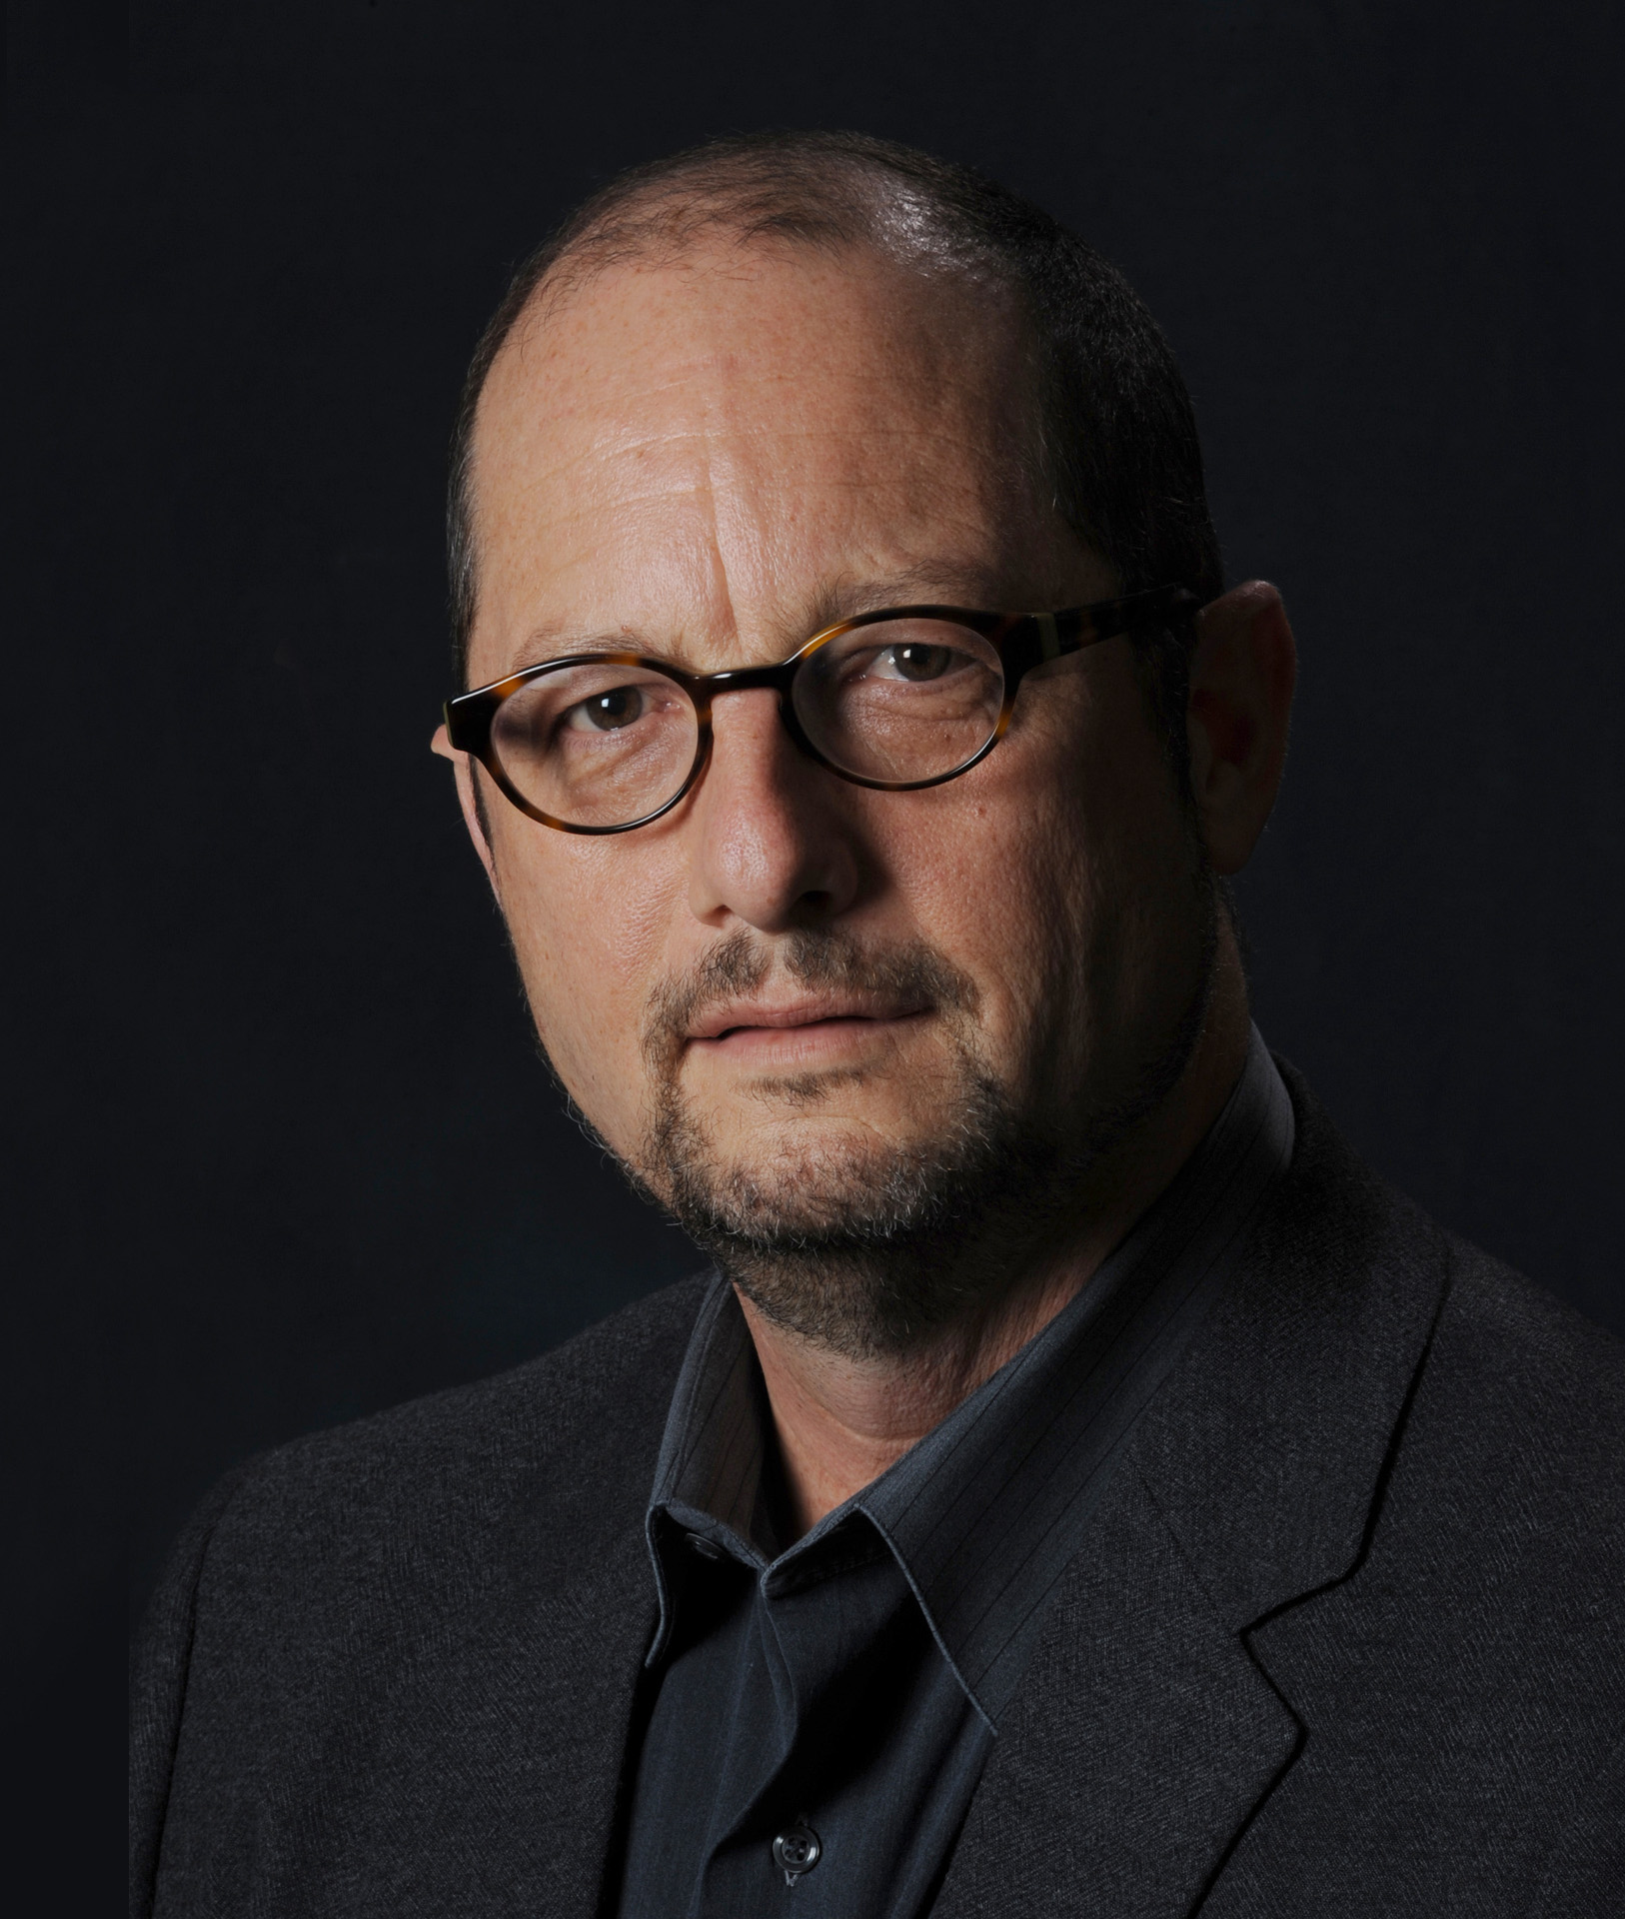
Liar, Lunatic, or Lord or Legend
You are probably familiar with the old birthday party game, “telephone.”… Invariably, the story has changed so much in the process of retelling that everyone gets a good laugh… Imagine playing “telephone” not in a solitary living room with ten kids on a sunny afternoon in July, but over the expanse of the Roman Empire (some 2,500 miles across!), with thousands of participants, from different backgrounds, with different concerns, and in different contexts, some of whom have to translate the stories into different languages all over the course of decades. What would happen to the stories? – Bart Ehrman, Jesus: Apocalyptic Prophet of the New Millennium, 51–52

Slide 7

Liar, Lunatic, or Lord or Legend
These are composite documents, the final products of long and creative traditions in which old material was reworked and new material interpolated. As they now stand, they are witness first of all to the faith of their individual writers and their late first-century, largely Gentile communities. Only at a distance do they relate to the people and the period they purport to describe. - Paula Fredriksen, From Jesus to Christ: The Origins of the New Testament Images of Jesus, 4

Slide 8
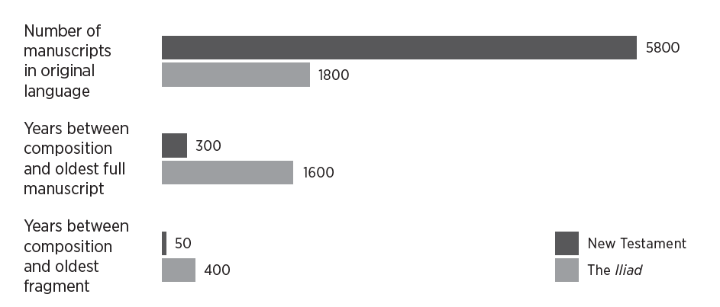
Manuscript evidence
Neil Shenvi, Why Believe?: A Reasoned Approach to Christianity, 33

Slide 9
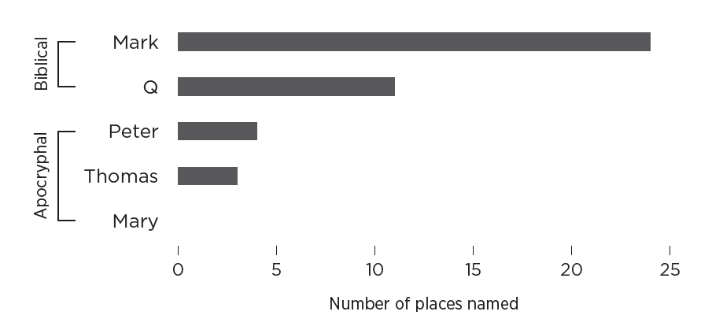
Geographic evidence
Neil Shenvi, Why Believe?: A Reasoned Approach to Christianity, 38

Slide 10
Contextual evidence
Aramaicisms: Boanerges (Mk. 3:17); Talitha cumi (Mk. 5:41); Corban (Mk. 7:11); Ephphatha (Mk. 7:34); Abba (Mk. 14:36); Eloi Eloi lema sabachthani (Mk. 15:34)
Religious controversies: ceremonial washing (Mk. 7:3-4), Corban (7:11), Sadducees’ denial of the Resurrection (Mk. 12:18)
Gentile circumcision:
“Look: I, Paul, say to you that if you accept circumcision, Christ will be of no advantage to you.” (Gal. 5:2)
“Look out for the dogs, look out for the evildoers, look out for those who mutilate the flesh” (Phil. 3:2)
  “some believers who belonged to the party of the Pharisees rose up and said, “It is necessary to circumcise them and to order them to keep the law of Moses.” (Acts 15:5)

Slide 11
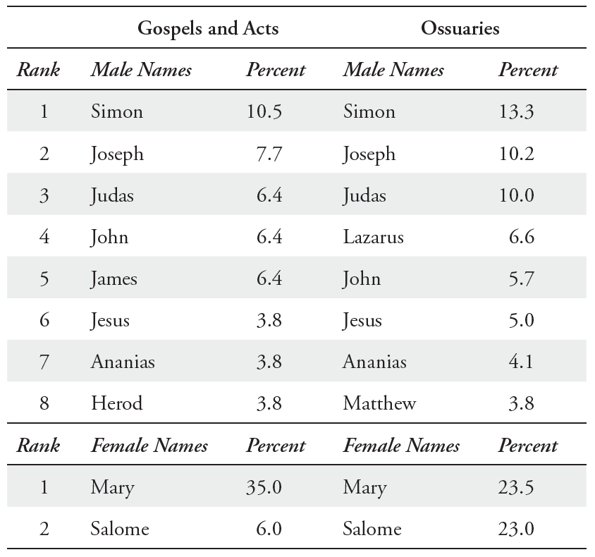
Onomastic evidence
Neil Shenvi, Why Believe?: A Reasoned Approach to Christianity, 44

Slide 12
Jesus’s claims
• Jesus claimed to be the Jewish Messiah, God’s chosen ruler of the nation of Israel (Matt. 26:63–64; Mark 8:29–30; John 4:25–26).
• He claimed to be able to forgive sin (Matt. 9:2–8; Mark 2:1–12; Luke 5:18–26; 7:36–50).
• He claimed that he was the only way to know God (Matt. 11:27; Luke 10:22; John 14:6).
• He claimed to have preexisted (Luke 10:18; John 8:57–58; 17:5).
• He claimed that we must love him more than our mothers or fathers or children or even our own lives (Matt. 10:37–39; Luke 9:23–24; 14:26–27; John 12:25).
• He claimed that our eternal destinies depend on our response to him (Matt. 16:24–27; Luke 12:8–9; John 5:24).
• He claimed that he would suffer for our sins (Matt. 26:28; Luke 22:20; John 3:14–15).
• He claimed that he would rise from the dead (Matt. 16:21; Mark 10:34; John 2:19).
• He claimed that he would return at the end of time to judge all of humanity (Matt. 25:31–46; Mark 13:26–27; John 5:28–30).

Slide 13
Liar, Lunatic, or Lord
You must make your choice. Either this man was, and is, the Son of God, or else a madman or something worse. You can shut Him up for a fool, you can spit at Him and kill Him as a demon or you can fall at His feet and call Him Lord and God. But let us not come with any patronizing nonsense about His being a great human teacher. He has not left that open to us. He did not intend to.
- C. S. Lewis, Mere Christianity, 55–56

Slide 14
Outline
Introduction
Trilemma
Moral Argument
Argument from the Gospel
Conclusion

Slide 15
Deductive Form
P1. If God does not exist, then objective moral values and duties do not exist.
P2. Objective moral values and duties do exist.
Therefore,
C. God exists.

Slide 16
Is Premise 1 True?
“God does not exist [and] all possibility of finding values in a heaven of ideas disappears along with Him. . . . Everything is permissible if God does not exist.” - Jean-Paul Sartre, Existentialism and Human Emotions, 22
“[Moral facts] constitute so odd a cluster of qualities and relations that they are most unlikely to have arisen in the ordinary course of events, without an all-powerful god to create them.” - J. L. Mackie, The Miracle of Theism: Arguments for and against the Existence of God, 115
“A ‘soft atheist’ would hold that one could be an atheist and still believe in morality [but] the religious fundamentalists are correct: without God, there is no morality.” - Joel Marks, “An Amoral Manifesto (Part I)” Philosophy Now 80 (2010), 30–33.

Slide 17
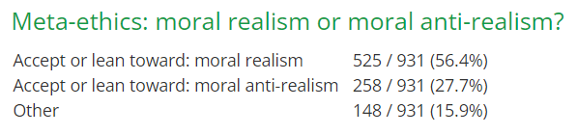
Is Premise 2 True?
Moral realism vs. external world realism
A survey of professional philosophers found that most are moral realists:
“distinguishing right and wrong” “good and bad distinguished” and “moral sentiments” are “human universals” found in every culture – Pinker, The Blank Slate, 435-439
Cypher’s Challenge
Amorality Pill

Slide 18
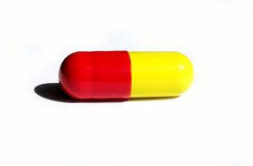
The amorality pill
You are offered a pill which will remove all your negative moral emotions like guilt, empathy and remorse, but will leave all positive emotions intact. In other words, you will still love your family, derive delight from watching your children play, feel tenderness and joy whenever you watch them sleeping. But if you decide one day, that killing them all would make you happier, you will be able to do so without any pangs of conscience. Would you take the pill?

Slide 19
Deductive Form
P1. If God does not exist, then objective moral values and duties do not exist.
P2. Objective moral values and duties do exist.
Therefore,
C. God exists.

Slide 20
Argument from truth-seeking
P1. If a truth-loving God does not exist, then you are not obligated to seek the truth.
P2. You are obligated to seek the truth.
Therefore,
C. A truth-loving God exists.

Slide 21
Outline
Introduction
Trilemma
Moral Argument
Argument from the Gospel
Conclusion

Slide 22
The Argument From the Gospel
P1. If a religion makes uniquely true claims about existential realities, the best explanation is that it is uniquely true.
P2. Christianity makes unique claims about the reality of our moral failure and our need for rescue.
P3. It is true that we are moral failures.
P4. It is true that we need rescue.
Therefore,
C. the best explanation is that Christianity is uniquely true.

Slide 23

Basketball Analogy

Slide 24
The Uniqueness of Christianity
Prof. Stephen Prothero’s classification of world religions:
Religion | The problem is… | The solution is…
Buddhism | Suffering | Awakening
Hinduism | Samsara (“wandering”) | Moksha (“release”)
Islam | Pride | Submission
Judaism | Exile | Return to God
Christianity | Sin | Salvation

Slide 25

The Uniqueness of Christianity
“[W]hile it may seem to be an act of generosity to state that Confucians and Buddhists and Muslims and Jews can also be saved, this statement is actually an act of obfuscation…
[J]ust as hitting home runs is the monopoly of one sport, salvation is the monopoly of one religion. If you see sin as the human predicament and salvation as the solution, then it makes sense to come to Christ.” – Stephen Prothero, God is Not One, p. 22-23.

Slide 26

The Bible on Sin
"The LORD saw that the wickedness of man was great in the earth, and that every intention of the thoughts of his heart was only evil continually." - Gen. 6:5
"Against you, you only, have I sinned and done what is evil in your sight... Behold, I was brought forth in iniquity, and in sin did my mother conceive me."
- Psalm 51:4-5
"None is righteous, no, not one; no one understands; no one seeks for God. All have turned aside; together they have become worthless; no one does good, not even one." - Rom. 3:10-12

Slide 27
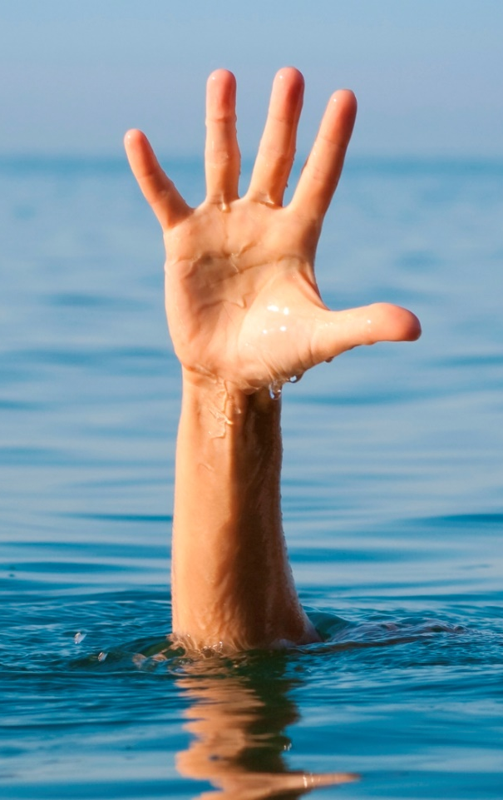
The Bible on Rescue
"God shows his love for us in that while we were still sinners, Christ died for us." - Rom. 5:8
"But God, being rich in mercy, because of the great love with which he loved us, even when we were dead in our trespasses, made us alive together with Christ—by grace you have been saved” - Eph. 2:4-5
"For the Son of Man came to seek and to save the lost.”- Luke 19:10

Slide 28
Outline
Introduction
Trilemma
Moral Argument
Argument from the Gospel
Conclusion

Slide 29



Why Believe?

Slide 30
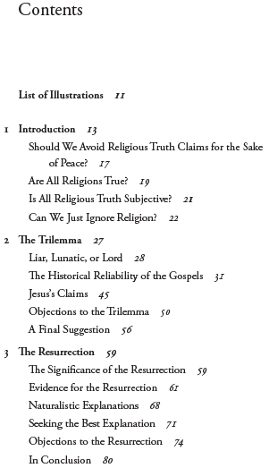
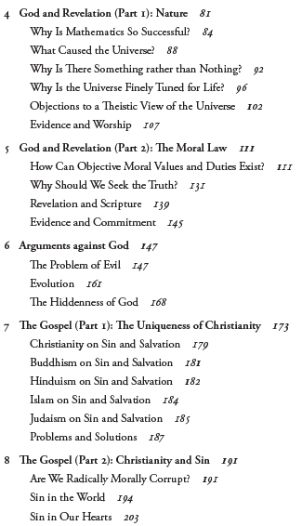
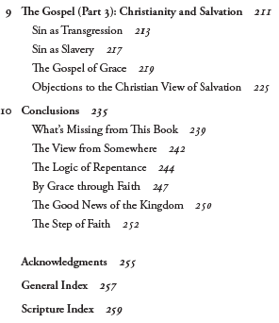

Slide 31

Acknowledgements
Dr. Christina Shenvi
shenviapologetics.com/
shenviapologetics.com/slides/
shenviapologetics.com/why-believe-a-reasoned-approach-to-christianity/
Twitter @NeilShenvi

