Slide 1
Critical Theory and Christianity: Are They Compatible?
Dr. Neil Shenvi
Cary Christian School
Feb. 25, 2026

Slide 2

This talk is not about Trump

Slide 3

This talk is not about Trump

Slide 4




This talk is not about Trump

Slide 5
This talk is not about Trump
This talk is not about Trump
This talk is not about Trump
This talk is not about Trump
This talk is not about Trump
This talk is not about Trump

Slide 6

This talk is not about Trump
This talk is not about Trump
This talk is not about Trump
THIS TALK IS ABOUT TRUMP!!!
This talk is not about Trump
This talk is not about Trump
This talk is not about Trump

Slide 7




NYTimes word usage
“Racism”
“Privilege”
“Whiteness”
“Intersectionality”

Slide 8
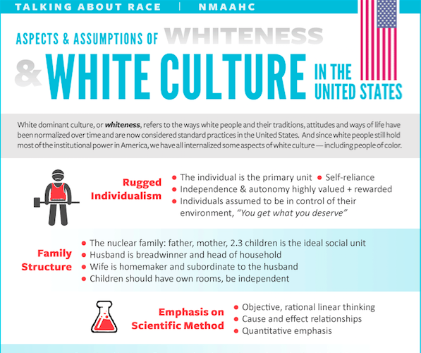
Smithsonian NMAAHC
“Whiteness and white racialized identity refer to the way that white people, their customs, culture, and beliefs operate as the standard by which all other groups of are compared.”

Slide 9

Black Lives Matter
“We are self-reflexive and do the work required to dismantle cisgender privilege and uplift Black trans folk, especially Black trans women who continue to be disproportionately impacted by trans-antagonistic violence…
We foster a queer‐affirming network. When we gather, we do so with the intention of freeing ourselves from the tight grip of heteronormative thinking, or rather, the belief that all in the world are heterosexual (unless s/he or they disclose otherwise).”

Slide 10





Is wokeness dead?

Slide 11


Wokeness is not dead

Slide 12
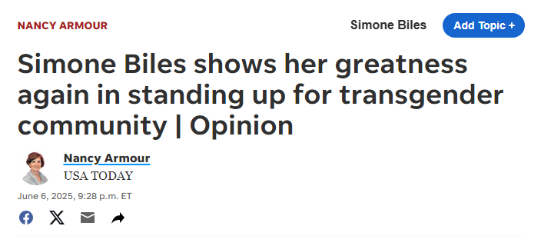
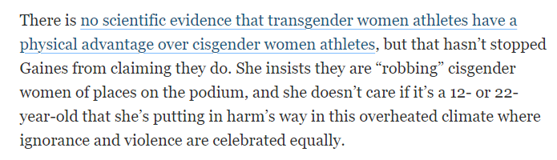
Wokeness is not dead

Slide 13

Wokeness is not dead
“Dominant science (sometimes referred to as Western science) is rooted in colonization, racism and white supremacy…The scientific community must acknowledge the value of research that is led by Indigenous communities, as well as research that centres Indigenous Knowledge systems… universities must stop treating Indigenous Knowledge as supplementary to ‘real knowledge’; this perpetuates white supremacy in science.”

Slide 14
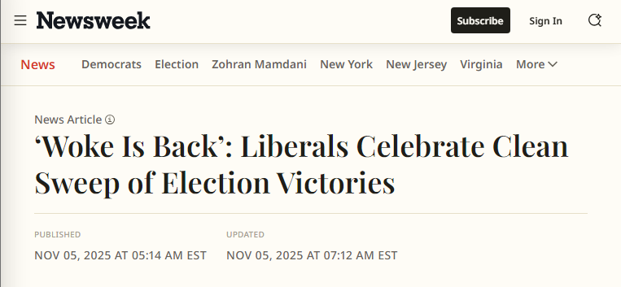


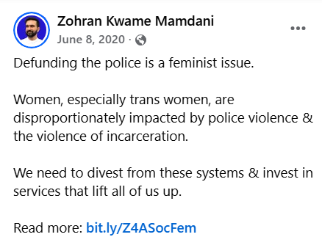
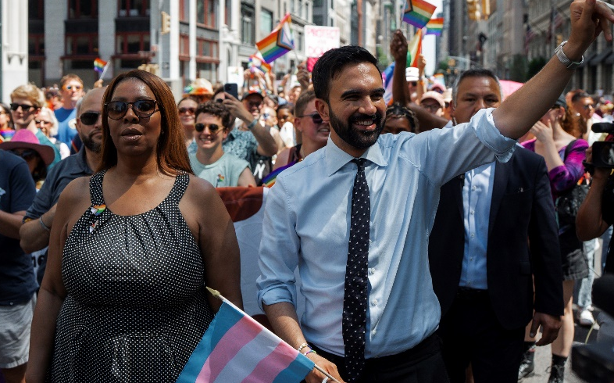
Wokeness is not dead

Slide 15
Outline
Why should we care?
The history of critical theory
What is “contemporary critical theory”?
What are the problems with contemporary critical theory?
Conclusions

Slide 16
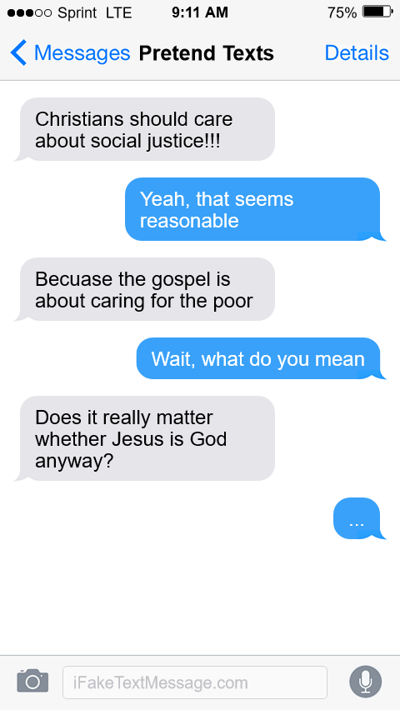
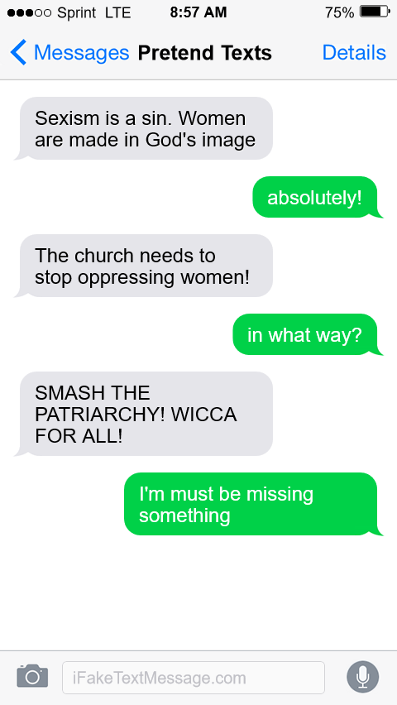
Why should we care?
Warning: fake texts. For pedagogical use only

Slide 17

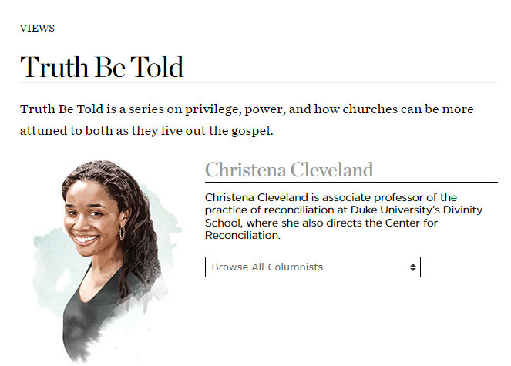
Why should we care?
2015
2016
“Paul, Peter, Luke, John, James, and the writer of Hebrews repeatedly and emphatically make the same point: the unified church is the vehicle through which the kingdom of God is powerfully communicated to the world” – Cleveland, Disunity in Christ, p. 37-38 (2013)

Slide 18
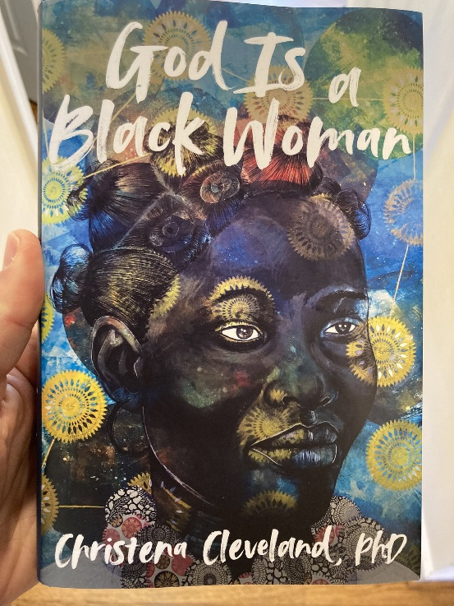
Why should we care?
“As the godhead of the white patriarchy hierarchy, [whitemalegod] alone gets to decide what is good and what is evil…He alone determines what forms of gender and sexual identities are acceptable–cisgender and heterosexual.. He gets to decide which interpretations of scripture are orthodox–the interpretations of cis-het white men” - Cleveland, God is a Black Woman, p. 167
“The liberation of all Black women requires the dismantling of all systems of oppression–white supremacy, patriarchy, capitalism, Islamophobia, homophobia, transphobia, and more” - Cleveland, God is a Black Woman, p. 223
“More than anything, we must eradicate the transphobia within ourselves and our communities. For if God is a Black woman, then She's a Black trans woman. Obviously." - Cleveland, God is a Black Woman, p. 232
2022

Slide 19
Outline
Why should we care?
The history of critical theory
What is “contemporary critical theory”?
What are the problems with contemporary critical theory?
Conclusions

Slide 20

Karl Marx and critical theory
“Alone among these thinkers [i.e., Horkheimer, Bourdieu, Foucault, etc.], Karl Marx invites consensus as a ‘true’ critical theorist. Indeed, for many, he alone inaugurates the critical tradition” (Levinson et al, Beyond Critique, p. 25-26)
1850
1900
1950
2000

Slide 21
Karl Marx and critical theory
Class conflict
Ideology
False consciousness
Liberatory praxis
1850
1900
1950
2000

Slide 22
Marx and class conflict
“The history of all hitherto existing society is the history of class struggles.
Freeman and slave, patrician and plebeian, lord and serf, guildmaster and journeyman, in a word, oppressor and oppressed, stood in constant opposition to one another, carried on an uninterrupted, now hidden, now open fight, that each time ended, either in the revolutionary reconstitution of society at large, or in the common ruin of the contending classes.” – Marx, The Communist Manifesto
1850
1900
1950
2000

Slide 23
Marx and ideology
“The ideas of the ruling class are in every epoch the ruling ideas, i.e. the class which is the ruling material force of society, is at the same time its ruling intellectual force…The ruling ideas are nothing more than the ideal expression of the dominant material relationships, the dominant material relationships grasped as ideas.”– Marx, The German Ideology
1850
1900
1950
2000

Slide 24
Marx and false consciousness
“Whilst in ordinary life every shopkeeper is very well able to distinguish between what somebody professes to be and what he really is, our historians have not yet won even this trivial insight. They take every epoch at its word and believe that everything it says and imagines about itself is true. This historical method which reigned in Germany, and especially the reason why, must be understood from its connection with the illusion of ideologists in general, e.g. the illusions of the jurist, politicians (of the practical statesmen among them, too), from the dogmatic dreamings and distortions of these fellows” - Marx, The German Ideology
1850
1900
1950
2000

Slide 25
Marx and liberatory praxis
“The philosophers have only interpreted the world, in various ways; the point, however, is to change it.”– Marx, Theses on Feuerbach
1850
1900
1950
2000

Slide 26




Critical theory and the Frankfurt School
“Critical theory was conceived within the crucible of Marxism” “The Frankfurt School not only contested establishmentarianism view of history, but projected a radical alternative. European radicals applied its ideas to reconfiguring the family, sexuality, and education.” – Bronner, Critical Theory: A Very Short Introduction, p. 2, 7
1850
1900
1950
2000

Slide 27
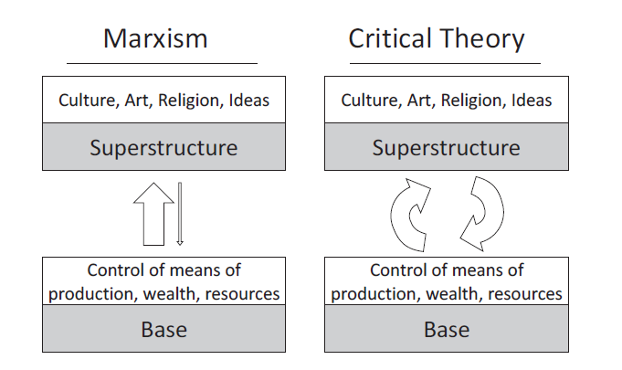
Shenvi and Sawyer, Critical Dilemma, p. 72

Slide 28
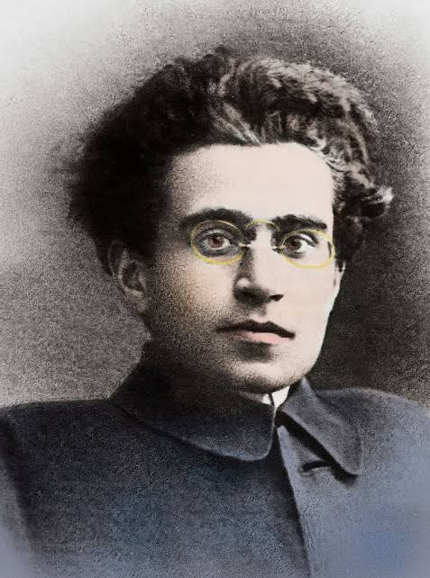
Critical theory and Antonio Gramsci
“With his concept of hegemony, [Gramsci] showed that the reason the much-anticipated revolution of the proletariat had not yet occurred as because within the realm of civil society the working class had come to identify their own best interests as being one and the same as the best interests of the bourgeoisie.” – Buchanan, Dictionary of Critical Theory, p. 216
1850
1900
1950
2000

Slide 29
















Other critical social theorists
Cultural Studies
Postcolonialism
Critical pedagogy
Postmodernism
Bourdieu
Hall
Fanon
Said
Freire
Giroux
Foucault
Derrida
Feminism
Black feminism
Queer theory
Critical Race Theory
de Beauvoir
Friedan
hooks
Lourde
Butler
Rich
Bell
Crenshaw
1850
1900
1950
2000

Slide 30
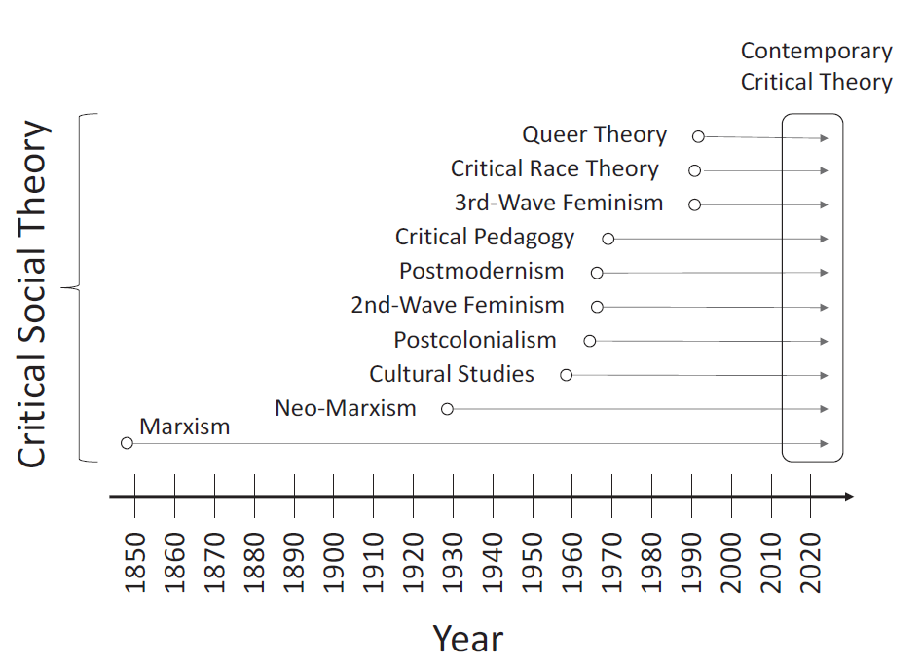
The evolution of critical social theory
Shenvi and Sawyer, Critical Dilemma, p. 64

Slide 31
Outline
Why should we care?
The history of critical theory
What is “contemporary critical theory”?
  Premise 1: Social binary
  Premise 2: Oppression through ideology
  Premise 3: Lived experience
  Premise 4: Social justice
  The strengths of critical theory
What are the problems with contemporary critical theory?
Conclusions

Slide 32





The central premises of contemporary critical theory
Premise I: Social binary
Premise II: Oppression through ideology
Premise III: Lived experience
Premise IV: Social justice

Slide 33


Premise #1: Society is divided into oppressed and oppressor groups
“For every social group, there is an opposite group… the primary groups that we name here are: race, class, gender, sexuality, ability status/exceptionality, religion, and nationality”
“Oppression describes a set of policies, practices, traditions, norm, definitions, and explanations (discourses), which function to systematically exploit one social group to the benefit of another social group. The group that benefits from this exploitation is termed the dominant (or agent) group, and the group that is exploited is termed the minoritized (or target) group…. Sexism, racism, classism, ableism, and heterosexism are specific forms of oppression” – Sensoy and DiAngelo, Is Everyone Really Equal? p. 44, 61

Slide 34

Premise #1: Society is divided into oppressed and oppressor groups
Sensoy and DiAngelo, Is Everyone Really Equal, p. 64

Slide 35
Outline
Why should we care?
The history of critical theory
What is “contemporary critical theory”?
  Premise 1: Social binary
  Premise 2: Oppression through ideology
  Premise 3: Lived experience
  Premise 4: Social justice
  The strengths of critical theory
What are the problems with contemporary critical theory?
Conclusions

Slide 36

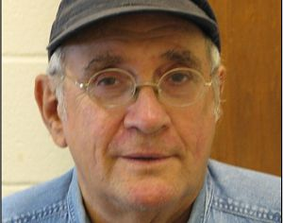
Premise #2: Oppression occurs through hegemonic power
“oppression also traditionally carries a strong connotation of conquest and colonial domination… New left social movements of the 1960s and 1970s, however, shifted the meaning of the concept of oppression. In its new usage, oppression designates the disadvantage and injustice some people suffer not because a tyrannical power coerces them, but because of the everyday practices of a well-intentioned liberal society… Oppression in this sense is structural, rather than the result of a few people’s choices or policies. Its causes are embedded in unquestioned norms, habits, and symbols.” – Iris Young, “Five Faces of Oppression,” Readings for Diversity and Social Justice, p. 36
“Marcuse’s notions of ‘one dimensional thought’…complements the critical theory tradition to better understand how hegemony, as cultural domination, normalizes and sustains the political/economic power of particular historic blocs – the ruling coalition of economic, political and cultural elites” – Lauren Langman, “From Domination to Liberation: Marcuse, Gramsci, and a Critical Theory of Social Mobilization”, p.14, Conference Papers – American Sociological Association.

Slide 37

Premise #2: Oppression occurs through hegemonic power
Old white men
~15%

Slide 38
Outline
Why should we care?
The history of critical theory
What is “contemporary critical theory”?
  Premise 1: Social binary
  Premise 2: Oppression through ideology
  Premise 3: Lived experience
  Premise 4: Social justice
  The strengths of critical theory
What are the problems with contemporary critical theory?
Conclusions

Slide 39


Premise #3: ‘Lived experience’ gives oppressed groups privileged access to truth
“The idea that objectivity is best reached only through rational thought is a specifically Western and masculine way of thinking – one that we will challenge throughout this book.” – Margaret L. Andersen and Patricia Hill Collins, “Reconstructing Knowledge,” in Anderson and Collins, Race, Class, and Gender, p. 4-5

Slide 40



Premise #3: ‘Lived experience’ gives oppressed groups privileged access to truth
Oppression and epistemology:
Privilege
Lived
experience
Internalized oppression
Liberatory consciousness

Slide 41
Outline
Why should we care?
The history of critical theory
What is “contemporary critical theory”?
  Premise 1: Social binary
  Premise 2: Oppression through ideology
  Premise 3: Lived experience
  Premise 4: Social justice
  The strengths of critical theory
What are the problems with contemporary critical theory?
Conclusions

Slide 42

Premise #4: Social justice demands the liberation of oppressed groups
Definition of social justice:
“Prior to celebrating diversity, we must first eliminate intolerance. No matter what form it takes or who does it, we must all take action to stop intolerance when it happens. Working towards a celebration of diversity implies working for social justice – the elimination of all forms of social oppression… Social injustice takes many forms. It can be injustice based on a person’s gender, race, ethnicity, religion, sexual orientation, physical or mental ability, or economic class.” – Mary McClintock, “How to Interrupt Oppressive Behavior,” Readings for Diversity and Social Justice, p. 483

Slide 43
From Karl Marx to contemporary critical theory
Class conflict
Ideology
False consciousness
Liberatory praxis
Social binary
Oppression through
ideology
Lived experience
Social justice
1850
1900
1950
2000

Slide 44
Outline
Why should we care?
The history of critical theory
What is “contemporary critical theory”?
  Premise 1: Social binary
  Premise 2: Oppression through ideology
  Premise 3: Lived experience
  Premise 4: Social justice
  The strengths of critical theory
What are the problems with contemporary critical theory?
Conclusions

Slide 45

Strength #1. Emphasis on the sinfulness of oppression
“Learn to do good; seek justice, correct oppression; bring justice to the fatherless, plead the widow's cause.” – Is. 1:17
“Do not oppress the widow, the fatherless, the sojourner, or the poor, and let none of you devise evil against another in your heart.” – Zech. 7:20
“Love your neighbor as yourself.” – Mark 12:30
“Listen! The wages of the laborers who mowed your fields which you kept back by fraud, cry out, and the cries of the har­vesters have reached the ears of the Lord of hosts” – James 5:4

Slide 46

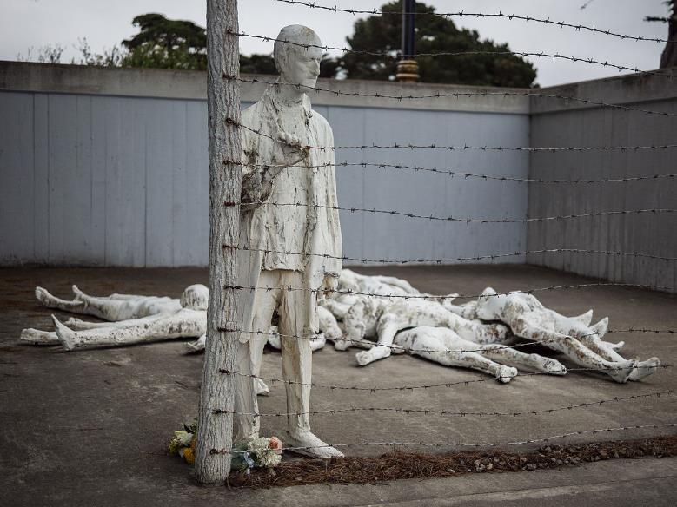
Strength #2. Focus on structures, systems, and norms

Slide 47

Strength #3: Recognition of hegemonic power

Slide 48
Outline
Why should we care?
The history of critical theory
What is “contemporary critical theory”?
What are the problems with contemporary critical theory?
  Worldview
  Epistemology
  Adversarial identities
  Hegemonic power
Conclusions

Slide 49
Worldview questions
Who are we?
What is our fundamental problem as human beings?
What is the solution to our problem?
What is our primary moral duty?
What is our purpose in life?

Slide 50
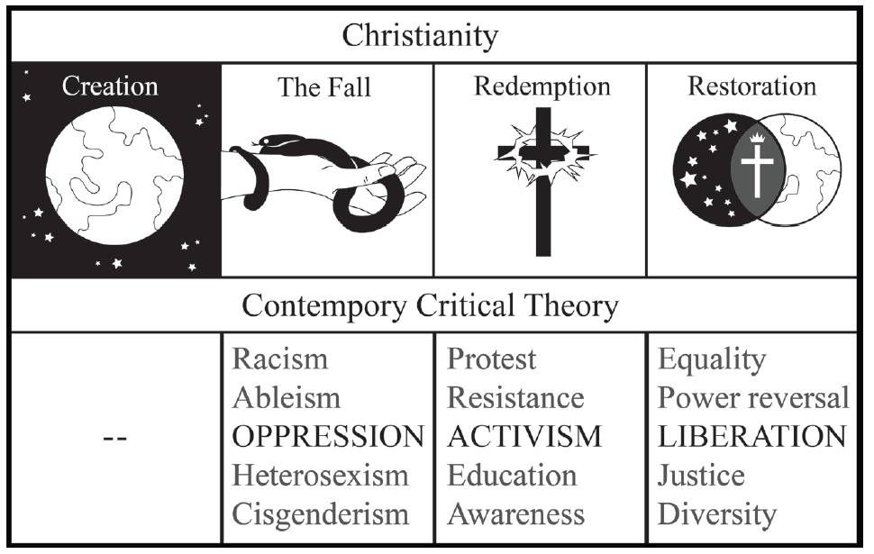
Christianity and contemporary critical theory are competing worldviews
Shenvi and Sawyer, Critical Dilemma, p. 284

Slide 51
Worldview questions
 | Christianity | Critical theory
Who are we? | God’s creatures | Members of various groups
What is our problem? | Sin | Oppression
What is the solution? | Jesus | Liberation
What is our duty? | Loving God | Liberating the oppressed
What is our purpose? | Glorifying God | Working for liberation

Slide 52

Unifying themes of critical theory
“the cluster of philosophical approaches to [issues of identity is] known by the umbrella term critical theory. Critical theory is today a diverse phenomenon that draws deeply and variously on strands of Marxist thought, psychoanalysis, feminist theory, postcolonialism, poststructuralism, queer theory, and deconstruction… at the core of the various approaches of critical theorists lies a relatively simple set of convictions: the world is to be divided up between those who have power and those who do not; the dominant Western narrative of truth is really an ideological construct designed to preserve the power structure of the status quo; and the goal of critical theory is therefore to destabilize this power structure by destabilizing the dominant narratives that are used to justify –to ‘naturalize’– it”
Trueman, The Rise and Triumph of the Modern Self, p. 225-226

Slide 53


Critical theory as worldview
“we now have Social Justice texts--forming a kind of Gospel of Social Justice--that express, with absolute certainty, that all white people are racist, all men are sexist, racism and sexism are systems that can exist and oppress absent even a single person with racist or sexist intentions or beliefs..., sex is not biological and exists on a spectrum, language can be literal violence, denial of gender identity is killing people, the wish to remedy disability and obesity is hateful, and everything needs to be decolonized.
Does this sound like a metanarrative? That's because it is. Social Justice scholarship and its educators and activists see these principles and conclusions as The Truth According to Social Justice--and they treat it as though they have discovered the analogue of the germ theory of disease, but for bigotry and oppression”
Pluckrose and Lindsay, Cynical Theories, p. 182-183

Slide 54
Outline
Why should we care?
The history of critical theory
What is “contemporary critical theory”?
What are the problems with contemporary critical theory?
  Worldview
  Epistemology
  Adversarial identities
  Hegemonic power
Conclusions

Slide 55
Epistemology
Claim
reason,
logic,
argument
Evidence

Slide 56

Bulverism
psychology,
economics,
politics
Claim
reason,
logic,
argument
Motivation/
hidden agenda
Evidence

Slide 57
Epistemology
psychology,
economics,
politics
Claim
reason,
logic,
argument,
exegesis
“maintaining supremacy”
“internalized oppression”
Scripture

Slide 58
Outline
Why should we care?
The history of critical theory
What is “contemporary critical theory”?
What are the problems with contemporary critical theory?
  Worldview
  Epistemology
  Adversarial identities
  Hegemonic power
Conclusions

Slide 59


Identity and solidarity

Slide 60
Identity and solidarity
Creation
Sin
Redemption

Slide 61
Outline
Why should we care?
The history of critical theory
What is “contemporary critical theory”?
What are the problems with contemporary critical theory?
  Worldview
  Epistemology
  Adversarial identities
  Hegemonic power
Conclusions

Slide 62

Christianity as hegemonic discourse
Religion
Morality
Sexuality
Gender
etc…

Slide 63
Outline
Why should we care?
The history of critical theory
What is “contemporary critical theory”?
What are the problems with contemporary critical theory?
Conclusions

Slide 64
Christianity and contemporary critical theory are competing worldviews
Shenvi and Sawyer, Critical Dilemma, p. 284

Slide 65


The enduring importance of Marx
Labor theory of value
Alienation
Dialectical materialism
Class conflict
Ideology
False consciousness
Liberatory praxis

Slide 66
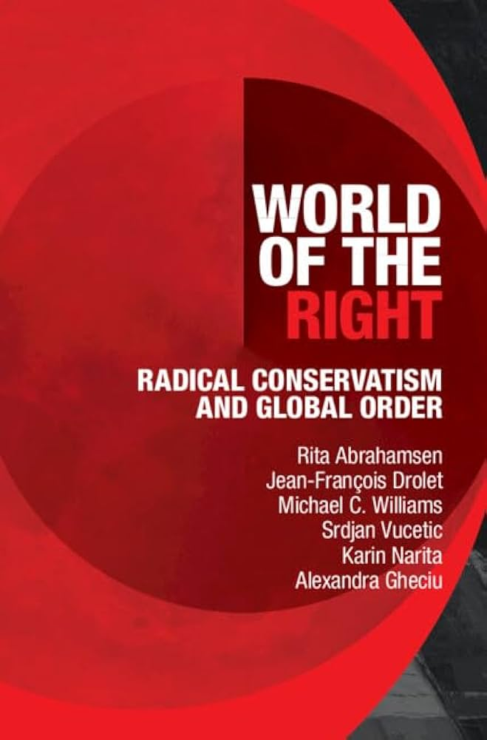
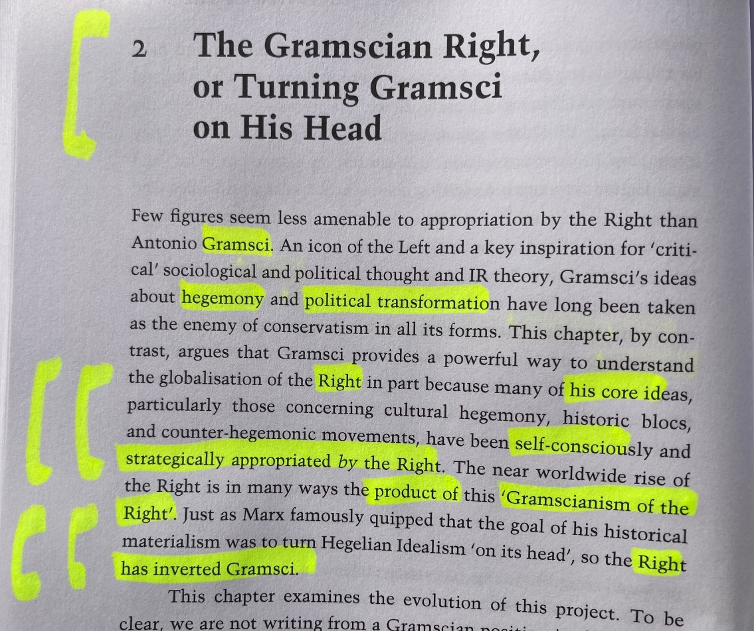
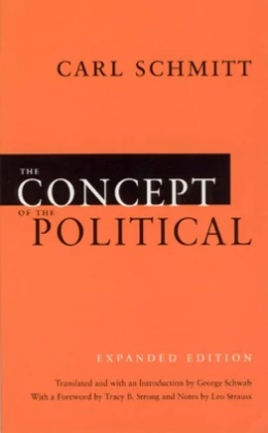

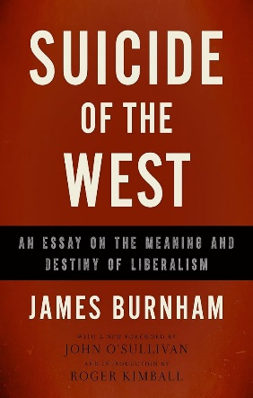

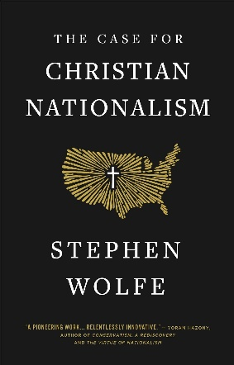

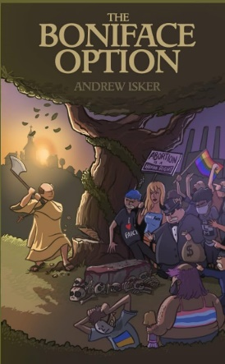

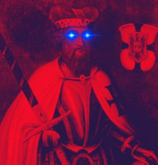

The Woke Right

Slide 67

Critical Dilemma (2023)
Academic and comprehensive
500+ pages
770+ footnotes
200+ primary sources on critical theory
Thousands of words of quotes from primary sources
Endorsements from: Ligon Duncan, JD Greear, Nancy Pearcey, Thomas Chatterton Williams, Alisa Childers, Peter Boghossian, John Cooper, Natasha Crain, Thaddeus Williams, John Stonestreet

Slide 68
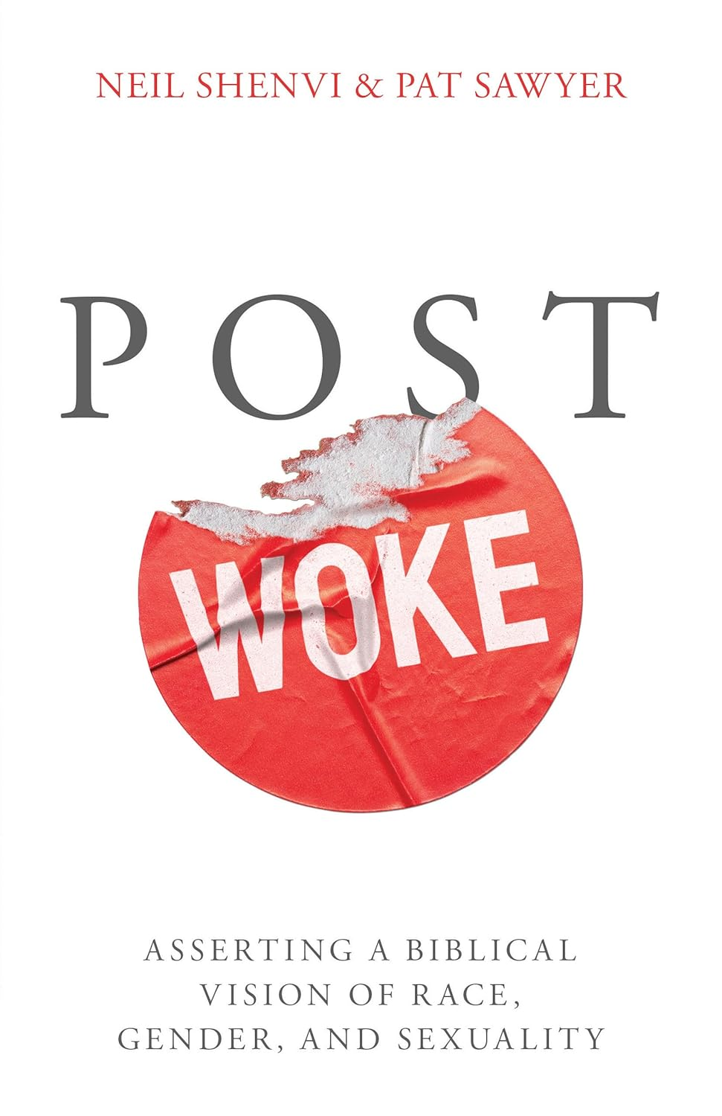
Post Woke (2026)
Accessible and practical
288 pages
250+ footnotes
200+ Scripture references
Examples, illustrations, case studies, action plans
Endorsements from: Kevin DeYoung, Christopher Yuan, Gavin Ortlund, Erwin Lutzer, Hillary Ferrer, Sean McDowell, Carl Trueman, Melissa Doherty

Slide 69


Acknowledgements and additional resources
Dr. Christina Shenvi
Dr. Pat Sawyer
www.shenviapologetics.com/slides/
“The Incompatibility of Critical Theory and Christianity,” The Gospel Coalition
“Gender, Intersectionality, and Critical Theory,” Eikon
“Critical Theory and the Social Justice Movement” Journal of Christian Legal Thought
shenviapologetics.com/
Twitter @NeilShenvi, @RealPatSawyer

