Slide 1


Truth-Seeking as Evidence for God
Dr. Neil Shenvi
Indianapolis, IN
Nov. 8, 2025

Slide 2
Talk outline
The moral argument for God’s existence
  Premise 1: Is God necessary to ground morality?
  Premise 2: Do objective moral facts exist?
  Thought experiments
The transcendental-moral argument
  Premise 1: Is God necessary to ground the moral duty of truth-seeking?
  Premise 2: Is truth-seeking a moral duty?
Summing up

Slide 3
Definitions
Objective moral values – values like compassion, love, and justice which are “good” or “evil” independent of human belief
Objective moral duties – obligations which are binding on us independent of our acceptance of them
Moral facts – statements about morality which can be objectively true or false, just like physical facts

Slide 4
The moral argument
P1. If God does not exist, then objective moral values and duties do not exist.
P2. Objective moral values and duties do exist.
Therefore,
C. God exists
This argument is valid, but is it sound? Are the two premises true?

Slide 5
Talk outline
The moral argument for God’s existence
  Premise 1: Is God necessary to ground morality?
  Premise 2: Do objective moral facts exist?
  Thought experiments
The transcendental-moral argument
  Premise 1: Is God necessary to ground the moral duty of truth-seeking?
  Premise 2: Is truth-seeking a moral duty?
Summing up

Slide 6
Is morality grounded in human flourishing?
“the question whether a [moral] code is good or bad is the same as the question whether or not it promotes human happiness” – Bertrand Russell, “Our Sexual Ethics,” Why I Am Not a Christian, 169.
“questions of right and wrong are really questions about the happiness and suffering of sentient creatures. If we are in a position to affect the happiness or suffering of others, we have ethical responsibilities towards them.” – Sam Harris, The End of Faith, 170-171

Slide 7
Morality versus human flourishing
The morality of lying
Victim-free immorality
Group flourishing versus individual suffering

Slide 8

The wardrobe experiment
Destroy one wardrobe. One contains a human being. One contains a highly complex self-sustaining chemical reaction of DNA, RNA, proteins and lipids. Which one do you destroy?

Slide 9
Premise 1: Is God necessary to ground morality?
“God does not exist [and] all possibility of finding values in a heaven of ideas disappears along with Him. . . . Everything is permissible if God does not exist.” - Jean-Paul Sartre, Existentialism and Human Emotions, 22
“[Moral facts] constitute so odd a cluster of qualities and relations that they are most unlikely to have arisen in the ordinary course of events, without an all-powerful god to create them.” - J. L. Mackie, The Miracle of Theism: Arguments for and against the Existence of God, 115
“A ‘soft atheist’ would hold that one could be an atheist and still believe in morality [but] the religious fundamentalists are correct: without God, there is no morality.” - Joel Marks, “An Amoral Manifesto (Part I)” Philosophy Now 80 (2010), 30–33.

Slide 10
Talk outline
The moral argument for God’s existence
  Premise 1: Is God necessary to ground morality?
  Premise 2: Do objective moral facts exist?
  Thought experiments
The transcendental-moral argument
  Premise 1: Is God necessary to ground the moral duty of truth-seeking?
  Premise 2: Is truth-seeking a moral duty?
Summing up

Slide 11
There is empirical evidence that objective moral facts exist
The ubiquity of basic moral behavior and true altruism.
The moral behavior of moral relativists.
Universal human moral intuition of objective moral categories.
The moral realism of philosophers.
The moral realism of naturalists.

Slide 12
Premise 2: do objective moral values and duties exist?
Morality is a properly basic belief because it need not be justified by other beliefs
Other properly basic beliefs include belief in the existence of the external universe, belief in the existence of other minds or belief in the reliability of memory
Belief in the existence of objective moral categories of right and wrong is basic and intrinsic to human beings

Slide 13
Talk outline
The moral argument for God’s existence
  Premise 1: Is God necessary to ground morality?
  Premise 2: Do objective moral facts exist?
  Thought experiments
The transcendental-moral argument
  Premise 1: Is God necessary to ground the moral duty of truth-seeking?
  Premise 2: Is truth-seeking a moral duty?
Summing up

Slide 14

Moral criticism
The universe we observe has precisely the properties we should expect if there is, at bottom, no design, no purpose, no evil and no good, nothing but blind, pitiless indifference. – Richard Dawkins, River Out of Eden, p. 132
“The God of the Old Testament is arguably the most unpleasant character in all fiction: jealous and proud of it; a petty, unjust, unforgiving control-freak; a vindictive, bloodthirsty ethnic cleanser; a misogynistic, homophobic, racist, infanticidal, genocidal, filicidal, pestilential, megalomaniacal, sadomasochistic, capriciously malevolent bully.” – Richard Dawkins, The God Delusion

Slide 15
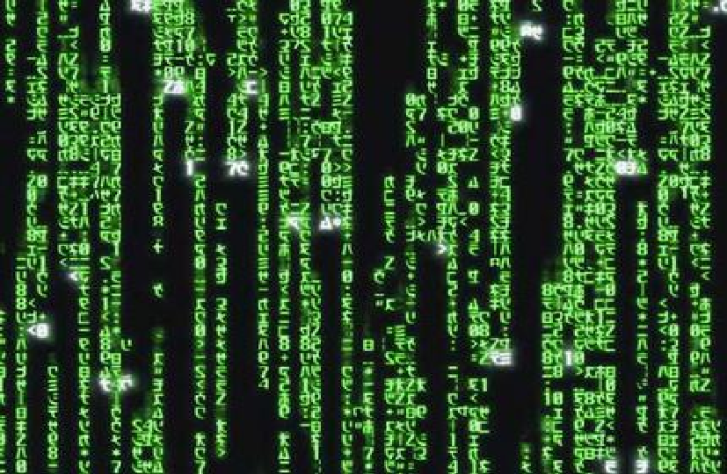
Cipher’s challenge
You are offered the chance to have whatever you want most in life in exchange for performing some horrific moral action on people you do not know. Afterwards, your memory will be erased. Do you accept the offer?
Follow-up: when you ignore suffering and injustice all over the world to protect your ability to enjoy your life, how is this different than accepting the offer daily?

Slide 16

The amorality pill
You are offered a pill which will remove all your negative moral emotions like guilt, empathy and remorse, but will leave all positive emotions intact. In other words, you will still love your family, derive delight from watching your children play, feel tenderness and joy whenever you watch them sleeping. But if you decide one day, that killing them all would make you happier, you will be able to do so without any pangs of conscience. Would you take the pill?

Slide 17
The moral argument
P1. If God does not exist, then objective moral values and duties do not exist.
P2. Objective moral values and duties do exist.
Therefore,
C. God exists
Both premises are true; therefore, the conclusion is true.

Slide 18
Talk outline
The moral argument for God’s existence
  Premise 1: Is God necessary to ground morality?
  Premise 2: Do objective moral facts exist?
  Thought experiments
The transcendental-moral argument
  Premise 1: Is God necessary to ground the moral duty of truth-seeking?
  Premise 2: Is truth-seeking a moral duty?
Summing up

Slide 19
The moral argument
P1. If God does not exist, then objective moral values and duties do not exist.
P2. Objective moral values and duties do exist.
Therefore,
C. God exists

Slide 20
The transcendental-moral argument
P1. If a truth-loving God does not exist, then a duty to seek the truth does not exist.
P2. A duty to seek the truth does exist.
Therefore,
C. A truth-loving God exists.

Slide 21
Talk outline
The moral argument for God’s existence
  Premise 1: Is God necessary to ground morality?
  Premise 2: Do objective moral facts exist?
  Thought experiments
The transcendental-moral argument
  Premise 1: Is God necessary to ground the moral duty of truth-seeking?
  Premise 2: Is truth-seeking a moral duty?
Summing up

Slide 22
Recall: atheists tend to ground morality in human flourishing
“the question whether a [moral] code is good or bad is the same as the question whether or not it promotes human happiness” – Bertrand Russell, “Our Sexual Ethics,” Why I Am Not a Christian, 169.
“questions of right and wrong are really questions about the happiness and suffering of sentient creatures. If we are in a position to affect the happiness or suffering of others, we have ethical responsibilities towards them.” – Sam Harris, The End of Faith, 170-171

Slide 23
Truth can be opposed to human flourishing
“That Man is the product of causes which had no prevision of the end they were achieving; that his origin, his growth, his hopes and fears, his loves and his beliefs, are but the outcome of accidental collocations of atoms; that no fire, no heroism, no intensity of thought and feeling, can preserve an individual life beyond the grave…all these things, if not quite beyond dispute, are yet so nearly certain, that no philosophy which rejects them can hope to stand. Only within the scaffolding of these truths, only on the firm foundation of unyielding despair, can the soul’s habitation henceforth be safely built.” – Bertrand Russell, “Our Sexual Ethics,” Why I Am Not a Christian, 169.
“If … faith eases [your dying grandmother’s] last moments, it would be churlish to attack it, for the costs are high and the benefits nil… I know of no nonbeliever who would sanction that, or say there’s anything wrong with allowing the dying to retain their faith.” – Jerry Coyne, Faith Vs. Fact, p. 253.

Slide 24


Falsehood can promote human flourishing

Slide 25
If a truth-loving God does not exist, truth-seeking cannot be a moral duty
Truth does not always lead to human flourishing
Falsehood sometimes leads to human flourishing
Therefore, if morality is grounded in human flourishing:
When truth does not lead to human flourishing, we are not morally obligated to seek it.
When falsehood does lead to human flourishing, we are morally obligated to promote it.

Slide 26
Talk outline
The moral argument for God’s existence
  Premise 1: Is God necessary to ground morality?
  Premise 2: Do objective moral facts exist?
  Thought experiments
The transcendental-moral argument
  Premise 1: Is God necessary to ground the moral duty of truth-seeking?
  Premise 2: Is truth-seeking a moral duty?
Summing up

Slide 27
Premise 2: Is truth-seeking morally obligatory?
If truth-seeking is not morally obligatory, then why should Christians seek to know whether atheism is true?
Paradoxically, atheists who insist that truth-seeking is their highest calling, have no basis to urge others to seek the truth or to seek it themselves!
The only way to ground the intrinsic goodness and obligatory nature of truth-seeking is through the existence of a truth-loving God.

Slide 28
Does the biblical God love and command truth-seeking?
“Show me your ways, O Lord, teach me your paths; guide me in your truth and teach me, for you are God my Savior, and my hope is in you all day long.” – Psalm 24:4-5
“Into your hands I commit my spirit; redeem me, O Lord, the God of truth.” – Psalm 31:1
“Then you will know the truth, and the truth will set you free.” – John 8:32
“Jesus answered, “I am the way and the truth and the life. No one comes to the Father except through me.” – John 14:6
“The wrath of God is being revealed from heaven against all the godlessness and wickedness of men who suppress the truth by their wickedness” – Rom. 1:18
“They perish because they refused to love the truth and so be saved.” – 2 Thess. 2:10

Slide 29
Talk outline
The moral argument for God’s existence
  Premise 1: Is God necessary to ground morality?
  Premise 2: Do objective moral facts exist?
  Thought experiments
The transcendental-moral argument
  Premise 1: Is God necessary to ground the moral duty of truth-seeking?
  Premise 2: Is truth-seeking a moral duty?
Summing up

Slide 30
The Moral Argument
P1. If God does not exist, then objective moral values and duties do not exist.
P2. Objective moral values and duties do exist.
Therefore,
C. God exists.
Denying P1 is difficult because naturalism cannot ground human value or moral obligation.
Denying P2 is difficult because moral realism is properly basic, explains empirical observations, and avoids inconsistency.
Christians can explain where morality comes from while atheists cannot.

Slide 31
The Transcendental-Moral Argument
P1. If a truth-loving God does not exist, then a duty to seek the truth does not exist.
P2. A duty to seek the truth does exist.
Therefore,
C. A truth-loving God exists.
Denying P1 is difficult even if we accept a naturalistic account of moral obligation.
Denying P2 is difficult because it means that we have no moral obligation to “seek to know the truth of atheism.”
Christians have a basis for urging people to seek to the truth while atheists do not.

Slide 32

Talking to postmodernists
They demand truth in fields they care about: politics, criminal justice, sports, etc.
True compassion requires truth, e.g. truth at the hospital.
Denial of objective truth is an objective truth claim.

Slide 33
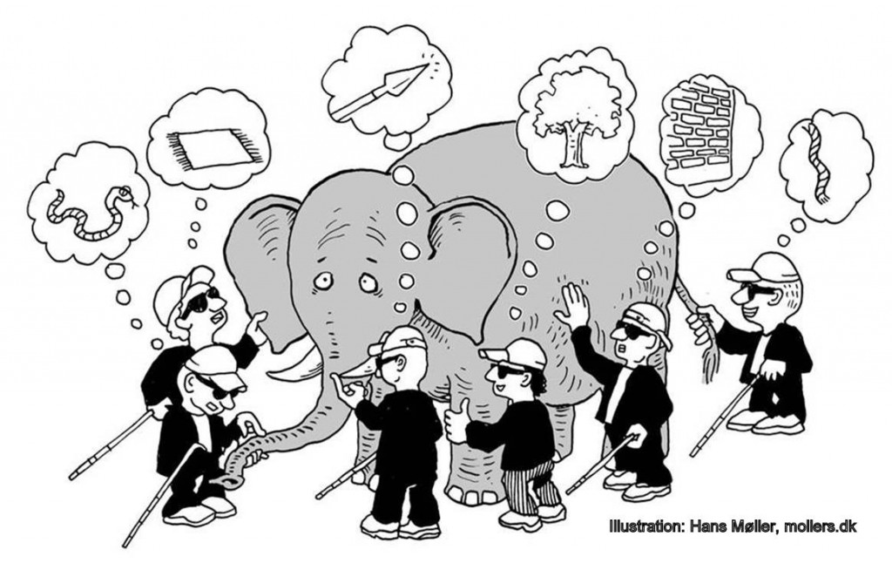
Talking to religious relativists
Religious relativism is a religious truth claim, e.g. the parable of the Blind Men and the Elephant.

Slide 34
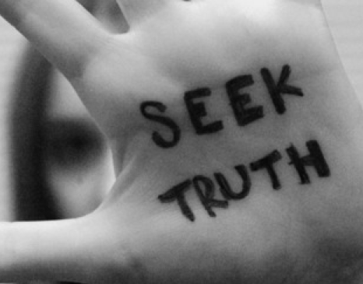
Talking to New Atheists
“Will atheism make me happier?”
“Will atheism make other people happier?”
“Why should I seek the truth?”

Slide 35
Talking to doubting Christians
“Why do you care whether Christianity is true? All that matters is whether it makes you happy!”
“You should stop reading atheist books! You should only read books that affirm your beliefs!”
To the extent that they reject (and are horrified by) these suggestions, they are affirming their duty to seek the truth.

Slide 36
The threat of the moral Law
“This is the verdict: Light has come into the world, but men loved darkness instead of light because their deeds were evil. Everyone who does evil hates the light, and will not come into the light for fear that his deeds will be exposed. But whoever lives by the truth comes into the light, so that it may be seen plainly that what he has done has been done through God” – John 3:19-21

Slide 37
The threat of a moral Lawgiver
“’Woe to me!’ I cried. ‘I am ruined! For I am a man of unclean lips, and I live among a people of unclean lips, and my eyes have seen the King, the Lord Almighty.’” – Is. 6:5
What will resolve the animosity we feel towards the reality of the moral Law and the moral Lawgiver?

Slide 38
The unique relationship of morality to the gospel
“As for you, you were dead in your transgressions and sins, in which you used to live when you followed the ways of this world and of the ruler of the kingdom of the air... All of us also lived among them at one time, gratifying the cravings of our flesh and following its desires and thoughts. Like the rest, we were by nature deserving of wrath. But because of his great love for us, God, who is rich in mercy, made us alive with Christ even when we were dead in transgressions... For it is by grace you have been saved, through faith—and this is not from yourselves, it is the gift of God— not by works, so that no one can boast. For we are God’s handiwork, created in Christ Jesus to do good works, which God prepared in advance for us to do.” – Eph. 2:1-5
Other religions: morality → God’s acceptance
Christianity: God’s acceptance → morality

Slide 39
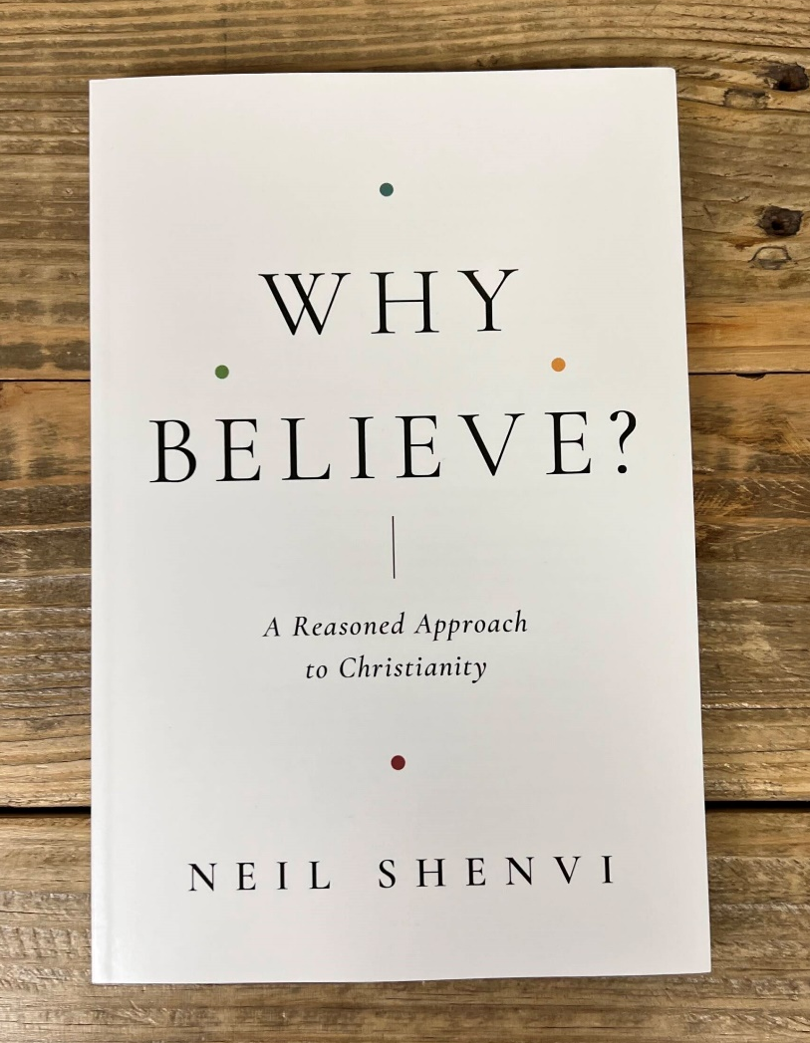
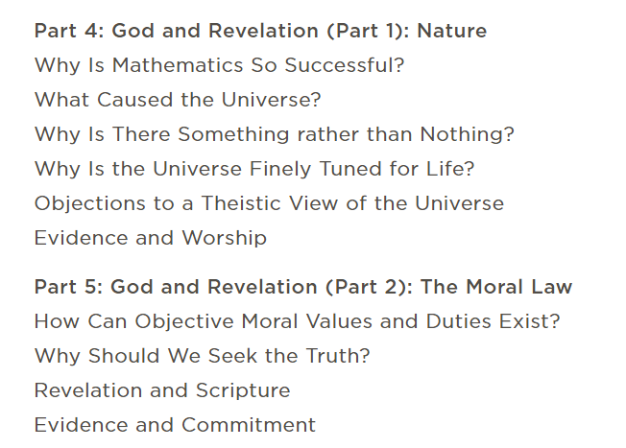
Neil Shenvi, Why Believe? Chapters 4-5

Slide 40


Acknowledgements
Dr. Christina Shenvi
Dr. Pat Sawyer
shenviapologetics.com/slides/
https://shenviapologetics.com/why-believe-a-reasoned-approach-to-christianity/
Twitter @NeilShenvi

