Slide 1
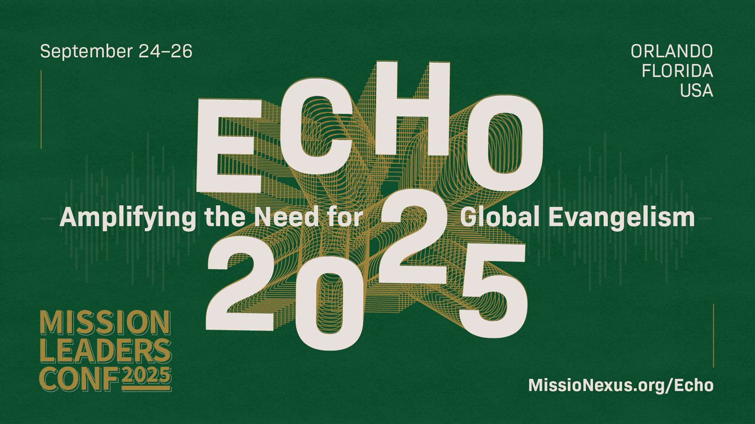

Slide 2


Slide 3


Slide 4
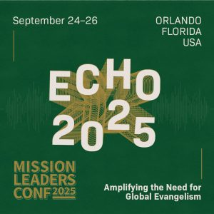
Christianity and Critical Theory: Are They Compatible?
Dr. Neil Shenvi
Missio Nexus
Sept. 25, 2025

Slide 5
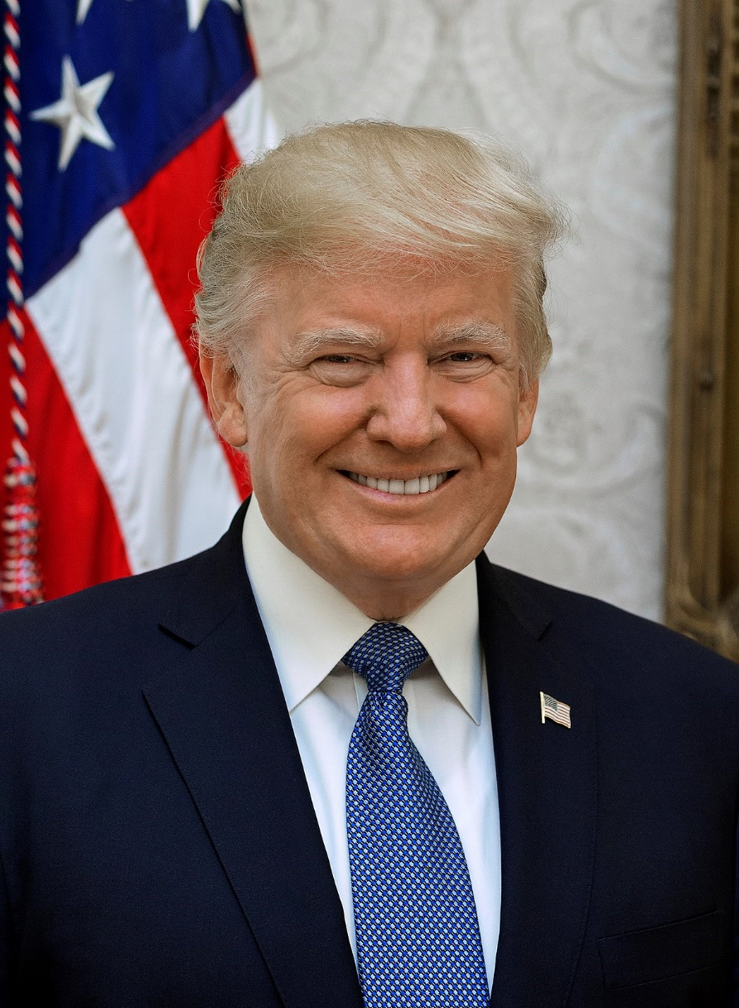
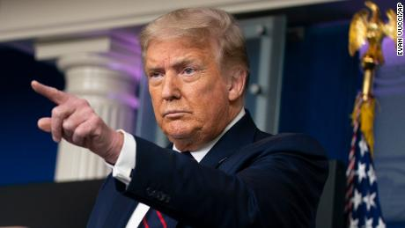


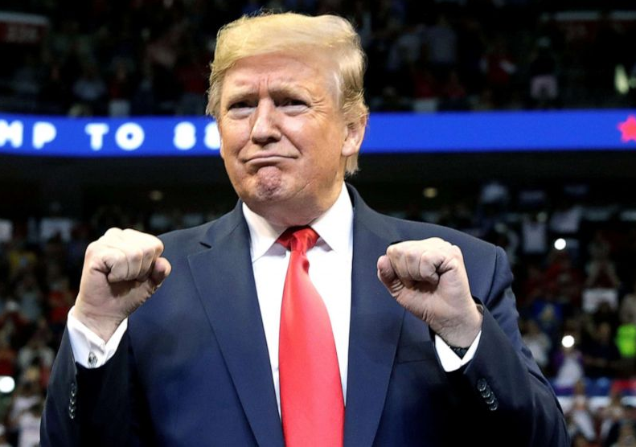
This talk is not about Trump

Slide 6
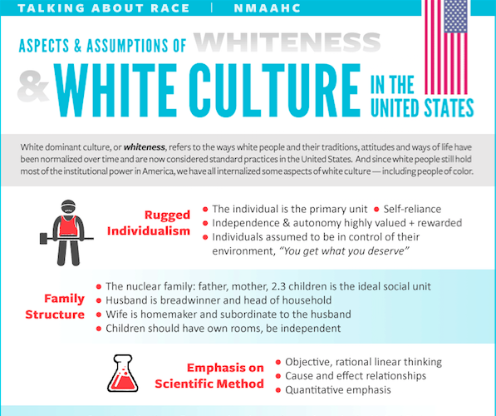
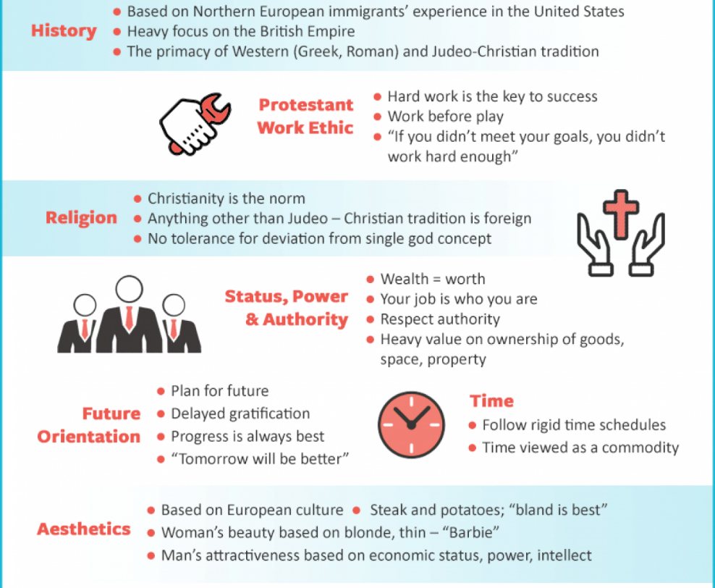
Smithsonian NMAAHC
“Whiteness and white racialized identity refer to the way that white people, their customs, culture, and beliefs operate as the standard by which all other groups of are compared.”

Slide 7

Blue’s Clues Pride Month Cartoon
“Families marching one-by-one
Hurrah, hurrah
Families marching one-by-one
Hurrah, hurrah
This family has two mommies
They love each other so proudly
And they all go marching in the Big Parade…
These babas are non-binary
They love each other so proudly…
Ace, bi and pan grown-ups you see can love each other so proudly
And they all go marching in the Big Parade"

Slide 8
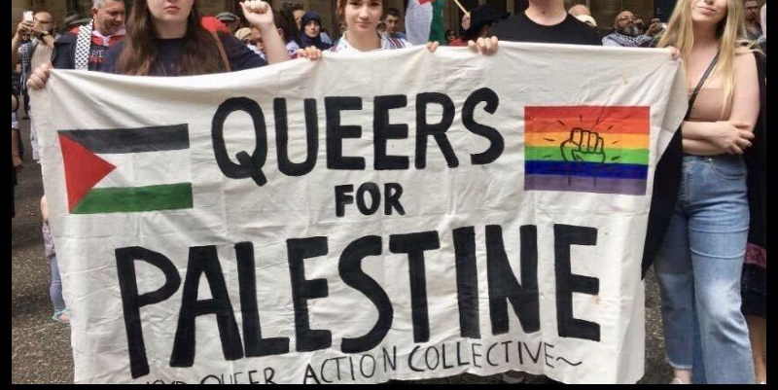
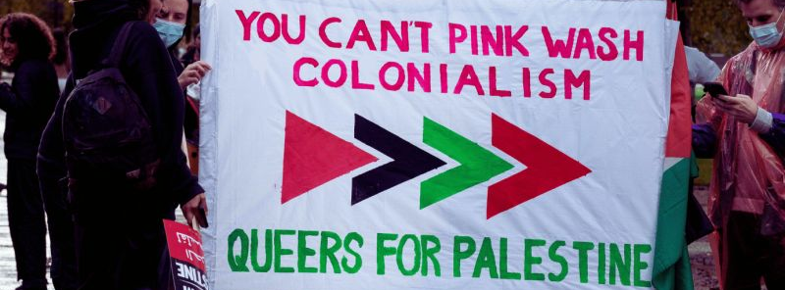
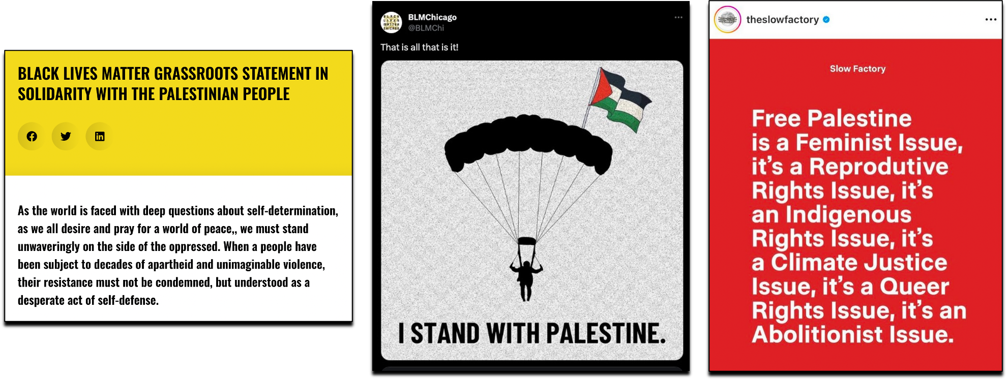
Queers for Palestine

Slide 9
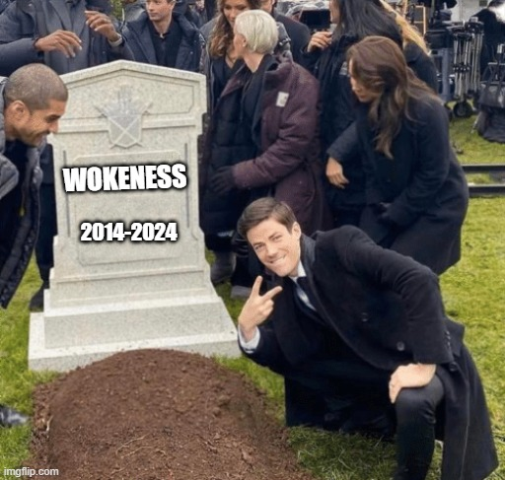
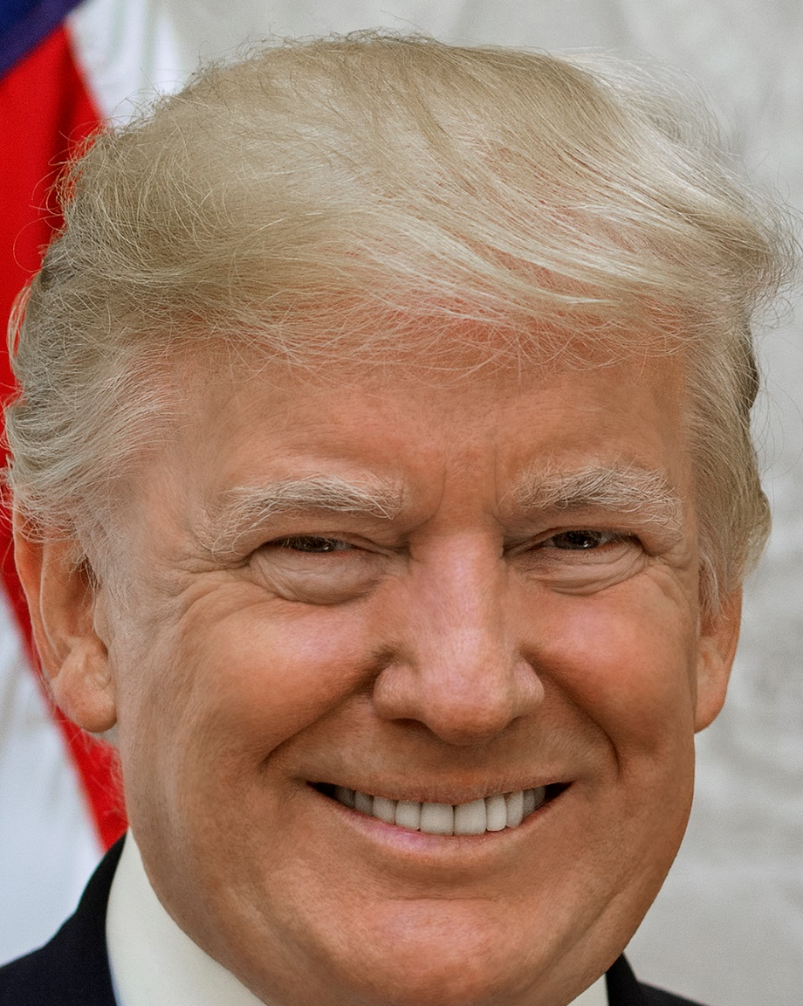
Is wokeness dead?

Slide 10
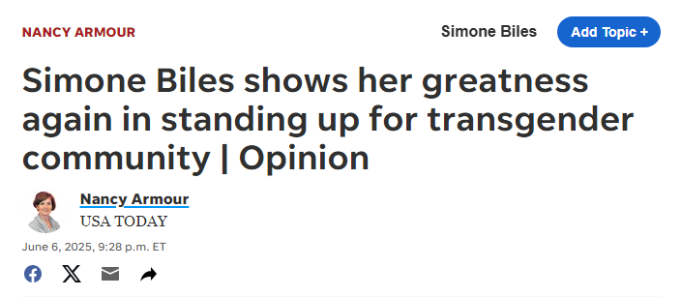
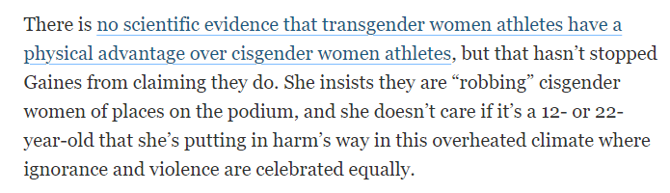
Wokeness is not dead

Slide 11
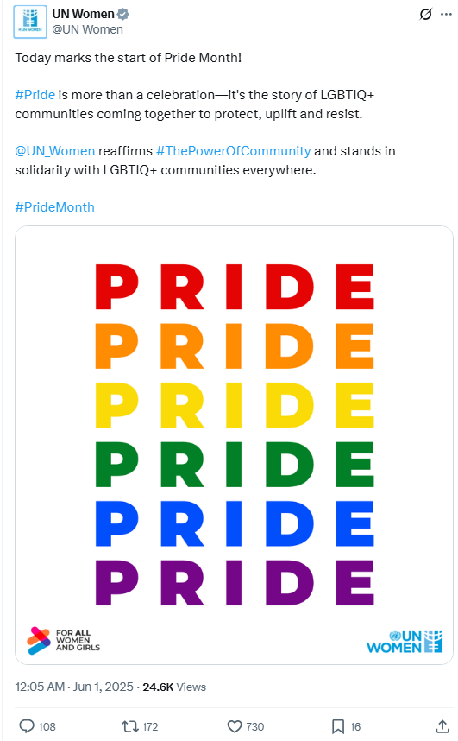
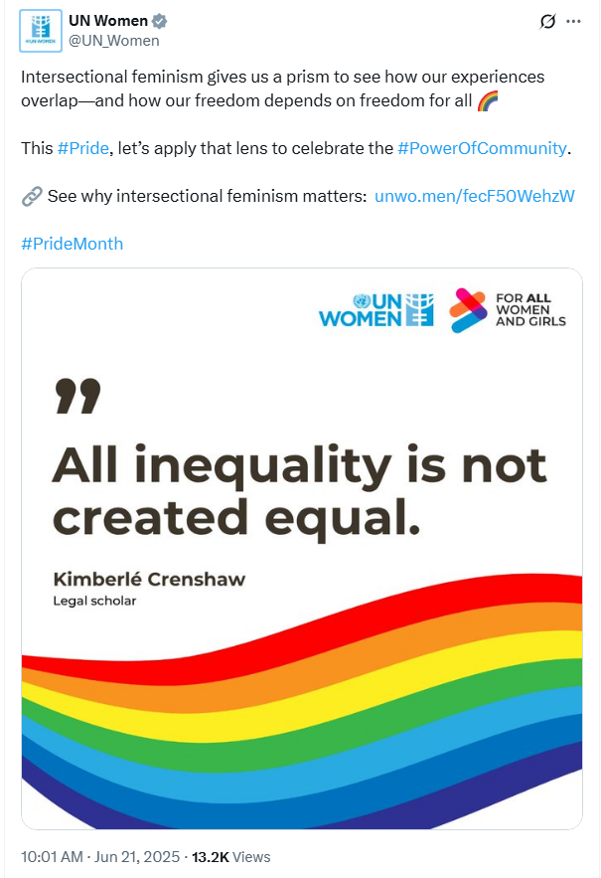
Wokeness is not dead

Slide 12
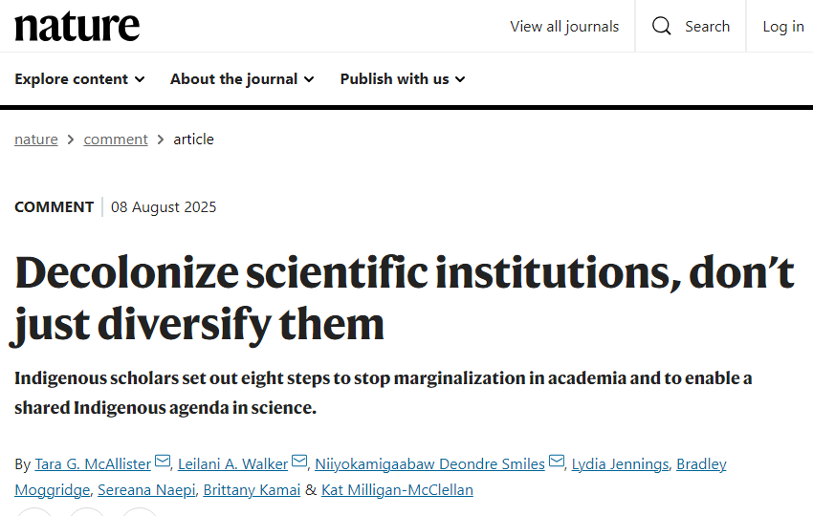
Wokeness is not dead
“Dominant science (sometimes referred to as Western science) is rooted in colonization, racism and white supremacy…The scientific community must acknowledge the value of research that is led by Indigenous communities, as well as research that centres Indigenous Knowledge systems… universities must stop treating Indigenous Knowledge as supplementary to ‘real knowledge’; this perpetuates white supremacy in science.”

Slide 13
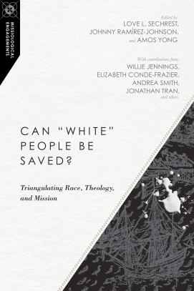
Why should we care?
“Decolonizing Salvation” - Andrea Smith in Sechrest et al., Can ‘White’ People Be Saved? (2019)
“what we presume to be true of the Bible is primarily the result of the history of European interpretation as translated into European languages… we would have a completely different understanding of the Bible if we read it through Indigenous languages translated directly from Greek and Hebrew.” (p. 54)
“According to the European positivist grammar of truth, if proposition p is true, then not-p must be false. Indigenous epistemologies are not beholden to such logic systems. Beliefs, even systems of belief that seem contradictory to European and Euro-American culture–for example, Christianity and Indigenous religions–can coexist in Indigenous culture” (p. 62)

Slide 14
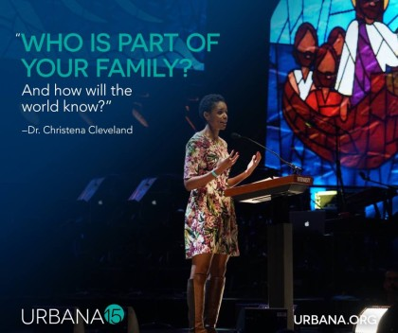
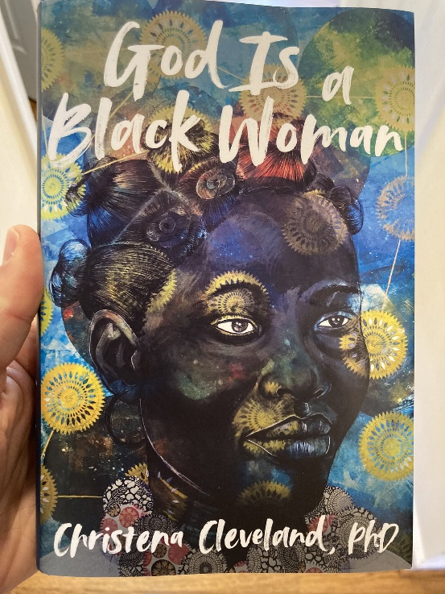
Why should we care?
2015
2019
2022
“Missions as Heroicization of Whiteness: Newbigin through a Critical Race Lens”
“there is a racial hierarchy.. Whiteness is about ideas. Whiteness is about culture. Whiteness is about power…white, cis, heterosexual, married, middle-class, formally educated men…at the top. And everybody else all the way down at the bottom, which would probably be black, transgender women.”
“Paul, Peter, Luke, John, James, and the writer of Hebrews repeatedly and emphatically make the same point: the unified church is the vehicle through which the kingdom of God is powerfully communicated to the world” – Cleveland, Disunity in Christ, p. 37-38 (2013)
"More than anything, we must eradicate the transphobia within ourselves and our communities. For if God is a Black woman, then She's a Black trans woman. Obviously" - Cleveland, God is a Black Woman, p. 232 (2022)

Slide 15
Outline
Contemporary Critical Theory
Contemporary Critical Theory vs. Christianity
Woke Terminology
The Woke Right?
Conclusions

Slide 16
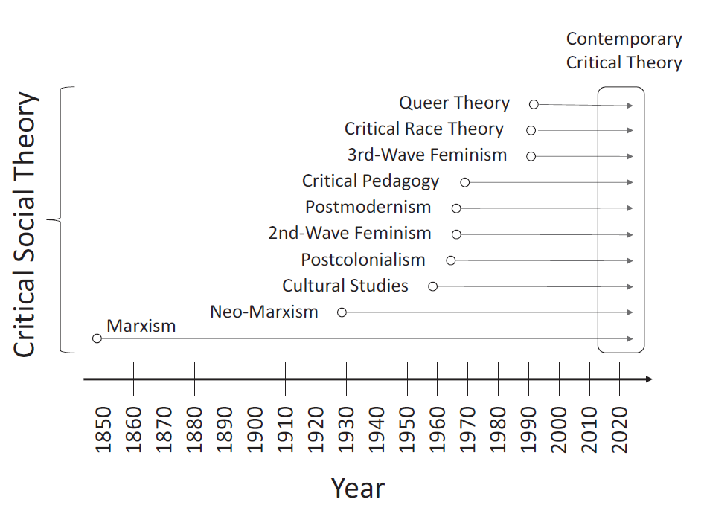
The history of contemporary critical theory
Shenvi and Sawyer, Critical Dilemma, p. 64

Slide 17





The central ideas of contemporary CT
Idea 1: Social binary
Idea 2: Oppression through ideology
Idea 3: Lived experience
Idea 4: Social justice

Slide 18


Idea #1: Society is divided into oppressed and oppressor groups
“For every social group, there is an opposite group… the primary groups that we name here are: race, class, gender, sexuality, ability status/exceptionality, religion, and nationality”
“Oppression describes a set of policies, practices, traditions, norms, definitions, and explanations (discourses), which function to systematically exploit one social group to the benefit of another social group. The group that benefits from this exploitation is termed the dominant (or agent) group, and the group that is exploited is termed the minoritized (or target) group…. Sexism, racism, classism, ableism, and heterosexism are specific forms of oppression” – Sensoy and DiAngelo, Is Everyone Really Equal? p. 44, 61

Slide 19

Idea #1: Society is divided into oppressed and oppressor groups
Sensoy and DiAngelo, Is Everyone Really Equal, p. 64

Slide 20

Idea #2: Oppression occurs through hegemonic power
“oppression also traditionally carries a strong connotation of conquest and colonial domination… New left social movements of the 1960s and 1970s, however, shifted the meaning of the concept of oppression. In its new usage, oppression designates the disadvantage and injustice some people suffer not because a tyrannical power coerces them, but because of the everyday practices of a well-intentioned liberal society… Oppression in this sense is structural, rather than the result of a few people’s choices or policies. Its causes are embedded in unquestioned norms, habits, and symbols.” – Iris Young, “Five Faces of Oppression,” Readings for Diversity and Social Justice, p. 36

Slide 21
Idea #2: Oppression occurs through hegemonic power
“Hegemony refers to the control of the ideology of society. The dominant group maintains power by imposing their ideology on everyone.”
“From a critical social justice perspective, privilege is defined as systemically conferred dominance and the institutional processes by which the beliefs and values of the dominant group are ‘made normal’ and universal.” – Sensoy and DiAngelo, Is Everyone Really Equal? p. 73, 80

Slide 22


Idea #3: ‘Lived experience’ gives oppressed groups privileged access to truth
“The idea that objectivity is best reached only through rational thought is a specifically Western and masculine way of thinking – one that we will challenge throughout this book.” – Margaret L. Andersen and Patricia Hill Collins, “Reconstructing Knowledge,” in Anderson and Collins, Race, Class, and Gender, p. 4-5

Slide 23


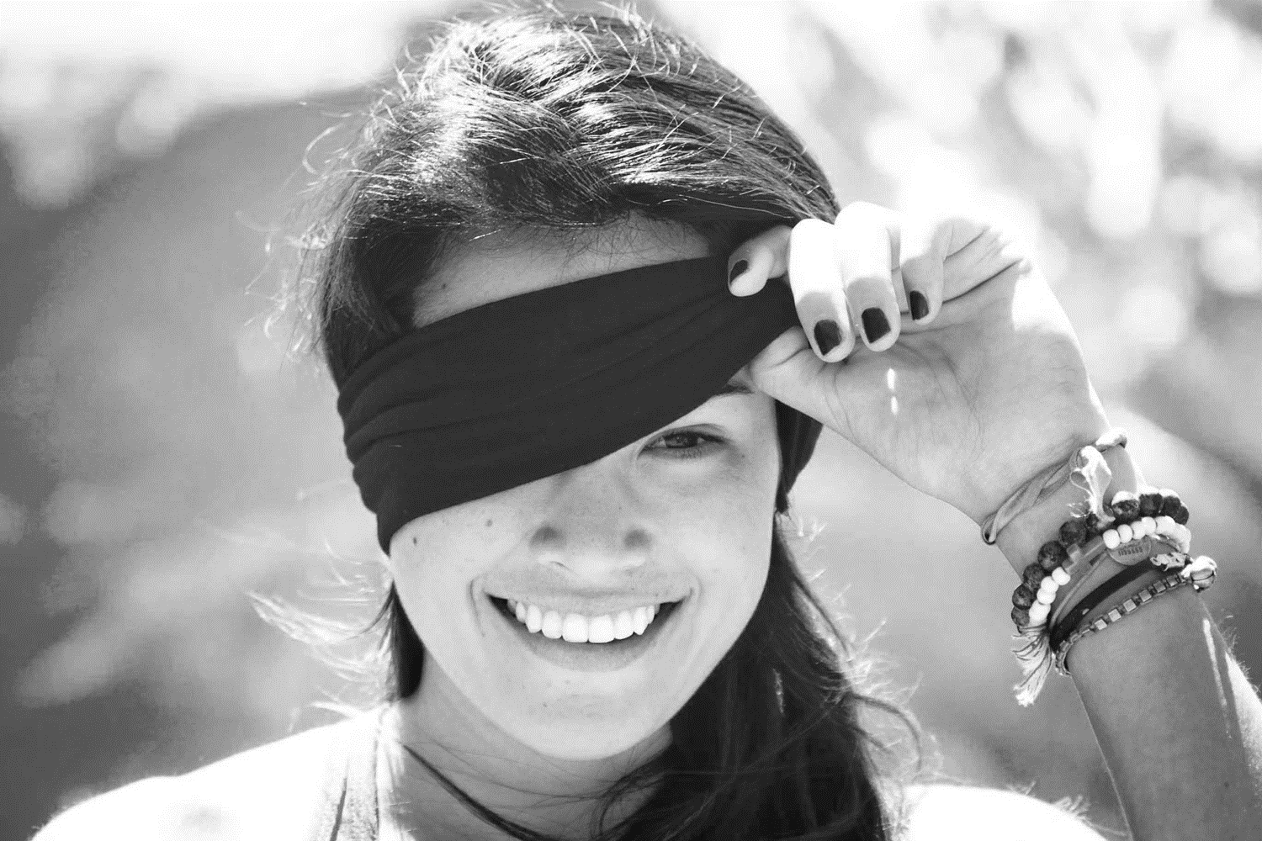
Idea #3: ‘Lived experience’ gives oppressed groups privileged access to truth
Oppression and epistemology:
Privilege
Lived
experience
Internalized oppression
Liberatory consciousness

Slide 24

Idea #4: Social justice demands the liberation of oppressed groups
Definition of social justice:
“Prior to celebrating diversity, we must first eliminate intolerance. No matter what form it takes or who does it, we must all take action to stop intolerance when it happens. Working towards a celebration of diversity implies working for social justice – the elimination of all forms of social oppression… Social injustice takes many forms. It can be injustice based on a person’s gender, race, ethnicity, religion, sexual orientation, physical or mental ability, or economic class.” – Mary McClintock, “How to Interrupt Oppressive Behavior,” Readings for Diversity and Social Justice, p. 483

Slide 25
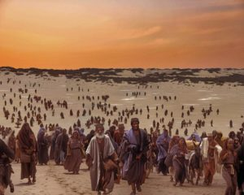

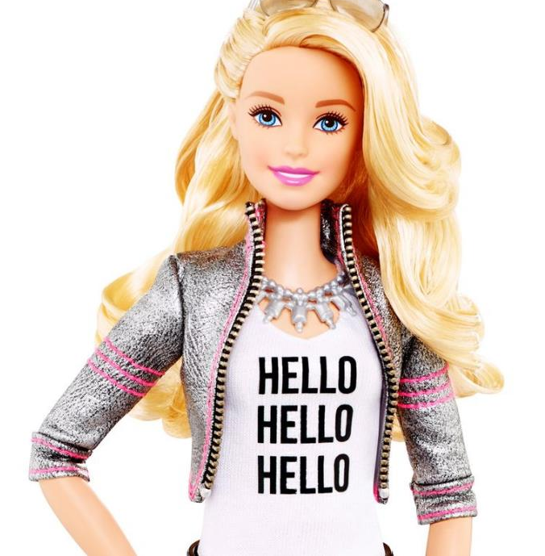
Positives of contemporary critical theory
Emphasis on sinfulness of oppression
Focus on structure, systems, and norms
Recognition of hegemonic power

Slide 26
Outline
Contemporary Critical Theory
Contemporary Critical Theory vs. Christianity
  A False Worldview
  A False Understanding of Oppression
  A False Identity
  A False Epistemology
  A False Salvation
Woke Terminology
The Woke Right?
Conclusions

Slide 27
Christianity and contemporary critical theory are competing worldviews
 | Christianity | Contemporary critical theory
Who are we? | God’s creatures | Members of various groups
How do we know truth? | Scripture and reason | Lived experience and embodied knowledge
What is our problem? | Sin | Oppression
What is the solution? | Jesus | Liberation
What is our duty? | Loving God | Liberating the oppressed
What is our purpose? | Glorifying God | Working for liberation

Slide 28
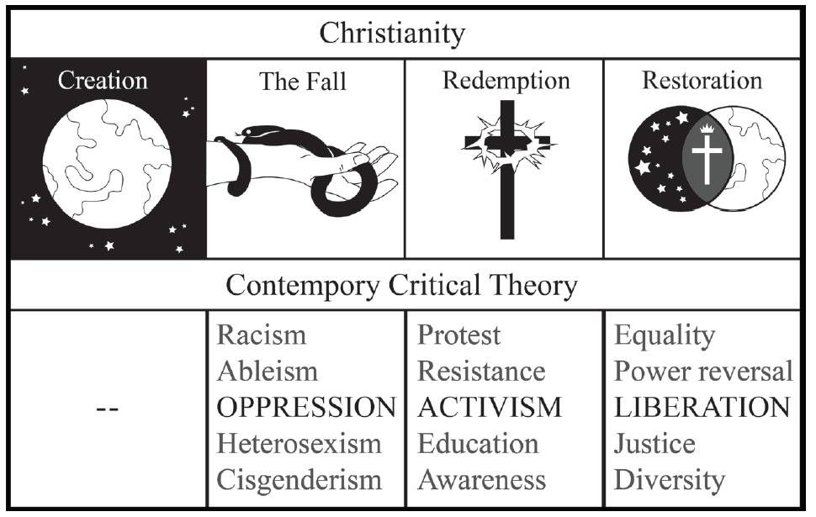
Christianity and contemporary critical theory are competing worldviews
Shenvi and Sawyer, Critical Dilemma, p. 284

Slide 29

Unifying themes of critical theory
“the cluster of philosophical approaches to [issues of identity is] known by the umbrella term critical theory. Critical theory is today a diverse phenomenon that draws deeply and variously on strands of Marxist thought, psychoanalysis, feminist theory, postcolonialism, poststructuralism, queer theory, and deconstruction… at the core of the various approaches of critical theorists lies a relatively simple set of convictions: the world is to be divided up between those who have power and those who do not; the dominant Western narrative of truth is really an ideological construct designed to preserve the power structure of the status quo; and the goal of critical theory is therefore to destabilize this power structure by destabilizing the dominant narratives that are used to justify –to ‘naturalize’– it” - Trueman
Trueman, The Rise and Triumph of the Modern Self, p. 225-226

Slide 30


Critical theory as worldview
“we now have Social Justice texts--forming a kind of Gospel of Social Justice--that express, with absolute certainty, that all white people are racist, all men are sexist, racism and sexism are systems that can exist and oppress absent even a single person with racist or sexist intentions or beliefs..., sex is not biological and exists on a spectrum, language can be literal violence, denial of gender identity is killing people, the wish to remedy disability and obesity is hateful, and everything needs to be decolonized.
Does this sound like a metanarrative? That's because it is. Social Justice scholarship and its educators and activists see these principles and conclusions as The Truth According to Social Justice--and they treat it as though they have discovered the analogue of the germ theory of disease, but for bigotry and oppression”
-Pluckrose and Lindsay, Cynical Theories, p. 182-183

Slide 31
Outline
Contemporary Critical Theory
Contemporary Critical Theory vs. Christianity
  A False Worldview
  A False Understanding of Oppression
  A False Identity
  A False Epistemology
  A False Salvation
Woke Terminology
The Woke Right?
Conclusions

Slide 32
Idea #1: Society is divided into oppressed and oppressor groups
Sensoy and DiAngelo, Is Everyone Really Equal, p. 64

Slide 33


Redefining oppression
Oppression = Unjust, tyrannical treatment
Oppression = Hegemonic norms
Whiteness = oppression
Gender roles = oppression
Heterosexism = oppression
Cisgenderism = oppression
Adultism = oppression

Slide 34
Outline
Contemporary Critical Theory
Contemporary Critical Theory vs. Christianity
  A False Worldview
  A False Understanding of Oppression
  A False Identity
  A False Epistemology
  A False Salvation
Woke Terminology
The Woke Right?
Conclusions

Slide 35


Adversarial identities
White
Male
Rich
Heterosexual
Cisgender
Christian
Able-bodied
Non-white
Female
Poor
Homosexual
Transgender
Non-Christian
Disabled

Slide 36

Adversarial identities
“I began to understand why we [White women] are justly seen as oppressive, even when we don't see ourselves that way. I began to count the ways in which I enjoy unearned skin privilege and have been conditioned into oblivion about its existence.
My schooling gave me no training in seeing myself as an oppressor, as an unfairly advantaged person, or as a participant in a damaged culture. I was taught to see myself as an individual whose moral state depended on her individual moral will.”
– Peggy McIntosh, “White Privilege and Male Privilege,” in Race, Class, and Gender, 72

Slide 37

Adversarial identities
“if you are white in a white supremacist society, you are racist. If you are male in a patriarchy, you are sexist. If you are able-bodied, you are ableist. If you are anything above poverty in a capitalist society, you are classist. You can sometimes be all of these things at once.”
– Ijeoma Oluo, So You Want to Talk About Race?, 220-221

Slide 38
Identity and solidarity
Creation
Sin
Redemption

Slide 39
Outline
Contemporary Critical Theory
Contemporary Critical Theory vs. Christianity
  A False Worldview
  A False Understanding of Oppression
  A False Identity
  A False Epistemology
  A False Salvation
Woke Terminology
The Woke Right?
Conclusions

Slide 40
Idea #3: ‘Lived experience’ gives oppressed groups privileged access to truth
Oppression and epistemology:
Privilege
Lived
experience
Internalized oppression
Liberatory consciousness

Slide 41
Deferring to lived experience
“It is about race if a person of color thinks it’s about race. This may sound at first like I’m asking you to just take every person of color’s word for it, as if they are infallible… But the truth is, whether or not someone is fallible is beside the point. We are, each and every one of us, a collection of our lived experiences… And our experiences are valid…And so, if a person of color says that something is about race, it is— because regardless of the details, regardless of whether or not you can connect the dots from the outside, their racial identity is a part of them, and it is interacting with the situation.”
–Oluo, So You Want to Talk About Race? 15

Slide 42
Scripture on Lived Experience
“let every person be quick to hear, slow to speak, slow to anger.” – James 1:19
“when a prophet speaks in the name of the Lord, if the word does not come to pass or come true, that is a word that the Lord has not spoken; the prophet has spoken it presumptuously. You need not be afraid of him.” – Deut. 18:22
“The one who states his case first seems right, until the other comes and examines him.” – Prov. 18:17
“To the teaching and to the testimony! If they will not speak according to this word, it is because they have no dawn.” – Isa. 8:20
“He presented himself alive to them after his suffering by many proofs, appearing to them during forty days and speaking about the kingdom of God.” – Acts 1:3

Slide 43
Outline
Contemporary Critical Theory
Contemporary Critical Theory vs. Christianity
  A False Worldview
  A False Understanding of Oppression
  A False Identity
  A False Epistemology
  A False Salvation
Woke Terminology
The Woke Right?
Conclusions

Slide 44
Conflicting Soteriology
 | Christianity | Contemporary Critical Theory
Sin | Rebellion: breaking God’s commandments | Privilege: whiteness, patriarchy, classism, heterosexism, ableism, cisgenderism
Salvation | Redemption: repent and believe the gospel | Activism: confess your privilege, divest from privilege, do the work, center marginalized voices, stop taking up space

Slide 45

The Sin of Privilege
“Antiracist policies cannot eliminate class racism without anticapitalism policies. Anticapitalism cannot eliminate class racism without antiracism.”
“To truly be antiracist is to be feminist. To truly be feminist is to be antiracist.”
“We cannot be antiracist if we are homophobic or transphobic… To be queer antiracist is to understand the privileges of my cisgender, of my masculinity, of my heterosexuality, of their intersections.”
– Kendi, How to Be Antiracist, 159, 189, 197.

Slide 46

The Sin of Privilege
“it is not possible for your parents to have taught you not to be racist, or for your parents to have been free of racism themselves. This is not possible because racism is a social system embedded in our culture and its institutions.”
“From an antiracist perspective, the question is not, ‘Did racism take place’ but ‘How was racism taking place’ because the assumption is that racism is always at play, always operating”
– DiAngelo, What Does It Mean to Be White?, 265, 330.

Slide 47

Doing the Work of Salvation
“The first and most important task in shaping an anti-racist church is to give birth to an anti-racist Christian identity… Taking this birthing metaphor one step further to the biblical imagery of rebirth, this identity-transforming process can be understood in no less powerful terms than what Jesus described as being ‘born again’--a complete spiritual transformation.”– Joseph Barndt, Becoming an Antiracist Church, 153.

Slide 48
Doing the Work of Salvation
“a positive white identity is an impossible goal. White identity is inherently racist; white people do not exist outside the system of white supremacy. This does not mean that we should stop identifying as white and start claiming only to be Italian or Irish. To do so is to deny the reality of racism in the here and now, and this denial would simply be color-blind racism. Rather, I strive to be ‘less white.’ To be less white is to be less racially oppressive.”
– DiAngelo, White Fragility, 149-150.

Slide 49
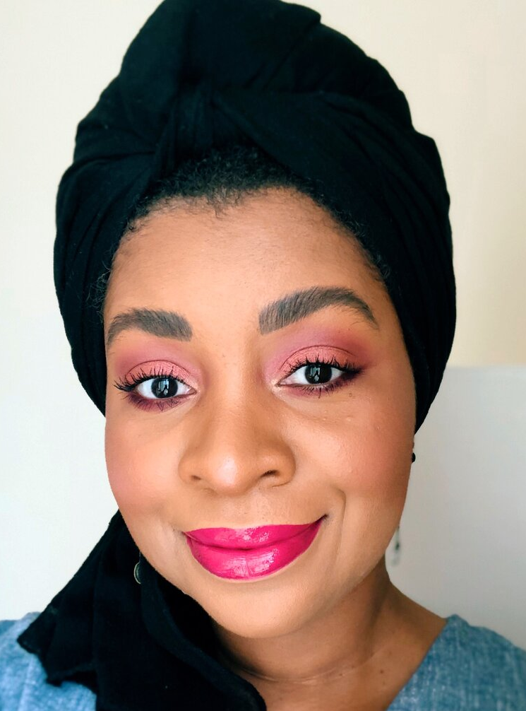
Doing the Work of Salvation
“Antiracism work is not a twenty-eight-day journey. It is a lifelong practice. It requires your lifelong commitment to antioppression… There is no feel-good reward at the end other than the knowledge that you are doing this because it’s the right thing to do.” – Layla Saad, Me and White Supremacy, 25.

Slide 50
Christianity and contemporary critical theory are competing worldviews
 | Christianity | Contemporary critical theory
Who are we? | God’s creatures | Members of various groups
How do we know truth? | Scripture and reason | Lived experience and embodied knowledge
What is our problem? | Sin | Oppression
What is the solution? | Jesus | Liberation
What is our duty? | Loving God | Liberating the oppressed
What is our purpose? | Glorifying God | Working for liberation

Slide 51
Outline
Contemporary Critical Theory
Contemporary Critical Theory vs. Christianity
Woke Terminology
The Woke Right?
Conclusions

Slide 52
Woke terminology
“White fragility” = “we should be humble and listen”?
“Intersectionality” = “our identities are complex”?
“Racial equity” = “we should treat everyone fairly”?

Slide 53
“White fragility”
White fragility - “a state in which even a minimum amount of racial stress … becomes intolerable, triggering a range of defensive moves.”
Manifestations of white fragility include:
Feelings:
Singled out
Attacked
Silenced
Guilty
Accused
Judged
Angry
Scared
Behaviors:
Crying
Physically leaving
Emotionally
withdrawing
Arguing
Denying
Seeking absolution
Claims:
I already know all this.
You are judging me
You are generalizing
I disagree
Some people find offense where there is none.
White fragility is a kafkatrap
Robin DiAngelo, White Fragility, (2018), p. 103

Slide 54
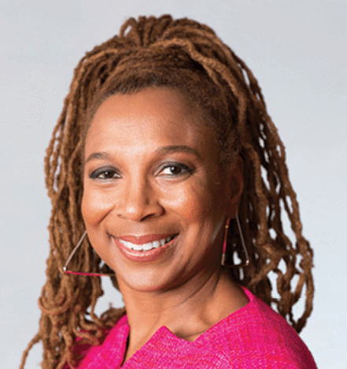
“Intersectionality”
Intersectionality – the idea that race, class, gender, sexuality, and other identities interact in complex ways to yield unique forms of oppression and privilege.
“the following analogy can be useful in describing how Black women are marginalized in the interface between antidiscrimination law and race and gender hierarchies: Imagine a basement which contains all people who are disadvantaged on the basis of race, sex, class, sexual preference, age and/or physical ability. These people are stacked—feet standing on shoulders—with those on the bottom being disadvantaged by the full array of factors, up to the very top, where the heads of all those disadvantaged by a singular factor brush up against the ceiling.”
Intersectionality treats “heterosexism” as oppressive
Kimberlé Crenshaw, "Demarginalizing the Intersection of Race and Sex," University of Chicago Legal Forum: Vol. 1989, Article 8, 1989.

Slide 55
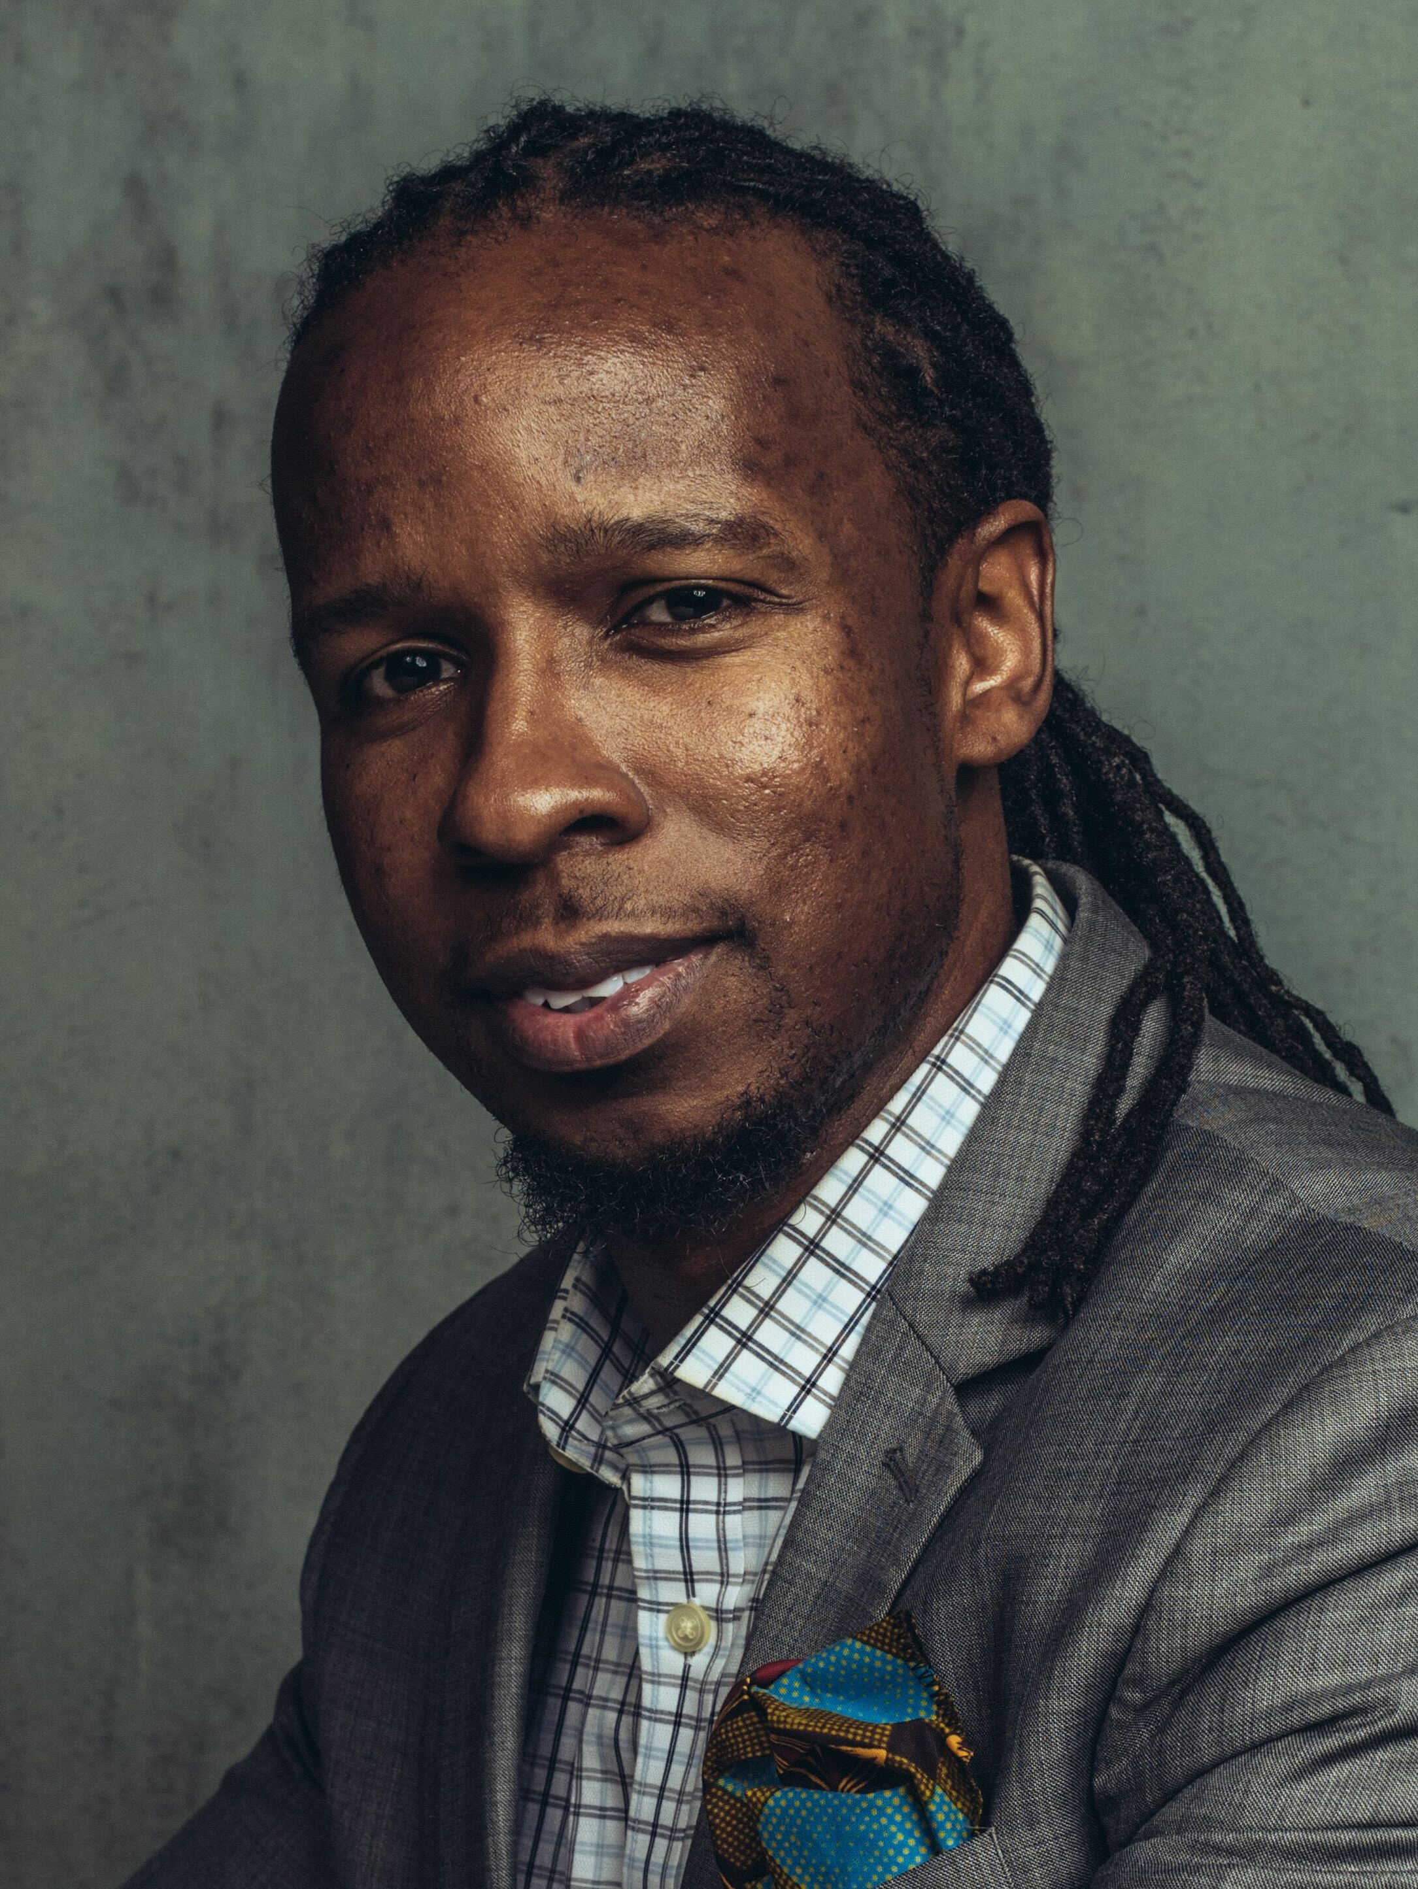
“Racial equity”
Racial equity – “Racial inequity is when two or more racial groups are not standing on approximately equal footing and racial equity is when two or more racial groups are standing on a relatively equal footing…A racist policy is any measure that produces or sustains racial inequity between racial groups. An antiracist policy is any measure that produces or sustains racial equity between racial groups”
“The only remedy to racist discrimination is antiracist discrimination. The only remedy to past discrimination is present discrimination. The only remedy to present discrimination is future discrimination.”
Equity demands equality of outcome
Ibram X. Kendi, How to Be an Antiracist (New York: One World, 2019), 18, 19.

Slide 56
Woke terminology is rooted in woke ideology
Idea 1: Social binary
Idea 2: Oppression through ideology
Idea 3: Lived experience
Idea 4: Social justice

Slide 57
Outline
Contemporary Critical Theory
Contemporary Critical Theory vs. Christianity
Woke Terminology
The Woke Right?
Conclusions

Slide 58
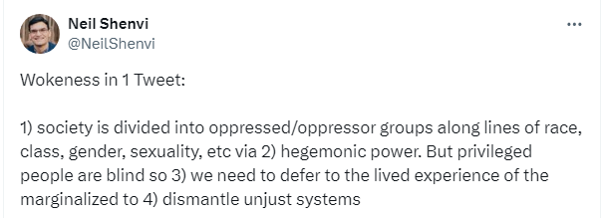
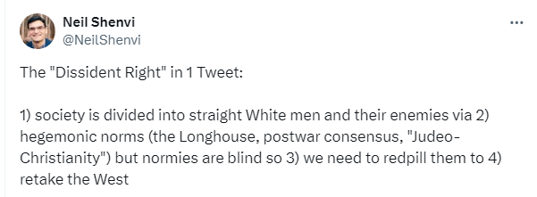
Woke left vs. woke right
Wokeness in 1 Tweet:
1) society is divided into oppressed/oppressor groups along lines of race, class, gender, sexuality, etc via
2) hegemonic power. But privileged people are blind so
3) we need to defer to the lived experience of the marginalized to
4) dismantle unjust systems
The “Dissident Right “in 1 Tweet:
1) society is divided into straight White men and their enemies via
2) hegemonic norms (the Longhouse, postwar consensus, "Judeo- Christianity") but normies are blind so
3) we need to redpill them to
4) retake the West

Slide 59
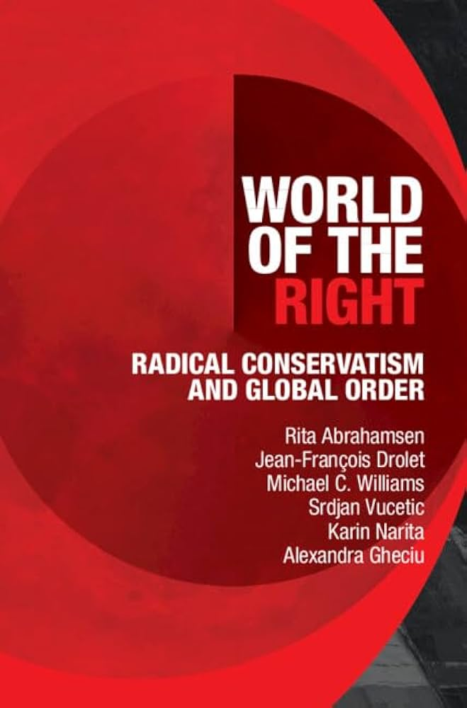
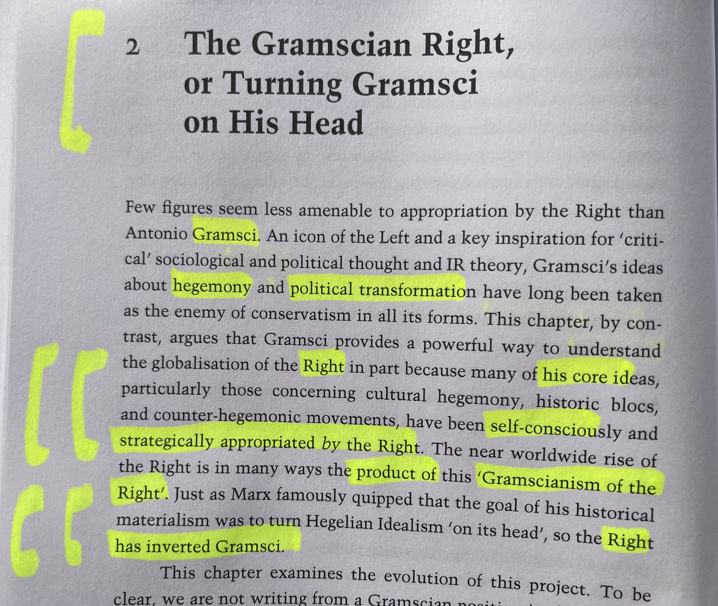
Abrahamsen et al’s World of the Right

Slide 60
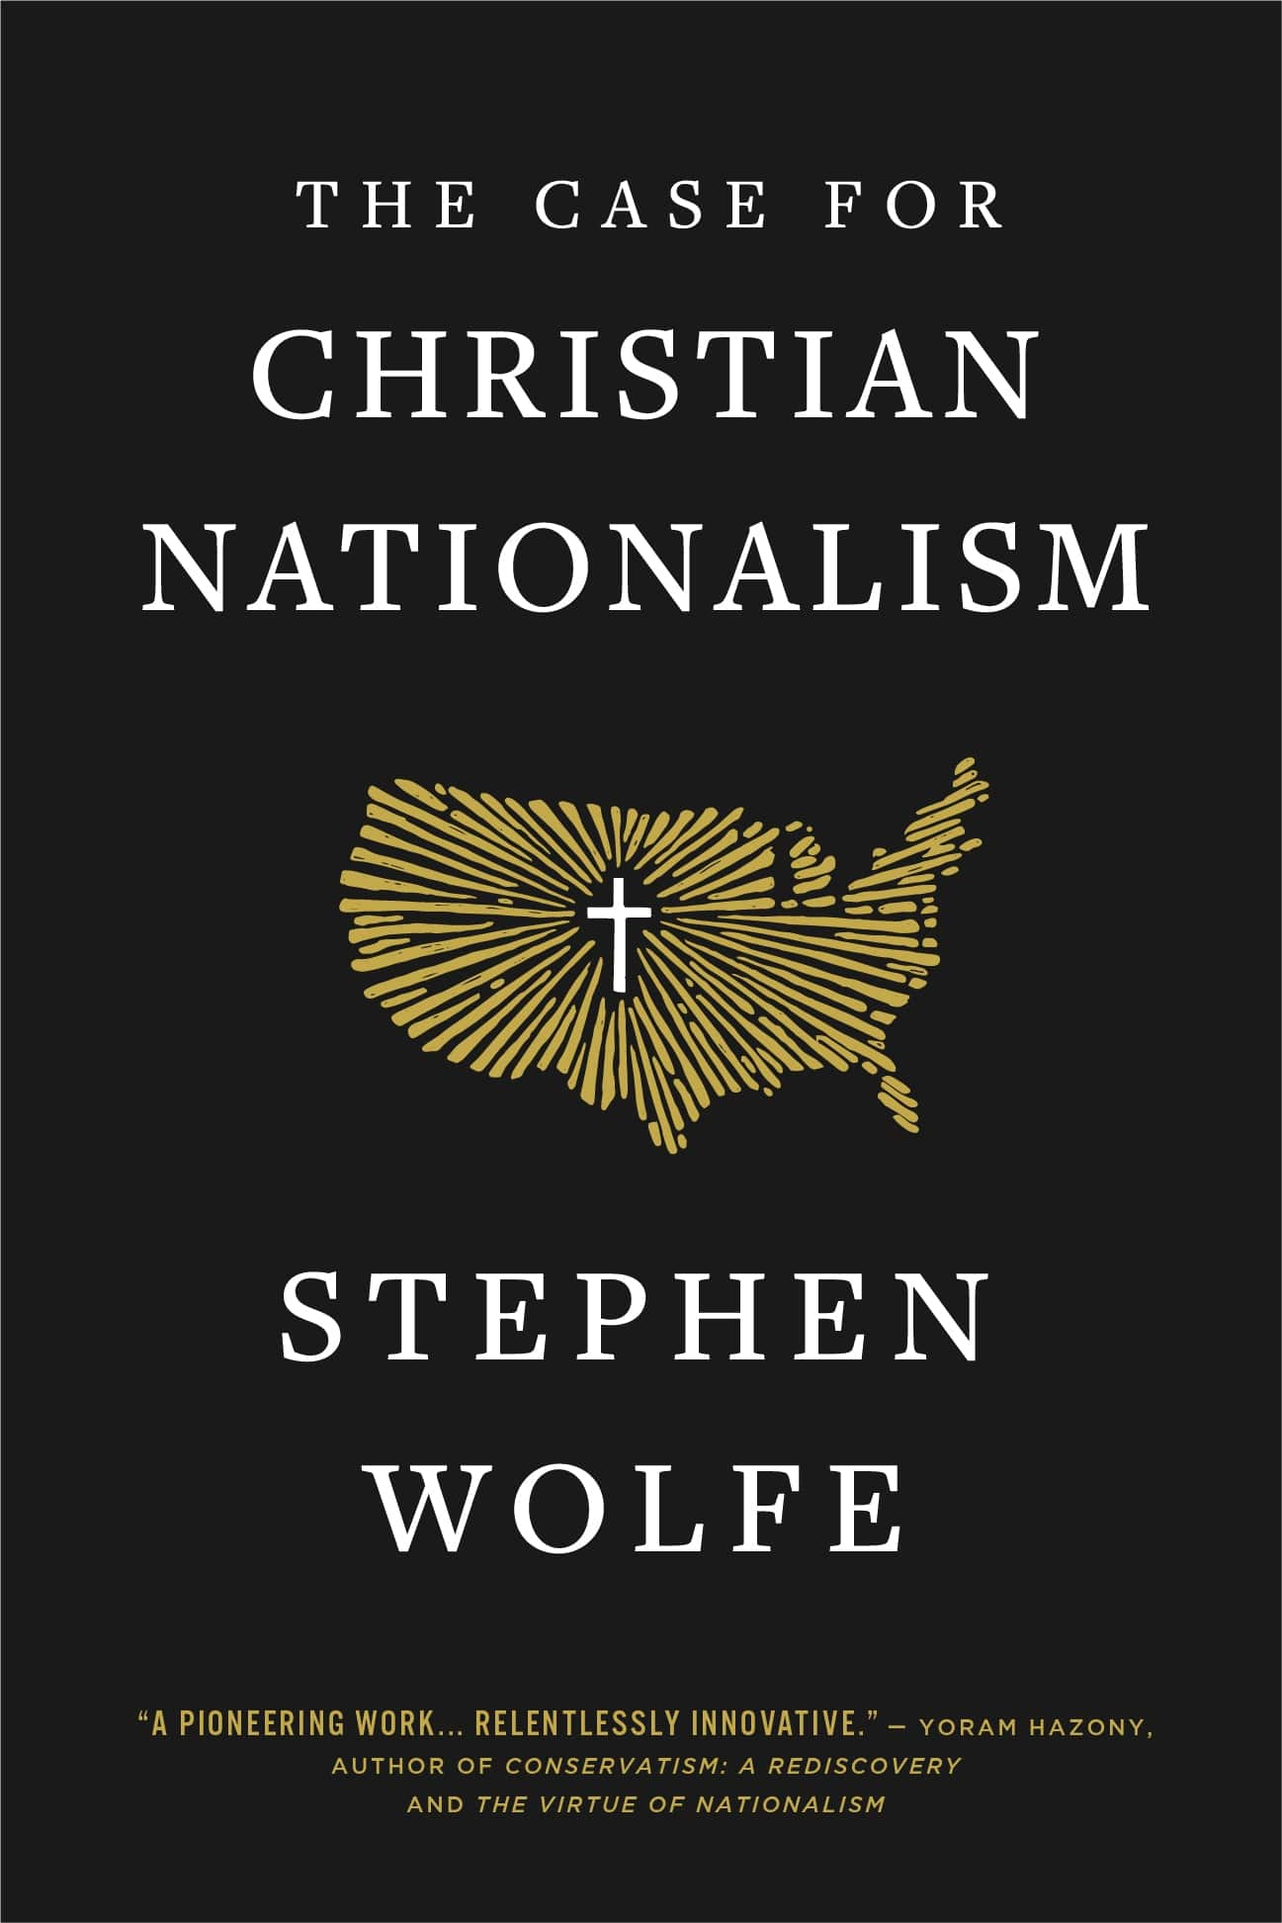
Stephen Wolfe’s Case for Christian Nationalism
“Every step of progress is overcoming you. Ask yourself, ‘What sort of villain does each event of progress have in common?’ The straight white male. That is the chief out-group of New America, the embodiment of regression and oppression.” (p. 436)
“We live under a gynocracy—a rule by women. This may not be apparent on the surface, since men still run many things. But the governing virtues of America are feminine vices, associated with certain feminine virtues, such as empathy, fairness, and equality.” (p. 448)
“If you are a white, heterosexual, cis-gendered male, then the world will not offer you any favors. Indeed, your career advancement depends on sacrificing your self-respect by praising and pandering to your inferiors who rule over you.” (p. 464)

Slide 61
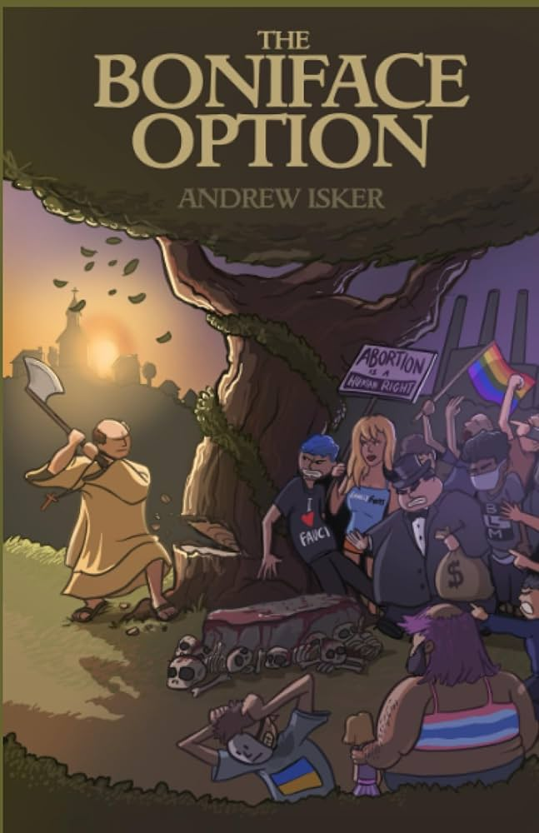
Andrew Isker’s Boniface Option
“You live in a dystopia. Every part of historical human existence in our world has been turned on its head…The insane, dystopian and totalitarian world we fear the elites might create is one we already live in…I use the term Trashworld to describe the dystopian society. And the point of The Boniface Option is to make you see it for what it is and to begin the hard work of escaping and overcoming it” (p. ix-xi).
“the globohomo cinematic universe that the modern bugman lives in must be chopped down. All of it is a seamless garment. Trannies, open borders, acceptance and promotion of sodomy and other sexual perversions, feminism, abortion and antinatalism, anti-white race hate (so-called Critical Race Theory), pornography and the entire consumerist lifestyle… must be sent through a woodchipper” (p. 18).
“We believe because modern, liberal, egalitarian society abolished the formal institutions of slavery that slavery qua slavery has been eradicated. But it very clearly has not. Instead, it is wrapped in a thin veneer of consent. If you were a wicked, evil social engineer and were going to design a massive slave state, the very best conditions would be where the masses believed they were totally free and that their own bondage was their choice” (p. 74).

Slide 62
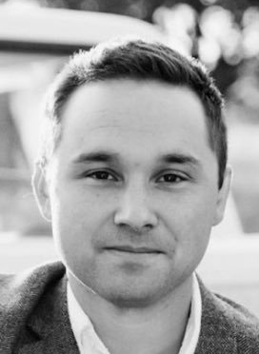
C.J. Engel, co-host of Contra Mundum
“the Right Wing is being called the ‘woke right’ because its detractors cannot think outside the hegemonic presumptions of liberalism, which is grounded in individualism.“
“There is indeed a war on Whites.”
“since the old cultural hegemony of Heritage America was centered around straight White men, it is clear that any revolution against that way of life would need to be directed against the hegemonic cultural base made up of these types of people. It is not woke to recognize this.”
“The mythos of liberalism… made the political leadership in this country blind to the actual Leftist revolution in our midst. Liberalism is absolutely a hegemonic norm—what else would be America’s hegemonic norm?”
“The Right can see this very clearly and understands that power is needed to confront new this Leftist hegemony.”
-- CJ Engel, “On the realization that the Right isn’t liberal,”
American Reformer

Slide 63
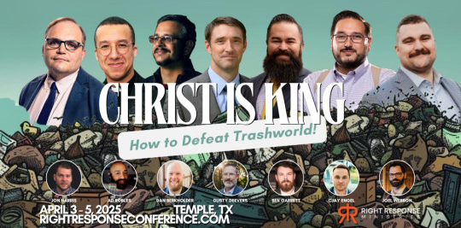
How to Defeat Trashworld

Slide 64
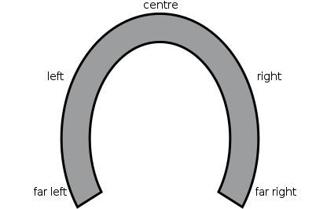
Critical theory is bad no matter who embraces it
Racial identitarianism
Oppression through ideology
Critical consciousness
Radical social transformation

Slide 65
Outline
Contemporary Critical Theory
Contemporary Critical Theory vs. Christianity
Woke Terminology
The Woke Right?
Conclusions

Slide 66
Christianity and contemporary critical theory are competing worldviews
Shenvi and Sawyer, Critical Dilemma, p. 284

Slide 67
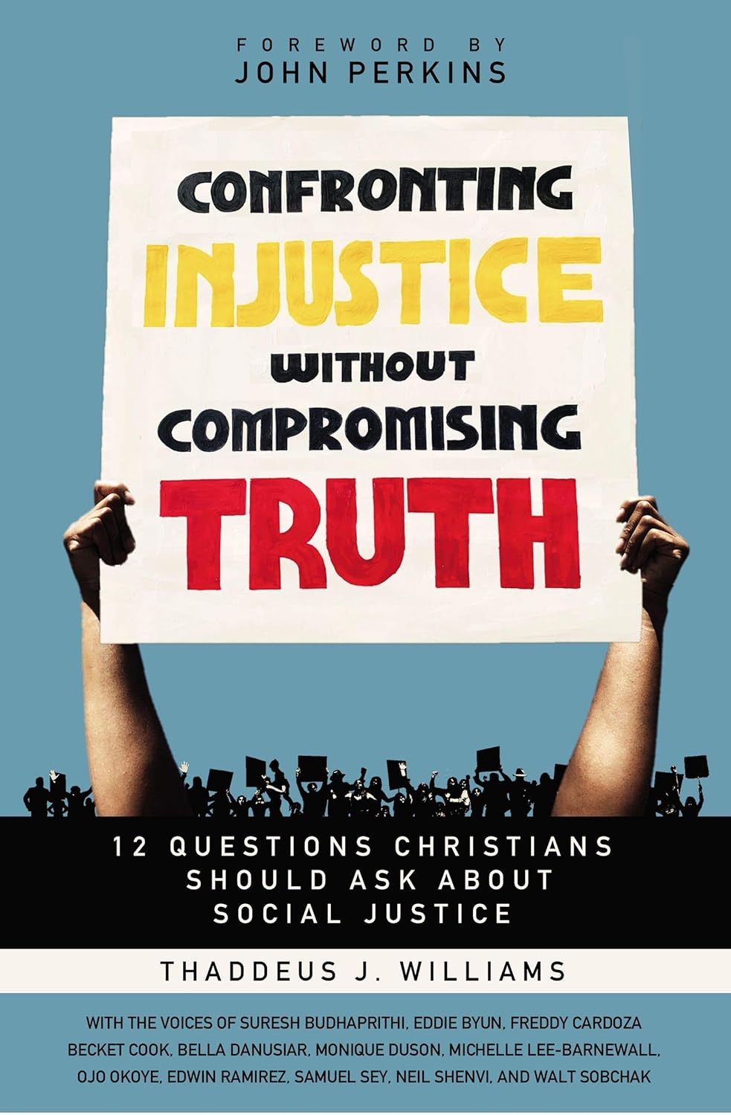
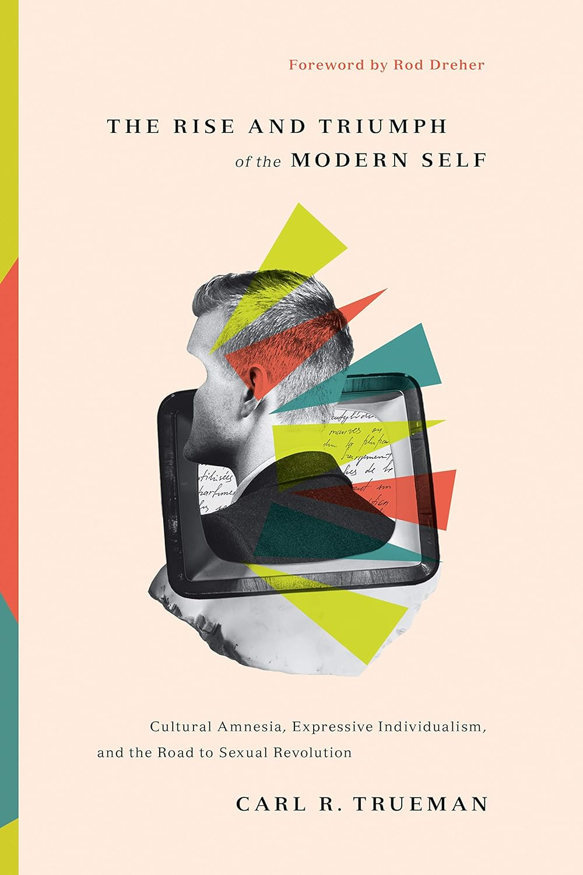
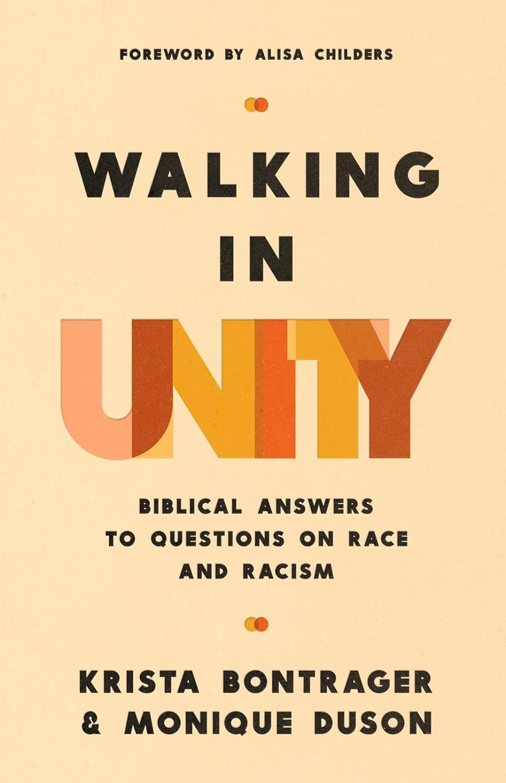
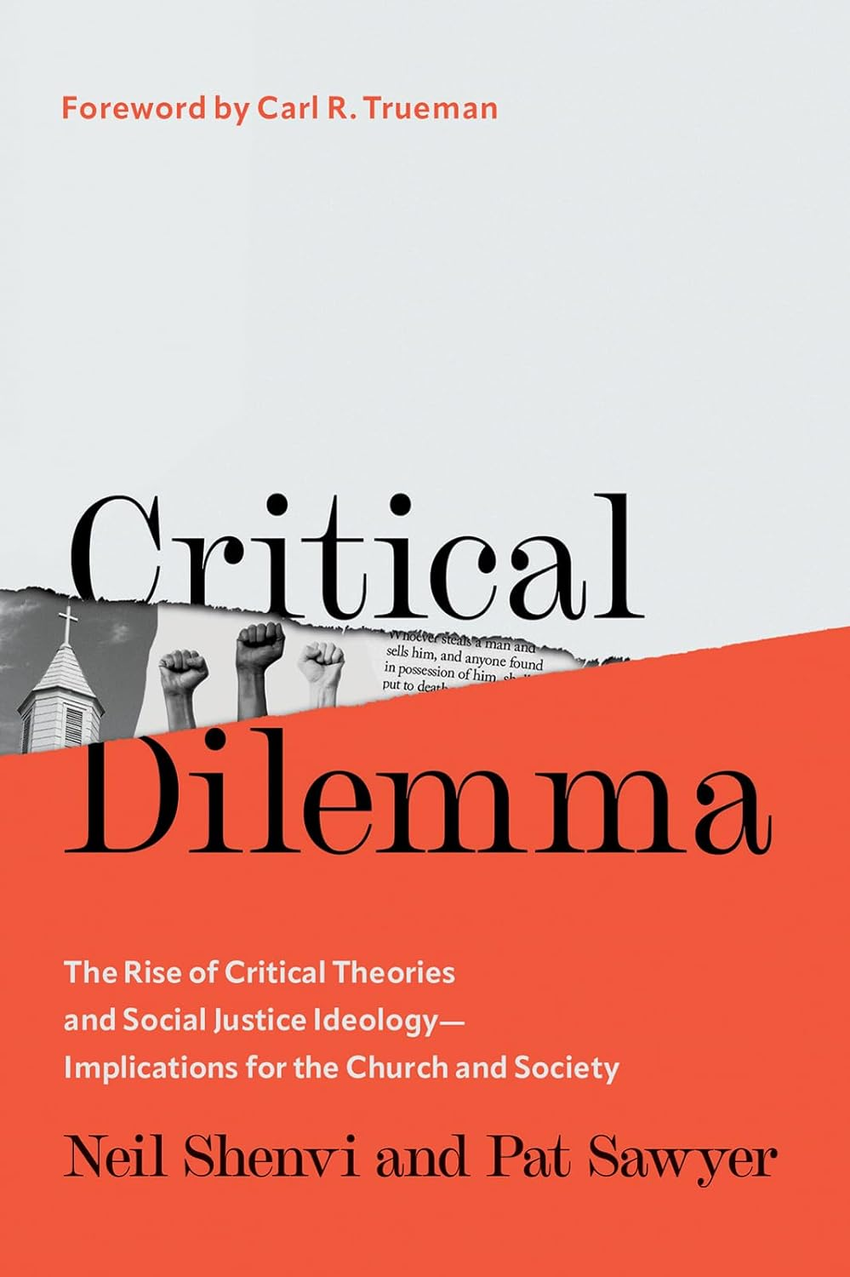
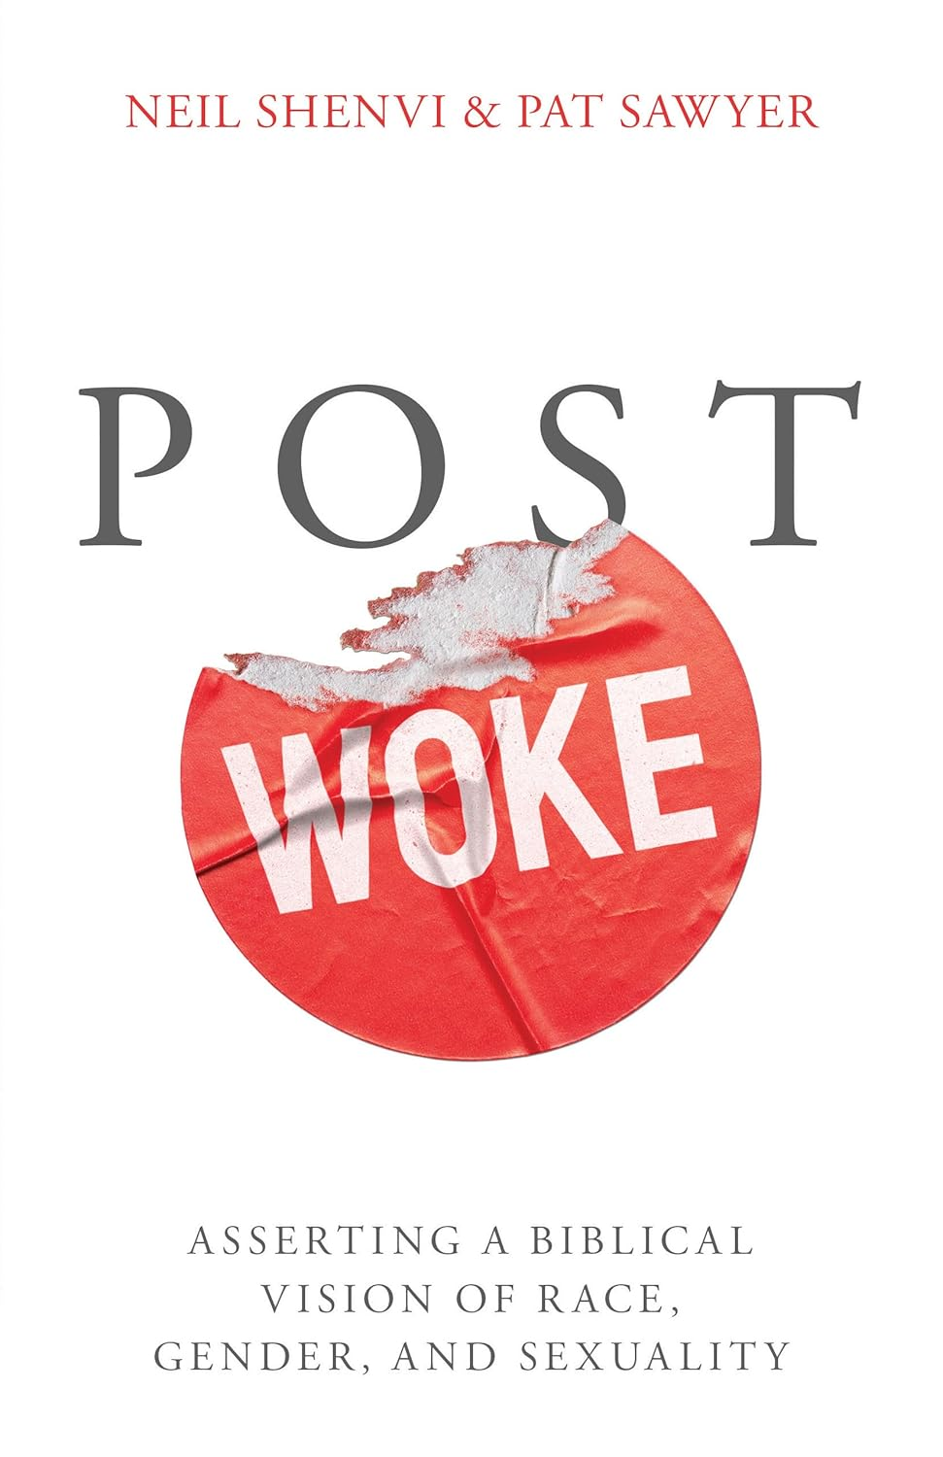
Additional resources
Thaddeus Williams, Confronting Injustice Without Compromising Truth
Carl Trueman, The Rise and Triumph of the Modern Self
Krista Bontrager and Monique Duson, Walking in Unity
Neil Shenvi and Pat Sawyer, Critical Dilemma
Neil Shenvi and Pat Sawyer, Post Woke

Slide 68

Critical Dilemma (2023)
Academic and comprehensive
500+ pages
770+ footnotes
200+ primary sources on critical theory
Thousands of words of quotes from primary sources
Endorsements from: Ligon Duncan, Carol Swain, JD Greear, Nancy Pearcey, Thomas Chatterton Williams, Alisa Childers, Peter Boghossian, John Cooper, Natasha Crain, Thaddeus Williams, John Stonestreet

Slide 69
Post Woke (2026)
Accessible and practical
288 pages
250+ footnotes
200+ Scripture references
Examples, illustrations, case studies, action plans
Endorsements from: Kevin DeYoung, Christopher Yuan, Gavin Ortlund, Erwin Lutzer, Hillary Ferrer, Sean McDowell, Carl Trueman, Melissa Doherty

Slide 70

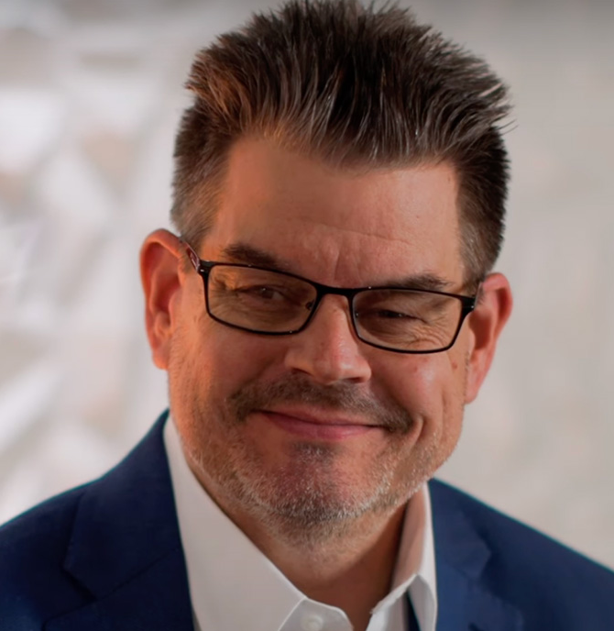
Acknowledgements
Dr. Christina Shenvi
Dr. Pat Sawyer
shenviapologetics.com/slides/
criticaldilemma.com/
Twitter @NeilShenvi

