Slide 1
The Problem of Evil?
Dr. Neil Shenvi
Heritage Leadership Academy
May 6, 2025

Slide 2
Outline
What Is the Problem of Evil?
Preliminaries
Philosophical Solutions
Biblical Solutions
Conclusions

Slide 3
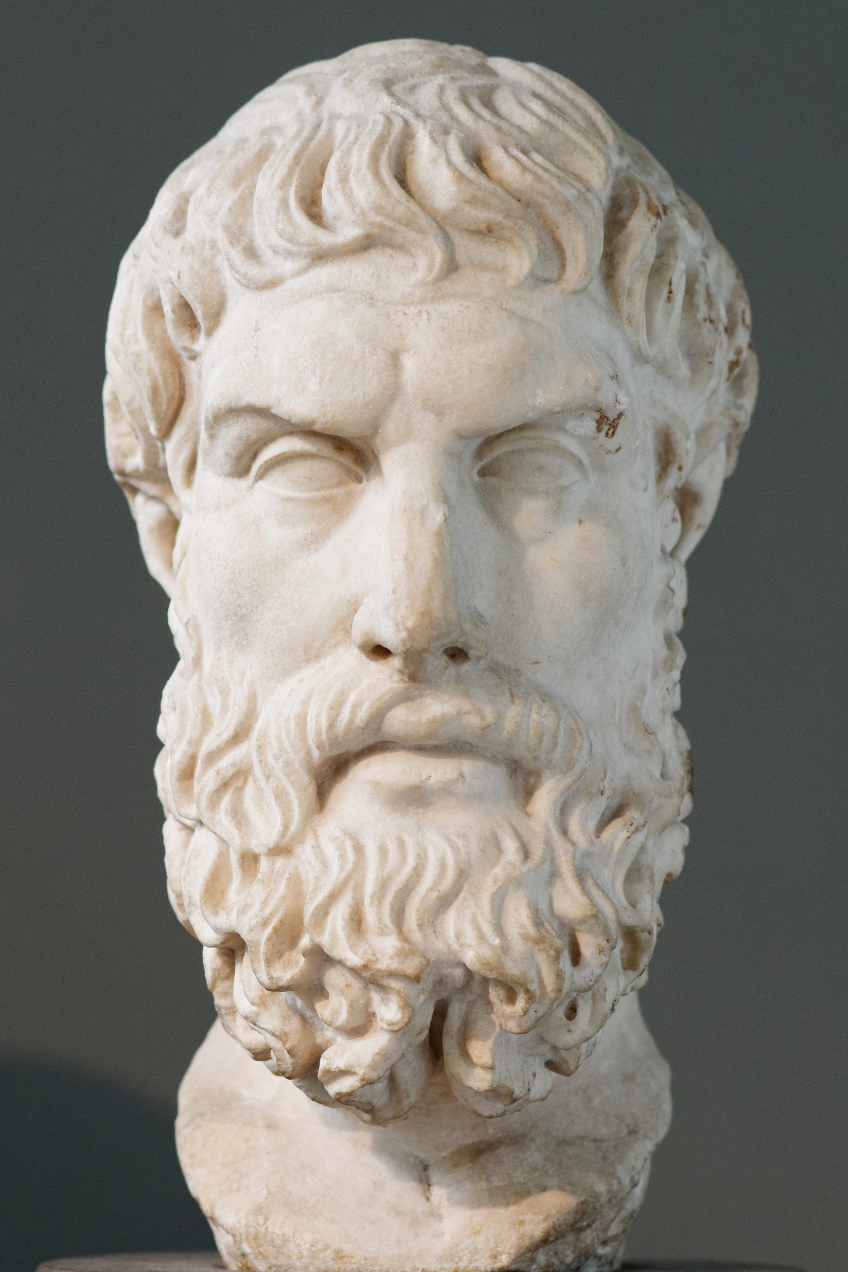
What is the problem of evil?
Epicurus’ Trilemma:
If God is unable to prevent evil, then he is not all-powerful.
If God is not willing to prevent evil, then he is not all-good.
If God is both willing and able to prevent evil, then why does evil exist?

Slide 4
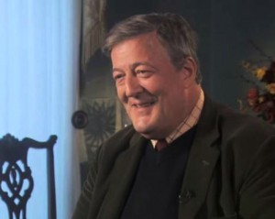
What is the problem of evil?
Byrn: Suppose it’s all true. And you walk up to the pearly gates, and you are confronted by God? What will Steven fry say to him or her or it?
Fry: How dare you? How dare you create a world to which there is such misery that is not our fault. It's not right, it's utterly, utterly evil. Why should I respect a capricious, mean-minded, stupid God who creates a world that is so full of injustice and pain. That's what I would say.

Slide 5
Outline
What Is the Problem of Evil?
Preliminaries
  Leaves positive arguments untouched
  A universal problem
  Concedes P2 of moral argument
Philosophical Solutions
Biblical Solutions
Conclusions

Slide 6
The problem of evil leaves other apologetic arguments untouched
Trilemma
Resurrection
Kalam Cosmological Argument
Argument from Contingency
Argument from Cosmological Fine Tuning
Moral Argument
Argument from Gospel

Slide 7
Assessing evidence
Soil on shoes matches crime scene
Tire tracks at crime scene match car
Fingerprints on murder weapon
DNA at crime scene
Eyewitness testimony
Means and motive
Strong alibi

Slide 8
Outline
What Is the Problem of Evil?
Preliminaries
  Leaves positive arguments untouched
  A universal problem
  Concedes P2 of moral argument
Philosophical Solutions
Biblical Solutions
Conclusions

Slide 9
The universal problem of evil
“Good and evil don’t exist.”
“Evil is an illusion.”
“God is not omnipotent.”
Every worldview and religion and philosophy, not just Christianity, has to explain the existence of evil.

Slide 10
Outline
What Is the Problem of Evil?
Preliminaries
  Leaves positive arguments untouched
  A universal problem
  Concedes P2 of moral argument
Philosophical Solutions
Biblical Solutions
Conclusions

Slide 11
The moral argument
Premise 1. If God does not exist, then objective moral values and duties do not exist.
Premise 2. Objective moral values and duties do exist.
Therefore,
God exists.

Slide 12
Naturalism and evil
“The universe that we observe has precisely the properties we should expect if there is, at bottom, no design, no purpose, no evil, no good, nothing but pitiless indifference.” – Richard Dawkins, River out of Eden
“The God of the Old Testament is arguably the most unpleasant character in all fiction: jealous and proud of it; a petty, unjust, unforgiving control-freak; a vindictive, bloodthirsty ethnic cleanser; a misogynistic, homophobic, racist, infanticidal, genocidal, filicidal, pestilential, megalomaniacal, sadomasochistic, capriciously malevolent bully.” – Richard Dawkins, The God Delusion

Slide 13
The problem of Brussels sprouts
Schmepicurus’ Trilemma:
If God is unable to prevent Brussels sprouts, then he is not all-powerful.
If God is not willing to prevent Brussels sprouts, then he is not all-good.
If God is both willing and able to prevent Brussels sprouts, then why do they exist?

Slide 14
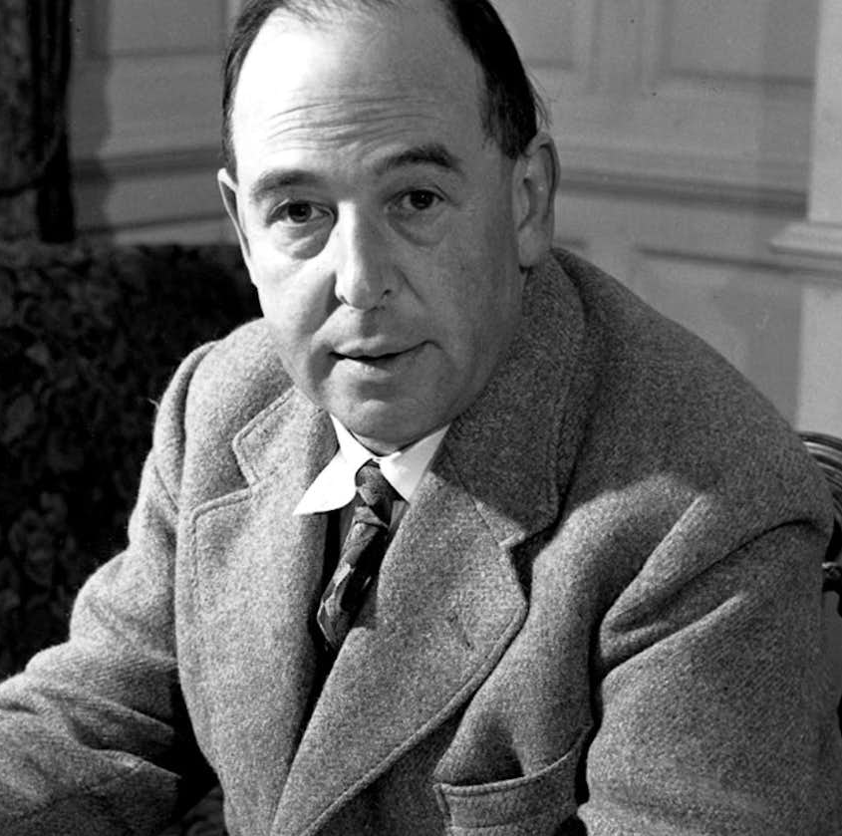
The problem of evil against moral antirealism
“My argument against God was that the universe seemed so cruel and unjust. But how had I got this idea of just and unjust? A man does not call a line crooked unless he has some idea of a straight line. What was I comparing this universe with when I called it unjust?... Of course, I could have given up my idea of justice by saying it was nothing but a private idea of my own. But if i did that, then my argument against God collapsed too--for the argument depended on saying the world was really unjust, not simply that it did not happen to please my fancies. Thus, in the very act of trying to prove that God did not exist - in other words, that the whole of reality was senseless - I found I was forced to assume that one part of reality - namely my idea of justice - was full of sense.” – C.S Lewis

Slide 15
The moral argument
Premise 1. If God does not exist, then objective moral values and duties do not exist.
Premise 2. Objective moral values and duties do exist.
Therefore,
God exists.

Slide 16
Outline
What Is the Problem of Evil?
Preliminaries
Philosophical Solutions
  Soul building
  Interconnectedness
  Free will
  Skeptical theism
Biblical Solutions
Conclusions

Slide 17
Evil and the whiteboard

Slide 18
Evil and the whiteboard

Slide 19
Evil and the whiteboard

Slide 20
Evil and the whiteboard

Slide 21
Evil and the whiteboard

Slide 22
What is the problem of evil?
Epicurus’ Trilemma:
If God is unable to prevent evil, then he is not all-powerful.
If God is not willing to prevent evil, then he is not all-good.
If God is both willing and able to prevent evil, then why does evil exist?
What if God has a morally justifying reason for allowing evil to exist?

Slide 23
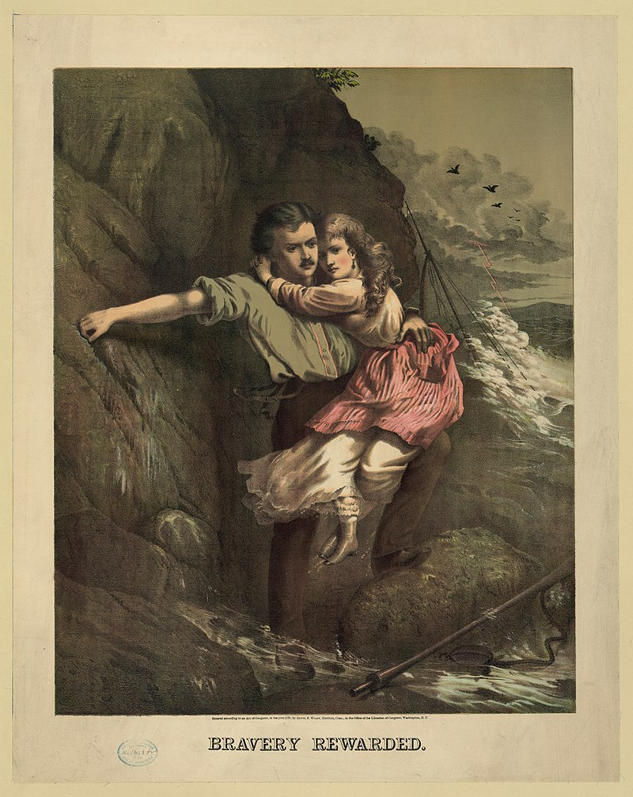
Soul building
Love
Kindness
Wisdom
Prudence
Obedience
Trust
Fortitude
Patience
Courage
Forgiveness
Mercy
Self-sacrifice

Slide 24
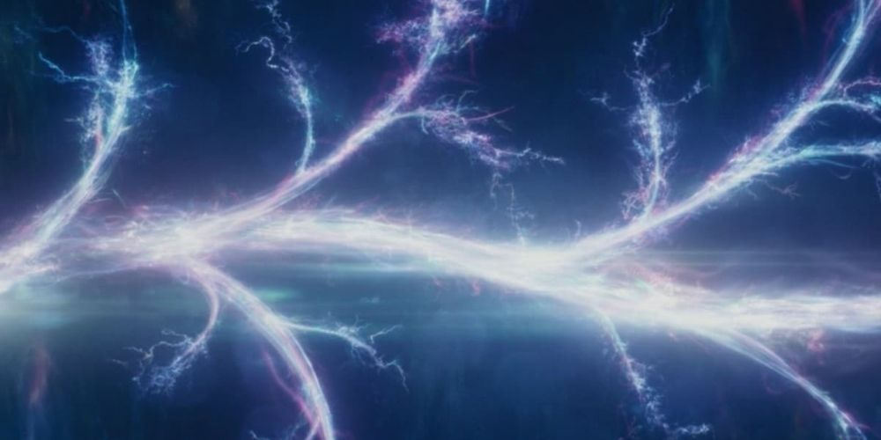
Interconnectedness
good
good
good
good
good
evil
good
good

Slide 25

Free will

Slide 26
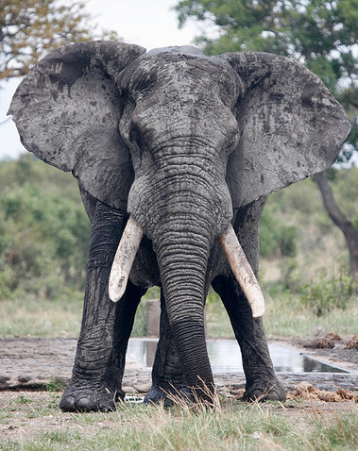
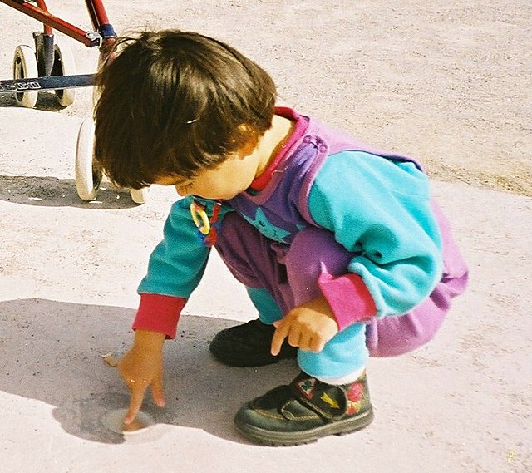
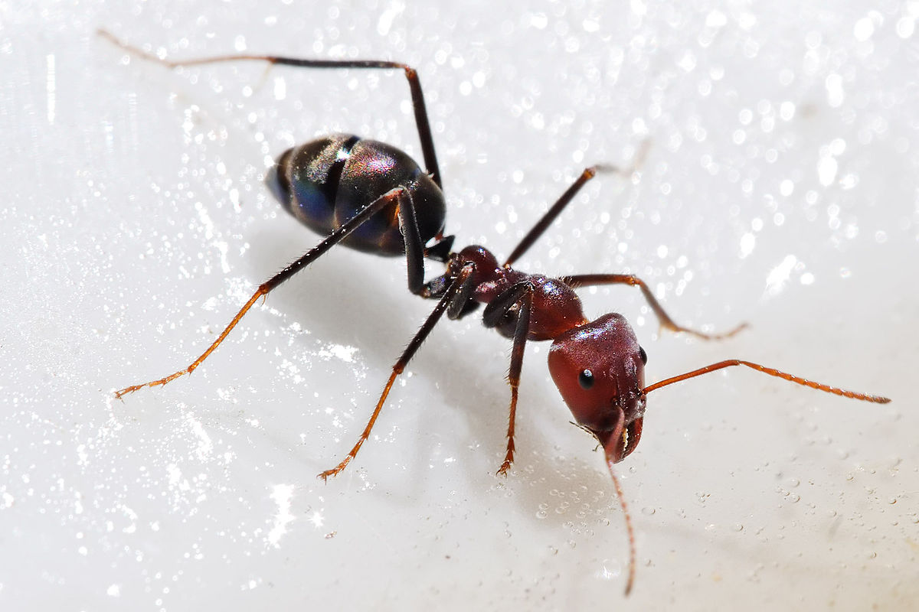
Skeptical theism

Slide 27
Outline
What Is the Problem of Evil?
Preliminaries
Philosophical Solutions
Biblical Solutions
  Sin
  Eternity
  Final judgement
  Justice and mercy
  Incarnation
Conclusions

Slide 28
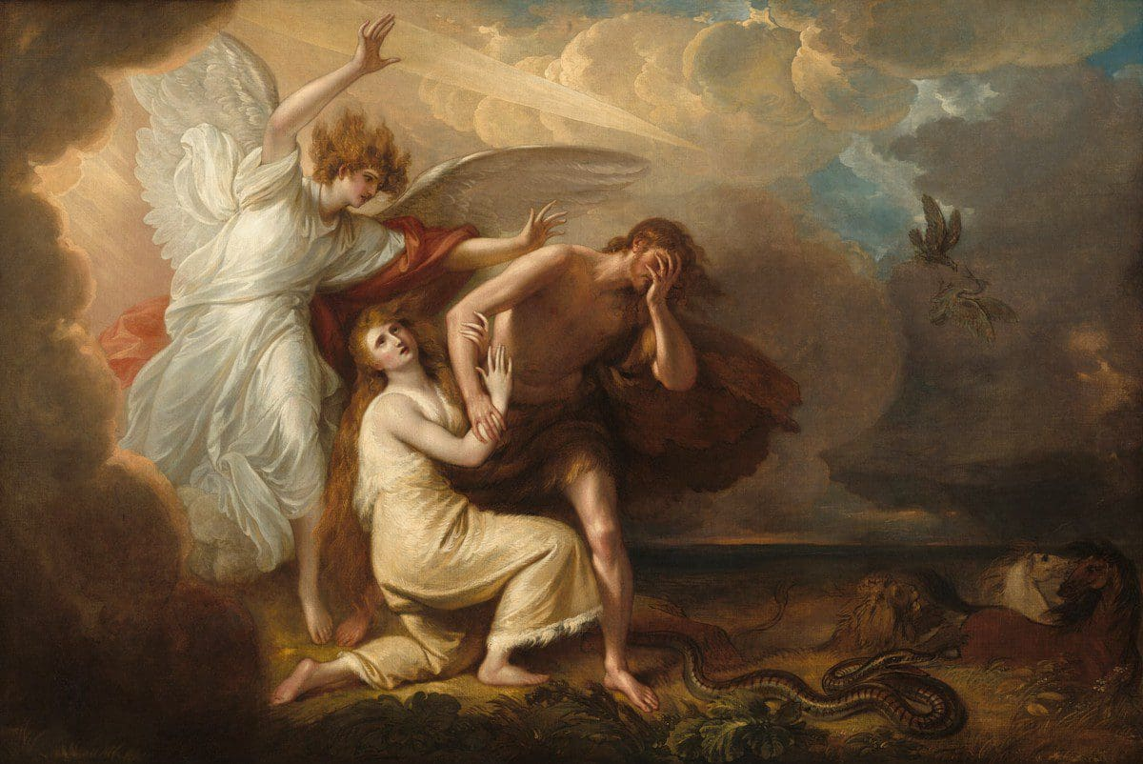
Sin
“None is righteous, no, not one; no one understands; no one seeks for God. All have turned aside; together they have become worthless; no one does good, not even one.” – Rom. 10-12

Slide 29
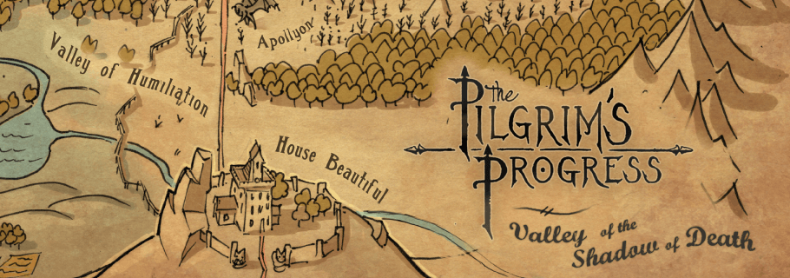
Eternity
“For what does it profit a man to gain the whole world and forfeit his soul?” – Mark 8:36
“See, I will create new heavens and a new earth. The former things will not be remembered, nor will they come to mind.” – Is. 65:17
“And between the throne and the four living creatures and among the elders I saw a Lamb standing, as though it had been slain” – Rev. 5:6

Slide 30
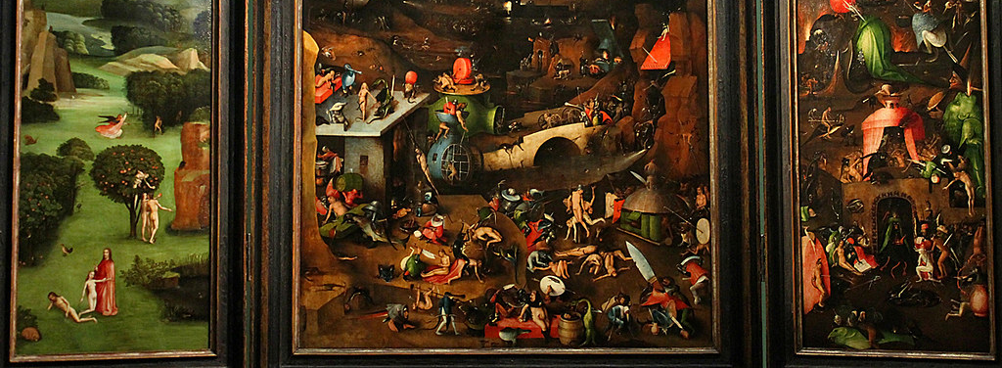
Final Judgment
“Now we know that whatever the law says it speaks to those who are under the law, so that every mouth may be stopped, and the whole world may be held accountable to God.” – Rom. 3:19
“And I saw the dead, great and small, standing before the throne, and books were opened. Also another book was opened, the book of life. And the dead were judged according to their works, as recorded in the books.” – Rev. 20:12-15

Slide 31

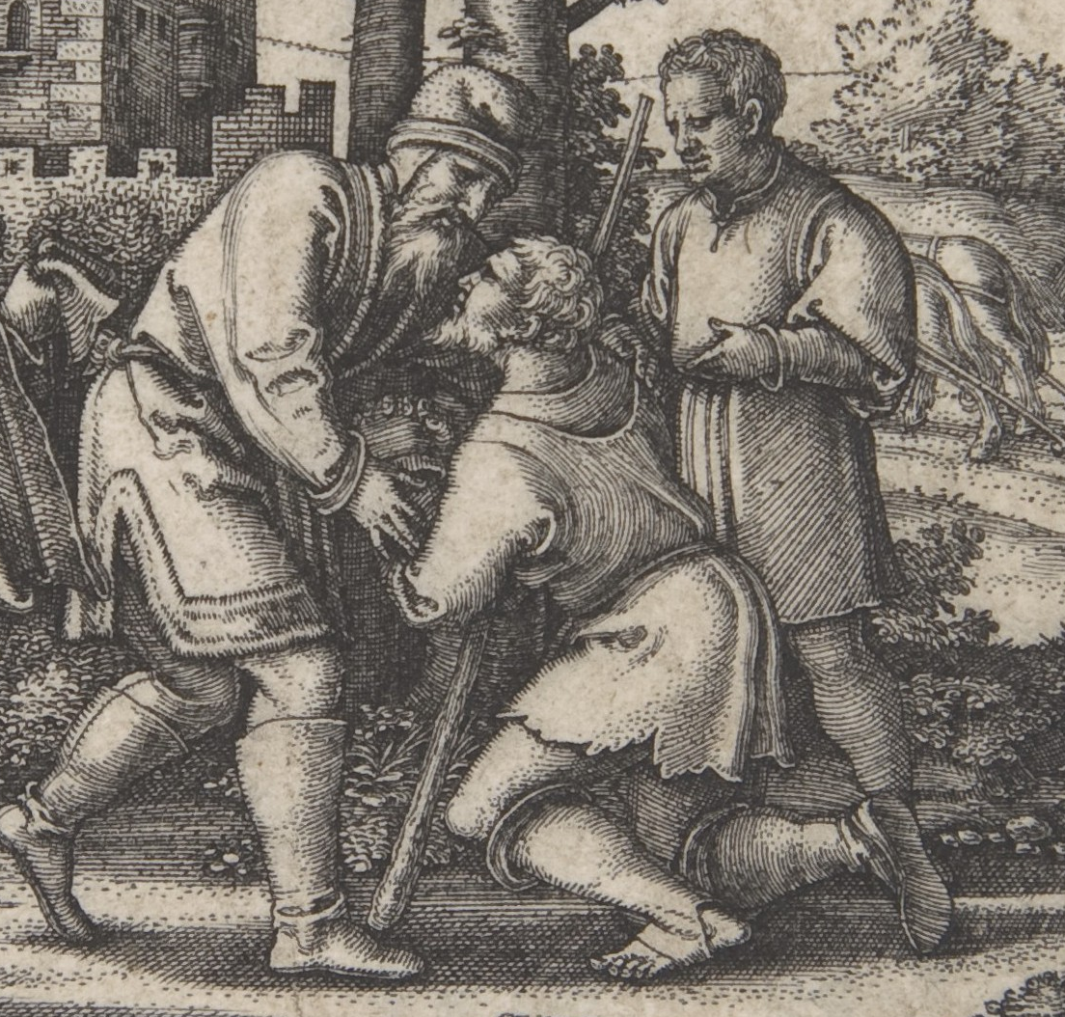
Justice and mercy
“All things were created through him and for him.” – Col. 1:16
“He will render to each one according to his works.” – Rom. 2:6
“he did it to demonstrate his righteousness at the present time, so as to be just and the one who justifies those who have faith in Jesus..” – Rom. 3:26

Slide 32
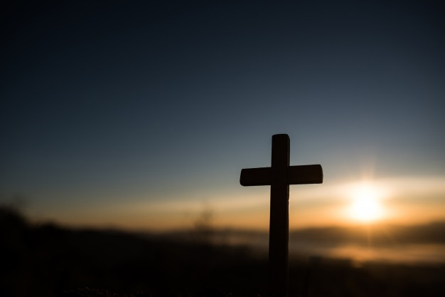
Incarnation
“Surely he has borne our griefs and carried our sorrows; yet we esteemed him stricken, smitten by God, and afflicted.” – Is. 53:4
“In all their distress he too was distressed, and the angel of his presence saved them. In his love and mercy he redeemed them” – Is. 63:9

Slide 33
Outline
What Is the Problem of Evil?
Preliminaries
Philosophical Solutions
Biblical Solutions
  Eternity
  Final judgement
  Justice and mercy
  Incarnation
Conclusions

Slide 34
Conclusions
The problem of evil is a problem for everyone.
The external problem of evil entails that objective good and evil exist.
There are philosophical defenses to the problem of evil.
There are biblical answers to the problem of evil.
The cross is God’s ultimate answer to the problem of evil.

Slide 35
Conclusions
““I could never myself believe in God, if it were not for the cross. The only God I believe in is the One Nietzsche ridiculed as 'God on the cross.' In the real world of pain, how could one worship a God who was immune to it?...He laid aside his immunity to pain. He entered our world of flesh and blood, tears and death. He suffered for us. Our sufferings become more manageable in the light of his. There is still a question mark against human suffering, but over it we boldly stamp another mark, the cross that symbolizes divine suffering.”
– John Stott

Slide 36

Resources
www.shenviapologetics.com/slides/
Twitter @NeilShenvi

