Slide 1
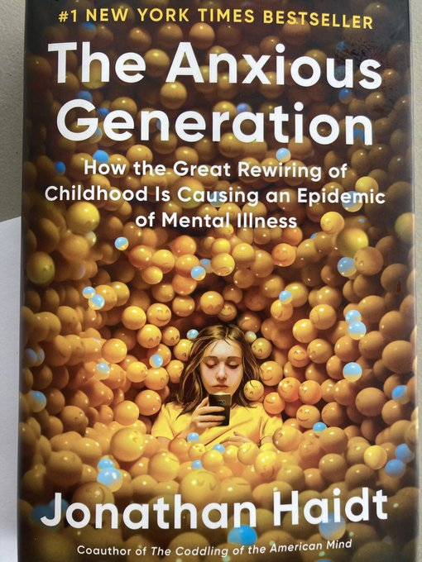
Summary of Jonathan Haidt’s The Anxious Generation
Neil Shenvi
Classical Conversations – South Durham
March 25, 2025

Slide 2
Thesis: The Great Rewiring of 2010-2015 had devastating effects on kids’ metal health and must be rolled back through collective action.
Part 1. A Tidal Wave
Part 2. The Backstory: The decline of the play-based childhood
Part 3. The Great Rewiring: The rise of the phone-based childhood
Part 4. Collective Action for healthier childhood

Slide 3
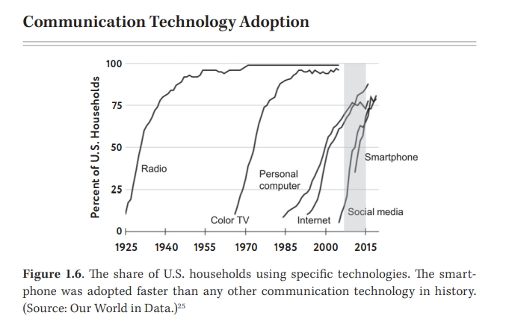
Chapter 1 – The Surge of Suffering

Slide 4
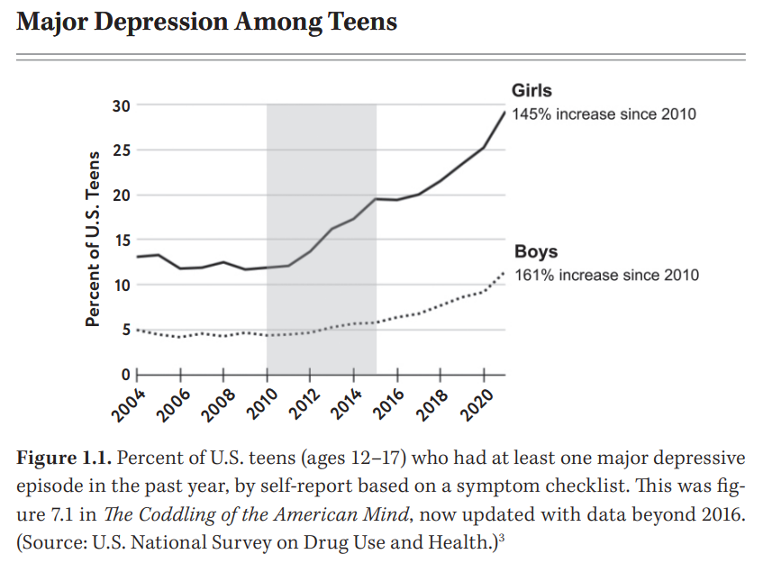
Chapter 1 – The Surge of Suffering

Slide 5
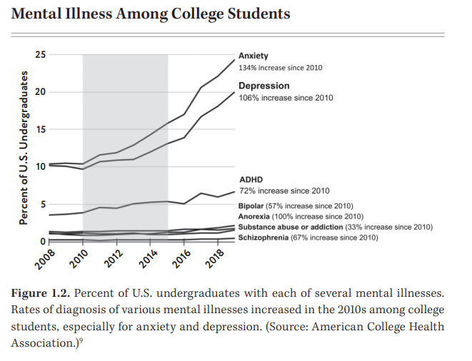
Chapter 1 – The Surge of Suffering

Slide 6
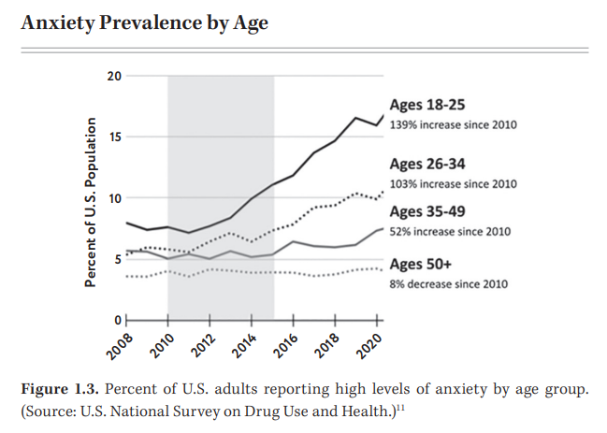
Chapter 1 – The Surge of Suffering

Slide 7
Chapter 1 – The Surge of Suffering
“Between 2010 and 2015, the social lives of American ttens moved largely onto smartphones”
“The first generation of Americans who went through puberty with smartphones… in their hands became more anxious, depressed, self-harming, and suicidal.”
“The tidal wave of anxiety, depression, and self-harm… hit preteen girls harest of all.”
“The increase in suffering was not limited to the United States”
“No other theory has been able to explain why rates of anxiety and depression surged among adolescents” (p. 44-45)

Slide 8
IRL versus social media
Real life
Embodied
Synchronous
One-to-one or one-to-several
High bar for entry and exit
Social media
Disembodied
Asynchronous
One-to-many
Low bar for entry and exit

Slide 9
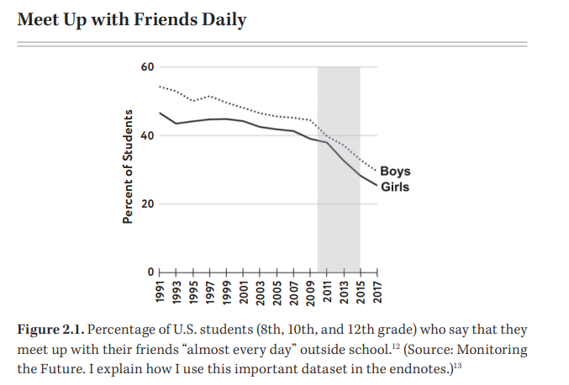
Chapter 2 – What Do Children Need to Do in Childhood

Slide 10
Chapter 5 – The Four Foundational Harms
Harm #1: Social deprivation
Harm #2: Sleep deprivation
Harm #3: Attention fragmentation
Harm #4: Addiction

Slide 11
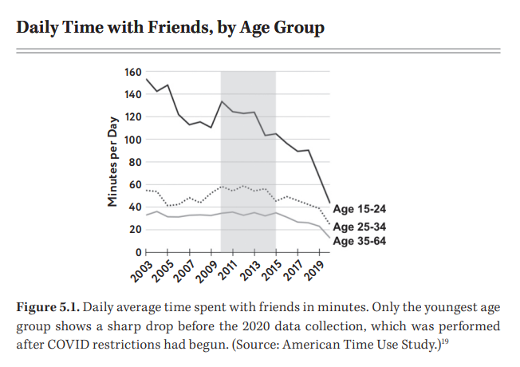
Chapter 5 – The Four Foundational Harms

Slide 12
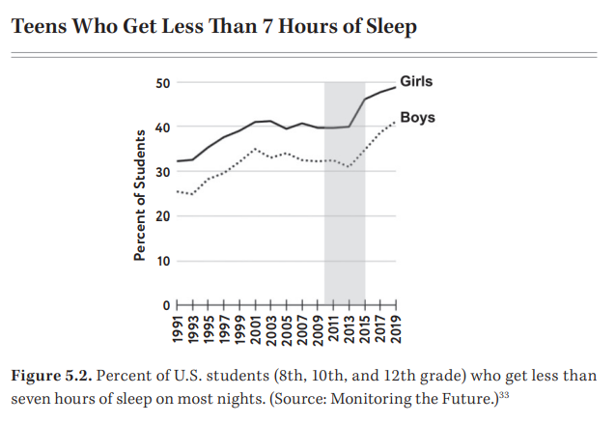
Chapter 5 – The Four Foundational Harms

Slide 13
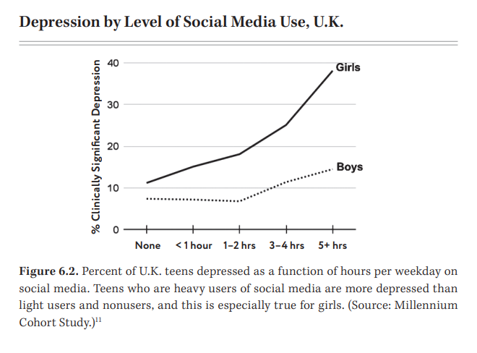
Chapter 6 – Why Social Media Harms Girls More Than Boys

Slide 14
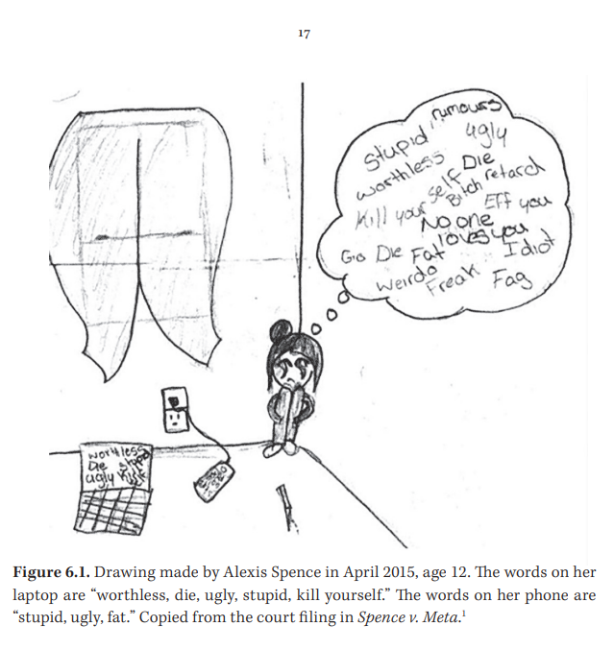
Chapter 6 – Why Social Media Harms Girls More Than Boys

Slide 15
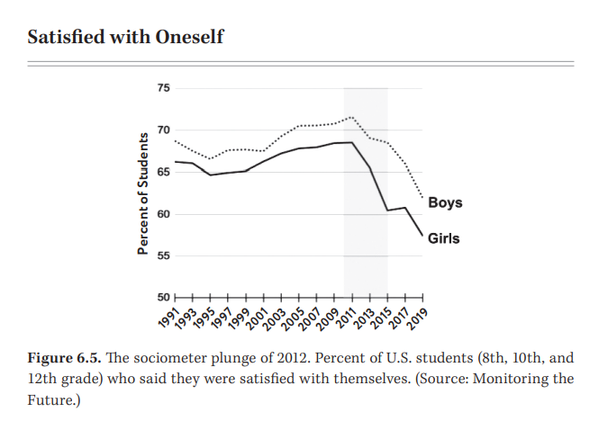
Chapter 6 – Why Social Media Harms Girls More Than Boys

Slide 16
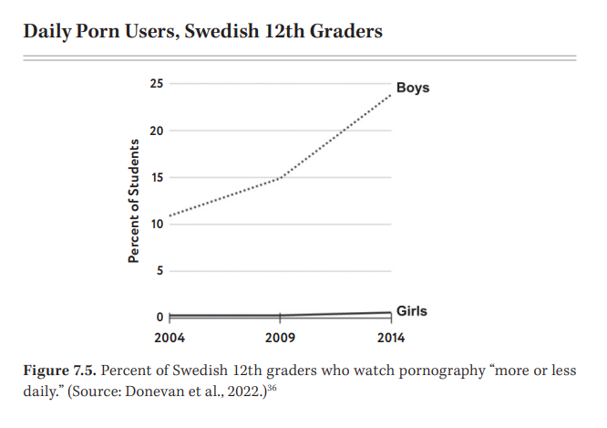
Chapter 7 – What Is Happening to Boys?

Slide 17
Chapter 12 – What Parents Can Do Now
No smart phones before high school
No social media until 16
Phone-free schools
Far more unsupervised play and childhood independence
Install internet filters/safety settings
More nature
Drastically reduce screen time

