Slide 1
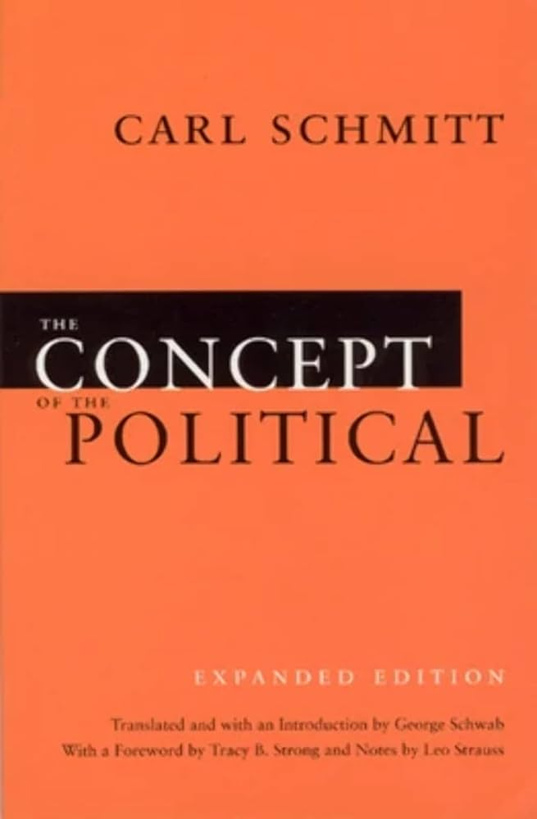

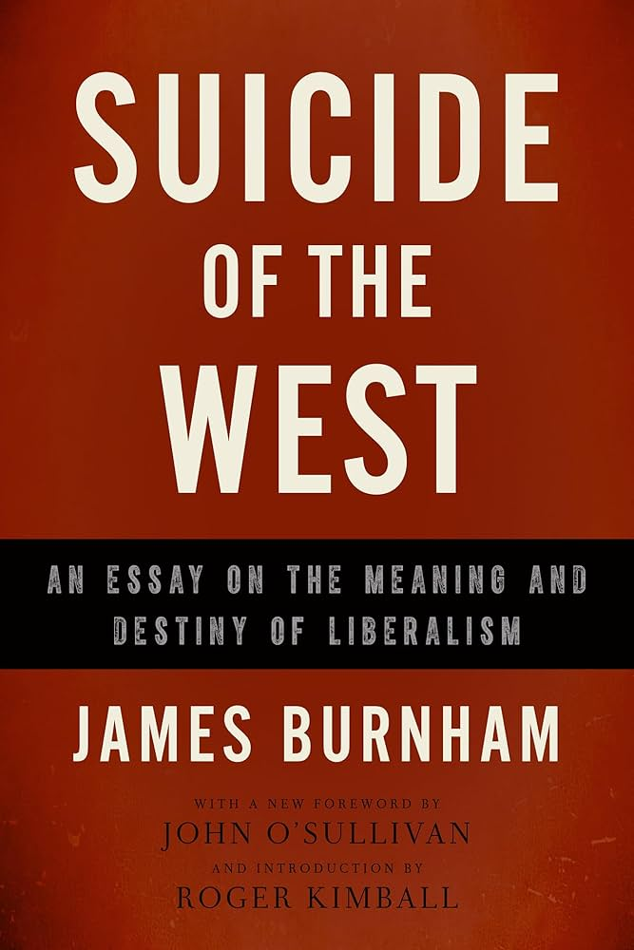

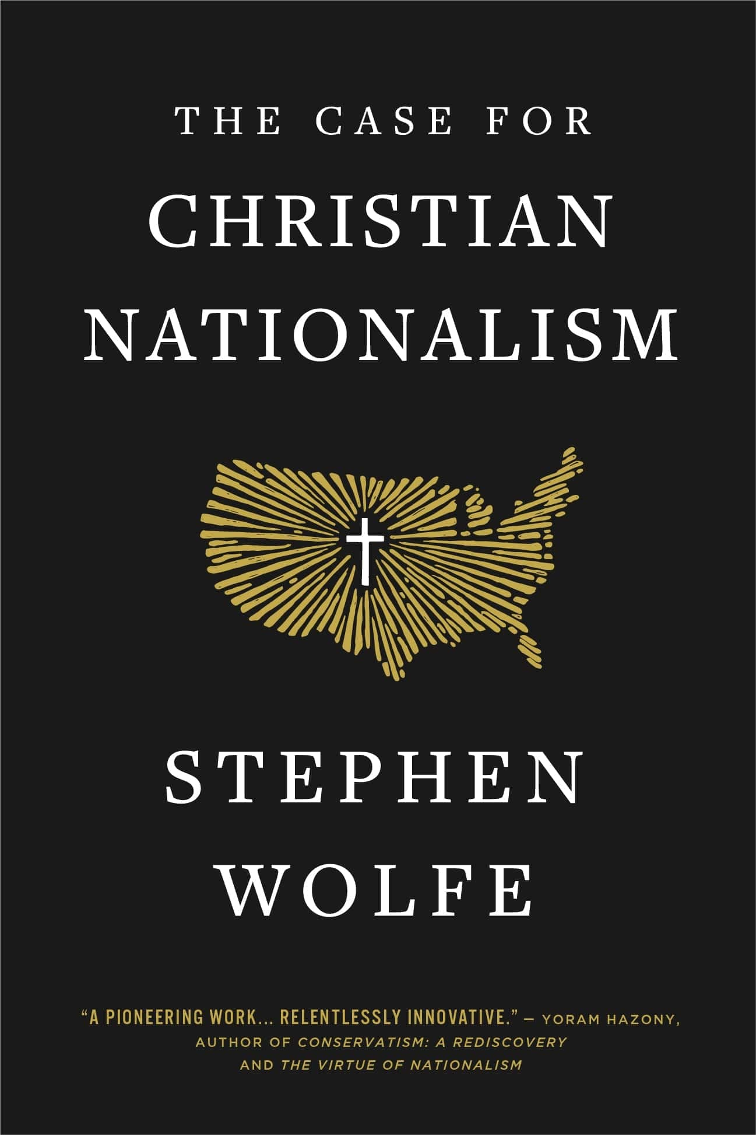
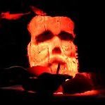
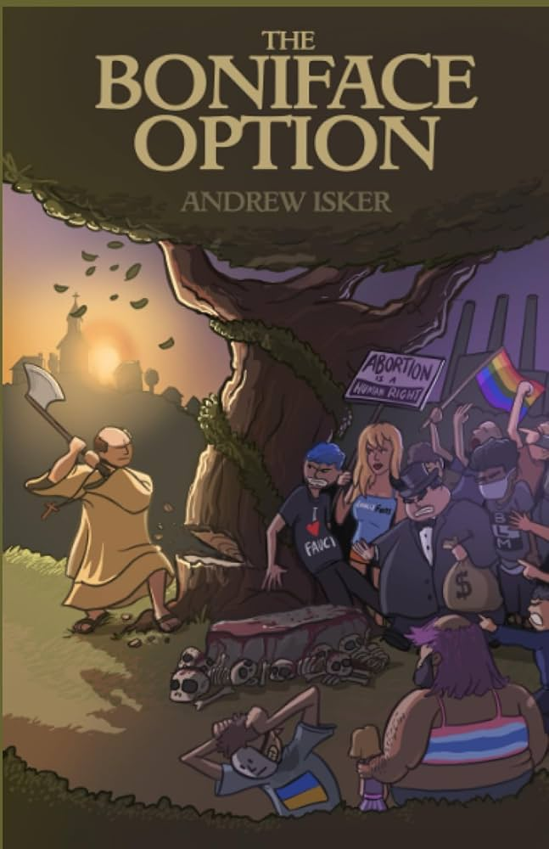
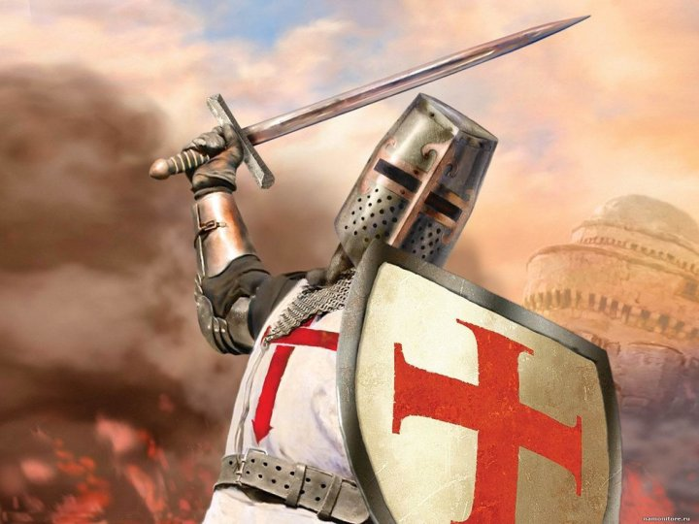
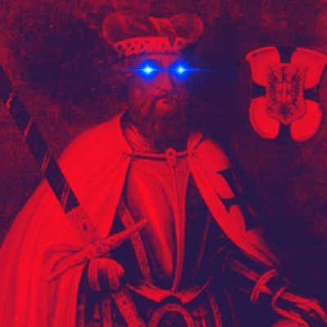
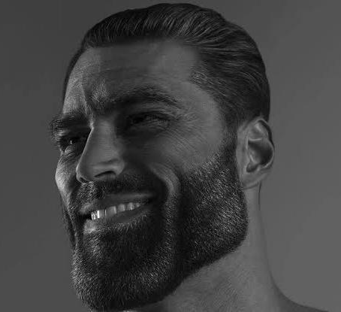
Understanding and Critiquing the Woke Right
Dr. Neil Shenvi
Nov. 24, 2024

Slide 2
Outline
What is wokeness?
What is the “woke right”?
Examples of the woke right
Legitimate considerations
Serious problems
Conclusions

Slide 3
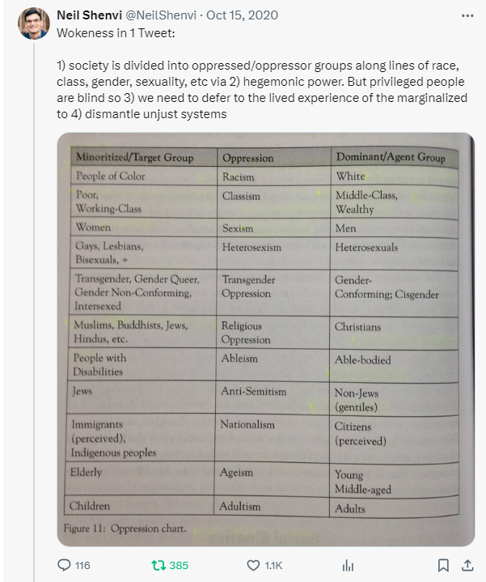
Wokeness In One Tweet
“1) society is divided into oppressed/oppressor groups along lines of race, class, gender, sexuality, etc via 2) hegemonic power. But privileged people are blind so 3) we need to defer to the lived experience of the marginalized to 4) dismantle unjust systems”

Slide 4

Critical theory and Karl Marx
“Alone among these thinkers [i.e., Horkheimer, Bourdieu, Foucault, etc.], Karl Marx invites consensus as a ‘true’ critical theorist. Indeed, for many, he alone inaugurates the critical tradition” (Levinson et al, Beyond Critique, p. 25-26)
1850
1900
1950
2000

Slide 5
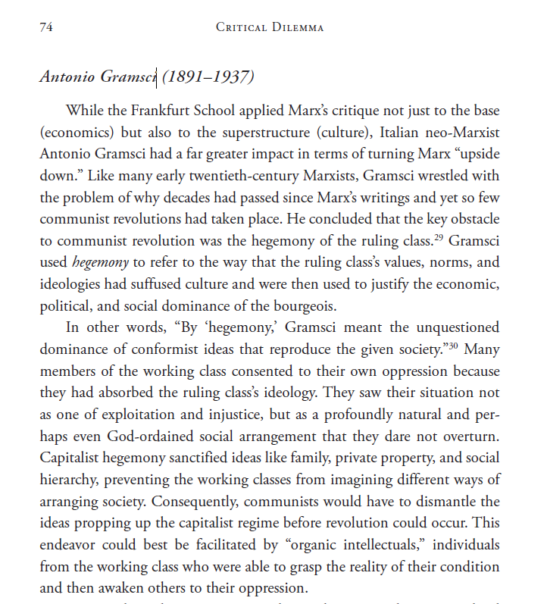
Gramsci and Neo-Marxism
“`By “hegemony,” Gramsci meant the unquestioned dominance of conformist ideas that reproduce the given society…’ Capitalist hegemony sanctified ideas like family, private property, and social hierarchy, preventing the working classes from imagining different ways of arranging society. Consequently, communists would have to dismantle the ideas propping up the capitalist regime before revolution could occur…While Gramsci’s goal was to unmask the capitalist hegemony that stood in the way of communist revolution, later scholars took the same approach to unmasking various racist, sexist, and heterosexist hegemonies that stood in the way of cultural revolution.” – Shenvi and Sawyer, Critical Dilemma, p. 74-75

Slide 6





The Central Ideas of Contemporary Critical Theory?
Idea 1: Social binary
Idea 2: Oppression through ideology
Idea 3: Lived experience
Idea 4: Social justice

Slide 7


Idea #1: Society is divided into oppressed and oppressor groups
“For every social group, there is an opposite group… the primary groups that we name here are: race, class, gender, sexuality, ability status/exceptionality, religion, and nationality”
“Oppression describes a set of policies, practices, traditions, norms, definitions, and explanations (discourses), which function to systematically exploit one social group to the benefit of another social group. The group that benefits from this exploitation is termed the dominant (or agent) group, and the group that is exploited is termed the minoritized (or target) group…. Sexism, racism, classism, ableism, and heterosexism are specific forms of oppression” – Sensoy and DiAngelo, Is Everyone Really Equal? p. 44, 61

Slide 8

Idea #1: Society is divided into oppressed and oppressor groups
Sensoy and DiAngelo, Is Everyone Really Equal, p. 64

Slide 9

Idea #2: Oppression occurs through hegemonic power
“oppression also traditionally carries a strong connotation of conquest and colonial domination… New left social movements of the 1960s and 1970s, however, shifted the meaning of the concept of oppression. In its new usage, oppression designates the disadvantage and injustice some people suffer not because a tyrannical power coerces them, but because of the everyday practices of a well-intentioned liberal society… Oppression in this sense is structural, rather than the result of a few people’s choices or policies. Its causes are embedded in unquestioned norms, habits, and symbols.” – Iris Young, “Five Faces of Oppression,” Readings for Diversity and Social Justice, p. 36

Slide 10
Idea #2: Oppression occurs through hegemonic power
“Hegemony refers to the control of the ideology of society. The dominant group maintains power by imposing their ideology on everyone.”
“From a critical social justice perspective, privilege is defined as systemically conferred dominance and the institutional processes by which the beliefs and values of the dominant group are ‘made normal’ and universal.” – Sensoy and DiAngelo, Is Everyone Really Equal? p. 73, 80

Slide 11


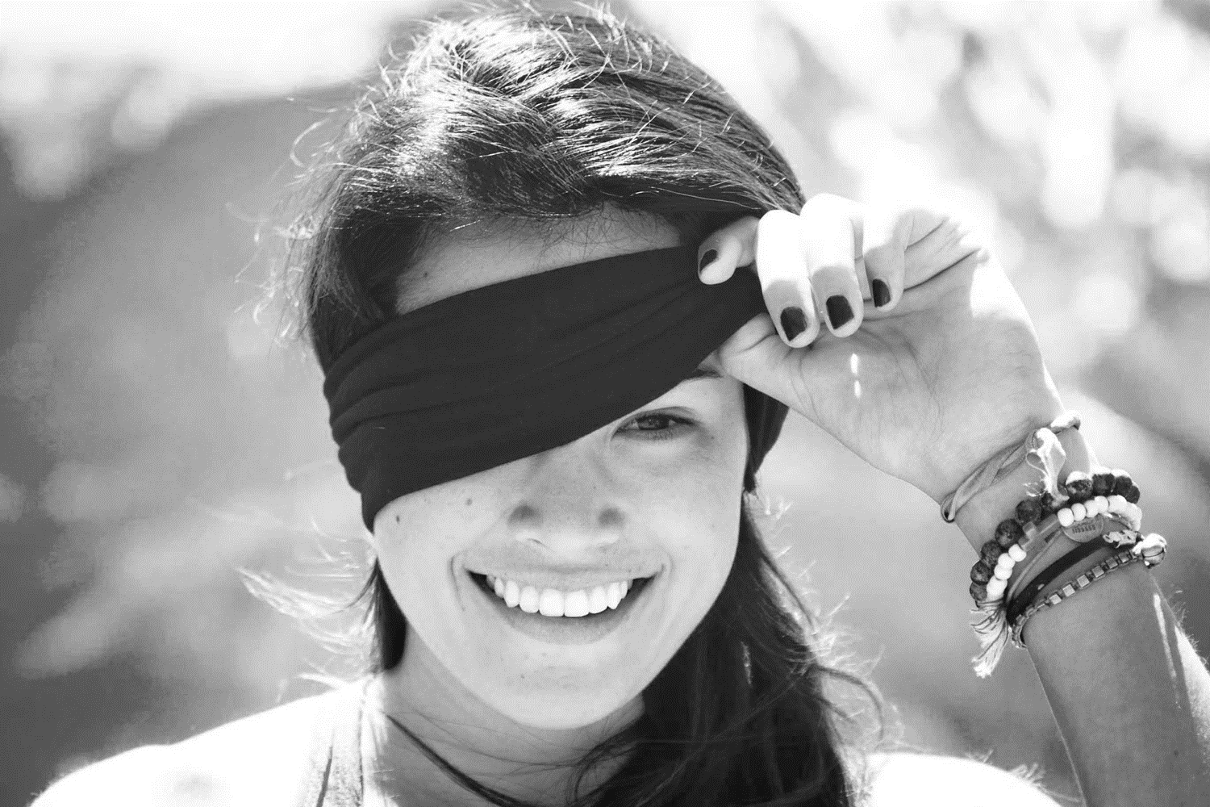
Idea #3: ‘Lived experience’ gives oppressed groups privileged access to truth
Oppression and epistemology:
Privilege
Lived
experience
Internalized oppression
Liberatory consciousness

Slide 12

Idea #4: Social justice demands the liberation of oppressed groups
Definition of social justice:
“Prior to celebrating diversity, we must first eliminate intolerance. No matter what form it takes or who does it, we must all take action to stop intolerance when it happens. Working towards a celebration of diversity implies working for social justice – the elimination of all forms of social oppression… Social injustice takes many forms. It can be injustice based on a person’s gender, race, ethnicity, religion, sexual orientation, physical or mental ability, or economic class.” – Mary McClintock, “How to Interrupt Oppressive Behavior,” Readings for Diversity and Social Justice, p. 483

Slide 13

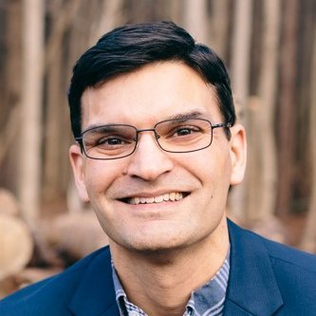
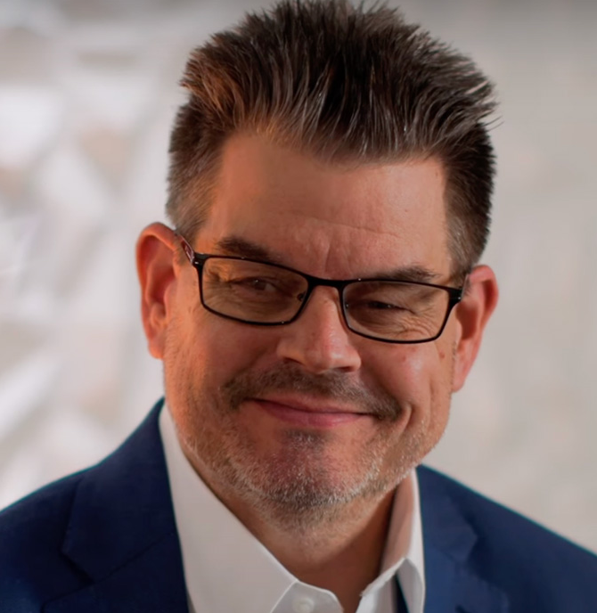
For more on critical theory, see Critical Dilemma
World magazine 2023 Book of the Year
500+ pages
770+ footnotes
440+ Scripture references
200+ primary sources on critical theory
Thousands of words of quotes from primary sources

Slide 14
Wokeness In One Tweet
“1) society is divided into oppressed/oppressor groups along lines of race, class, gender, sexuality, etc via 2) hegemonic power. But privileged people are blind so 3) we need to defer to the lived experience of the marginalized to 4) dismantle unjust systems”

Slide 15
Outline
What is wokeness?
What is the “woke right”?
Examples of the woke right
Legitimate considerations
Serious problems
Conclusions

Slide 16
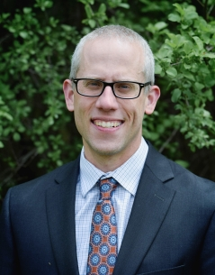
Kevin DeYoung’s Review of Wolfe’s Case for Christian Nationalism
Besides trafficking in sweeping and unsubstantiated claims about the totalizing control of the Globalist American Empire and the gynocracy, Wolfe’s apocalyptic vision—for all of its vitriol toward the secular elites—borrows liberally from the playbook of the left. He not only redefines the nature of oppression as psychological oppression (making it easier to justify extreme measures and harder to argue things aren’t as bad as they seem), he also rallies the troops (figuratively, but perhaps also literally?) by reminding them they’re victims. “The world is out to get you, and people out there hate you” is not a message that will ultimately help white men or any other group that considers themselves oppressed.
When Wolfe sarcastically thanks those who “woke many from their dogmatic slumber” and rejoices that “more are awakening each day,” one might be forgiven for seeing his version of Christian Nationalism as a form of right-wing wokeism. What does it mean to be woke if not that we’re awakened to the “reality” that oppression is everywhere, extreme measures are necessary, and the regime must be overthrown?
If critical race theory teaches that America has failed, that the existing order is irredeemable, that Western liberalism was a mistake from the beginning, that the current system is rigged against our tribe, and that we ought to make ethnic consciousness more important—it seems to me that Wolfe’s project is the right-wing version of these same impulses.” – Kevin DeYoung, “The Rise of Right-Wing Wokeism”

Slide 17
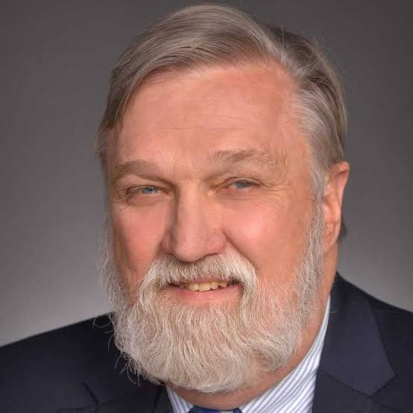
Doug Wilson’s interview with Sean DeMars
Demars: Do you believe in the “woke right”?
Rigney: Like basically the equivalent of the woke left but the Dissident Right guys…
Wilson: This is something I’m actually quite concerned about [–] identity politics on the right…these are people who’ve been taunted their entire adult lives for being White. And finally they say “I might as well be proud of it…I’m going to be White and proud and start hating Jews.” That is a big concern of mine… On the anti-Semitism which is starting to manifest itself on the Right: I’ve been fighting that tooth and nail. And a lot of people on the Right have responded with ‘Ok Boomer’

Slide 18
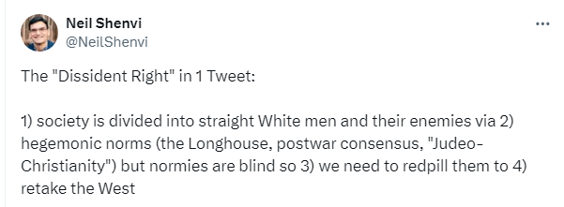
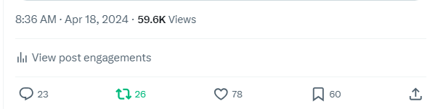
Neil Shenvi’s Summary of the Dissident Right
“1) society is divided into straight White men and their enemies via 2) hegemonic norms (the Longhouse, postwar consensus, "Judeo-Christianity") but normies are blind so 3) we need to redpill them to 4) retake the West”

Slide 19
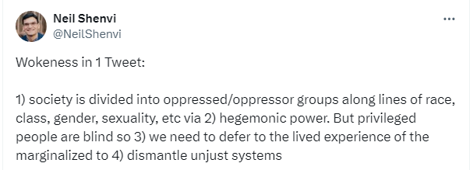
Comparison to the woke left
1) society is divided into oppressed/oppressor groups along lines of race, class, gender, sexuality, etc via
2) hegemonic power. But privileged people are blind so
3) we need to defer to the lived experience of the marginalized to
4) dismantle unjust systems
1) society is divided into straight White men and their enemies via
2) hegemonic norms (the Longhouse, postwar consensus, "Judeo- Christianity") but normies are blind so
3) we need to redpill them to
4) retake the West

Slide 20
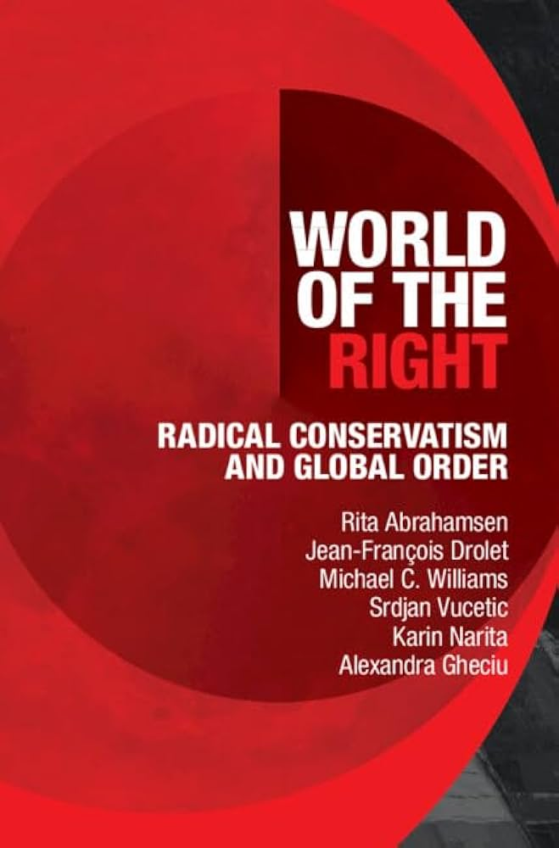
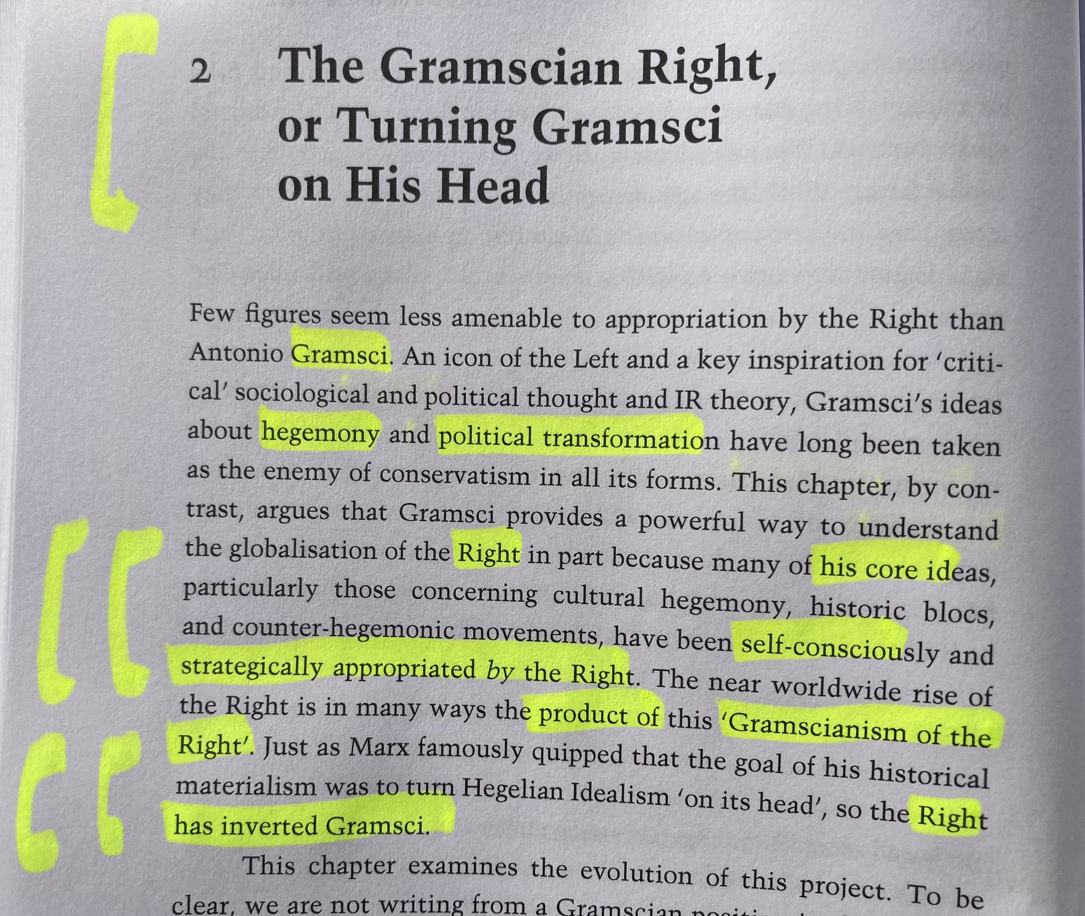
Abrahamsen et al.’s World of the Right

Slide 21
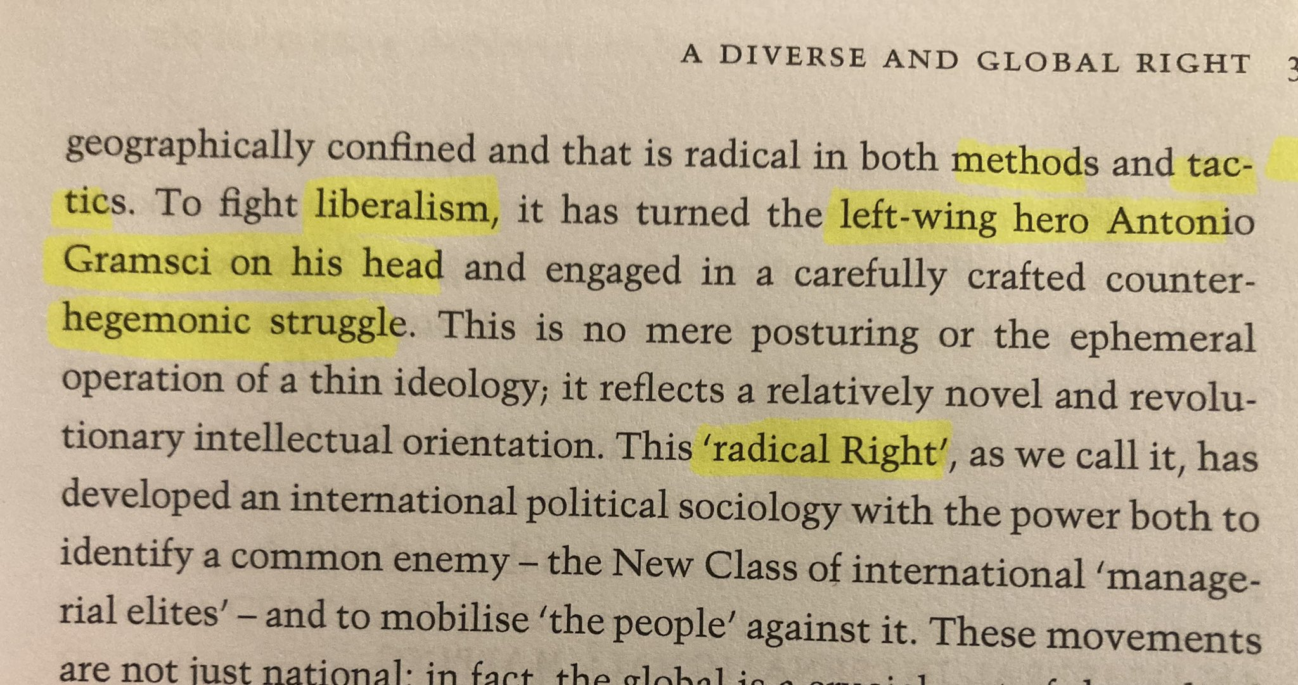
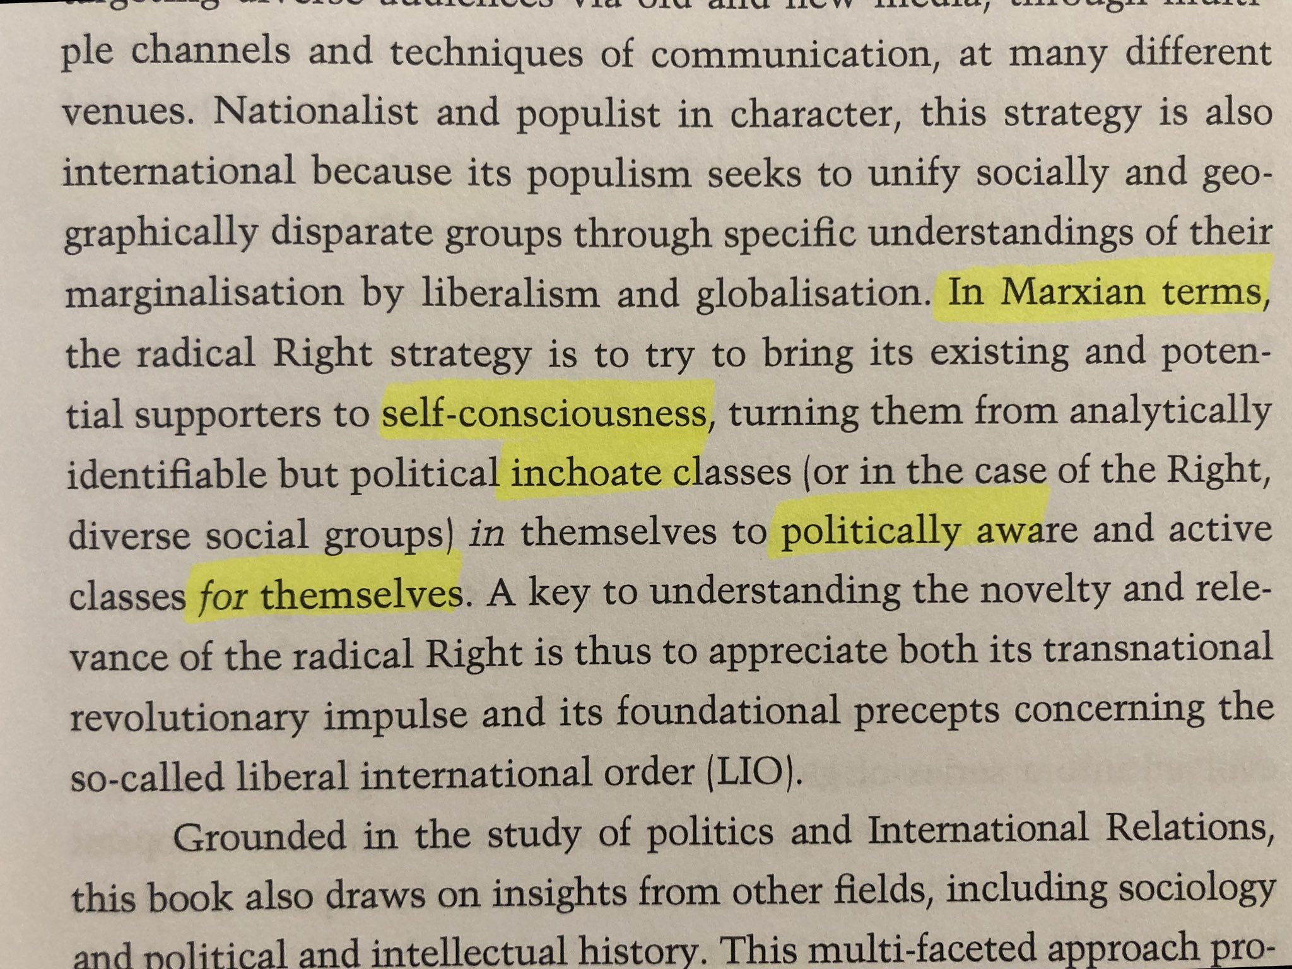
Quotes from World of the Right
“To fight liberalism, [the Radical Right] has turned the left-wing hero [Neomarxist] Antonio Gramsci on his head and engaged in a carefully crafted counter-hegemonic struggle.” - World of the Right, p.3
“In Marxian terms, the radical Right strategy is to try to bring its existing and potential supporters to self-consciousness, turning them from analytically identifiable but political inchoate classes… to politically aware and active classes for themselves.” - World of the Right, p.3

Slide 22
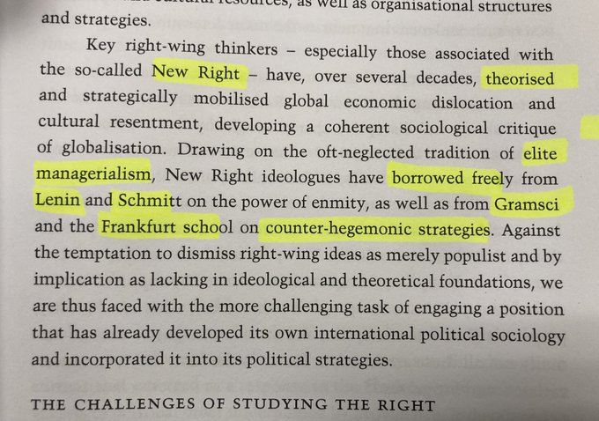
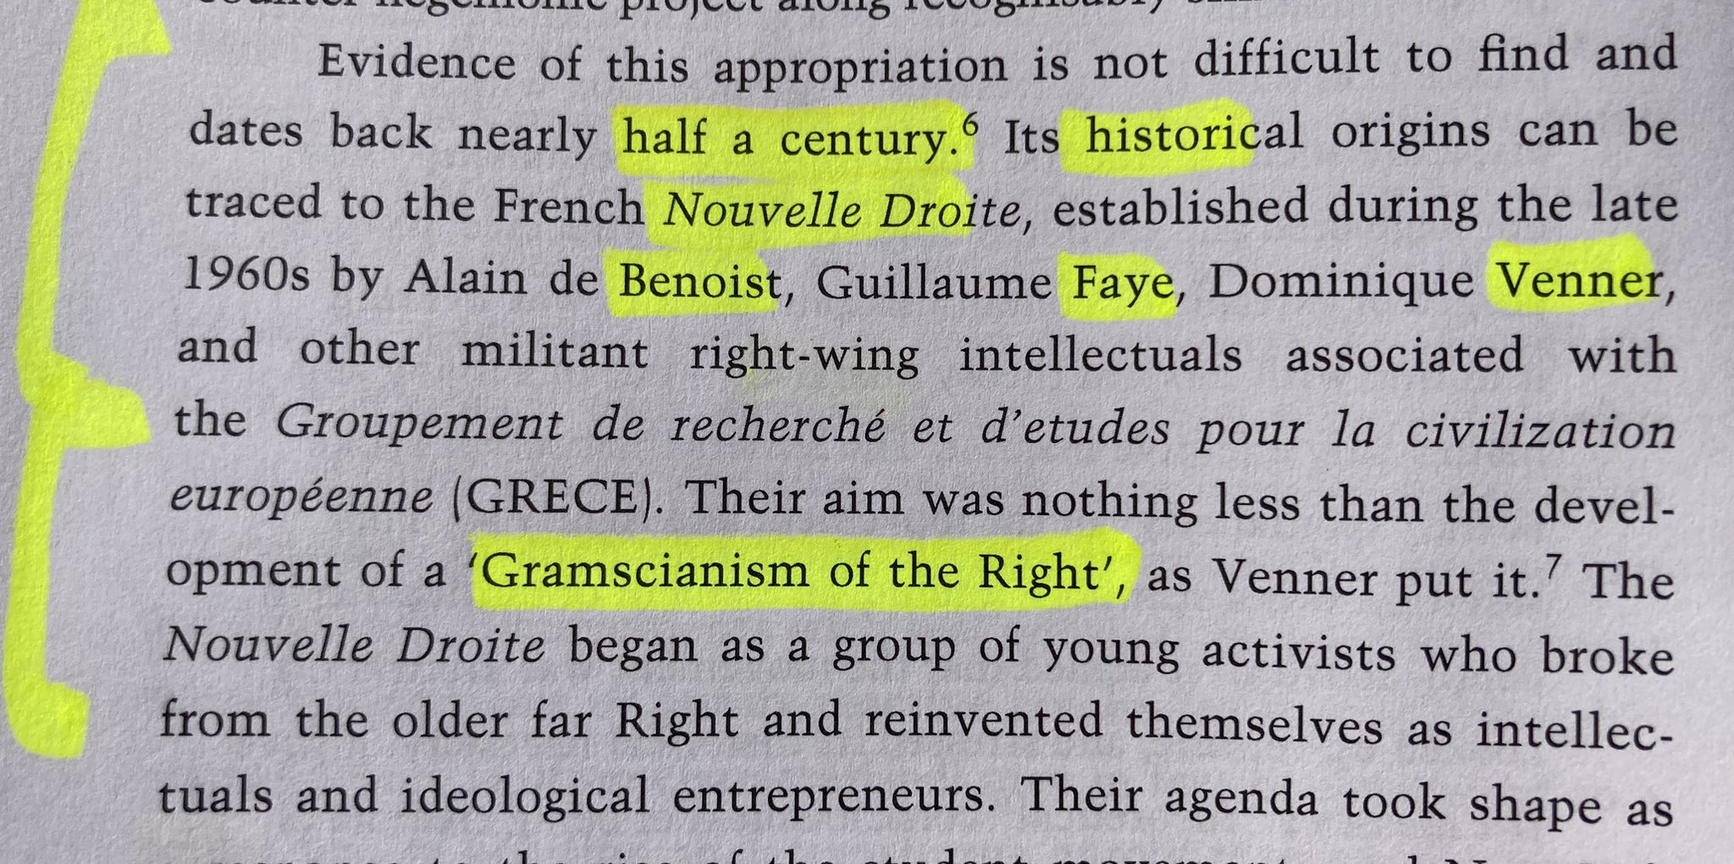
Quotes from World of the Right
“New Right ideologues have borrowed freely from Lenin and Schmitt on the power of enmity, as well as from [Neo-Marxist Antonio] Gramsci and the Frankfurt school on counter-hegemonic strategies.” - World of the Right, p.21
“Gramsci’s strategic analysis of political transformation [has] been effectively appropriated and in many ways actualized by the Right… Evidence of this appropriation is not difficult to find… Its historical origins can be traced to the French Nouvelle Droite [New Right]… Their aim was nothing less than the development of a Gramscianism of the Right,’ as Venner put it.” – World of the Right, p. 40

Slide 23
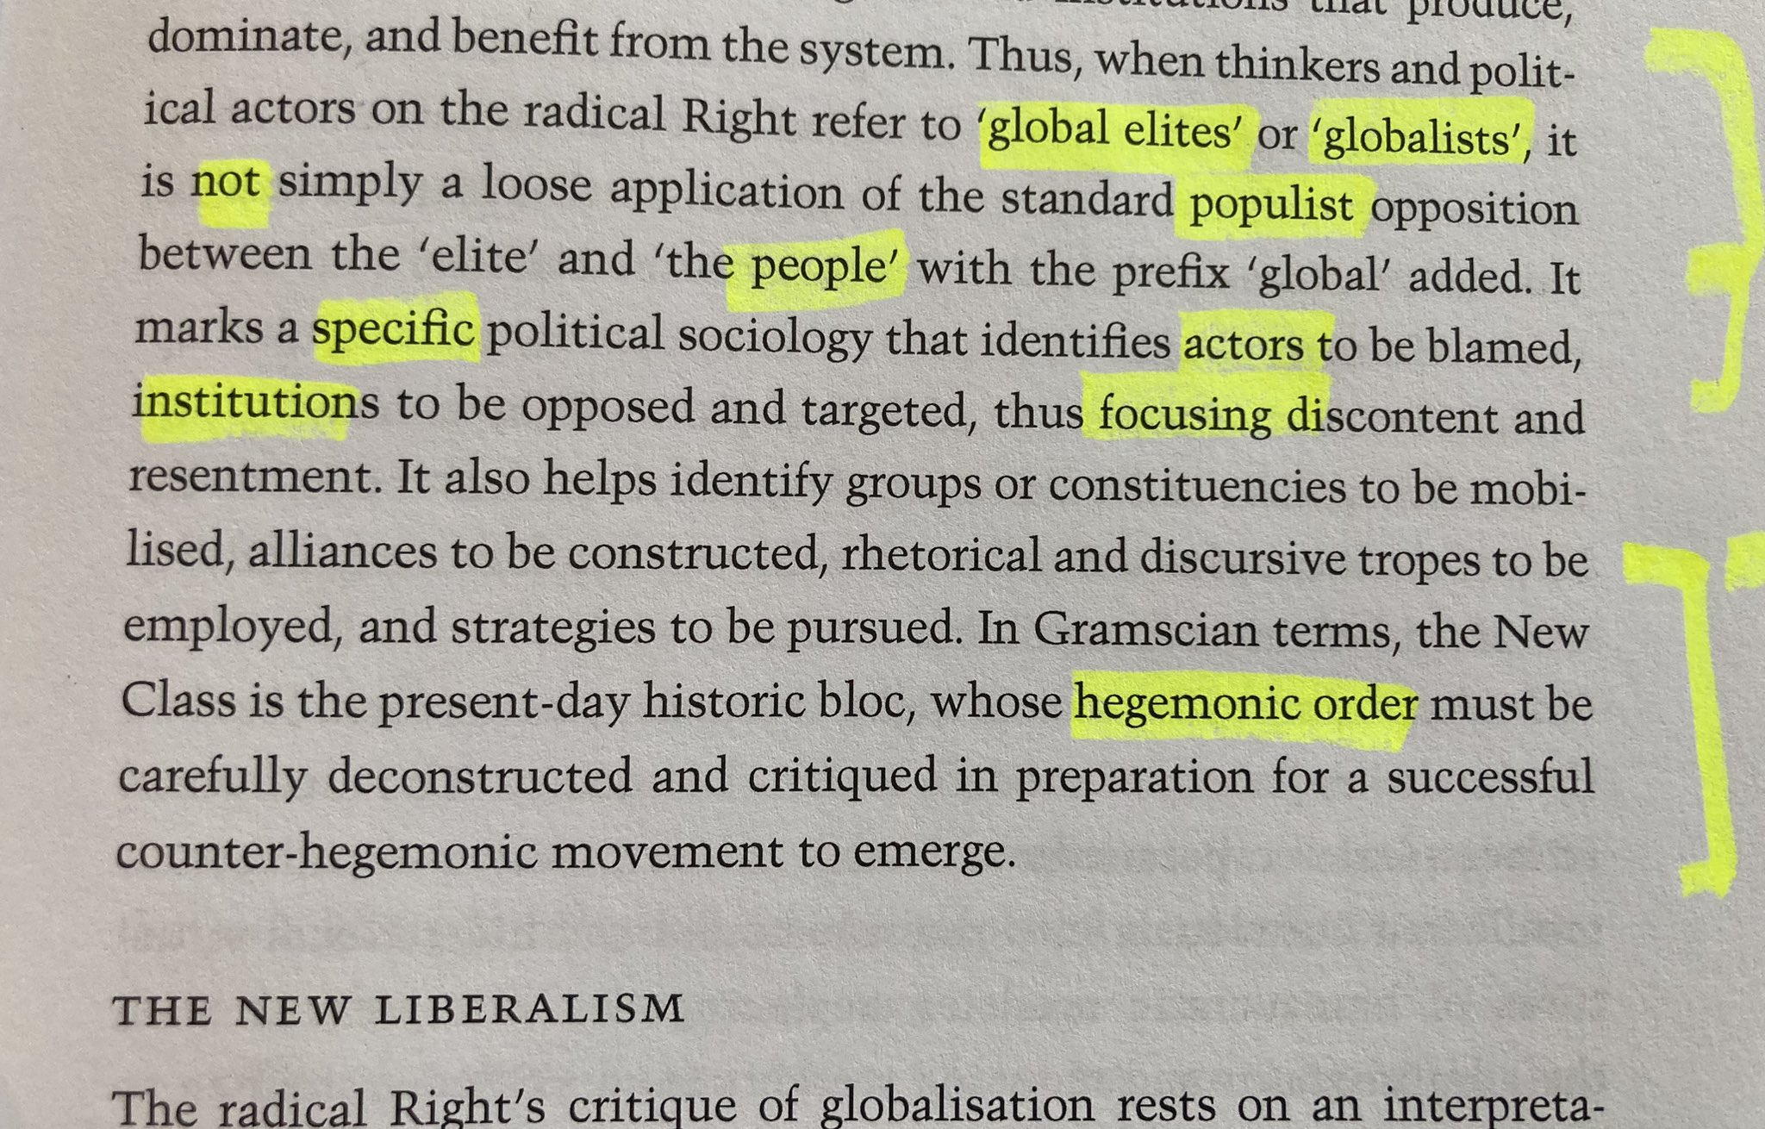
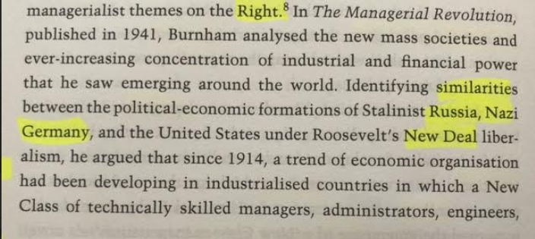
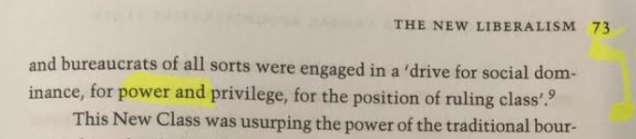
Quotes from World of the Right
“In Gramscian terms, the New Class [of global, managerial elites] is the present-day historic bloc, whose hegemonic order must be carefully deconstructed and critiqued in preparation for a successful counter-hegemonic movement to emerge.” - World of the Right, p.69
“In The Managerial Revolution, [James] Burnham argued that… a New Class of technically skilled managers, administrators, engineers and bureaucrats of all sorts were engaged in a ‘drive for social dominance, for power and privilege, for the position of the ruling class.’” – World of the Right, p. 72-73

Slide 24
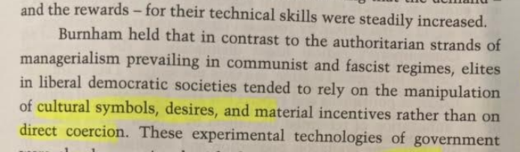
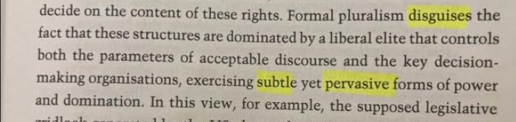
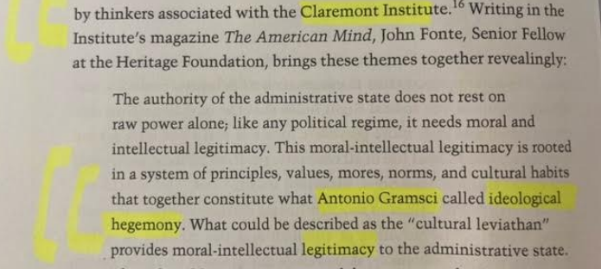
Quotes from World of the Right
“Burnham held that… elites in liberal democratic societies tend to rely on the manipulation of cultural symbols, desires, and material incentives rather than on direct coercion… Formal pluralism disguises the fact that these structures are dominated by a liberal elite that controls both the parameters of acceptable discourse and the key decision-making organisations, exercising subtle yet pervasive forms of power and domination.” - World of the Right, p.73
“’The authority of the administrative state does not rest on raw power along; like any political regime, it needs moral and intellectual legitimacy. This moral-intellectual legitimacy is rooted in a system of principles, values, mores, norms, and cultural habits that together constitute what Antonio Gramsci called ideological hegemony’” – Heritage Senior Fellow John Fonte writing in the Claremont Institute’s American Mind magazine, quoted in World of the Right, p.78

Slide 25
Outline
What is wokeness?
What is the “woke right”?
Examples of the woke right
Legitimate considerations
Serious problems
Conclusions

Slide 26

Stephen Wolfe’s Case for Christian Nationalism
“Every step of progress is overcoming you. Ask yourself, ‘What sort of villain does each event of progress have in common?’ The straight white male. That is the chief out-group of New America, the embodiment of regression and oppression.” (p. 436)
“We live under a gynocracy—a rule by women. This may not be apparent on the surface, since men still run many things. But the governing virtues of America are feminine vices, associated with certain feminine virtues, such as empathy, fairness, and equality.” (p. 448)
“If you are a white, heterosexual, cis-gendered male, then the world will not offer you any favors. Indeed, your career advancement depends on sacrificing your self-respect by praising and pandering to your inferiors who rule over you.” (p. 464)

Slide 27
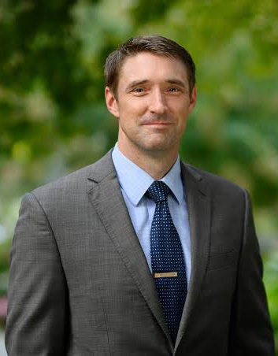
Stephen Wolfe on Twitter
“Anti-woke Christians, in their rejection of ‘power hierarchies’ and ‘privilege,’ have rendered themselves incapable of seeing the absurd but real privileges and power hierarchy at work in our world. This is why I will not reject a ‘critical’ approach to social phenomena. There are subtle hierarchies of power, some natural and proper, and others artificial and absurd.”
“I fully admit that if being a ‘conservative’ requires one to reject a ‘critical’ approach to social phenomena, then I’m not a conservative. We live in liberal hegemony, and [Twitter user @Wokal_Distance] reflects precisely its commitments and power structures.”
“Our social world runs on subtle power relations. The problem with the left is they call them all arbitrary and unjust, based on an egalitarian principle (which the anti-woke largely share)”

Slide 28
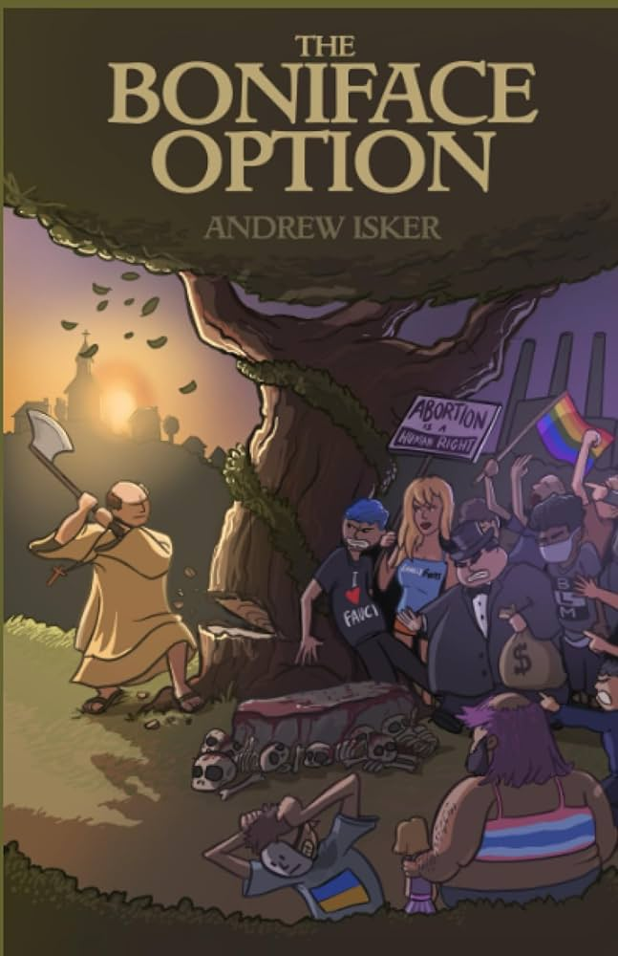
Andrew Isker’s Boniface Option
“You live in a dystopia. Every part of historical human existence in our world has been turned on its head…The insane, dystopian and totalitarian world we fear the elites might create is one we already live in…I use the term Trashworld to describe the dystopian society. And the point of The Boniface Option is to make you see it for what it is and to begin the hard work of escaping and overcoming it” (p. ix-xi).
“the globohomo cinematic universe that the modern bugman lives in must be chopped down. All of it is a seamless garment. Trannies, open borders, acceptance and promotion of sodomy and other sexual perversions, feminism, abortion and antinatalism, anti-white race hate (so-called Critical Race Theory), pornography and the entire consumerist lifestyle… must be sent through a woodchipper” (p. 18).
“We believe because modern, liberal, egalitarian society abolished the formal institutions of slavery that slavery qua slavery has been eradicated. But it very clearly has not. Instead, it is wrapped in a thin veneer of consent. If you were a wicked, evil social engineer and were going to design a massive slave state, the very best conditions would be where the masses believed they were totally free and that their own bondage was their choice” (p. 74).

Slide 29

C.J. Engel, co-host of Contra Mundum
“Once [the] ethos [of Heritage America] was liquidated [after WWII], America was subverted and taken over…Heritage America, of course, is most consistent with anglo Protestantism. But that does not mean that all groups outside of that core are equally dangerous to it. There is a spectrum at play wherein some peoples are less threatening to its ethos than others. There is a high correlation between that spectrum and the broadening circles extending out from Western Europe. Such that peoples like Indians, or South East Asians or Ecuadorians or immigrated Africans are the least capable of fitting in and should be sent home immediately. Whereas groups, like Irish or Italians or Catholics may not fit the original core, but were closer on the spectrum, being Europeans. All politics is contextual and situational.”

Slide 30
C.J. Engel, co-host of Contra Mundum
“the Right Wing is being called the ‘woke right’ because its detractors cannot think outside the hegemonic presumptions of liberalism, which is grounded in individualism.“
“There is indeed a war on Whites.”
“since the old cultural hegemony of Heritage America was centered around straight White men, it is clear that any revolution against that way of life would need to be directed against the hegemonic cultural base made up of these types of people. It is not woke to recognize this.”
“The mythos of liberalism… made the political leadership in this country blind to the actual Leftist revolution in our midst. Liberalism is absolutely a hegemonic norm—what else would be America’s hegemonic norm?”
“The Right can see this very clearly and understands that power is needed to confront new this Leftist hegemony.”
– “On the realization that the Right isn’t liberal,” American Reformer

Slide 31

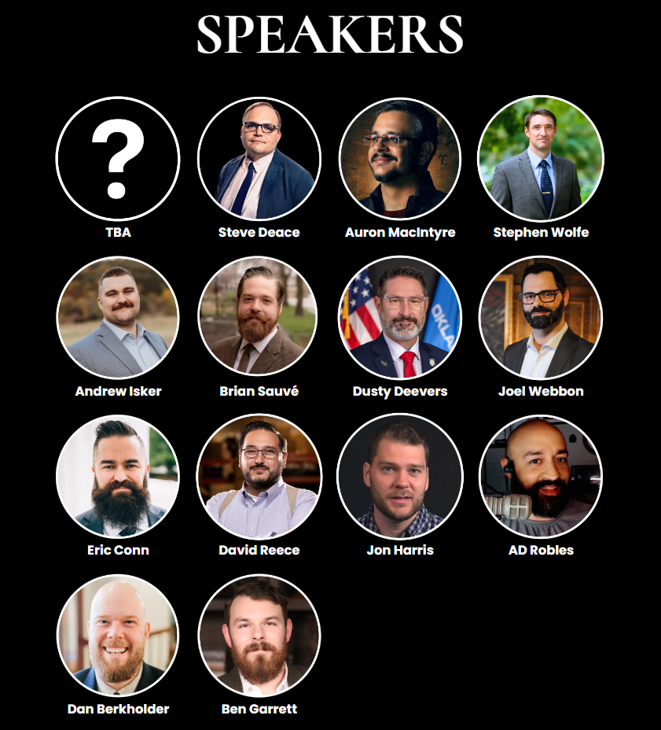
No Woke Right?

Slide 32
Outline
What is wokeness?
What is the “woke right”?
Examples of the woke right
Legitimate considerations
Serious problems
Conclusions

Slide 33
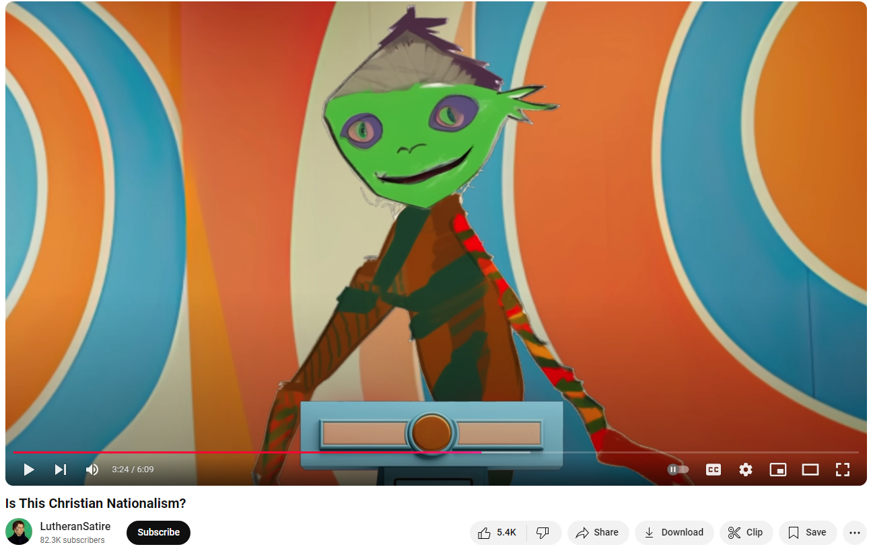
Anti-White sentiment

Slide 34
Questioning liberalism
Why is tolerance good?
Why is democracy good?
Why think people are equal?
Why think theocracy is bad?
Why should we support free speech?

Slide 35
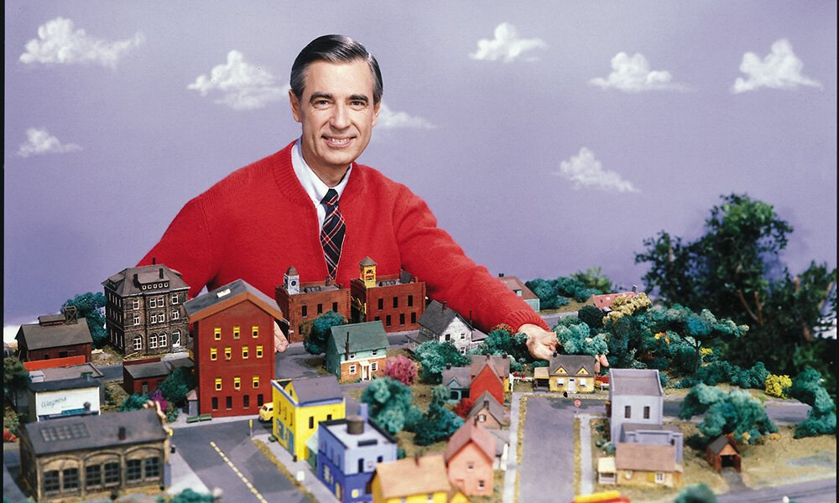
Rejecting “niceness”

Slide 36
Outline
What is wokeness?
What is the “woke right”?
Examples of the woke right
Legitimate considerations
Serious problems
Conclusions

Slide 37
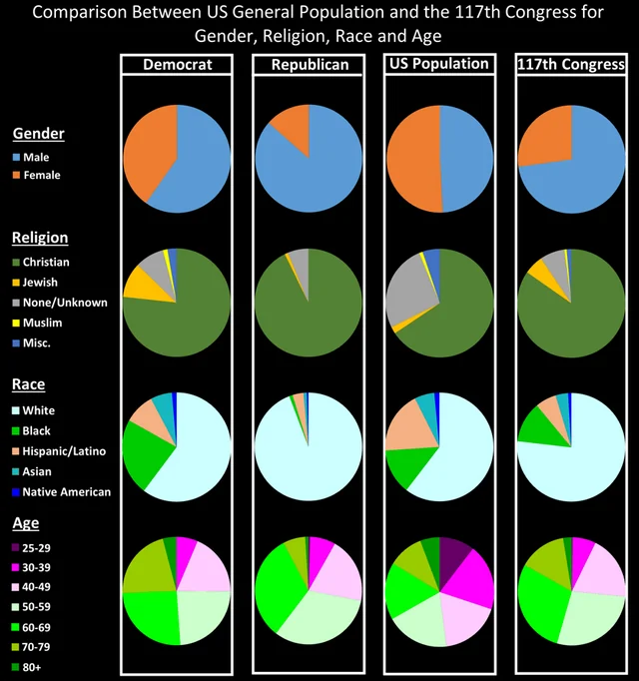
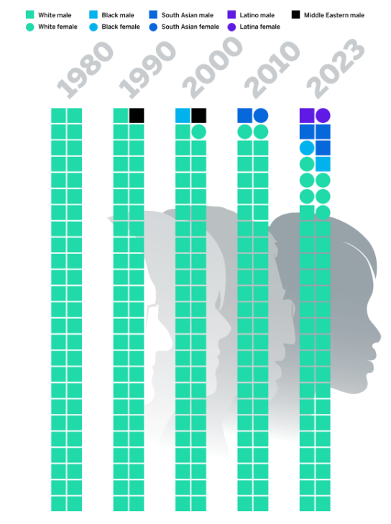
Hegemonic Power Is Contextual
Congress
Top Fortune 500 CEOs

Slide 38
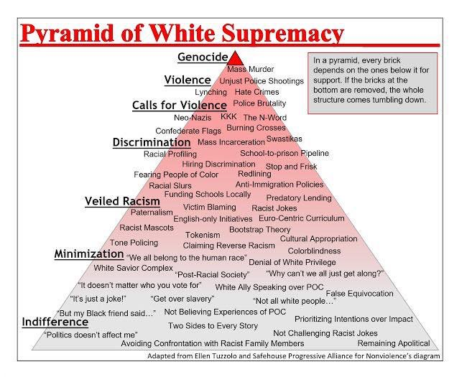
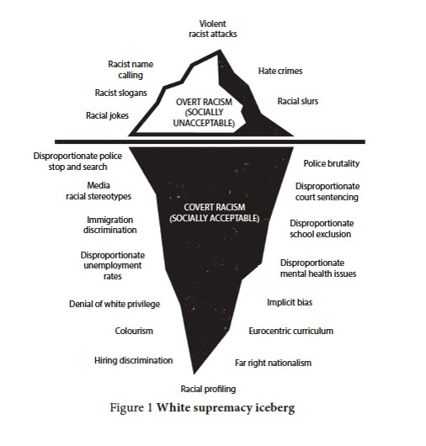
Oppression Isn’t Ideological

Slide 39
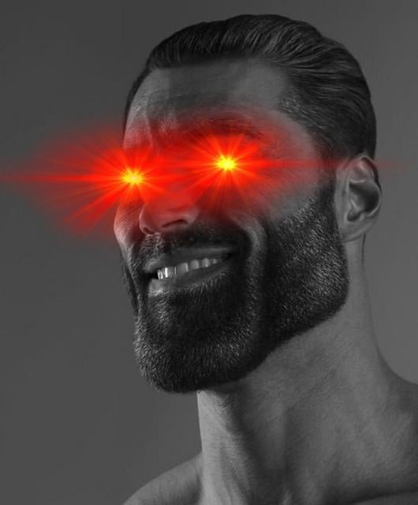
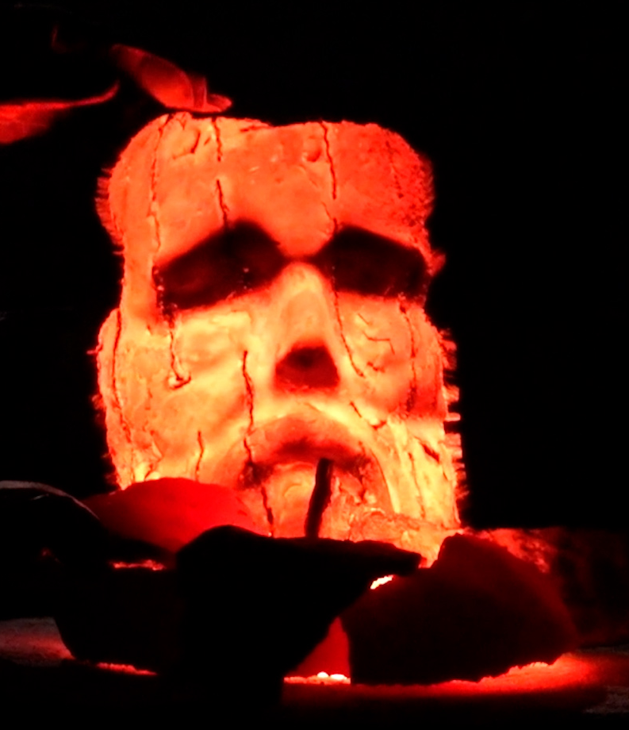
Internalized Identities

Slide 40
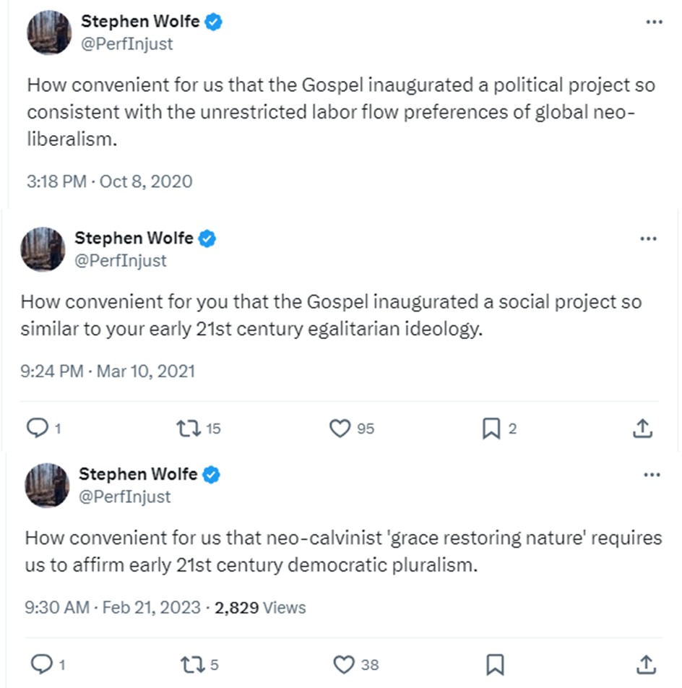
Critical Consciousness and Bulverism
White supremacist
conservative
Evangelicalism.
19th century slaveholder theology.
17th century European racial dogma.

Slide 41
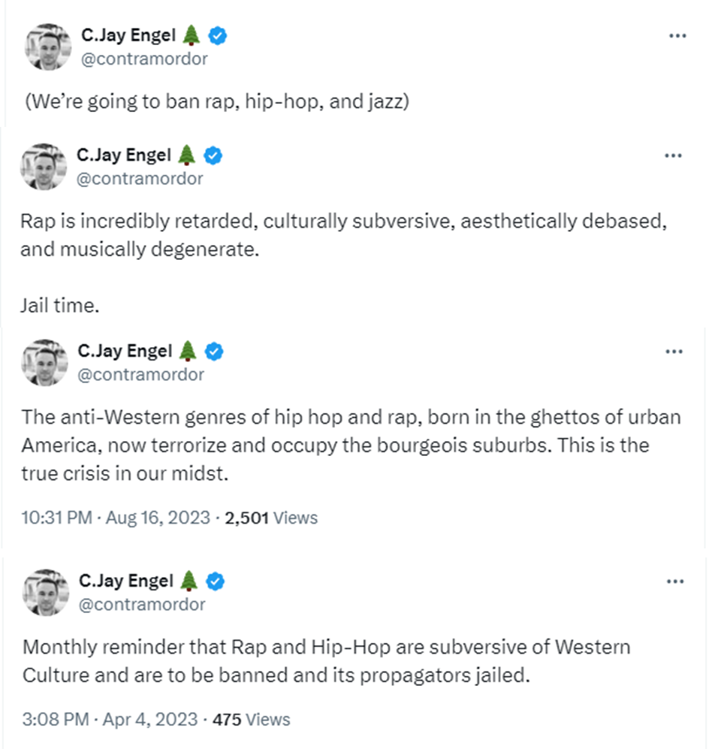
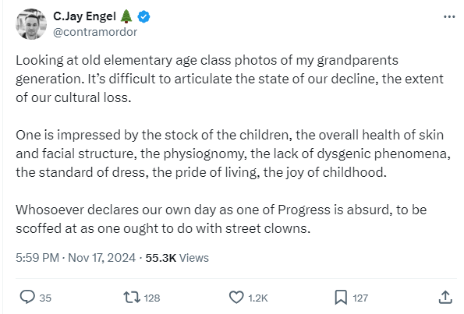
Ethnocentrism

Slide 42
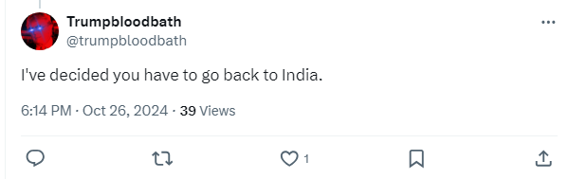
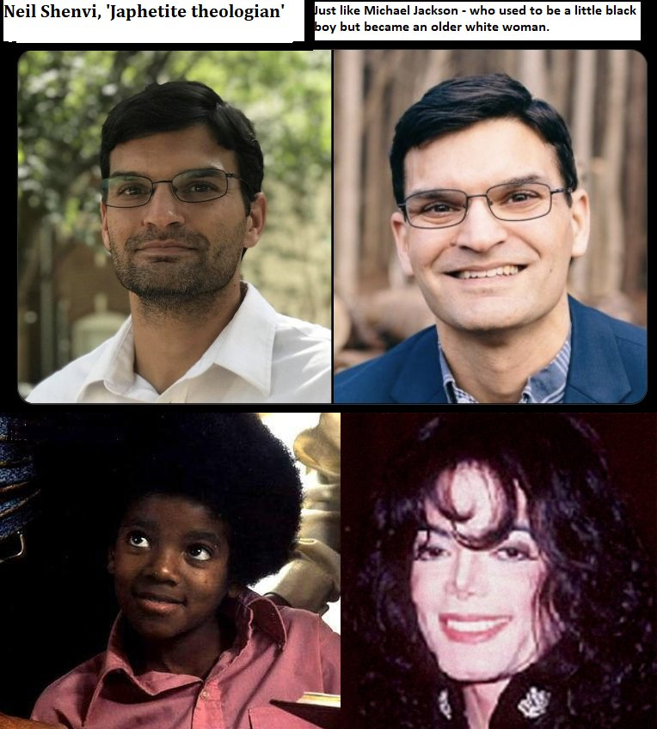
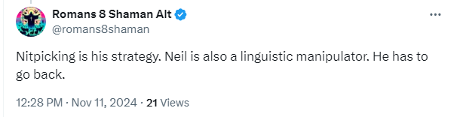
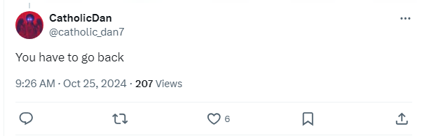
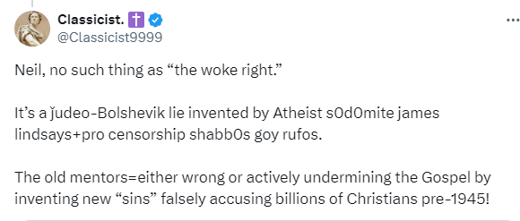
Godless behavior

Slide 43
Outline
What is wokeness?
What is the “woke right”?
Examples of the woke right
Legitimate considerations
Serious problems
Conclusions

Slide 44
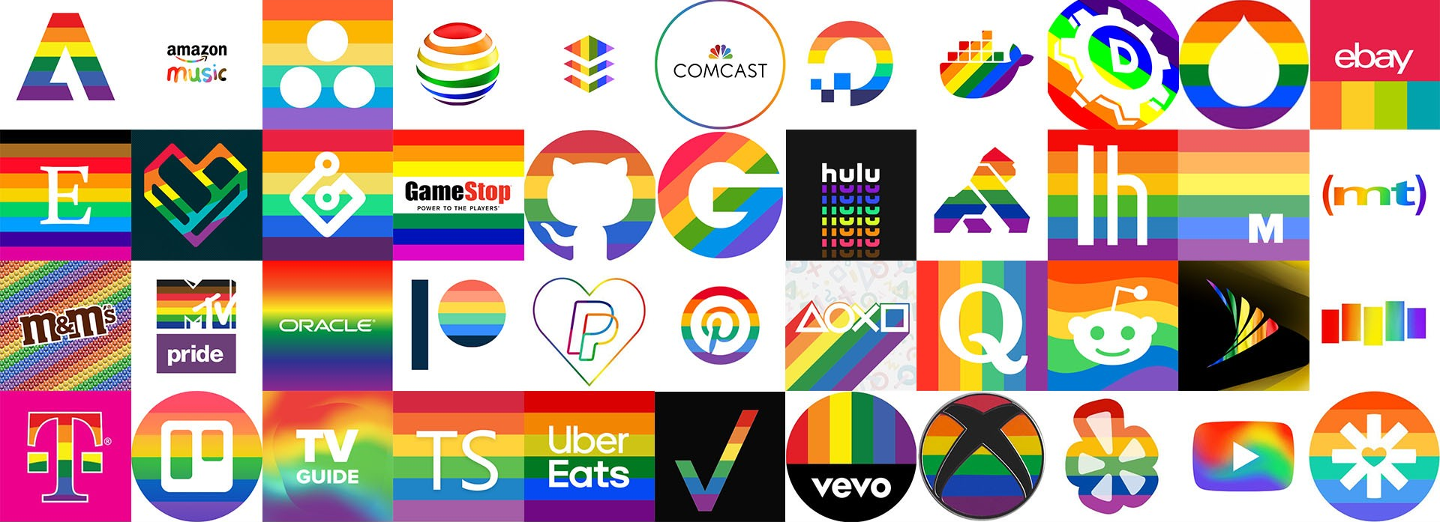
The Woke Left is a far greater institutional threat than the Woke Right

Slide 45

Critical theory is bad no matter who embraces it

Slide 46

Acknowledgements
Dr. Christina Shenvi
Dr. Pat Sawyer
shenviapologetics.com/slides/
criticaldilemma.com/
Twitter @NeilShenvi

