Slide 1

How should the church respond to critical theories?
Dr. Neil Shenvi
East Carolina University
Nov. 14, 2024

Slide 2

This talk is not about Trump

Slide 3

This talk is not about Trump

Slide 4




This talk is not about Trump

Slide 5
This talk is not about Trump
This talk is not about Trump
This talk is not about Trump
This talk is not about Trump
This talk is not about Trump
This talk is not about Trump

Slide 6




NYTimes word usage
“Racism”
“Privilege”
“Whiteness”
“Intersectionality”

Slide 7
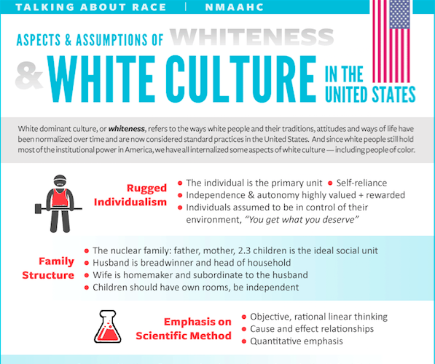
Smithsonian NMAAHC
“Whiteness and white racialized identity refer to the way that white people, their customs, culture, and beliefs operate as the standard by which all other groups of are compared.”

Slide 8

Black Lives Matter
“We are self-reflexive and do the work required to dismantle cisgender privilege and uplift Black trans folk, especially Black trans women who continue to be disproportionately impacted by trans-antagonistic violence…
We foster a queer‐affirming network. When we gather, we do so with the intention of freeing ourselves from the tight grip of heteronormative thinking, or rather, the belief that all in the world are heterosexual (unless s/he or they disclose otherwise).”

Slide 9

Blue’s Clues Pride Month Cartoon
“Families marching one-by-one
Hurrah, hurrah
Families marching one-by-one
Hurrah, hurrah
This family has two mommies
They love each other so proudly
And they all go marching in the Big Parade…
These babas are non-binary
They love each other so proudly…
Ace, bi and pan grown-ups you see can love each other so proudly
And they all go marching in the Big Parade"

Slide 10
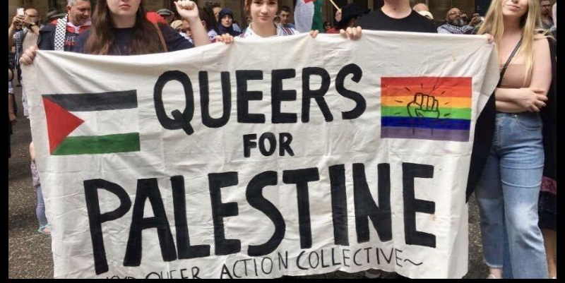
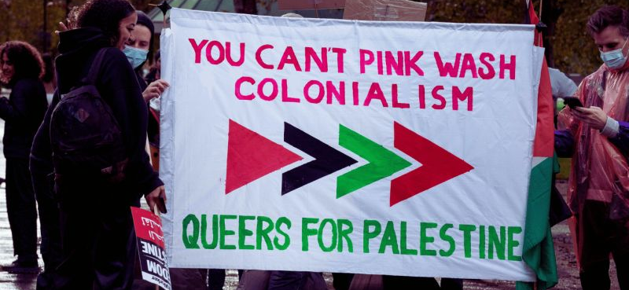
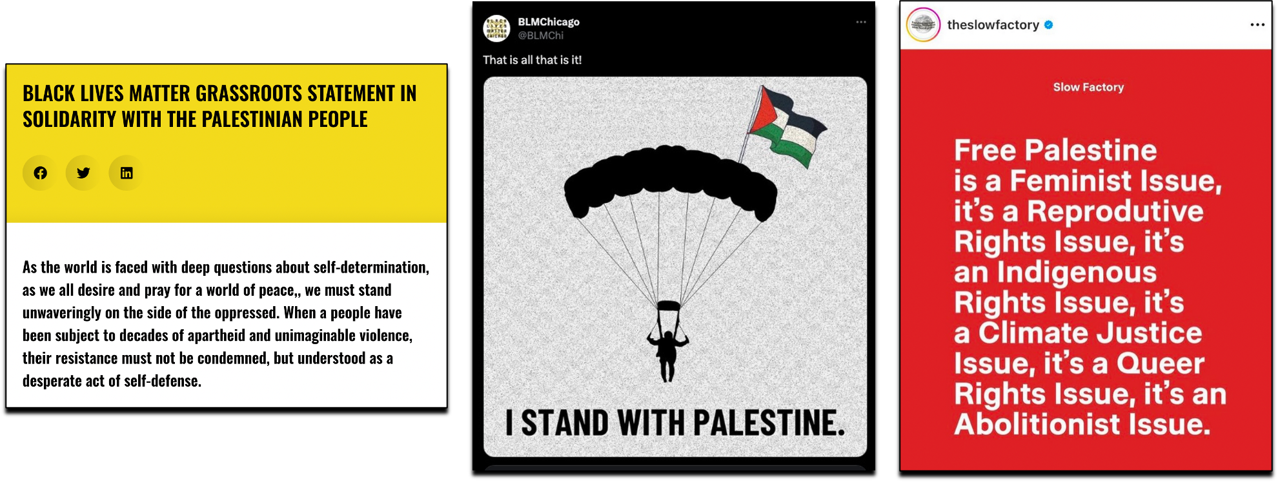
Queers for Palestine

Slide 11
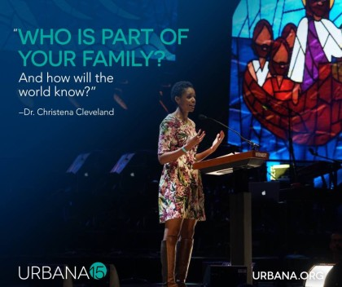
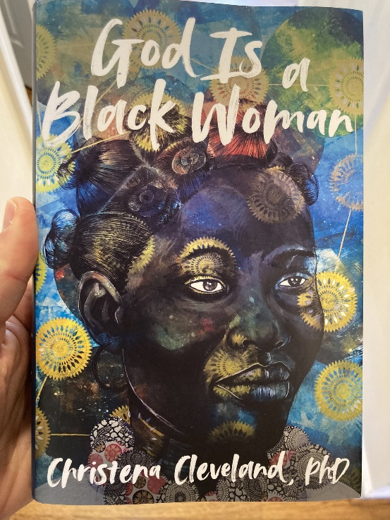
Why should we care?
2015
2022
“Paul, Peter, Luke, John, James, and the writer of Hebrews repeatedly and emphatically make the same point: the unified church is the vehicle through which the kingdom of God is powerfully communicated to the world” – Cleveland, Disunity in Christ, p. 37-38 (2013)
"More than anything, we must eradicate the transphobia within ourselves and our communities. For if God is a Black woman, then She's a Black trans woman. Obviously" - Cleveland, God is a Black Woman, p. 232 (2022)

Slide 12
Outline
The Origins of Contemporary Critical Theory
The Ideas of Contemporary Critical Theory
The Strengths of Contemporary Critical Theory
The Problems of Contemporary Critical Theory
Advice for Dialogue
Conclusions

Slide 13

Critical theory and Karl Marx
“Alone among these thinkers [i.e., Horkheimer, Bourdieu, Foucault, etc.], Karl Marx invites consensus as a ‘true’ critical theorist. Indeed, for many, he alone inaugurates the critical tradition” (Levinson et al, Beyond Critique, p. 25-26)
1850
1900
1950
2000

Slide 14




Critical theory and the Frankfurt School
“Critical theory was conceived within the crucible of Marxism” “The Frankfurt School not only contested establishmentarianism view of history, but projected a radical alternative. European radicals applied its ideas to reconfiguring the family, sexuality, and education.” – Bronner, Critical Theory: A Very Short Introduction, p. 2, 7
1850
1900
1950
2000

Slide 15
















Other critical theorists
Cultural Studies
Postcolonialism
Critical pedagogy
Postmodernism
Bourdieu
Hall
Fanon
Said
Freire
Giroux
Foucault
Derrida
Feminism
Black feminism
Queer theory
Critical Race Theory
de Beauvoir
Friedan
hooks
Lourde
Butler
Rich
Bell
Crenshaw
1850
1900
1950
2000

Slide 16
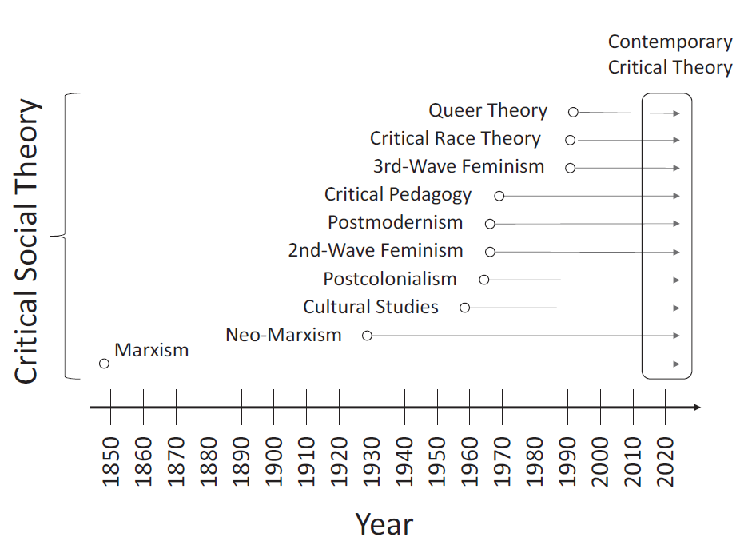
The history of contemporary critical theory
Shenvi and Sawyer, Critical Dilemma, p. 64

Slide 17
Outline
The Origins of Contemporary Critical Theory
The Ideas of Contemporary Critical Theory
The Strengths of Contemporary Critical Theory
The Problems of Contemporary Critical Theory
Advice for Dialogue
Conclusions

Slide 18





The Central Ideas of Contemporary Critical Theory?
Idea 1: Social binary
Idea 2: Oppression through ideology
Idea 3: Lived experience
Idea 4: Social justice

Slide 19


Idea #1: Society is divided into oppressed and oppressor groups
“For every social group, there is an opposite group… the primary groups that we name here are: race, class, gender, sexuality, ability status/exceptionality, religion, and nationality”
“Oppression describes a set of policies, practices, traditions, norms, definitions, and explanations (discourses), which function to systematically exploit one social group to the benefit of another social group. The group that benefits from this exploitation is termed the dominant (or agent) group, and the group that is exploited is termed the minoritized (or target) group…. Sexism, racism, classism, ableism, and heterosexism are specific forms of oppression” – Sensoy and DiAngelo, Is Everyone Really Equal? p. 44, 61

Slide 20

Idea #1: Society is divided into oppressed and oppressor groups
Sensoy and DiAngelo, Is Everyone Really Equal, p. 64

Slide 21

Idea #2: Oppression occurs through hegemonic power
“oppression also traditionally carries a strong connotation of conquest and colonial domination… New left social movements of the 1960s and 1970s, however, shifted the meaning of the concept of oppression. In its new usage, oppression designates the disadvantage and injustice some people suffer not because a tyrannical power coerces them, but because of the everyday practices of a well-intentioned liberal society… Oppression in this sense is structural, rather than the result of a few people’s choices or policies. Its causes are embedded in unquestioned norms, habits, and symbols.” – Iris Young, “Five Faces of Oppression,” Readings for Diversity and Social Justice, p. 36

Slide 22
Idea #2: Oppression occurs through hegemonic power
“Hegemony refers to the control of the ideology of society. The dominant group maintains power by imposing their ideology on everyone.”
“From a critical social justice perspective, privilege is defined as systemically conferred dominance and the institutional processes by which the beliefs and values of the dominant group are ‘made normal’ and universal.” – Sensoy and DiAngelo, Is Everyone Really Equal? p. 73, 80

Slide 23


Idea #3: ‘Lived experience’ gives oppressed groups privileged access to truth
“The idea that objectivity is best reached only through rational thought is a specifically Western and masculine way of thinking – one that we will challenge throughout this book.” – Margaret L. Andersen and Patricia Hill Collins, “Reconstructing Knowledge,” in Anderson and Collins, Race, Class, and Gender, p. 4-5

Slide 24



Idea #3: ‘Lived experience’ gives oppressed groups privileged access to truth
Oppression and epistemology:
Privilege
Lived
experience
Internalized oppression
Liberatory consciousness

Slide 25

Idea #4: Social justice demands the liberation of oppressed groups
Definition of social justice:
“Prior to celebrating diversity, we must first eliminate intolerance. No matter what form it takes or who does it, we must all take action to stop intolerance when it happens. Working towards a celebration of diversity implies working for social justice – the elimination of all forms of social oppression… Social injustice takes many forms. It can be injustice based on a person’s gender, race, ethnicity, religion, sexual orientation, physical or mental ability, or economic class.” – Mary McClintock, “How to Interrupt Oppressive Behavior,” Readings for Diversity and Social Justice, p. 483

Slide 26
Outline
The Origins of Contemporary Critical Theory
The Ideas of Contemporary Critical Theory
The Strengths of Contemporary Critical Theory
The Problems of Contemporary Critical Theory
Advice for Dialogue
Conclusions

Slide 27

Strength #1. Emphasis on the sinfulness of oppression
“Learn to do good; seek justice, correct oppression; bring justice to the fatherless, plead the widow's cause.” – Is. 1:17
“Do not oppress the widow, the fatherless, the sojourner, or the poor, and let none of you devise evil against another in your heart.” – Zech. 7:20
“Love your neighbor as yourself.” – Mark 12:30
“Listen! The wages of the laborers who mowed your fields which you kept back by fraud, cry out, and the cries of the har­vesters have reached the ears of the Lord of hosts” – James 5:4

Slide 28

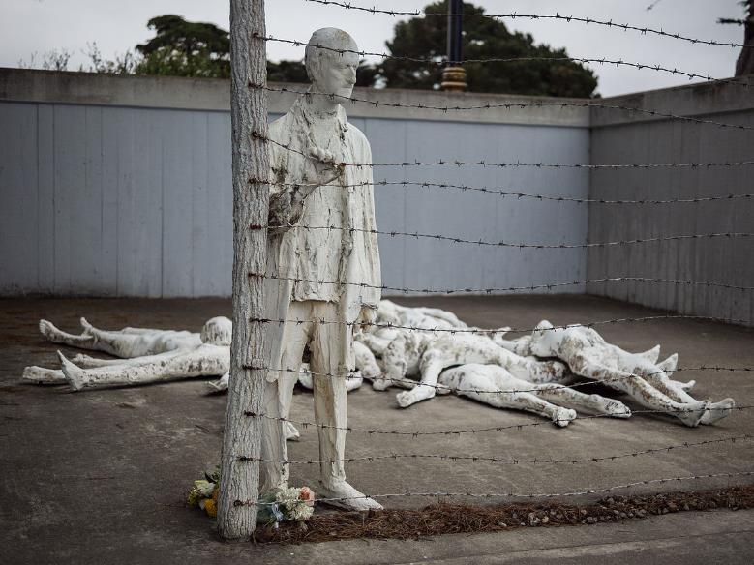
Strength #2. Focus on structures, systems, and norms

Slide 29

Strength #3: Recognition of hegemonic power

Slide 30
Outline
The Origins of Contemporary Critical Theory
The Ideas of Contemporary Critical Theory
The Strengths of Contemporary Critical Theory
The Problems of Contemporary Critical Theory
  A False Worldview
  A False Identity
  A False Epistemology
  A False Salvation
Advice for Dialogue
Conclusions

Slide 31
Christianity and contemporary critical theory are competing worldviews
 | Christianity | Contemporary critical theory
Who are we? | God’s creatures | Members of various groups
What is our problem? | Sin | Oppression
What is the solution? | Jesus | Liberation
What is our duty? | Loving God | Liberating the oppressed
What is our purpose? | Glorifying God | Working for liberation

Slide 32
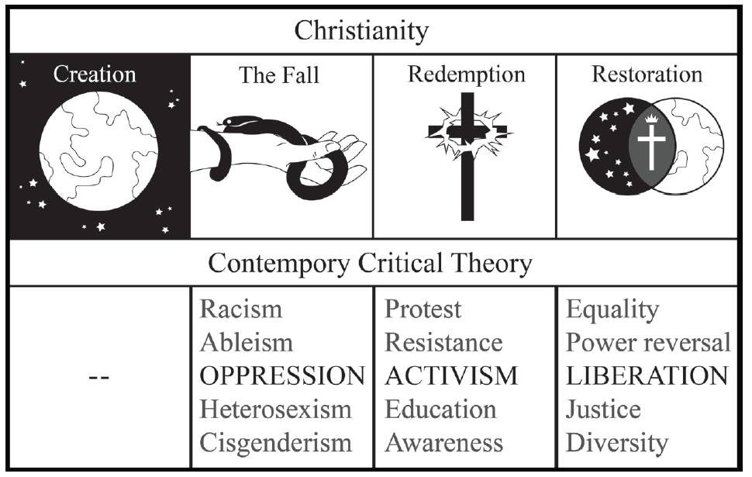
Christianity and contemporary critical theory are competing worldviews
Shenvi and Sawyer, Critical Dilemma, p. 284

Slide 33

Unifying themes of critical theory
“the cluster of philosophical approaches to [issues of identity is] known by the umbrella term critical theory. Critical theory is today a diverse phenomenon that draws deeply and variously on strands of Marxist thought, psychoanalysis, feminist theory, postcolonialism, poststructuralism, queer theory, and deconstruction… at the core of the various approaches of critical theorists lies a relatively simple set of convictions: the world is to be divided up between those who have power and those who do not; the dominant Western narrative of truth is really an ideological construct designed to preserve the power structure of the status quo; and the goal of critical theory is therefore to destabilize this power structure by destabilizing the dominant narratives that are used to justify –to ‘naturalize’– it” - Trueman
Trueman, The Rise and Triumph of the Modern Self, p. 225-226

Slide 34


Critical theory as worldview
“we now have Social Justice texts--forming a kind of Gospel of Social Justice--that express, with absolute certainty, that all white people are racist, all men are sexist, racism and sexism are systems that can exist and oppress absent even a single person with racist or sexist intentions or beliefs..., sex is not biological and exists on a spectrum, language can be literal violence, denial of gender identity is killing people, the wish to remedy disability and obesity is hateful, and everything needs to be decolonized.
Does this sound like a metanarrative? That's because it is. Social Justice scholarship and its educators and activists see these principles and conclusions as The Truth According to Social Justice--and they treat it as though they have discovered the analogue of the germ theory of disease, but for bigotry and oppression”
-Pluckrose and Lindsay, Cynical Theories, p. 182-183

Slide 35
Outline
The Origins of Contemporary Critical Theory
The Ideas of Contemporary Critical Theory
The Strengths of Contemporary Critical Theory
The Problems of Contemporary Critical Theory
  A False Worldview
  A False Identity
  A False Epistemology
  A False Salvation
Advice for Dialogue
Conclusions

Slide 36


Adversarial identities
White
Male
Rich
Heterosexual
Cisgender
Christian
Able-bodied
Non-white
Female
Poor
Homosexual
Transgender
Non-Christian
Disabled

Slide 37

Adversarial identities
“I began to understand why we [White women] are justly seen as oppressive, even when we don't see ourselves that way. I began to count the ways in which I enjoy unearned skin privilege and have been conditioned into oblivion about its existence.
My schooling gave me no training in seeing myself as an oppressor, as an unfairly advantaged person, or as a participant in a damaged culture. I was taught to see myself as an individual whose moral state depended on her individual moral will.”
– Peggy McIntosh, “White Privilege and Male Privilege,” in Race, Class, and Gender, 72

Slide 38

Adversarial identities
“if you are white in a white supremacist society, you are racist. If you are male in a patriarchy, you are sexist. If you are able-bodied, you are ableist. If you are anything above poverty in a capitalist society, you are classist. You can sometimes be all of these things at once.”
– Ijeoma Oluo, So You Want to Talk About Race?, 220-221

Slide 39
Identity and solidarity
Creation
Sin
Redemption

Slide 40
Identity and solidarity
“God created man in his own image,
in the image of God he created him;
male and female he created them.”
- Genesis 1:27
“there is no distinction: for all have sinned and fall short of the glory of God” - Romans 3:22-23
“he himself is our peace, who has made us both one and has broken down in his flesh the dividing wall of hostility by abolishing the law of commandments expressed in ordinances, that he might create in himself one new man in place of the two, so making peace, and might reconcile us both to God in one body through the cross, thereby killing the hostility.” - Eph. 2:11-16

Slide 41
Outline
The Origins of Contemporary Critical Theory
The Ideas of Contemporary Critical Theory
The Strengths of Contemporary Critical Theory
The Problems of Contemporary Critical Theory
  A False Worldview
  A False Identity
  A False Epistemology
  A False Salvation
Advice for Dialogue
Conclusions

Slide 42
Contemporary critical theory and “lived experience”
Oppression and epistemology:
Privilege
Lived
experience
Internalized oppression
Liberatory consciousness

Slide 43
Deferring to lived experience
“It is about race if a person of color thinks it’s about race. This may sound at first like I’m asking you to just take every person of color’s word for it, as if they are infallible… But the truth is, whether or not someone is fallible is beside the point. We are, each and every one of us, a collection of our lived experiences… And our experiences are valid…And so, if a person of color says that something is about race, it is— because regardless of the details, regardless of whether or not you can connect the dots from the outside, their racial identity is a part of them, and it is interacting with the situation.”
–Oluo, So You Want to Talk About Race? 15

Slide 44

Deferring to lived experience
“Privileged people who are truly committed to standing in solidarity with oppressed folks [must] commit to knowing, bearing and even being targeted by their anger…Now is not the time for privileged folks to be a ‘prophetic voice’ in the lives of oppressed people by speaking hard truth about what (privileged people think) oppressed people should be doing to improve their situation. Privileged people lost their right to the prophetic megaphone when they knowingly or unknowingly participated in societal systems that benefit some people and oppress others. Sorry folks - you can’t be a prophet and an oppressor at the same time.”
– Dr. Christena Cleveland, Listening Well as a Person of Privilege – Seek to Understand and Embrace Anger,” April 15, 2013.

Slide 45
Scripture on Lived Experience
“let every person be quick to hear, slow to speak, slow to anger.” – James 1:19
“when a prophet speaks in the name of the Lord, if the word does not come to pass or come true, that is a word that the Lord has not spoken; the prophet has spoken it presumptuously. You need not be afraid of him.” – Deut. 18:22
“The one who states his case first seems right, until the other comes and examines him.” – Prov. 18:17
“To the teaching and to the testimony! If they will not speak according to this word, it is because they have no dawn.” – Isa. 8:20
“He presented himself alive to them after his suffering by many proofs, appearing to them during forty days and speaking about the kingdom of God.” – Acts 1:3

Slide 46
Outline
The Origins of Contemporary Critical Theory
The Ideas of Contemporary Critical Theory
The Strengths of Contemporary Critical Theory
The Problems of Contemporary Critical Theory
  A False Worldview
  A False Identity
  A False Epistemology
  A False Salvation
Advice for Dialogue
Conclusions

Slide 47
Conflicting Soteriology
 | Christianity | Contemporary Critical Theory
Sin | Rebellion: breaking God’s commandments | Privilege: whiteness, patriarchy, classism, heterosexism, ableism, cisgenderism
Salvation | Redemption: repent and believe the gospel | Activism: confess your privilege, divest from privilege, do the work, center marginalized voices, stop taking up space

Slide 48

The Sin of Privilege
“Antiracist policies cannot eliminate class racism without anticapitalism policies. Anticapitalism cannot eliminate class racism without antiracism.”
“To truly be antiracist is to be feminist. To truly be feminist is to be antiracist.”
“We cannot be antiracist if we are homophobic or transphobic… To be queer antiracist is to understand the privileges of my cisgender, of my masculinity, of my heterosexuality, of their intersections.”
– Kendi, How to Be Antiracist, 159, 189, 197.

Slide 49

The Sin of Privilege
“it is not possible for your parents to have taught you not to be racist, or for your parents to have been free of racism themselves. This is not possible because racism is a social system embedded in our culture and its institutions.”
“From an antiracist perspective, the question is not, ‘Did racism take place’ but ‘How was racism taking place’ because the assumption is that racism is always at play, always operating”
– DiAngelo, What Does It Mean to Be White?, 265, 330.

Slide 50

Doing the Work of Salvation
“The first and most important task in shaping an anti-racist church is to give birth to an anti-racist Christian identity… Taking this birthing metaphor one step further to the biblical imagery of rebirth, this identity-transforming process can be understood in no less powerful terms than what Jesus described as being ‘born again’--a complete spiritual transformation.”– Joseph Barndt, Becoming an Antiracist Church, 153.

Slide 51
Doing the Work of Salvation
“a positive white identity is an impossible goal. White identity is inherently racist; white people do not exist outside the system of white supremacy. This does not mean that we should stop identifying as white and start claiming only to be Italian or Irish. To do so is to deny the reality of racism in the here and now, and this denial would simply be color-blind racism. Rather, I strive to be ‘less white.’ To be less white is to be less racially oppressive.”
– DiAngelo, White Fragility, 149-150.

Slide 52

Doing the Work of Salvation
“Antiracism work is not a twenty-eight-day journey. It is a lifelong practice. It requires your lifelong commitment to antioppression… There is no feel-good reward at the end other than the knowledge that you are doing this because it’s the right thing to do.” – Layla Saad, Me and White Supremacy, 25.

Slide 53

The Bible on Sin
"The LORD saw that the wickedness of man was great in the earth, and that every intention of the thoughts of his heart was only evil continually." - Gen. 6:5
"Against you, you only, have I sinned and done what is evil in your sight... Behold, I was brought forth in iniquity, and in sin did my mother conceive me."
- Psalm 51:4-5
"None is righteous, no, not one; no one understands; no one seeks for God. All have turned aside; together they have become worthless; no one does good, not even one." - Rom. 3:10-12

Slide 54

The Bible on Rescue
"God shows his love for us in that while we were still sinners, Christ died for us." - Rom. 5:8
"But God, being rich in mercy, because of the great love with which he loved us, even when we were dead in our trespasses, made us alive together with Christ—by grace you have been saved” - Eph. 2:4-5
"For the Son of Man came to seek and to save the lost.”- Luke 19:10

Slide 55
Outline
The Origins of Contemporary Critical Theory
The Ideas of Contemporary Critical Theory
The Strengths of Contemporary Critical Theory
The Problems of Contemporary Critical Theory
  A False Worldview
  A False Identity
  A False Epistemology
  A False Salvation
Advice for Dialogue
Conclusions

Slide 56
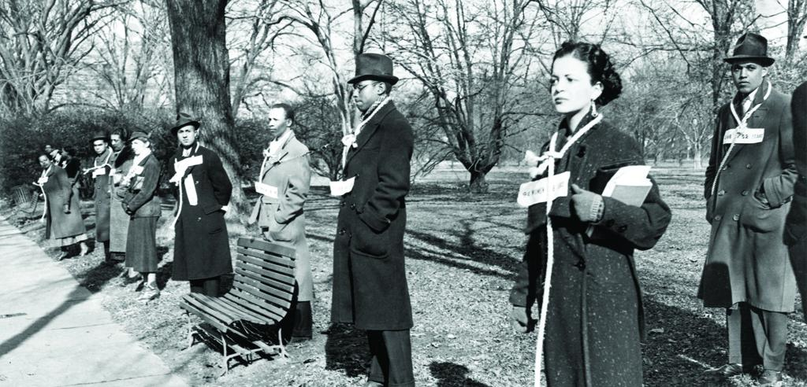
Acknowledge and fight racism

Slide 57
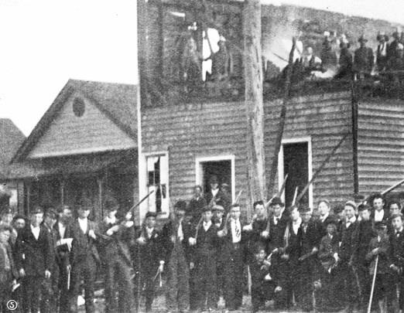
Acknowledge and fight racism

Slide 58
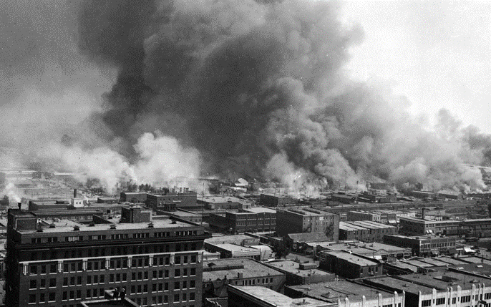
Acknowledge and fight racism

Slide 59
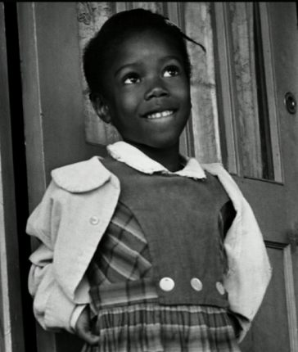
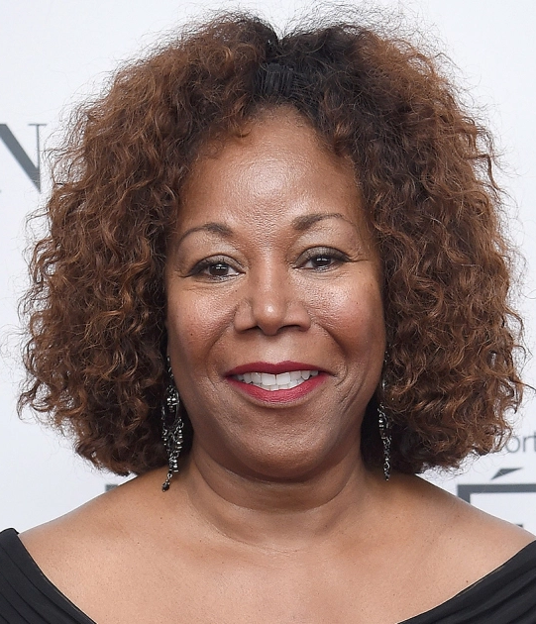
Acknowledge and fight racism

Slide 60
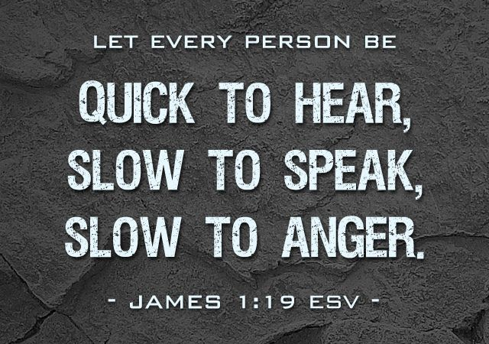
Be charitable

Slide 61

Don’t be that guy

Slide 62
Outline
The Origins of Contemporary Critical Theory
The Ideas of Contemporary Critical Theory
The Strengths of Contemporary Critical Theory
The Problems of Contemporary Critical Theory
  A False Worldview
  A False Identity
  A False Epistemology
  A False Salvation
Advice for Dialogue
Conclusions

Slide 63
Christianity and contemporary critical theory are competing worldviews
Shenvi and Sawyer, Critical Dilemma, p. 284

Slide 64


Redefining oppression
Oppression = Unjust, tyrannical treatment
Oppression = Hegemonic norms
Whiteness = oppression
Gender roles = oppression
Heterosexism = oppression
Cisgenderism = oppression
Adultism = oppression

Slide 65
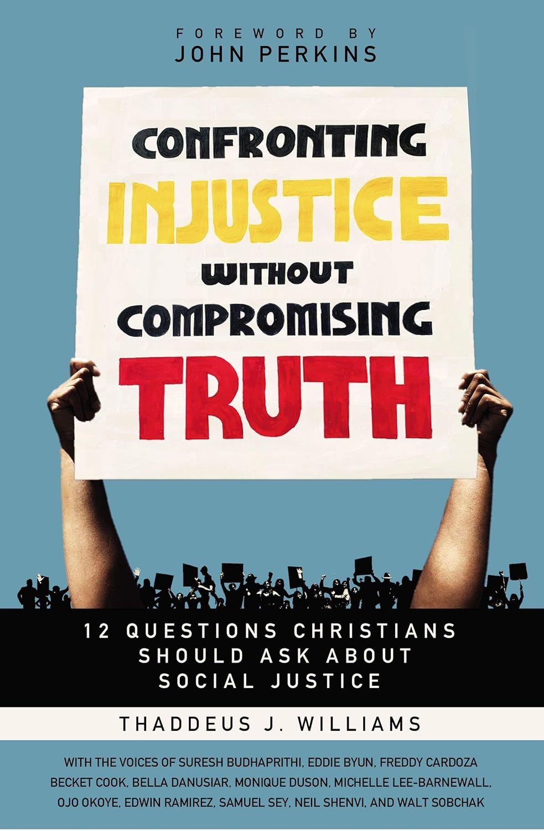
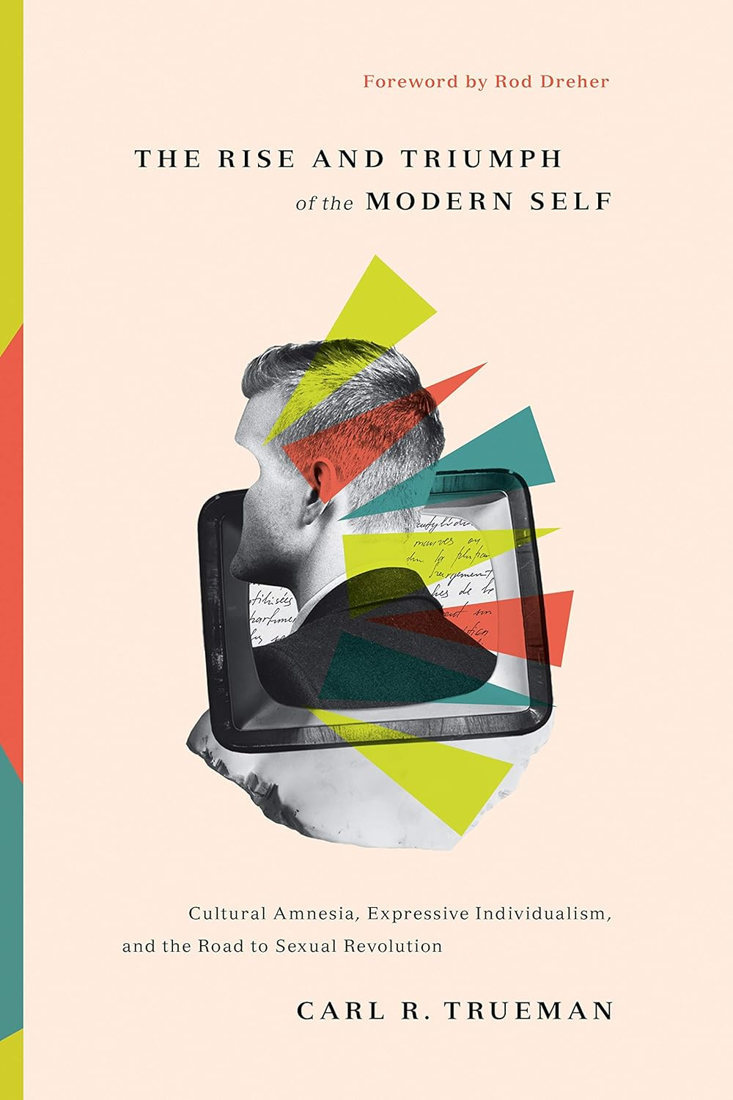
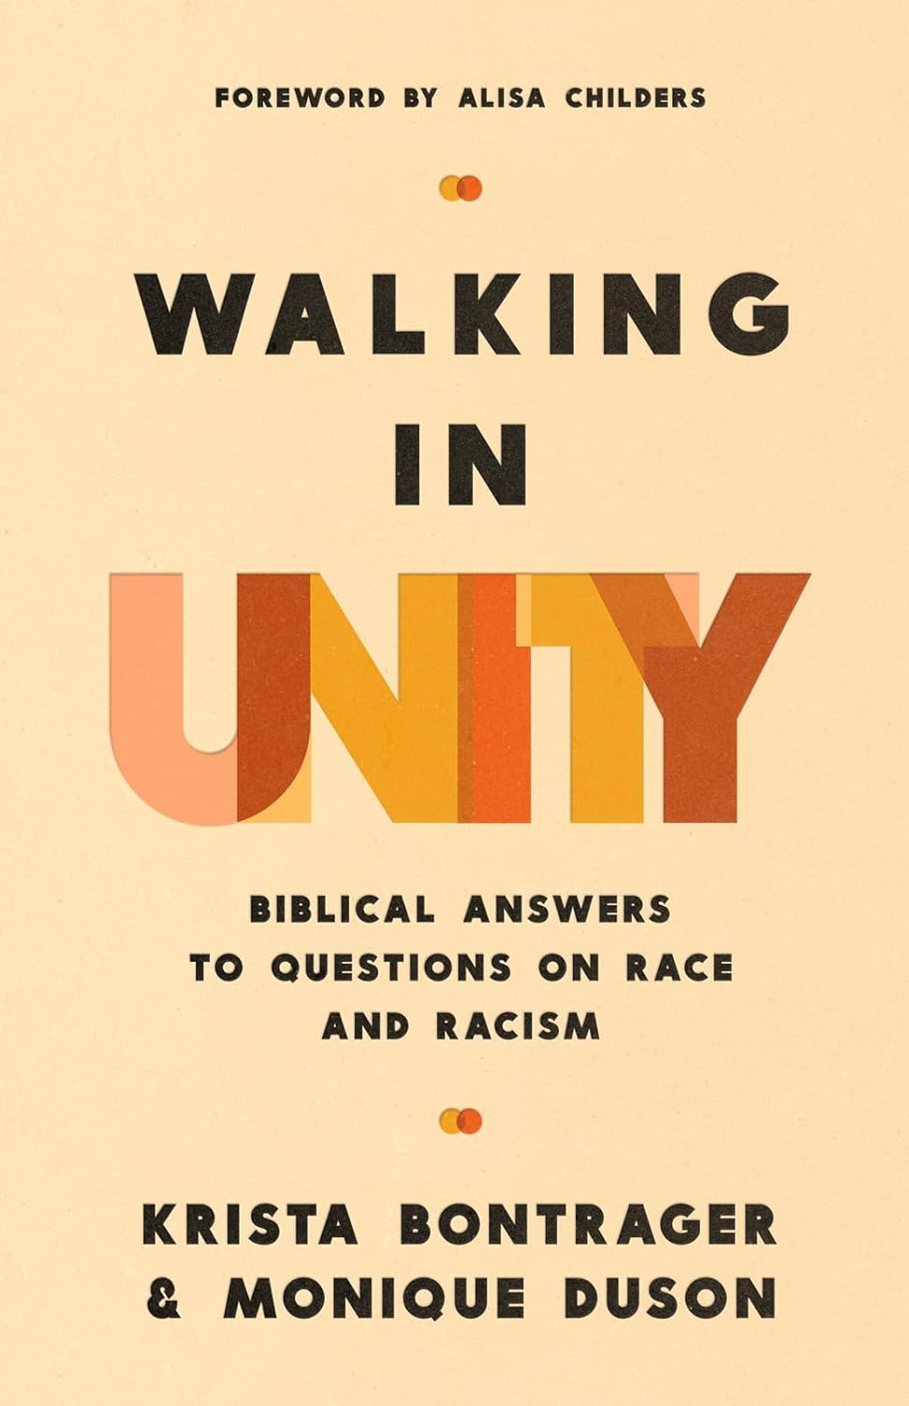
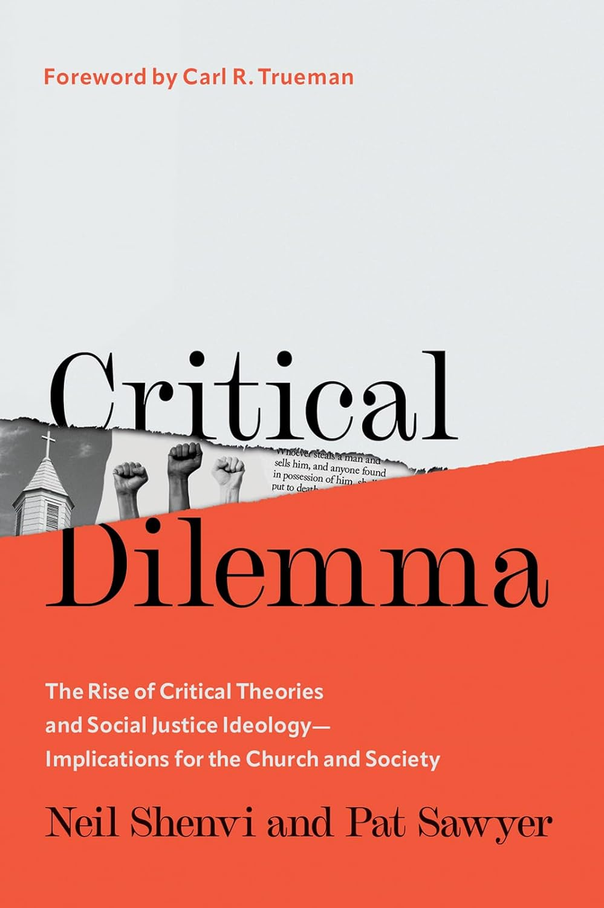
Additional resources
Thaddeus Williams, Confronting Injustice Without Compromising Truth
Carl Trueman, The Rise and Triumph of the Modern Self
Krista Bontrager and Monique Duson, Walking in Unity
Neil Shenvi and Pat Sawyer, Critical Dilemma

Slide 66

BUY MY BOOK
500+ pages
770+ footnotes
440+ Scripture references
200+ primary sources on critical theory
Thousands of words of quotes from primary sources
Free 23-page discussion guide

Slide 67

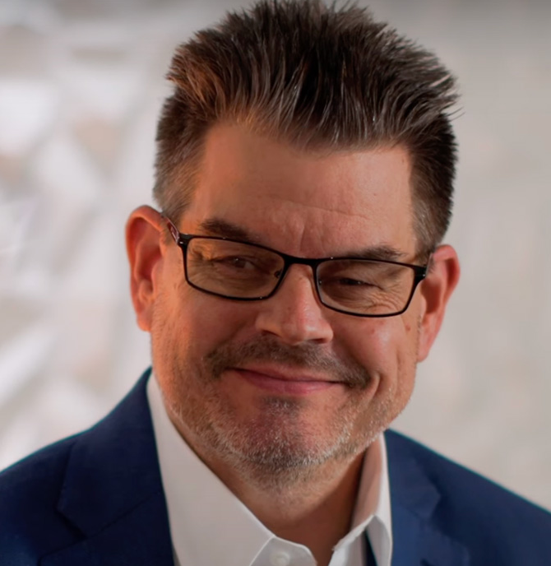
Acknowledgements
Dr. Christina Shenvi
Dr. Pat Sawyer
shenviapologetics.com/slides/
criticaldilemma.com/
Twitter @NeilShenvi

