Slide 1
How Critical Theory Robs Us of the Imago Dei
(and more)
Dare to Defend Conference
March 1-2, 2024
NEIL SHENVI

Slide 2

This talk is not about Trump

Slide 3

This talk is not about Trump

Slide 4




This talk is not about Trump

Slide 5
This talk is not about Trump
This talk is not about Trump
This talk is not about Trump
This talk is not about Trump
This talk is not about Trump
This talk is not about Trump

Slide 6




NYTimes word usage
“Racism”
“Privilege”
“Whiteness”
“Intersectionality”

Slide 7

Smithsonian NMAAHC
“Whiteness and white racialized identity refer to the way that white people, their customs, culture, and beliefs operate as the standard by which all other groups of are compared.”

Slide 8

Black Lives Matter
“We are self-reflexive and do the work required to dismantle cisgender privilege and uplift Black trans folk, especially Black trans women who continue to be disproportionately impacted by trans-antagonistic violence…
We foster a queer‐affirming network. When we gather, we do so with the intention of freeing ourselves from the tight grip of heteronormative thinking, or rather, the belief that all in the world are heterosexual (unless s/he or they disclose otherwise).”

Slide 9
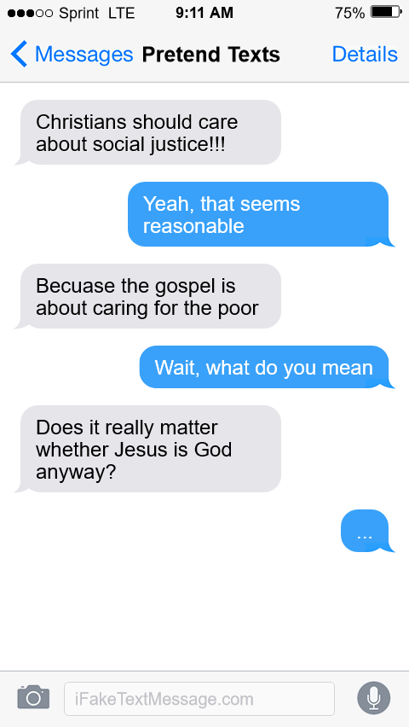
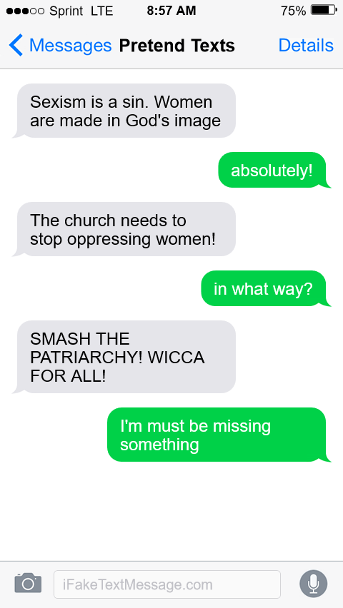
Why should we care?
Warning: fake texts. For pedagogical use only

Slide 10
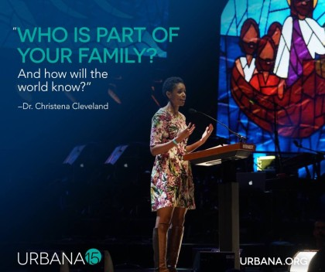
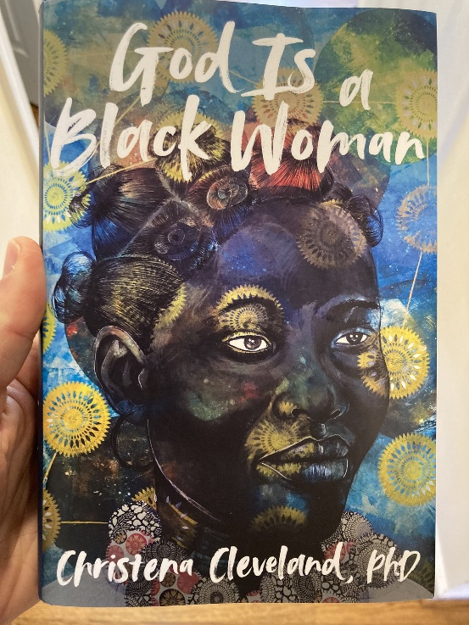
Why should we care?
2015
2022
“Paul, Peter, Luke, John, James, and the writer of Hebrews repeatedly and emphatically make the same point: the unified church is the vehicle through which the kingdom of God is powerfully communicated to the world” – Cleveland, Disunity in Christ, p. 37-38 (2013)
"More than anything, we must eradicate the transphobia within ourselves and our communities. For if God is a Black woman, then She's a Black trans woman. Obviously" - Cleveland, God is a Black Woman, p. 232 (2022)

Slide 11

Why should we care?

Slide 12
Outline
The Worldview of Contemporary Critical Theory
A Stolen Identity
A Warped Epistemology
A Counterfeit Salvation
Conclusions

Slide 13

Critical theory and Karl Marx
“Alone among these thinkers [i.e., Horkheimer, Bourdieu, Foucault, etc.], Karl Marx invites consensus as a ‘true’ critical theorist. Indeed, for many, he alone inaugurates the critical tradition” (Levinson et al, Beyond Critique, p. 25-26)
1850
1900
1950
2000

Slide 14




Critical theory and the Frankfurt School
“Critical theory was conceived within the crucible of Marxism” “The Frankfurt School not only contested establishmentarianism view of history, but projected a radical alternative. European radicals applied its ideas to reconfiguring the family, sexuality, and education.” – Bronner, Critical Theory: A Very Short Introduction, p. 2, 7
1850
1900
1950
2000

Slide 15
















Other critical social theorists
Cultural Studies
Postcolonialism
Critical pedagogy
Postmodernism
Bourdieu
Hall
Fanon
Said
Freire
Giroux
Foucault
Derrida
Feminism
Black feminism
Queer theory
Critical Race Theory
de Beauvoir
Friedan
hooks
Lourde
Butler
Rich
Bell
Crenshaw
1850
1900
1950
2000

Slide 16





The worldview of contemporary critical theory
Idea 1: Social binary
Idea 2: Oppression through ideology
Idea 3: Lived experience
Idea 4: Social justice

Slide 17

Premise #1: Society is divided into oppressed and oppressor groups
Sensoy and DiAngelo, Is Everyone Really Equal, p. 64

Slide 18

Premise #2: Oppression occurs through hegemonic power
Old white men
~15%

Slide 19


Premise #3: ‘Lived experience’ gives oppressed groups privileged access to truth
“The idea that objectivity is best reached only through rational thought is a specifically Western and masculine way of thinking – one that we will challenge throughout this book.” – Margaret L. Andersen and Patricia Hill Collins, “Reconstructing Knowledge,” in Anderson and Collins, Race, Class, and Gender, p. 4-5

Slide 20



Premise #3: ‘Lived experience’ gives oppressed groups privileged access to truth
Oppression and epistemology:
Privilege
Lived
experience
Internalized oppression
Liberatory consciousness

Slide 21

Premise #4: Social justice demands the liberation of oppressed groups
Definition of social justice:
“Prior to celebrating diversity, we must first eliminate intolerance. No matter what form it takes or who does it, we must all take action to stop intolerance when it happens. Working towards a celebration of diversity implies working for social justice – the elimination of all forms of social oppression… Social injustice takes many forms. It can be injustice based on a person’s gender, race, ethnicity, religion, sexual orientation, physical or mental ability, or economic class.” – Mary McClintock, “How to Interrupt Oppressive Behavior,” Readings for Diversity and Social Justice, p. 483

Slide 22
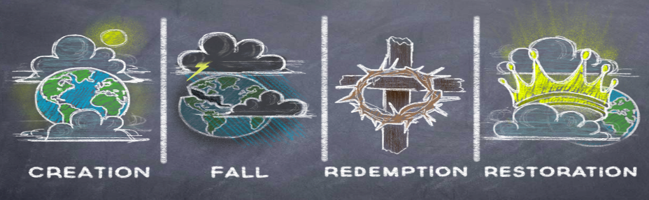
Competing metanarratives
Christianity
-----
OPPRESSION
ACTIVISM
LIBERATION
Patriarchy
White supremacy
Heteronormativity
Toxic masculinity
Classism
Ageism
Ableism
Cisgenderism
Protest
Resistance
Education
Awareness
Equity
Power reversal
Justice
Diversity
Contemporary critical theory

Slide 23
Outline
The Worldview of Contemporary Critical Theory
A Stolen Identity
A Warped Epistemology
A Counterfeit Salvation
Conclusions

Slide 24


Adversarial identities
White
Male
Rich
Heterosexual
Cisgender
Christian
Able-bodied
Non-white
Female
Poor
Homosexual
Transgender
Non-Christian
Disabled

Slide 25

Adversarial identities
“I began to understand why we [White women] are justly seen as oppressive, even when we don't see ourselves that way. I began to count the ways in which I enjoy unearned skin privilege and have been conditioned into oblivion about its existence.
My schooling gave me no training in seeing myself as an oppressor, as an unfairly advantaged person, or as a participant in a damaged culture. I was taught to see myself as an individual whose moral state depended on her individual moral will.”
– Peggy McIntosh, “White Privilege and Male Privilege,” in Race, Class, and Gender, 72

Slide 26

Adversarial identities
“if you are white in a white supremacist society, you are racist. If you are male in a patriarchy, you are sexist. If you are able-bodied, you are ableist. If you are anything above poverty in a capitalist society, you are classist. You can sometimes be all of these things at once.”
– Ijeoma Oluo, So You Want to Talk About Race?, 220-221

Slide 27
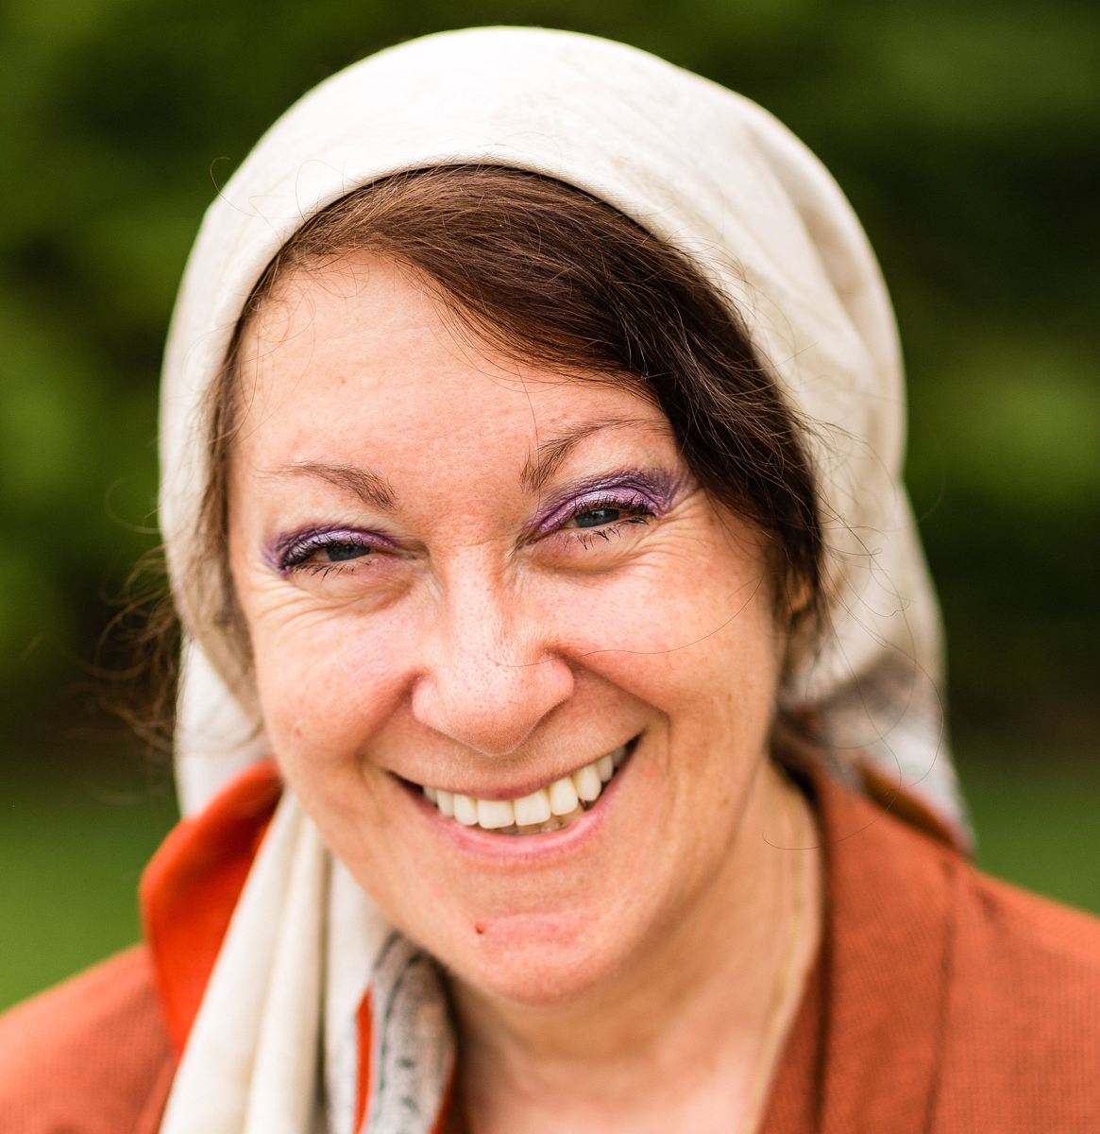
Adversarial identities
“white people, through the practices of whiteness and by benefiting from white privilege, contribute to the maintenance of systemic racial injustice”
“all whites, by virtue of systemic white privilege that is inseparable from white ways of being, are implicated in the production and reproduction of systemic racial injustice.”
“[Bartky writes] ’On my view, I am guilty by virtue of simply being who and what I am: a white woman, born into an aspiring middle-class family in a racist and class-ridden society.’”
– Barbara Applebaum, Being White, Being Good, 3, 179, 16.

Slide 28
Identity and solidarity
Creation
Sin
Redemption

Slide 29
Identity and solidarity
Then God said, “Let us make man in our image, after our likeness. And let them have dominion over the fish of the sea and over the birds of the heavens and over the livestock and over all the earth and over every creeping thing that creeps on the earth.”
So God created man in his own image,
in the image of God he created him;
male and female he created them.
- Genesis 1:26-27

Slide 30
Identity and solidarity
But now the righteousness of God has been manifested apart from the law, although the Law and the Prophets bear witness to it— the righteousness of God through faith in Jesus Christ for all who believe. For there is no distinction: for all have sinned and fall short of the glory of God, and are justified by his grace as a gift, through the redemption that is in Christ Jesus…
- Romans 3:21-24

Slide 31
Identity and solidarity
“And [God] made from one man every nation of mankind to live on all the face of the earth, having determined allotted periods and the boundaries of their dwelling place, that they should seek God, and perhaps feel their way toward him and find him. Yet he is actually not far from each one of us, for
“‘In him we live and move and have our being’;
as even some of your own poets have said,
“‘For we are indeed his offspring.’
Being then God's offspring, we ought not to think that the divine being is like gold or silver or stone, an image formed by the art and imagination of man. The times of ignorance God overlooked, but now he commands all people everywhere to repent…”
- Acts 17:26-30

Slide 32
Identity and solidarity
Therefore remember that at one time you Gentiles in the flesh, called “the uncircumcision” by what is called the circumcision, which is made in the flesh by hands— remember that you were at that time separated from Christ, alienated from the commonwealth of Israel and strangers to the covenants of promise, having no hope and without God in the world. But now in Christ Jesus you who once were far off have been brought near by the blood of Christ. For he himself is our peace, who has made us both one and has broken down in his flesh the dividing wall of hostility by abolishing the law of commandments expressed in ordinances, that he might create in himself one new man in place of the two, so making peace, and might reconcile us both to God in one body through the cross, thereby killing the hostility. - Eph. 2:11-16

Slide 33
Outline
The Worldview of Contemporary Critical Theory
A Stolen Identity
A Warped Epistemology
A Counterfeit Salvation
Conclusions

Slide 34
Contemporary critical theory and “lived experience”
Oppression and epistemology:
Privilege
Lived
experience
Internalized oppression
Liberatory consciousness

Slide 35
Deferring to lived experience
“It is about race if a person of color thinks it’s about race. This may sound at first like I’m asking you to just take every person of color’s word for it, as if they are infallible… But the truth is, whether or not someone is fallible is beside the point. We are, each and every one of us, a collection of our lived experiences… And our experiences are valid…And so, if a person of color says that something is about race, it is— because regardless of the details, regardless of whether or not you can connect the dots from the outside, their racial identity is a part of them, and it is interacting with the situation.”
–Oluo, So You Want to Talk About Race? 15

Slide 36
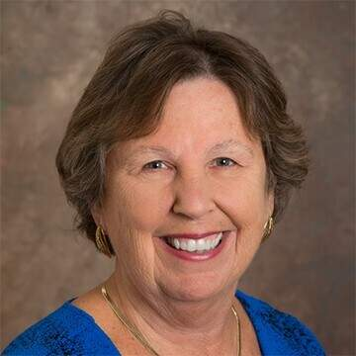
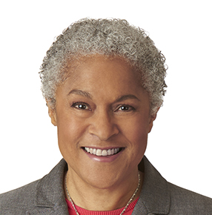
Deferring to lived experience
“exclusionary thinking has been increasingly challenged by scholars and teachers who want to include the diversity of human experience in the construction and transmission of knowledge… Inclusive thinking shifts our perspective from the white, male-centered forms of thinking that have characterized much of Western thought.”
“the idea that objectivity is best reached only through rational thought is a specifically Western and masculine way of thinking—one that we will challenge throughout this book.”
- Margaret Andersen and Patricia Hill Collins, Race, Class, and Gender, 2, 5.

Slide 37

Deferring to lived experience
“Privileged people who are truly committed to standing in solidarity with oppressed folks [must] commit to knowing, bearing and even being targeted by their anger…Now is not the time for privileged folks to be a ‘prophetic voice’ in the lives of oppressed people by speaking hard truth about what (privileged people think) oppressed people should be doing to improve their situation. Privileged people lost their right to the prophetic megaphone when they knowingly or unknowingly participated in societal systems that benefit some people and oppress others. Sorry folks - you can’t be a prophet and an oppressor at the same time.”
– Dr. Christena Cleveland, Listening Well as a Person of Privilege – Seek to Understand and Embrace Anger,” April 15, 2013.

Slide 38

Should we defer to lived experience?
“As a woman, I know that our society is deeply sexist.”
“As a Black man, I know that our society is deeply racist.”
“As a lesbian, I know that sexual orientation is fixed from birth.”
“As a Sufi Muslim, I know that Islam is true.”
“As a polyamorous man, I know that sex outside of marriage is okay.”
“As a Hindu, I know that all paths lead to God.”

Slide 39
Scripture on Lived Experience
“let every person be quick to hear, slow to speak, slow to anger.” – James 1:19
“when a prophet speaks in the name of the Lord, if the word does not come to pass or come true, that is a word that the Lord has not spoken; the prophet has spoken it presumptuously. You need not be afraid of him.” – Deut. 18:22
“The one who states his case first seems right, until the other comes and examines him.” – Prov. 18:17
“To the teaching and to the testimony! If they will not speak according to this word, it is because they have no dawn.” – Isa. 8:20
“He presented himself alive to them after his suffering by many proofs, appearing to them during forty days and speaking about the kingdom of God.” – Acts 1:3

Slide 40
Outline
The Worldview of Contemporary Critical Theory
A Stolen Identity
A Warped Epistemology
A Counterfeit Salvation
Conclusions

Slide 41
Conflicting Soteriology
 | Contemporary critical theory | Christianity
Sin | Privilege: whiteness, patriarchy, classism, heterosexism, ableism, cisgenderism | Rebellion: breaking God’s commandments
Salvation | Activism: confess your privilege, divest from privilege, do the work, center marginalized voices, stop taking up space | Redemption: repent and believe the gospel

Slide 42
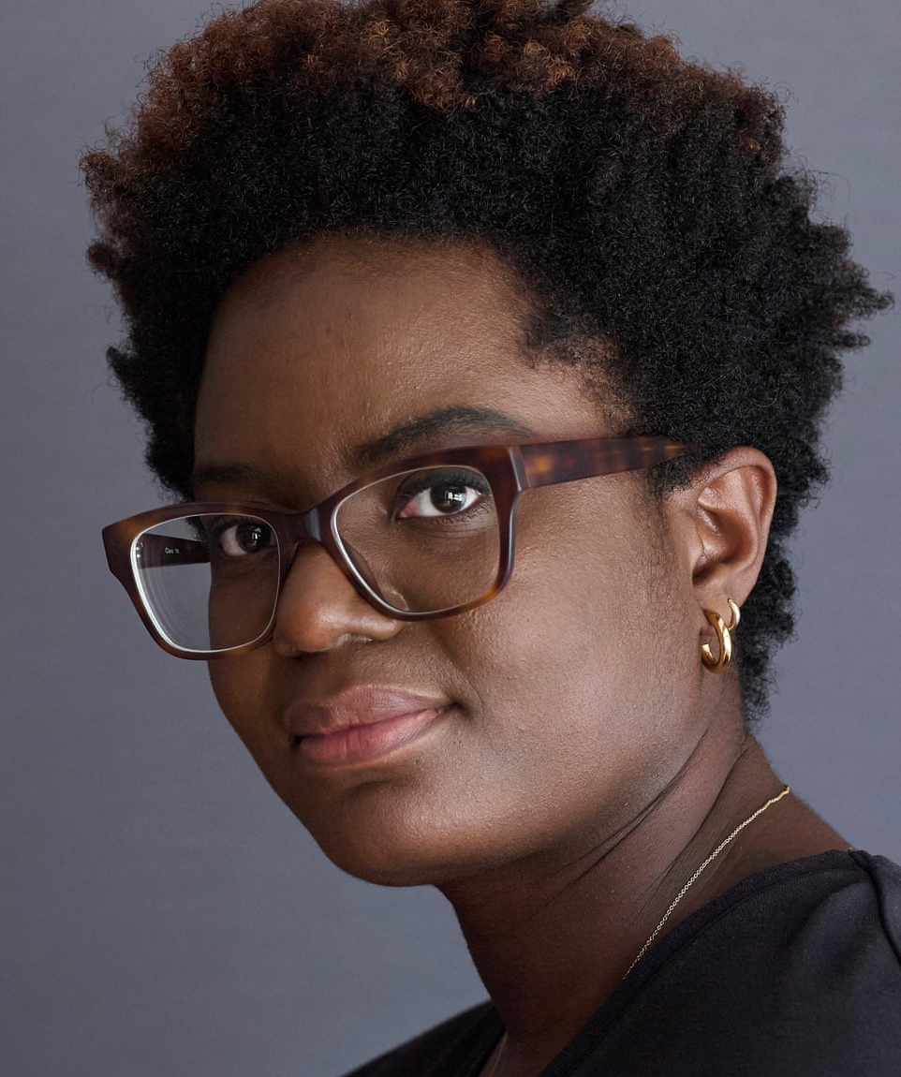
The Sin of Privilege
“Whiteness positions itself as the norm. It refuses to recognize itself for what it is. Its so-called ‘objectivity’ and ‘reason’ is its most potent and insidious tool for maintaining power”
“We need to see racism as structural in order to see its insidiousness. We need to see how it seeps, like a noxious gas, into everything”
– Eddo-Lodge, Why I Am No Longer Talking to White People About Race, 169, 222.

Slide 43

The Sin of Privilege
“Antiracist policies cannot eliminate class racism without anticapitalism policies. Anticapitalism cannot eliminate class racism without antiracism.”
“To truly be antiracist is to be feminist. To truly be feminist is to be antiracist.”
“We cannot be antiracist if we are homophobic or transphobic… To be queer antiracist is to understand the privileges of my cisgender, of my masculinity, of my heterosexuality, of their intersections.”
– Kendi, How to Be Antiracist, 159, 189, 197.

Slide 44

The Sin of Privilege
“it is not possible for your parents to have taught you not to be racist, or for your parents to have been free of racism themselves. This is not possible because racism is a social system embedded in our culture and its institutions.”
“From an antiracist perspective, the question is not, ‘Did racism take place’ but ‘How was racism taking place’ because the assumption is that racism is always at play, always operating.” (p. 330)”
– DiAngelo, What Does It Mean to Be White?, 265, 330.

Slide 45

Doing the Work of Salvation
“The first and most important task in shaping an anti-racist church is to give birth to an anti-racist Christian identity… Taking this birthing metaphor one step further to the biblical imagery of rebirth, this identity-transforming process can be understood in no less powerful terms than what Jesus described as being ‘born again’--a complete spiritual transformation.”– Joseph Barndt, Becoming an Antiracist Church, 153.

Slide 46
Doing the Work of Salvation
“a positive white identity is an impossible goal. White identity is inherently racist; white people do not exist outside the system of white supremacy. This does not mean that we should stop identifying as white and start claiming only to be Italian or Irish. To do so is to deny the reality of racism in the here and now, and this denial would simply be color-blind racism. Rather, I strive to be ‘less white.’ To be less white is to be less racially oppressive.”
– DiAngelo, White Fragility, 149-150.

Slide 47

Doing the Work of Salvation
“Antiracism work is not a twenty-eight-day journey. It is a lifelong practice. It requires your lifelong commitment to antioppression… There is no feel-good reward at the end other than the knowledge that you are doing this because it’s the right thing to do.” – Layla Saad, Me and White Supremacy, 25.

Slide 48
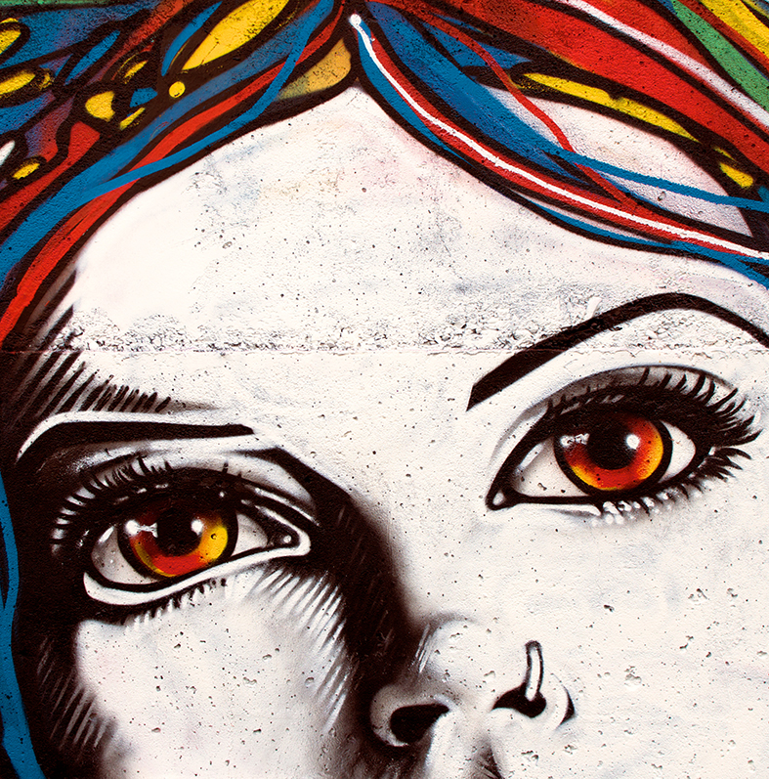
Doing the Work of Salvation
“When I became an anarchist I was 18, depressed, anxious, and ready to save the world…While my radical community was deconstructing gender, monogamy, and mental health, we lived and breathed concepts and tools like call-outs, intersectionality, cultural appropriation, trigger warnings, safe spaces, privilege theory, and rape culture.”
“Commentators have accurately noted how social justice seems to take the form of a religion… As a radical activist, much of my time was devoted to proselytizing. Non-anarchists were like pagans to be converted through zines and wheatpasted posters rather than by Bible and baptism. When non-radicals listened to my assertions that nazis deserved death, that all life had devolved into spectacle, and that monogamy was a capitalist social construct, they were probably bewildered instead of enticed.”
- Conor Barnes, “Sad Radicals,” Quillette.

Slide 49
Doing the Work of Salvation
“toxicity in radical communities is not a bug. It is a feature. The ideology and norms of radicalism have evolved to produce toxic, paranoid, depressed subjects.”
“Activists anxiously pore over interactions, looking for ways in which the mundane conceals domination. To see every interaction as containing hidden violence is to become a permanent victim, because if all you are is a nail, everything looks like a hammer”
“Flee the cult.”
- Conor Barnes, “Sad Radicals,” Quillette.

Slide 50

The Bible on Sin
"The LORD saw that the wickedness of man was great in the earth, and that every intention of the thoughts of his heart was only evil continually." - Gen. 6:5
"Against you, you only, have I sinned and done what is evil in your sight... Behold, I was brought forth in iniquity, and in sin did my mother conceive me."
- Psalm 51:4-5
"None is righteous, no, not one; no one understands; no one seeks for God. All have turned aside; together they have become worthless; no one does good, not even one." - Rom. 3:10-12

Slide 51

The Bible on Rescue
"God shows his love for us in that while we were still sinners, Christ died for us." - Rom. 5:8
"But God, being rich in mercy, because of the great love with which he loved us, even when we were dead in our trespasses, made us alive together with Christ—by grace you have been saved” - Eph. 2:4-5
"For the Son of Man came to seek and to save the lost.”- Luke 19:10

Slide 52

The Uniqueness of Christianity
“[W]hile it may seem to be an act of generosity to state that Confucians and Buddhists and Muslims and Jews can also be saved, this statement is actually an act of obfuscation…
[J]ust as hitting home runs is the monopoly of one sport, salvation is the monopoly of one religion. If you see sin as the human predicament and salvation as the solution, then it makes sense to come to Christ.” – Stephen Prothero, God is Not One, p. 22-23.

Slide 53
Outline
The Worldview of Contemporary Critical Theory
A Stolen Identity
A Warped Epistemology
A Counterfeit Salvation
Conclusions

Slide 54
Two masters
Christianity
-----
OPPRESSION
ACTIVISM
LIBERATION
Patriarchy
White supremacy
Heteronormativity
Toxic masculinity
Classism
Ageism
Ableism
Cisgenderism
Protest
Resistance
Education
Awareness
Equity
Power reversal
Justice
Diversity
Critical theory

Slide 55

BUY MY BOOK

Slide 56
BUY MY BOOK
500+ pages
770+ footnotes
440+ Scripture references
200+ primary sources on critical theory
Thousands of words of quotes from primary sources
Free 23-page discussion guide
Endorsements from Carl Trueman, (foreword), JD Greear, Ligon Duncan, Alisa Childers, Peter Boghossian, and more

Slide 57
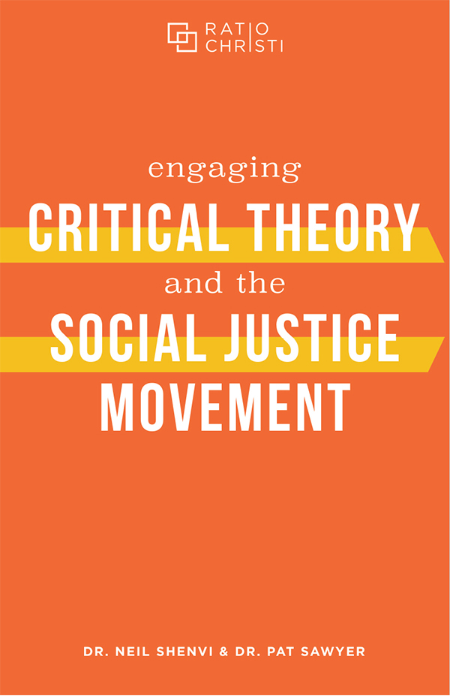


Engaging Critical Theory and the Social Justice Movement by Shenvi and Sawyer

Slide 58
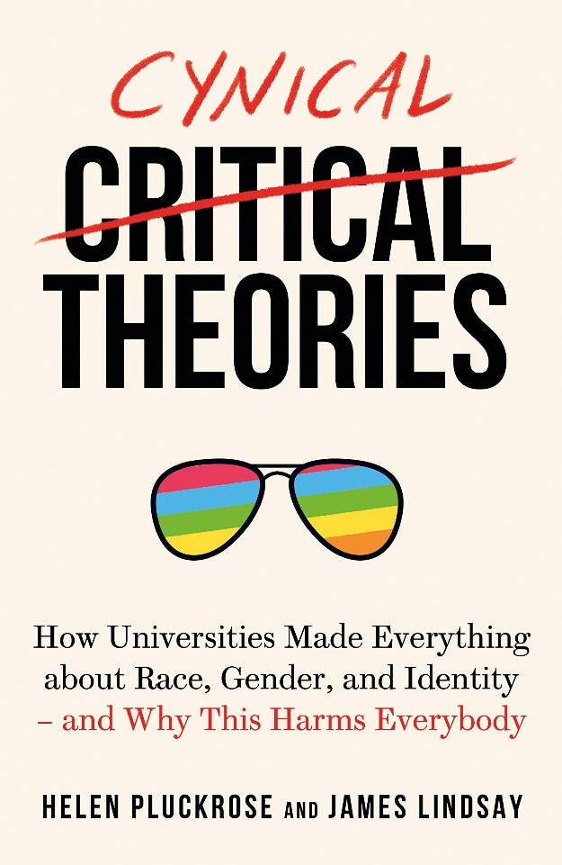


Doing the reading: Secondary sources
Pluckrose and Lindsay, Cynical Theories

Slide 59
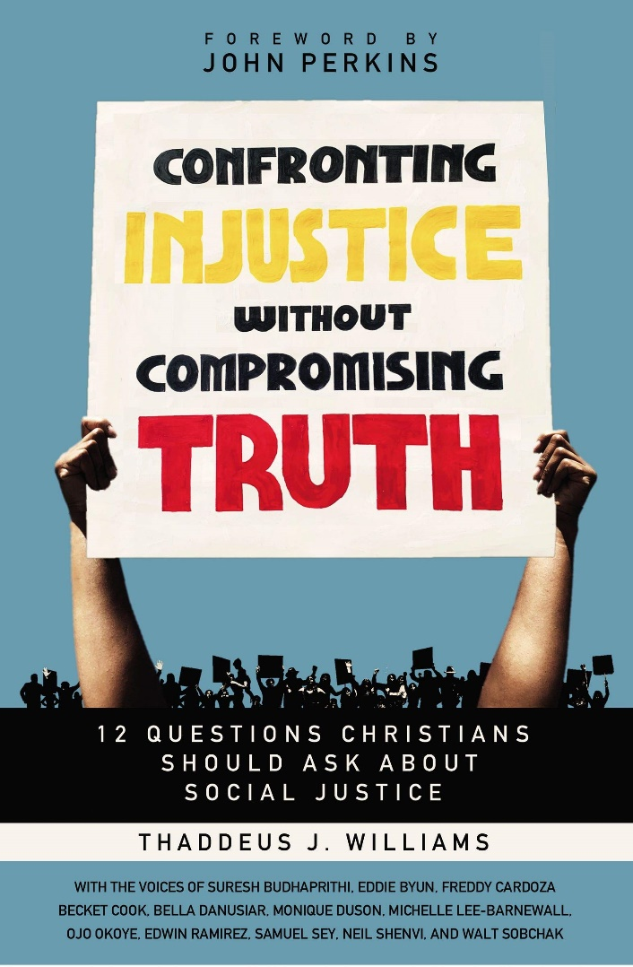
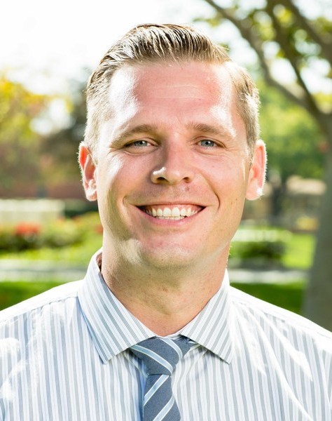
Doing the reading: Christian sources
Baucham, Fault Lines

Slide 60
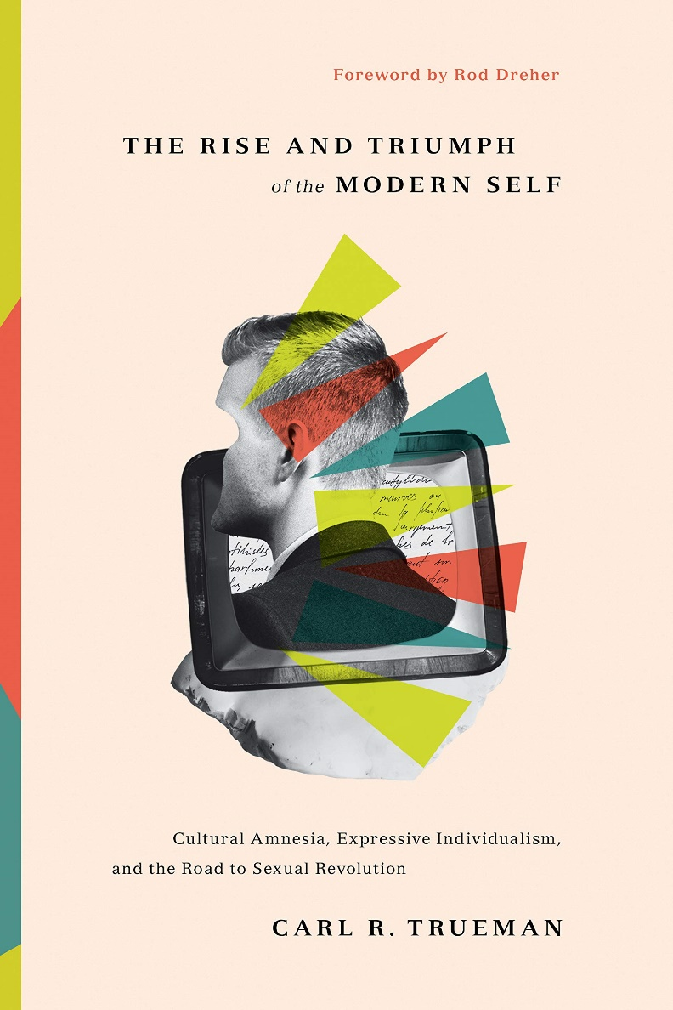

The Rise and Triumph of the Modern Self by Carl Trueman

Slide 61

Acknowledgements
Dr. Christina Shenvi
Dr. Pat Sawyer
criticaldilemma.com/
shenviapologetics.com/slides/
Twitter @NeilShenvi

