Slide 1

Queer Theory: A deep dive
Dr. Neil Shenvi
American Christian Tours
Jan. 12-13, 2023

Slide 2
A Biblical Response to Gender Ideology
Why does it matter?
Understanding Queer Theory
Engaging Gender Ideology
Practical Questions
Acknowledgements

Slide 3
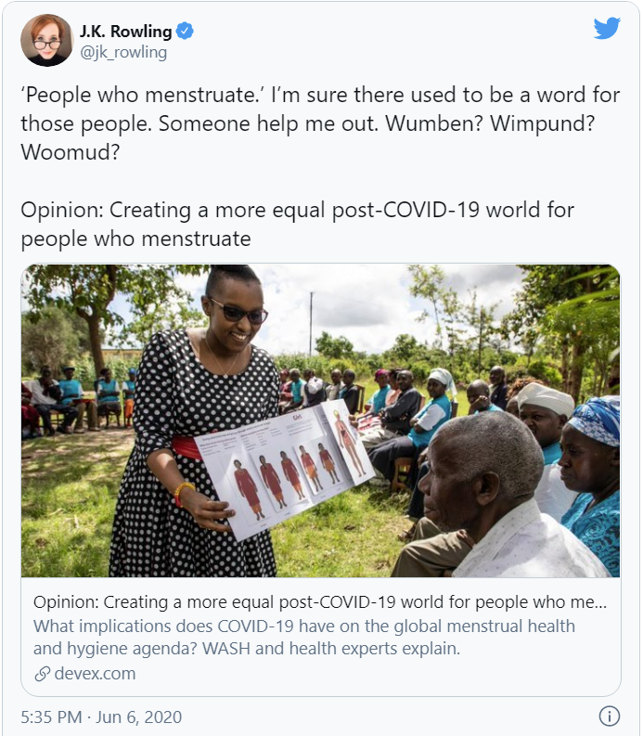
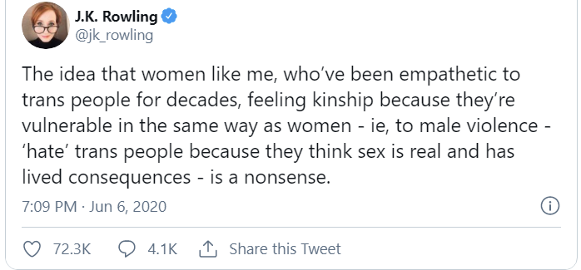
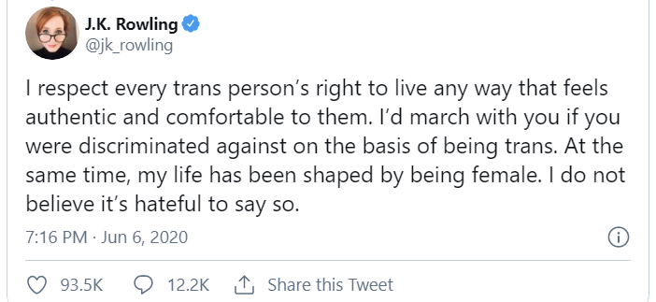
J.K. Rowling

Slide 4
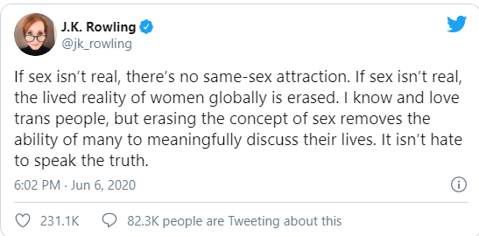
J.K. Rowling
“Transgender women are women.” – Daniel Radcliffe (Harry)
“Trans people are who they say they are” – Emma Watson (Hermione)
“Trans women are women. Trans men are men,” – Rupert Grint (Ron)
“Transwomen are women.” – Bonnie Wright (Ginny)
“Trans women are women, trans men are men” – Eddie Redmayne (Newt)
Abby Gardner, A Complete Breakdown of the J.K. Rowling Transgender-Comments Controversy, Glamour, July 6, 2020

Slide 5
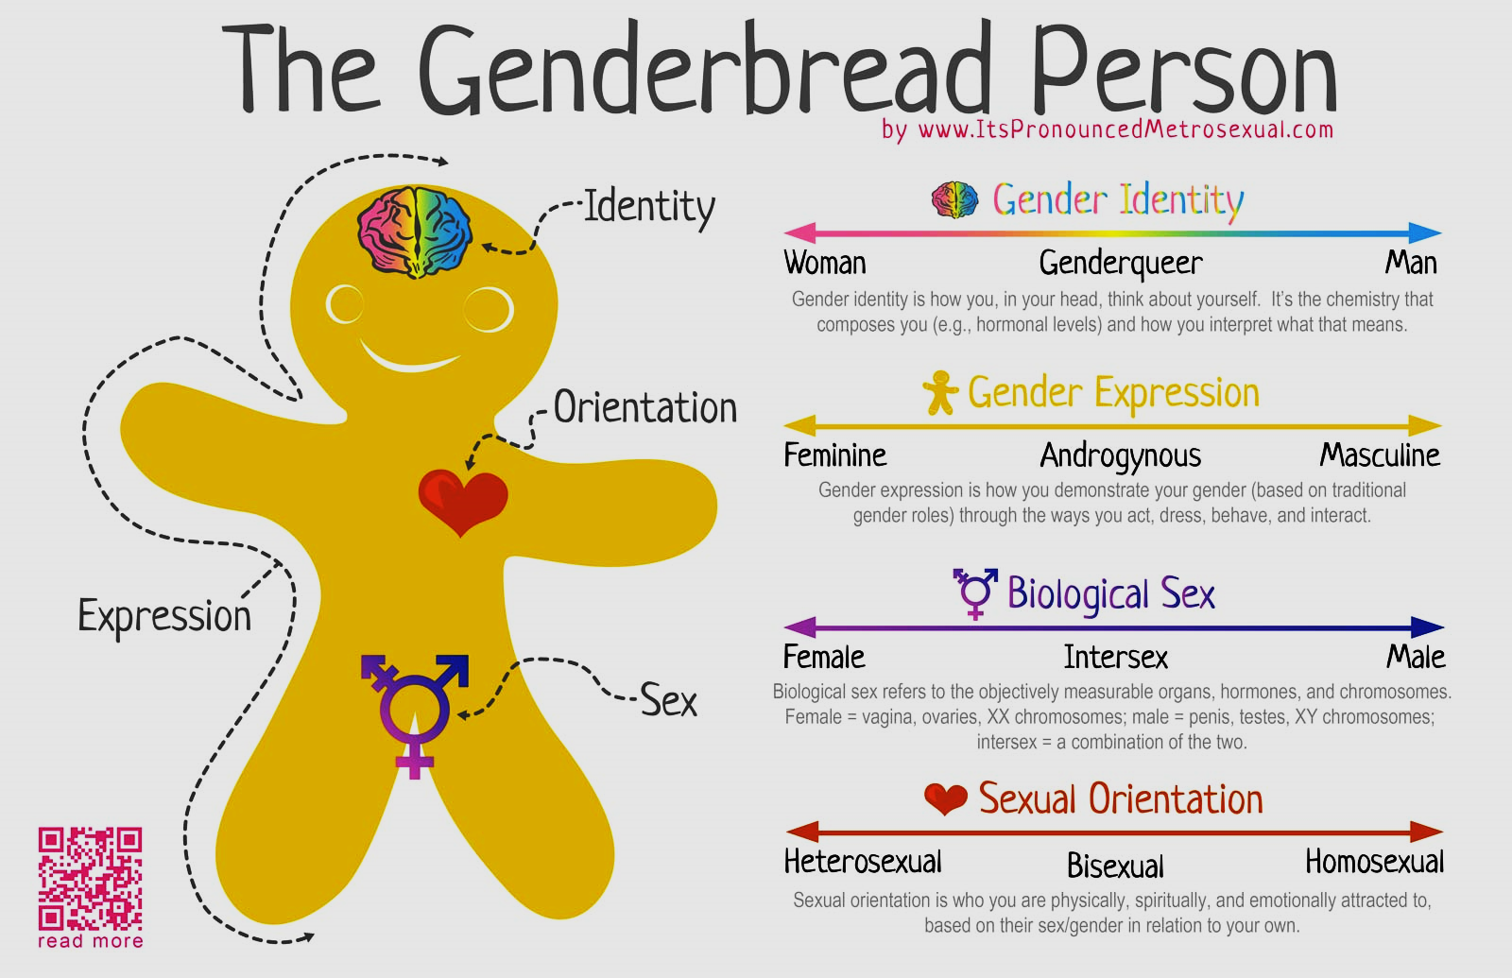

Slide 6
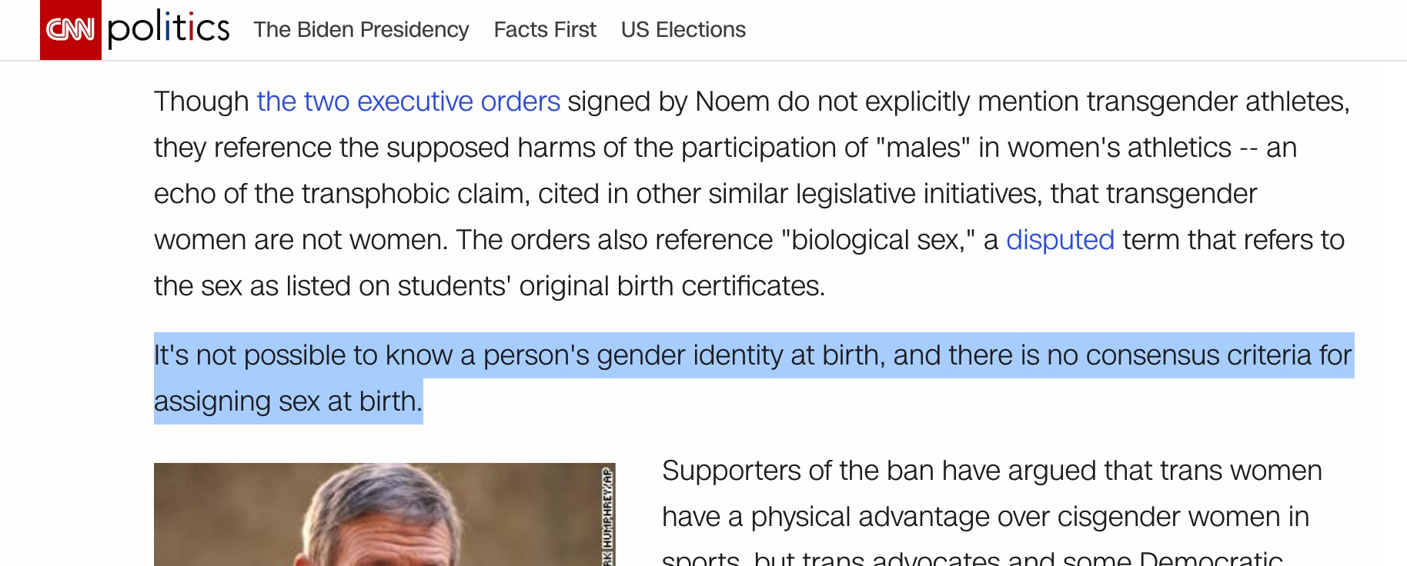
CNN on Sex and Gender Identity

Slide 7

Black Lives Matter
“We are self-reflexive and do the work required to dismantle cisgender privilege and uplift Black trans folk, especially Black trans women who continue to be disproportionately impacted by trans-antagonistic violence…
We foster a queer‐affirming network. When we gather, we do so with the intention of freeing ourselves from the tight grip of heteronormative thinking, or rather, the belief that all in the world are heterosexual (unless s/he or they disclose otherwise).”

Slide 8

Blue’s Clues Pride Month Cartoon
“Families marching one-by-one
Hurrah, hurrah
Families marching one-by-one
Hurrah, hurrah
This family has two mommies
They love each other so proudly
And they all go marching in the Big Parade…
These babas are non-binary
They love each other so proudly…
Ace, bi and pan grown-ups you see can love each other so proudly
And they all go marching in the Big Parade"

Slide 9
A Biblical Response to Gender Ideology
Why does it matter?
Understanding Queer Theory
  Sex vs. gender
  Gender and sexual norms as oppressive social constructs
  Intersectional oppression
  Deconstruction of all norms
Engaging Gender Ideology
Practical Questions
Acknowledgements

Slide 10
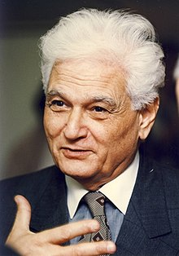

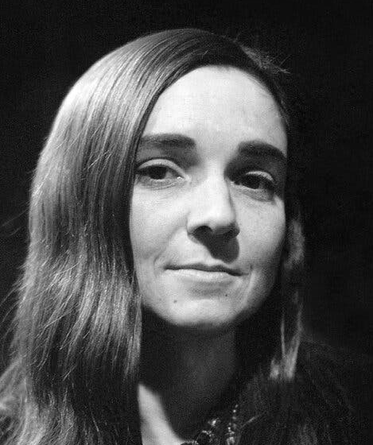
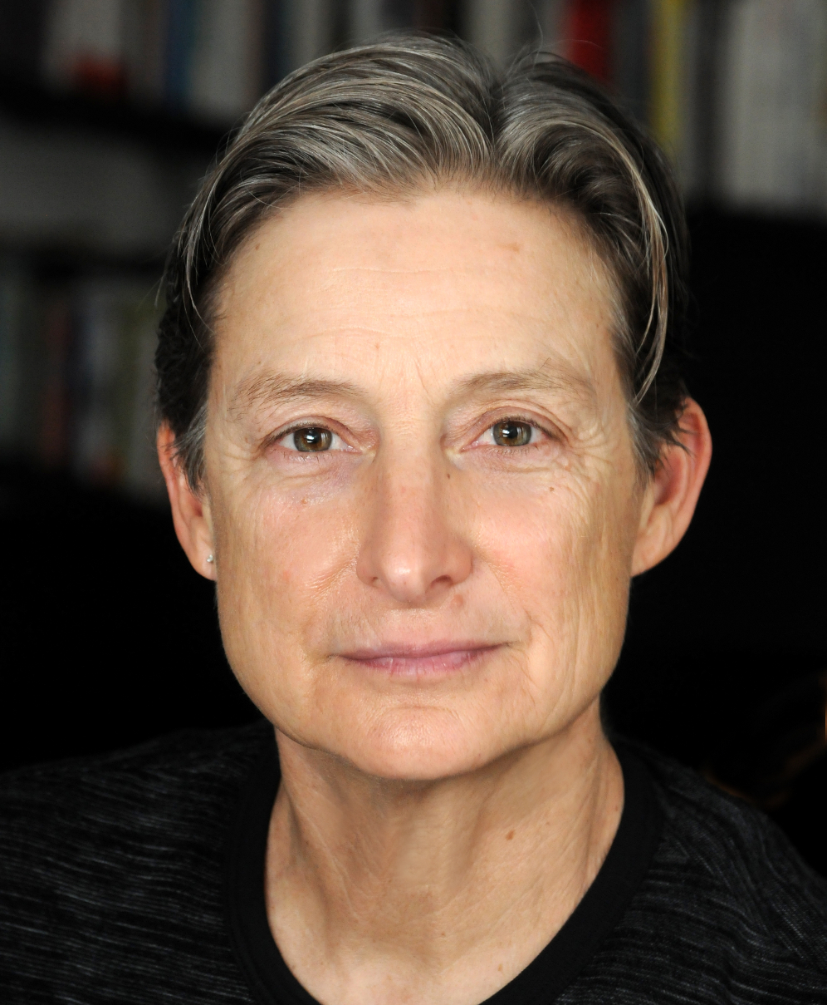
The Origins of Queer Theory
Jacques Derrida
Michel Foucault
Adrienne Rich
Judith Butler
1970
1980
1990

Slide 11
A Biblical Response to Gender Ideology
Why does it matter?
Understanding Queer Theory
  Sex vs. gender
  Gender and sexual norms as oppressive social constructs
  Intersectional oppression
  Deconstruction of all norms
Engaging Gender Ideology
Practical Questions
Acknowledgements

Slide 12
Sex vs. Gender

Slide 13
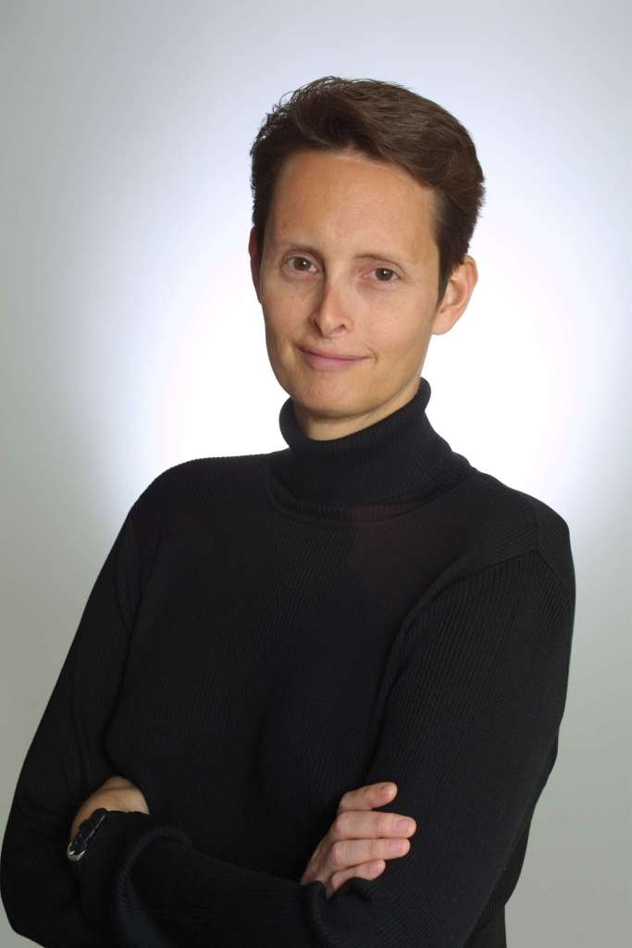
Sex vs. Gender
“Gender is a language, a system of meanings and symbols, along with the rules, privileges, and punishments pertaining to their use—for power and sexuality (masculinity and femininity, strength and vulnerability, action and passivity, dominance and weakness)” – Wilchins, Queer Theory, Gender Theory, p. 40-41

Slide 14
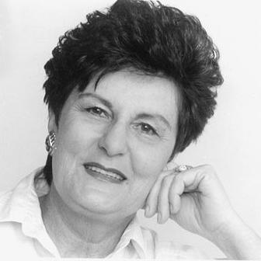
Sex vs. Gender
“Western society’s values legitimate gendering by claiming that it all comes from physiology – female and male procreative differences. But gender and sex are not equivalent, and gender as a social construction does not flow automatically from genitalia and reproductive organs, the main physiological differences of females and males” - Judith Lorber, “Night to His Day,” in Readings for Diversity and Social Justice, p. 205

Slide 15


Sex vs. Gender
“gender, like race, is a socially constructed experience, not a biological imperative…Sex refers to one’s biological identity as male or female; gender refers to the systematic structuring of relationships between women and men in social institutions. Gender is a learned identity, but, as with race, it cannot be understood at the individual level alone.” - Anderson and Collins, Race, Class, and Gender, p. 51

Slide 16


Analogy to “Jock” and “Nerd”
“Jock”
“Nerd”
Social Category:
Biological Category:
> 6-feet tall
< 6-feet tall

Slide 17
A Biblical Response to Gender Ideology
Why does it matter?
Understanding Queer Theory
  Sex vs. gender
  Gender and sexual norms as oppressive social constructs
  Intersectional oppression
  Deconstruction of all norms
Engaging Gender Ideology
Practical Questions
Acknowledgements

Slide 18
Gender and Sexual Norms as Oppressive Social Constructs
“Western thought tends to cast any difference into opposing halves that between them exhaust all meaning… But with gender, it’s exactly this space in between – familiar binaries like masculine/feminine, man/woman, top/bottom, butch/femme, and real/artificial – that we want to explore, reclaim, uphold… In the end, binaries are not just a curious way we have of understanding the world. They are political. They are about power. They create hierarchies – male/female, white/black, colonial/native – that produce winners and losers” - Wilchins, Queer Theory, Gender Theory p. 46-47

Slide 19

Gender and Sexual Norms as Oppressive Social Constructs
“gay liberation understood that the marginalization and devaluation of homosexuality was effected by that dominant and rigidly hierarchical conceptualization of sex and gender which constituted the social norm. In order to liberate homosexuality, gay liberation was committed to eradicating fixed notions of femininity and masculinity: that move would similarly liberate any other groups oppressed by what it critiqued as normative sex and gender roles.” - Jagose, Queer Theory, p. 41

Slide 20
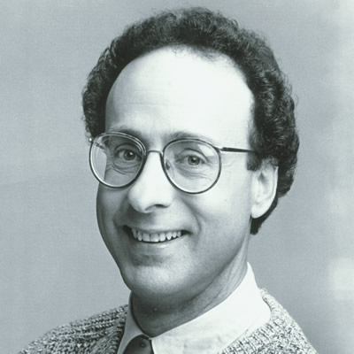
Gender and Sexual Norms as Oppressive Social Constructs
“Heterosexism, which has its roots in sexism, is the institutionalization of a heterosexual norm or standard, which establishes and perpetuates the notion that all people are or should be heterosexual thereby privileging heterosexuals and heterosexuality, and excluding the needs, concerns, cultures, and life experiences of LGBTQ people.” – Blumenfeld, Readings for Diversity and Social Justice, p. 262

Slide 21
Analogy to “Jock” and “Nerd”
“Jock” > 6-feet
“Nerd” < 6-feet
Strong
Athletic
Attractive
Assertive
Permitted to participate in student government
Awarded college scholarships
Weak
Unathletic
Unattractive
Submissive
Not permitted to participate in student government
Not awarded college
scholarships
Norms

Slide 22
A Biblical Response to Gender Ideology
Why does it matter?
Understanding Queer Theory
  Sex vs. gender
  Gender and sexual norms as oppressive social constructs
  Intersectional oppression
  Deconstruction of all norms
Engaging Gender Ideology
Practical Questions
Acknowledgements

Slide 23
Intersectional Oppression
“Gay liberation also has a perspective for revolution based on the unity of all oppressed people–that is, there can be no freedom for gays in a society which enslaves others through male supremacy, racism and economic exploitation (capitalism).” – Allen Young cited in Jagose, Queer Theory, p. 34

Slide 24
Intersectional Oppression
“[race is] inseparable from other dimensions like age, sex, class, sexual orientation, and gender… Proponents of Critical Race Theorist [sic] (CRT) are reimagining race, racial identity, and its intersection with homosexuality and even queerness.”
“Motivating their work is the assertion that racialist -and even racist- behavior is not simply a cultural aberration, but an important cultural norm.”– Wilchins, Queer Theory, Gender Theory, p. 110, 116

Slide 25
Intersectional Oppression
“The ideology of sexism supports the system of gender relations, just as the ideology of racism supports the system of race relations. Like racism, sexism is a system of beliefs and behaviors by which a group is oppressed, controlled, and exploited because of presumed gender differences…. Homophobia – the fear of homosexuality- is part of the system of social control that legitimates and enforces gender oppression. It supports the system of compulsory heterosexuality” Andersen, p. 51-52- Anderson and Collins, Race, Class, and Gender, p. 51-52

Slide 26



Intersectional Oppression
Sensoy and DiAngelo, Is Everyone Really Equal, p. 64

Slide 27
A Biblical Response to Gender Ideology
Why does it matter?
Understanding Queer Theory
  Sex vs. gender
  Gender and sexual norms as oppressive social constructs
  Intersectional oppression
  Deconstruction of all norms
Engaging Gender Ideology
Practical Questions
Acknowledgements

Slide 28
Deconstruction of all norms
“what if Sex is already a gendered way of looking at bodies? What if Sex is already gender, so that the distinction between the two is no distinction at all? What ifs Sex—the original Given, transcendent and universal—could be deconstructed?”
“Like the body itself, the facts of sexual reproduction have resonance only if we imbue them within a meaningful narrative, a context. In this case it’s the cultural narrative of power and gender, as we understand it in a sexist, hetero-centric culture.”– Wilchins, Queer Theory, Gender Theory, p. 77, 83-84

Slide 29
Deconstruction of all norms
“Variously referred to as intergenerational sex, child abuse, man-boy love and paedophilia, even the semantic continuum of terms used to describe the concept evokes a variety of positions in a debate structured overwhelmingly by such issues as consent, power and the legal definition of childhood… the issue of intergenerational sex continues to be debated vigorously in many gay and lesbian communities. The protection of children is deemed by some to be ethically crucial to the development of gay identity, but is dismissed by others as “‘erotic hysteria”’ (Rubin, 1993:6). What is the status of different, and arbitrary, age-of-consent laws? Do children have a sexuality and a right to sexual agency? Why is age—unlike, say, race or class—–understood as a sexualized power-differential protected by law? Is it possible to eroticise children in an ethical way? These are the questions commonly raised—–and by no means yet resolved—–in the controversy over intergenerational sex.” – Jagose, Queer Theory, p. 70-71

Slide 30
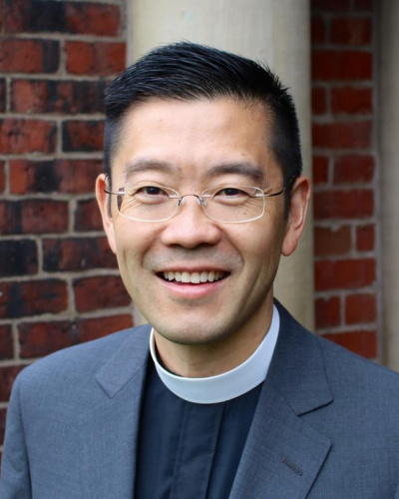
Deconstruction of all norms
“the Trinity needs to be understood as an orgy, which breaks down the privileging of binary or pair-bonded relationships…each person of the Trinity has her/her [sic] own closet of lovers and ‘forbidden desires’ (for example, Jesus’ relationships with Mary Magdalene and Lazarus), which in turn results in the death of the ‘illusion of limited relationships.’” – Althaus-Reid summarized in Patrick Cheng, Radical Love, p. 58-59

Slide 31
A Biblical Response to Gender Ideology
Why does it matter?
Understanding Queer Theory
  Sex vs. gender
  Gender and sexual norms as oppressive social constructs
  Intersectional oppression
  Deconstruction of all norms
Engaging Gender Ideology
Practical Questions
Acknowledgements

Slide 32
Gender is a God-ordained category
“So God created man in His own image; in the image of God He created him; male and female He created them.” – Gen. 1:27
[Jesus said:] “But from the beginning of creation, ‘God made them male and female.’ ‘Therefore a man shall leave his father and mother and hold fast to his wife, and the two shall become one flesh.’ So they are no longer two but one flesh. What therefore God has joined together, let not man separate.” – Mark 10:5-9

Slide 33
Gender is good
“And God saw everything that he had made, and behold, it was very good. And there was evening and there was morning, the sixth day.” – Gen. 1:31
“And I saw the holy city, new Jerusalem, coming down out of heaven from God, prepared as a bride adorned for her husband.” – Rev. 21:2

Slide 34
Some, but not all, norms are social constructs
Blue is for boys; pink is for girls
Husbands should lead their families
Men shouldn’t wear skirts
Children should obey their parents
Physical aggression is a masculine trait
Boys like trucks; girls like dolls
Only men should be pastors
Hunting is a masculine activity; cooking is a feminine activity

Slide 35
Some, but not all, norms are oppressive
Women shouldn’t be educated
People shouldn’t walk around naked in public
Men shouldn’t express emotion
Widows should commit sati
Children shouldn’t be left unsupervised
A wife should take her husband’s last name
Men shouldn’t have long hair

Slide 36
Love does not require affirmation
“You shall not hate your brother in your heart, but you shall reason frankly with your neighbor, lest you incur sin because of him.” – Lev. 19:17
“Love takes no pleasure in evil, but rejoices in the truth” – 1 Cor. 13:6
“Those whom I love, I reprove and discipline, so be zealous and repent.” – Rev. 3:18-19

Slide 37
A Biblical Response to Gender Ideology
Why does it matter?
Understanding Queer Theory
Engaging Gender Ideology
Practical Questions
  What causes gender dysphoria?
  Do the brains of transgender people resemble the brains of their experiences sex?
  How do I navigate gender ideology in the workplace?
  Should we refer to people by their preferred pronouns or chosen names?
  What is intersex? Is it different than transgender?
Acknowledgements

Slide 38
What causes gender dysphoria?
(NO ONE KNOWS)

Slide 39
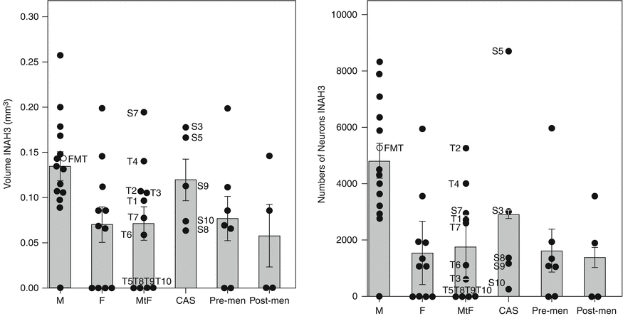
Do the brains of transgender people resemble the brains of their experienced gender?
Swaab D., Bao AM. In: Neuroscience in the 21st Century, Springer, New York, NY. (2013)

Slide 40
How do I navigate gender ideology in the workplace?
Good relationships
Proactive
Provide input
Do your homework
Freedom of conscience
Compelled speech

Slide 41
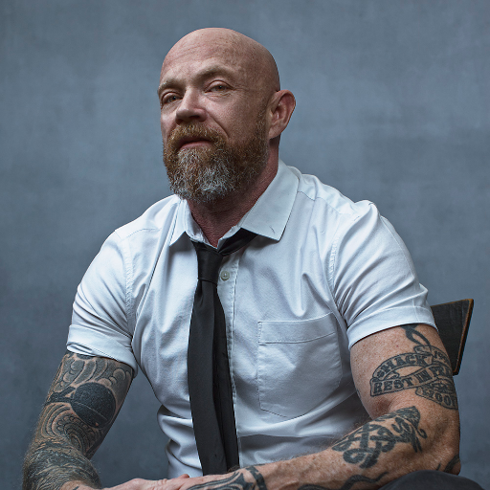
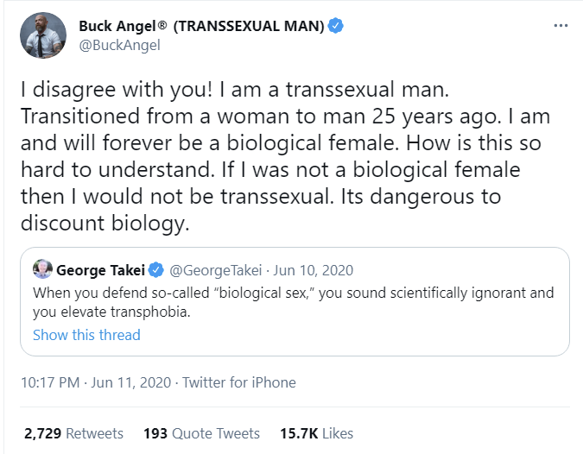
Should we refer to people by their preferred pronouns or chosen names?

Slide 42
Should we refer to people by their preferred pronouns or chosen names?
Primary motivation should be to honor God
Secondary motivation should be to love your neighbor
Last names are gender-neutral
Proper names are chosen; biological sex is not
Singular “they” has been in use since 14th century

Slide 43
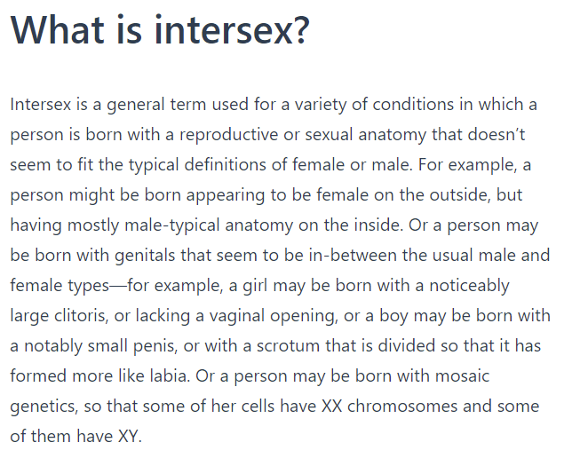
What is intersex? How is it different than transgender?
Intersex Society of North America, https://isna.org/faq/what_is_intersex/

Slide 44
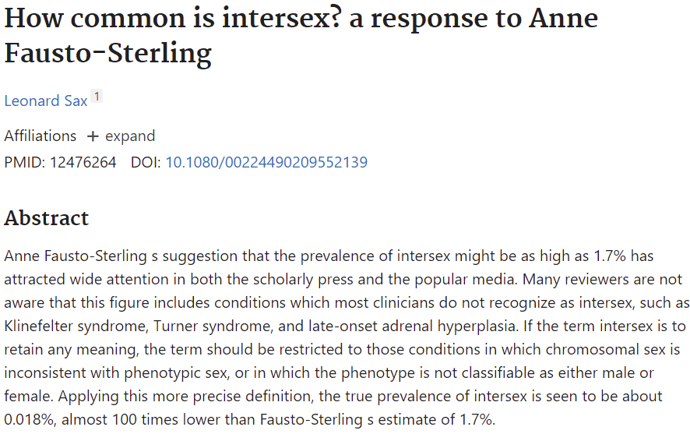
What is intersex? How is it different than transgender?
Sax L. How common is intersex? a response to Anne Fausto-Sterling. J Sex Res. 2002 Aug;39(3):174-8.

Slide 45
A Biblical Response to Gender Ideology
Why does it matter?
Understanding Queer Theory
Engaging Gender Ideology
Practical questions
Acknowledgements

Slide 46
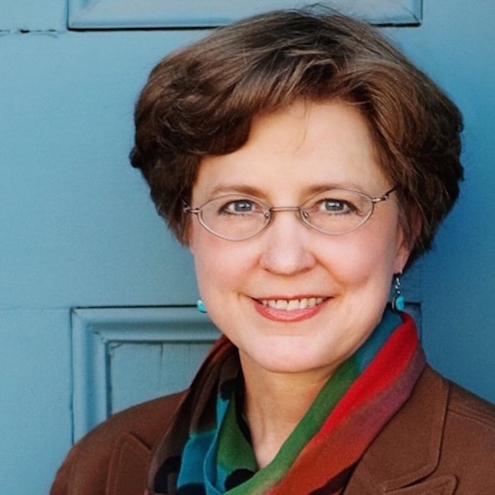

Pearcey’s Love Thy Body

Slide 47
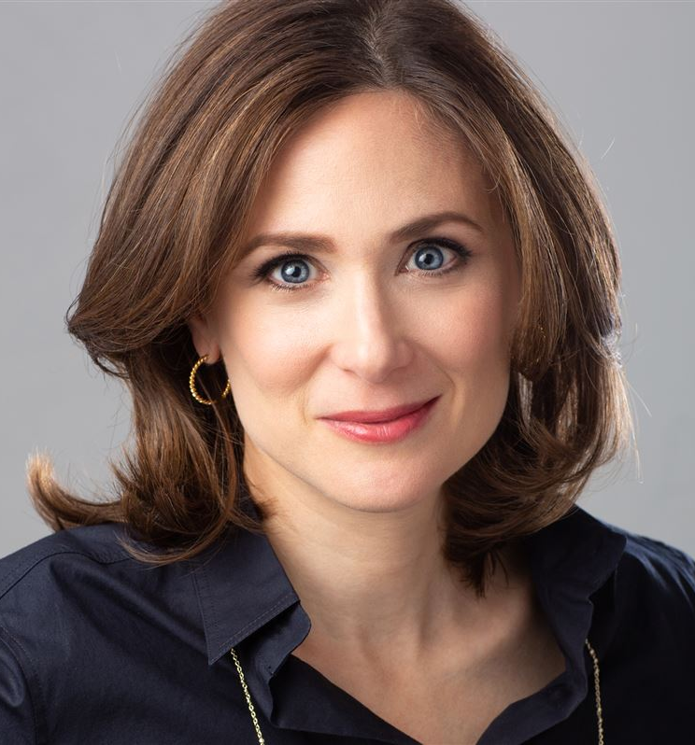
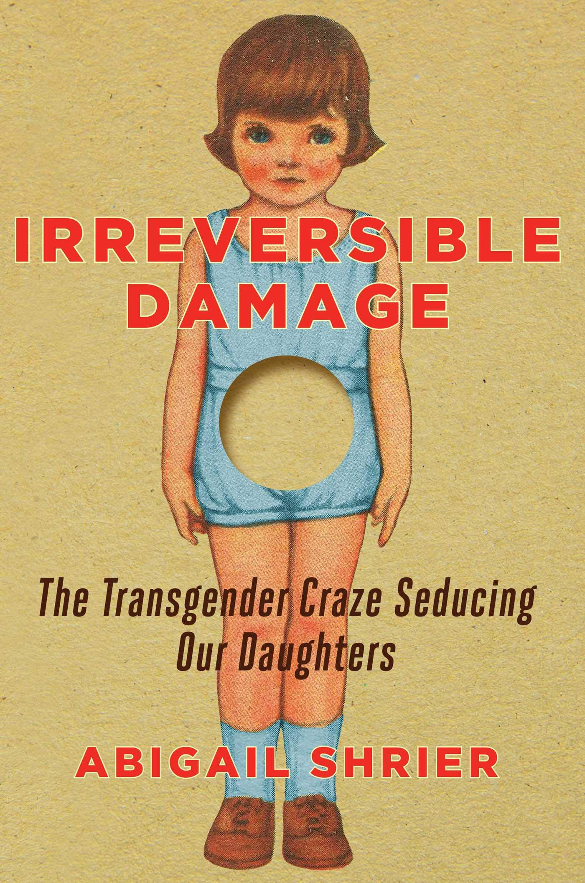
Shrier’s Irreversible Damage

Slide 48

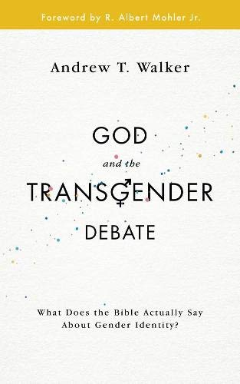
Walker’s God and The Transgender Debate

Slide 49
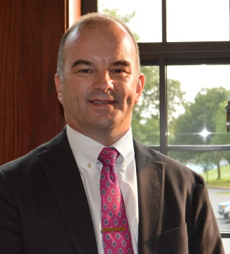
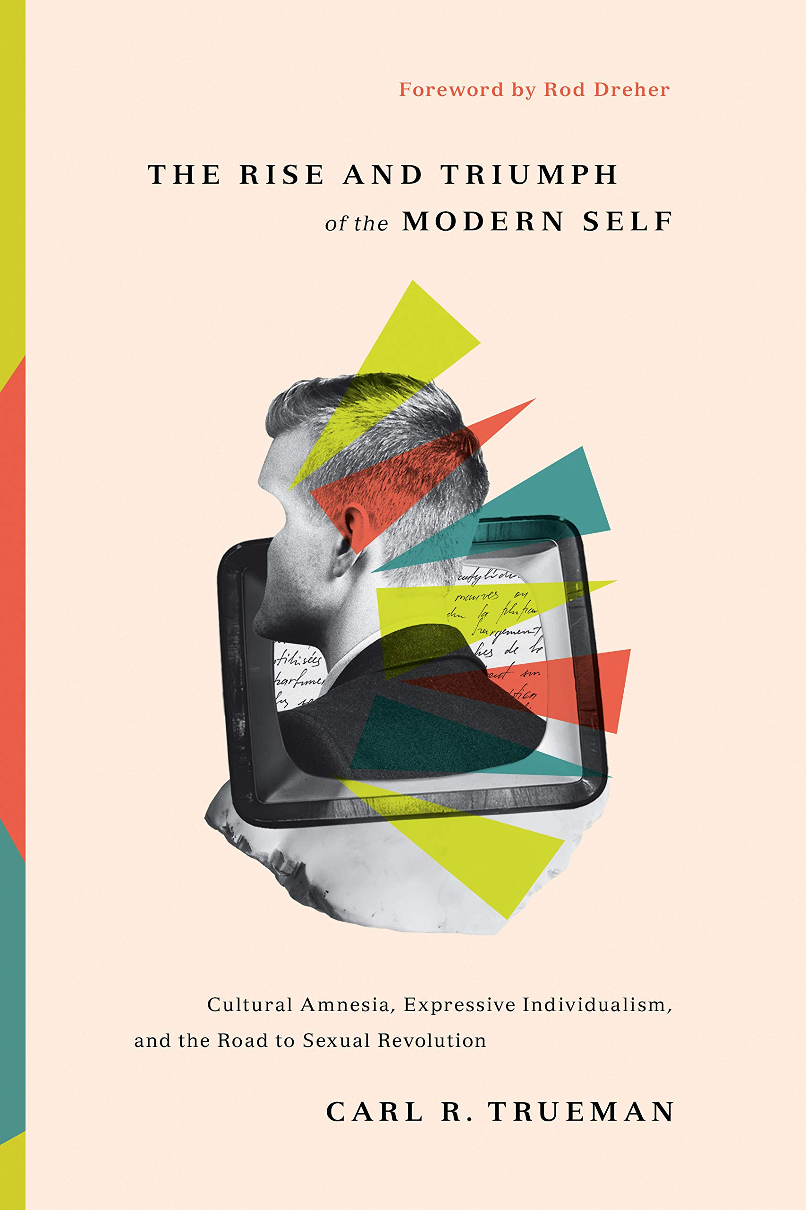
Trueman’s Rise and Triumph of the Modern Self

Slide 50

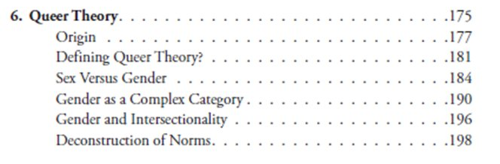
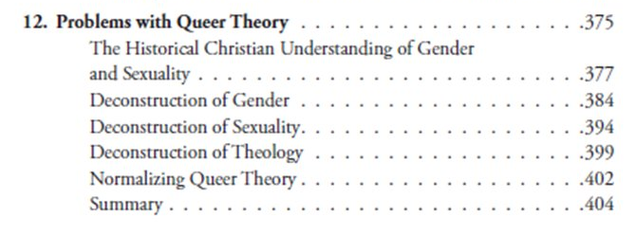
Critical Dilemma
https://criticaldilemma.com/

Slide 51


Acknowledgements
Dr. Christina Shenvi
Dr. Pat Sawyer
“Affirming Ourselves to Death,”
https://shenviapologetics.com/affirming-ourselves-to-death-a-review-of-shriers-irreversible-damage/
“Book review: Cynical Theories,” Themelios
“Gender, Intersectionality, and Critical Theory,” Eikon
Twitter @NeilShenvi, @RealPatSawyer

