Slide 1

Dr. Neil Shenvi
May 11, 2023
Trinity Christian School

Slide 2

This talk is not about Trump

Slide 3
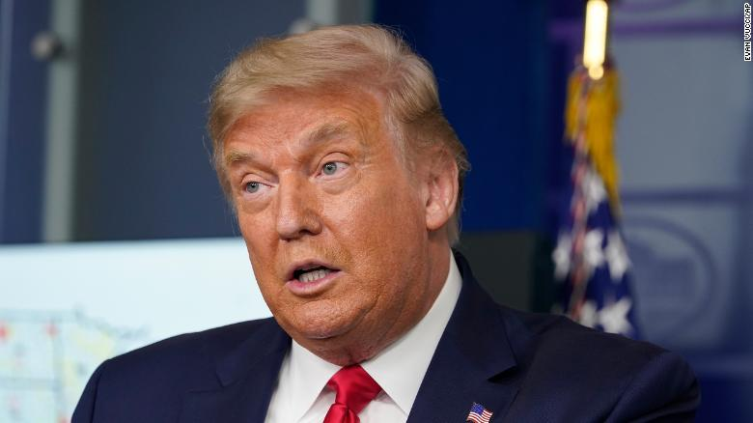
This talk is not about Trump

Slide 4




This talk is not about Trump

Slide 5
This talk is not about Trump
This talk is not about Trump
This talk is not about Trump
This talk is not about Trump
This talk is not about Trump
This talk is not about Trump

Slide 6




New York Times word usage
“Racism”
“Privilege”
“Whiteness”
“Intersectionality”

Slide 7

Smithsonian NMAAHC
“Whiteness and white racialized identity refer to the way that white people, their customs, culture, and beliefs operate as the standard by which all other groups of are compared.”

Slide 8

Black Lives Matter
“We are self-reflexive and do the work required to dismantle cisgender privilege and uplift Black trans folk, especially Black trans women who continue to be disproportionately impacted by trans-antagonistic violence…
We foster a queer‐affirming network. When we gather, we do so with the intention of freeing ourselves from the tight grip of heteronormative thinking, or rather, the belief that all in the world are heterosexual (unless s/he or they disclose otherwise).”

Slide 9
Outline
Why should we care?
What is critical theory?
What are the problems with critical theory?
What can we do?

Slide 10
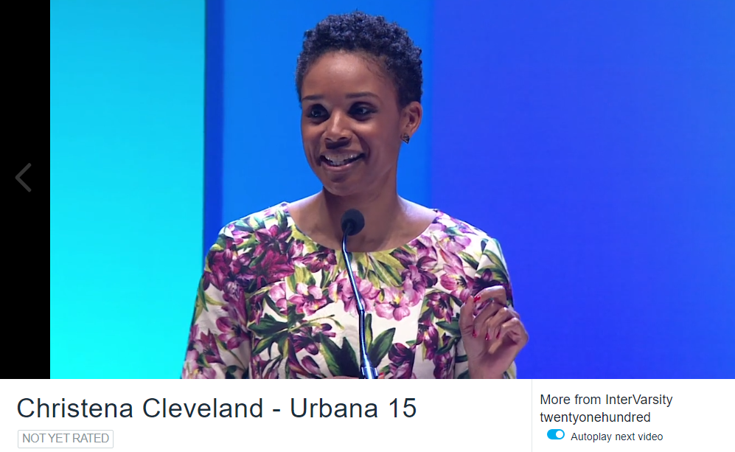

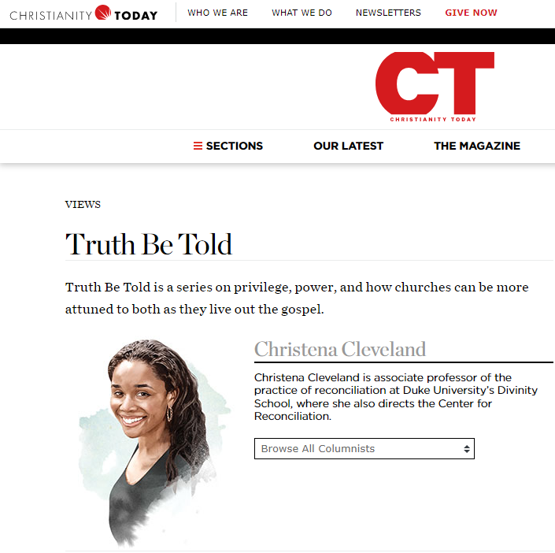

Why should we care?

Slide 11
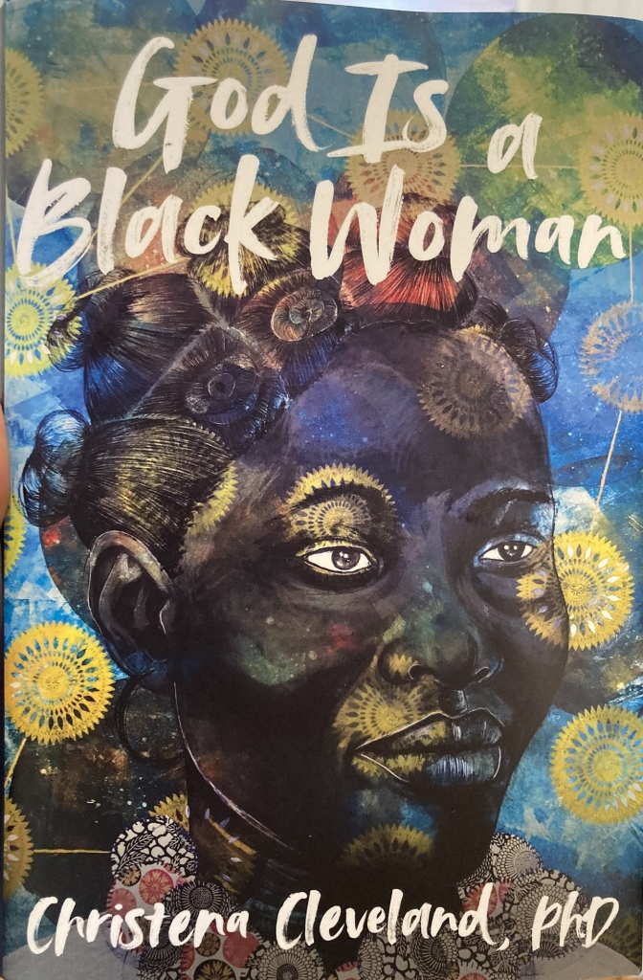
Why should we care?
“I increasingly recognized that [Intervarsity Christian Fellowship] was homophobic, anti-Black, money driven, and imperialistic” (p. 179)
“The liberation of all Black women requires the dismantling of all systems of oppression–white supremacy, patriarchy, capitalism, Islamophobia, homophobia, transphobia, and more” (p. 223)
“more than anything, we must eradicate the transphobia within ourselves and our communities. For if God is a Black woman, then She’s a Black trans woman. Obviously.” (p. 232)

Slide 12

Why should we care?

Slide 13
Outline
Why should we care?
What is critical theory?
What are the problems with critical theory?
What can we do?

Slide 14










The Taxonomy of Critical Theory
“critical theory” = critical social theories
“Critical Theory”
= Frankfurt School
Critical theory resists essentialism (it is hard to define!)

Slide 15





The central premises of contemporary critical theory
Premise I: Social binary
Premise II: Oppression through ideology
Premise III: Lived experience
Premise IV: Social justice

Slide 16
Outline
Why should we care?
What is critical theory?
  Premise 1: Social binary
  Premise 2: Oppression through ideology
  Premise 3: Lived experience
  Premise 4: Social justice
  The strengths of critical theory
What are the problems with critical theory?
What can we do?

Slide 17

Premise #1: Society is divided into oppressed and oppressor groups
Sensoy and DiAngelo, Is Everyone Really Equal, p. 64

Slide 18
Outline
Why should we care?
What is critical theory?
  Premise 1: Social binary
  Premise 2: Oppression through ideology
  Premise 3: Lived experience
  Premise 4: Social justice
  The strengths of critical theory
What are the problems with critical theory?
What can we do?

Slide 19


Idea #2: Oppression occurs through hegemonic power
“Hegemony refers to the control of the ideology of society. The dominant group maintains power by imposing their ideology on everyone.”
“From a critical social justice perspective, privilege is defined as systemically conferred dominance and the institutional processes by which the beliefs and values of the dominant group are ‘made normal’ and universal.” – Sensoy and DiAngelo, Is Everyone Really Equal? p. 73, 80

Slide 20

Premise #2: Oppression occurs through hegemonic power
Old white men
~15%

Slide 21
Outline
Why should we care?
What is critical theory?
  Premise 1: Social binary
  Premise 2: Oppression through ideology
  Premise 3: Lived experience
  Premise 4: Social justice
  The strengths of critical theory
What are the problems with critical theory?
What can we do?

Slide 22


Premise #3: ‘Lived experience’ gives oppressed groups privileged access to truth
“The idea that objectivity is best reached only through rational thought is a specifically Western and masculine way of thinking – one that we will challenge throughout this book.” – Margaret L. Andersen and Patricia Hill Collins, “Reconstructing Knowledge,” in Anderson and Collins, Race, Class, and Gender, p. 4-5

Slide 23


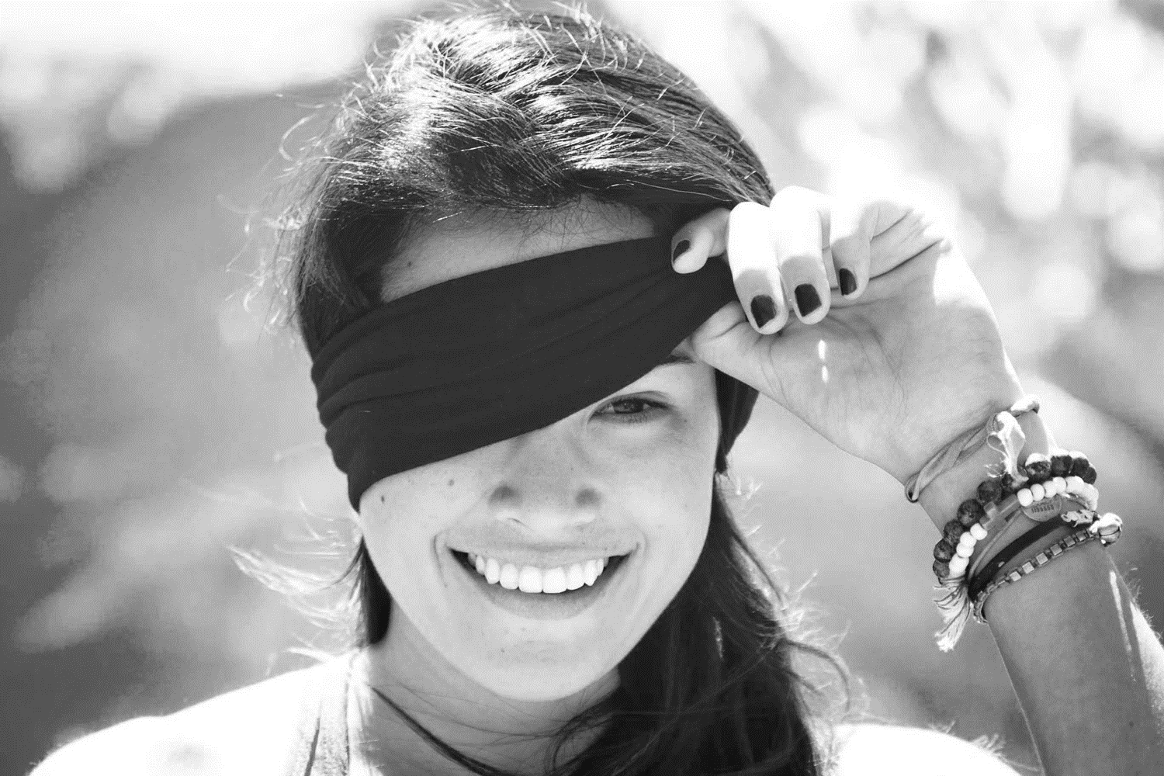
Premise #3: ‘Lived experience’ gives oppressed groups privileged access to truth
Oppression and epistemology:
Privilege
Lived
experience
Internalized oppression
Liberatory consciousness

Slide 24
Outline
Why should we care?
What is critical theory?
  Premise 1: Social binary
  Premise 2: Oppression through ideology
  Premise 3: Lived experience
  Premise 4: Social justice
  The strengths of critical theory
What are the problems with critical theory?
What can we do?

Slide 25

Premise #4: Social justice demands the liberation of oppressed groups
Definition of social justice:
“Prior to celebrating diversity, we must first eliminate intolerance. No matter what form it takes or who does it, we must all take action to stop intolerance when it happens. Working towards a celebration of diversity implies working for social justice – the elimination of all forms of social oppression… Social injustice takes many forms. It can be injustice based on a person’s gender, race, ethnicity, religion, sexual orientation, physical or mental ability, or economic class.” – Mary McClintock, “How to Interrupt Oppressive Behavior,” Readings for Diversity and Social Justice, p. 483

Slide 26
Outline
Why should we care?
What is critical theory?
  Premise 1: Social binary
  Premise 2: Oppression through ideology
  Premise 3: Lived experience
  Premise 4: Social justice
  The strengths of critical theory
What are the problems with critical theory?
What can we do?

Slide 27

Strength #1. Emphasis on the sinfulness of oppression
“Learn to do good; seek justice, correct oppression; bring justice to the fatherless, plead the widow's cause.” – Is. 1:17
“Do not oppress the widow, the fatherless, the sojourner, or the poor, and let none of you devise evil against another in your heart.” – Zech. 7:20
“Love your neighbor as yourself.” – Mark 12:30
“Listen! The wages of the laborers who mowed your fields which you kept back by fraud, cry out, and the cries of the har­vesters have reached the ears of the Lord of hosts” – James 5:4

Slide 28

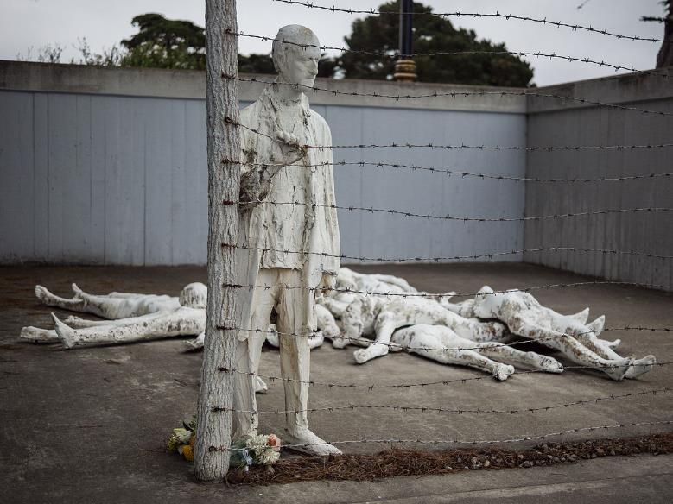
Strength #2. Focus on structures, systems, and norms

Slide 29

Strength #3: Recognition of hegemonic power

Slide 30
Outline
Why should we care?
What is critical theory?
What are the problems with critical theory?
  Worldview
  Epistemology
  Adversarial identities
  Hegemonic power
What can we do?

Slide 31
Worldview questions
Who are we?
What is our fundamental problem as human beings?
What is the solution to our problem?
What is our primary moral duty?
What is our purpose in life?

Slide 32

Christianity and critical theory are competing worldviews
Christianity
-----
OPPRESSION
ACTIVISM
LIBERATION
Patriarchy
White supremacy
Heteronormativity
Toxic masculinity
Classism
Ageism
Ableism
Cisgenderism
Protest
Resistance
Education
Awareness
Equity
Power reversal
Justice
Diversity
Critical theory

Slide 33
Worldview questions
 | Christianity | Critical theory
Who are we? | God’s creatures | Members of various groups
What is our problem? | Sin | Oppression
What is the solution? | Jesus | Liberation
What is our duty? | Loving God | Liberating the oppressed
What is our purpose? | Glorifying God | Working for liberation

Slide 34

Critical theory as worldview
“the cluster of philosophical approaches to [issues of identity is] known by the umbrella term critical theory. Critical theory is today a diverse phenomenon that draws deeply and variously on strands of Marxist thought, psychoanalysis, feminist theory, postcolonialism, poststructuralism, queer theory, and deconstruction… at the core of the various approaches of critical theorists lies a relatively simple set of convictions: the world is to be divided up between those who have power and those who do not; the dominant Western narrative of truth is really an ideological construct designed to preserve the power structure of the status quo; and the goal of critical theory is therefore to destabilize this power structure by destabilizing the dominant narratives that are used to justify –to ‘naturalize’– it” - Trueman
Trueman, The Rise and Triumph of the Modern Self, p. 225-226

Slide 35


Critical theory as worldview
“we now have Social Justice texts--forming a kind of Gospel of Social Justice--that express, with absolute certainty, that all white people are racist, all men are sexist, racism and sexism are systems that can exist and oppress absent even a single person with racist or sexist intentions or beliefs..., sex is not biological and exists on a spectrum, language can be literal violence, denial of gender identity is killing people, the wish to remedy disability and obesity is hateful, and everything needs to be decolonized.
Does this sound like a metanarrative? That's because it is. Social Justice scholarship and its educators and activists see these principles and conclusions as The Truth According to Social Justice--and they treat it as though they have discovered the analogue of the germ theory of disease, but for bigotry and oppression”
-Pluckrose and Lindsay, Cynical Theories, p. 182-183

Slide 36
Outline
Why should we care?
What is critical theory?
What are the problems with critical theory?
  Worldview
  Epistemology
  Adversarial identities
  Hegemonic power
What can we do?

Slide 37
Epistemology
Claim
reason,
logic,
argument
Evidence

Slide 38

Bulverism
psychology,
economics,
politics
Claim
reason,
logic,
argument
Motivation/
hidden agenda
Evidence

Slide 39
Epistemology
psychology,
economics,
politics
Claim
reason,
logic,
argument,
exegesis
“maintaining supremacy”
“internalized oppression”
Scripture

Slide 40
Outline
Why should we care?
What is critical theory?
What are the problems with critical theory?
  Worldview
  Epistemology
  Adversarial identities
  Hegemonic power
What can we do?

Slide 41


Identity and solidarity

Slide 42
Identity and solidarity
Creation
Sin
Redemption

Slide 43
Outline
Why should we care?
What is critical theory?
What are the problems with critical theory?
  Worldview
  Epistemology
  Adversarial identities
  Hegemonic power
What can we do?

Slide 44

Christianity as hegemonic discourse
Religion
Morality
Sexuality
Gender
etc…

Slide 45
Christianity and critical theory are competing worldviews
Christianity
-----
OPPRESSION
ACTIVISM
LIBERATION
Patriarchy
White supremacy
Heteronormativity
Toxic masculinity
Classism
Ageism
Ableism
Cisgenderism
Protest
Resistance
Education
Awareness
Equality
Power reversal
Justice
Diversity
Critical theory

Slide 46
Outline
Why should we care?
What is critical theory?
What are the problems with critical theory?
What can we do?
  Acknowledge and fight racism
  Be charitable
  Recognize the biblical issues at stake
  Read broadly

Slide 47
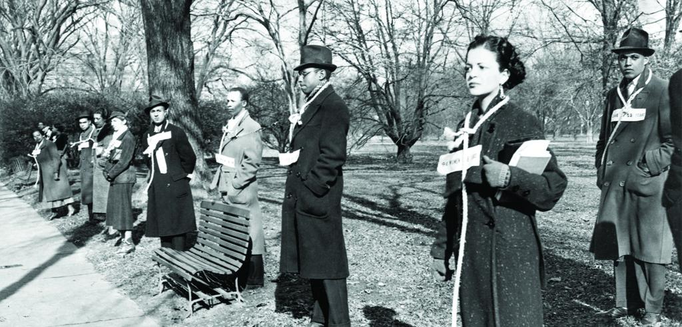
Acknowledge and fight racism

Slide 48
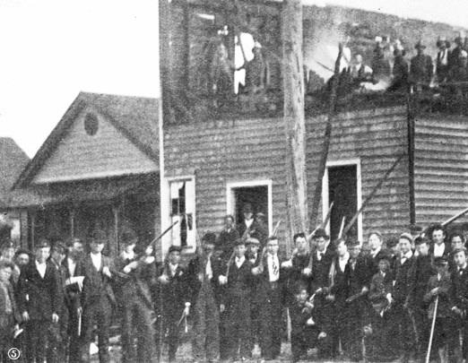
Acknowledge and fight racism

Slide 49
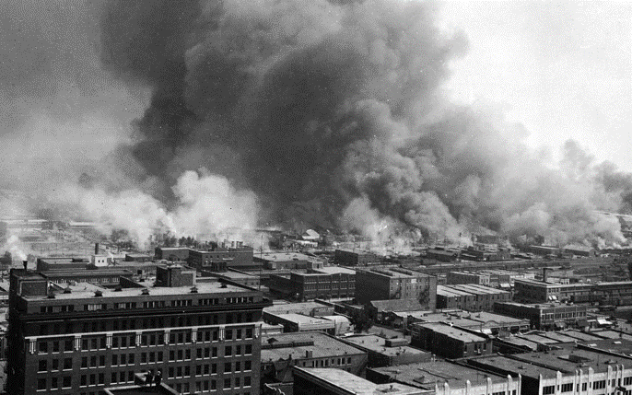
Acknowledge and fight racism

Slide 50
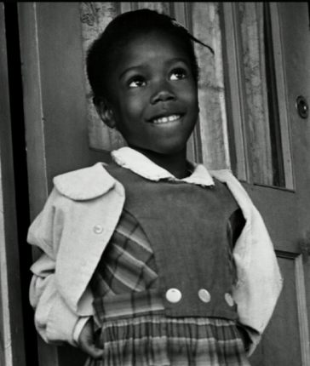
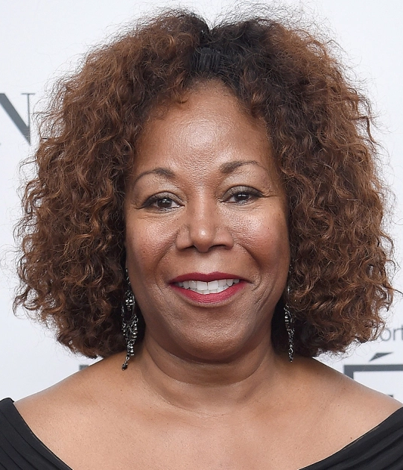
Acknowledge and fight racism

Slide 51
Outline
Why should we care?
What is critical theory?
What are the problems with critical theory?
What can we do?
  Acknowledge and fight racism
  Be charitable
  Recognize the biblical issues at stake
  Read broadly

Slide 52
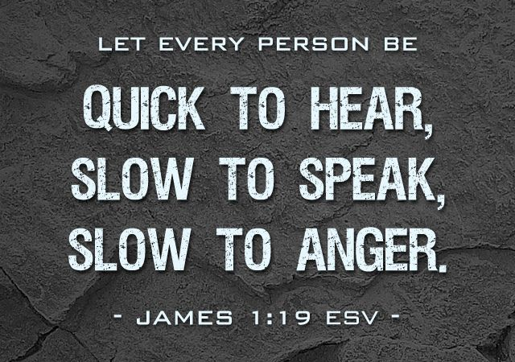
Be charitable

Slide 53
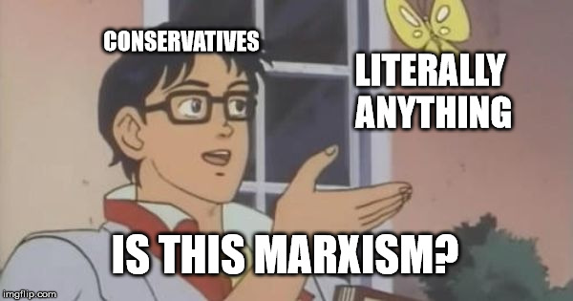
Don’t be that guy

Slide 54
Outline
Why should we care?
What is critical theory?
What are the problems with critical theory?
What can we do?
  Acknowledge and fight racism
  Be charitable
  Recognize the biblical issues at stake
  Read broadly

Slide 55
What’s at stake
Our primary identity is in Christ, not in race, ethnicity, gender, or anything else. (Gal. 3:26-28, Phil. 3:3-11)
We can only repent for our own sins. (Ez. 18:14-20, Deut. 24:16 and Jer. 31:27-34)
No one’s “lived experience” makes them infallible. (Prov. 14:12, Jer. 17:9)
Biblical justice means “giving people their due,” not “dismantling hegemonic norms.” (Rom. 13:1-7, Is. 1:17)
Diversity is not always good. (Jdg. 21:25, Rev. 17:13-14)
The gospel is an indicative, not an imperative. (Rom. 4:5, John 6:29)

Slide 56
Outline
Why should we care?
What is critical theory?
What are the problems with critical theory?
What can we do?
  Acknowledge and fight racism
  Be charitable
  Recognize the biblical issues at stake
  Read broadly

Slide 57


Read broadly

Slide 58
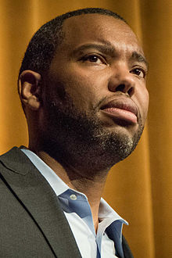
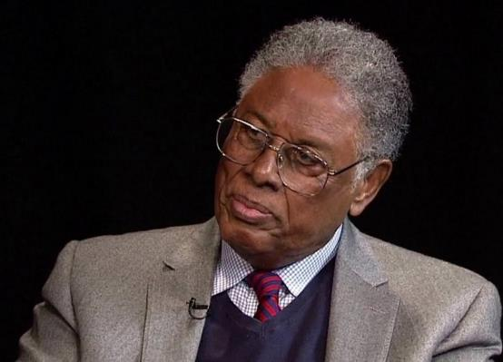
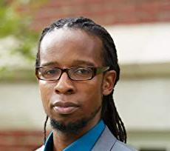
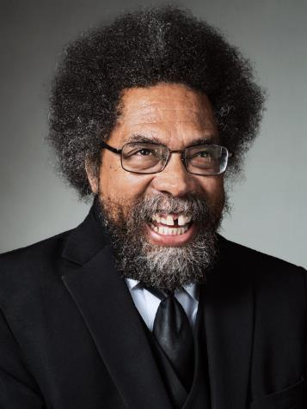
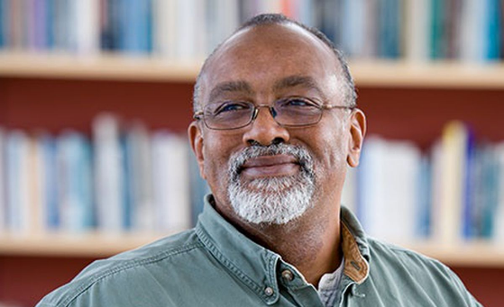
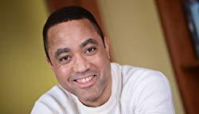
Read broadly

Slide 59
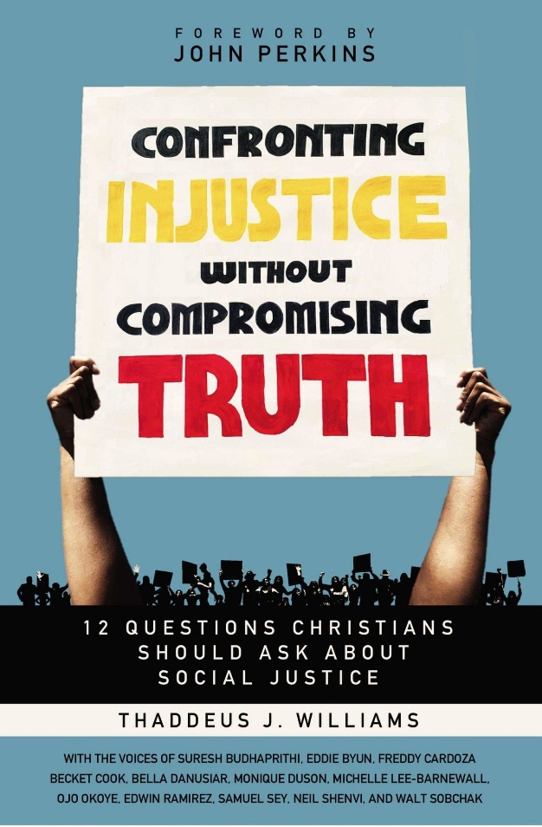
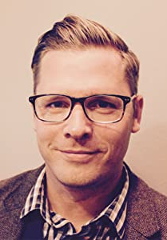
Confronting Injustice Without Compromising Truth by Thaddeus Williams

Slide 60
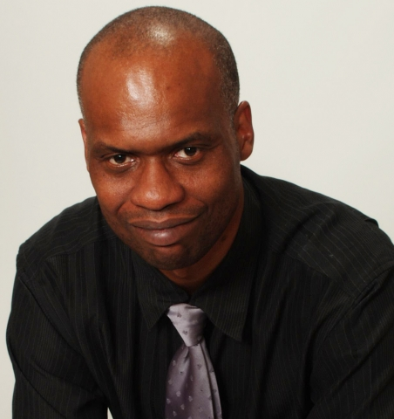

Beyond Racial Gridlock, by Dr. George Yancey

Slide 61
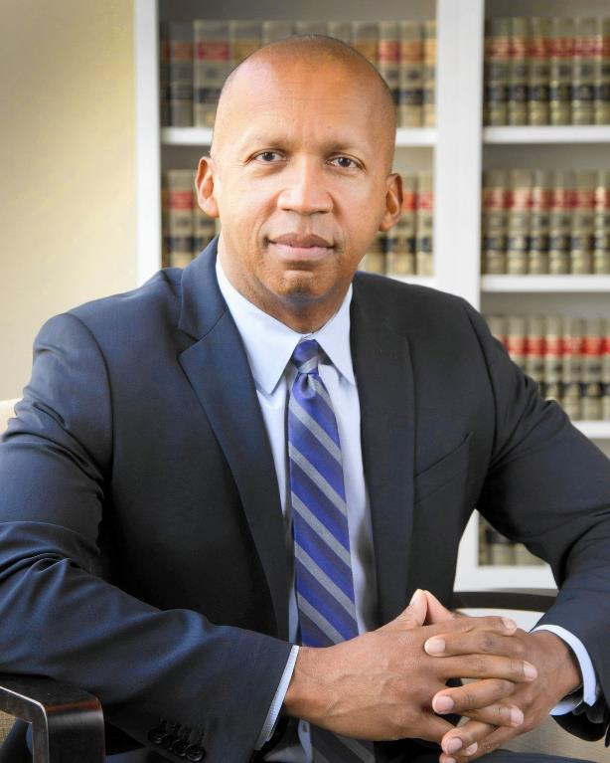

Just Mercy, Bryan Stevenson

Slide 62
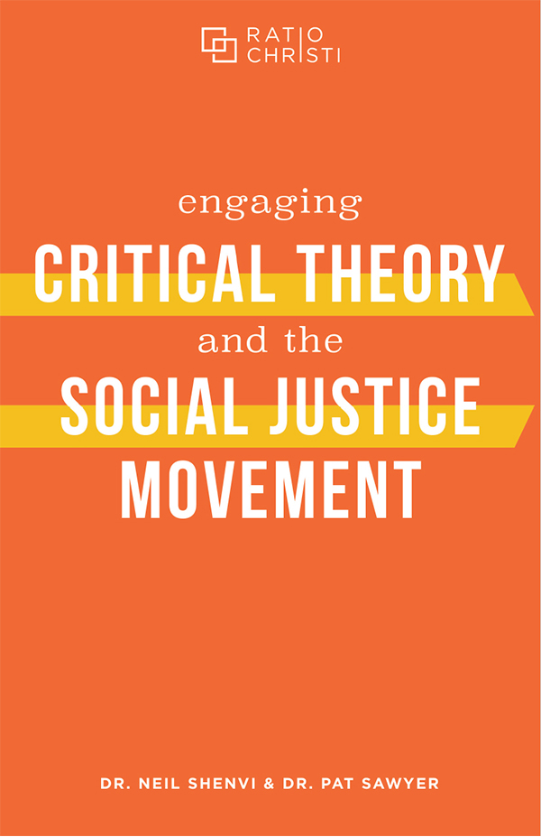


Engaging Critical Theory and the Social Justice Movement by Shenvi and Sawyer

Slide 63

Critical Dilemma by Shenvi and Sawyer (Fall 2023)

Slide 64

Acknowledgements
Dr. Christina Shenvi
Dr. Pat Sawyer
“The Incompatibility of Critical Theory and Christianity,” The Gospel Coalition
“Gender, Intersectionality, and Critical Theory,” Eikon
“Engaging Critical Theory and the Social Justice Movement” Ratio Christi
shenviapologetics.com/defend19
Twitter @NeilShenvi, @RealPatSawyer

