Slide 1
Are CRT and Christianity Compatible?
Dr. Neil Shenvi
Grace Fellowship
March 25, 2023

Slide 2
Outline
Critical Theory and Critical Race Theory
What is Critical Race Theory?
Problems with Critical Race Theory
Talking about Race
Conclusions and book recommendations

Slide 3










The Taxonomy of Critical Theory
“critical theory” = critical social theories
“Critical Theory”
= Frankfurt School
Critical theory resists essentialism (it is hard to define!)

Slide 4
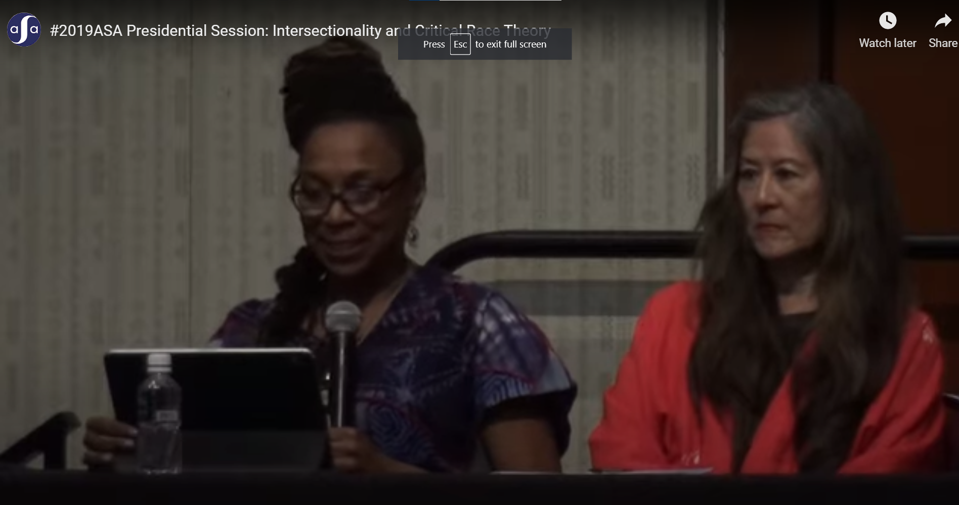
Crenshaw: “These refusals [to recruit scholars of color] led to our eventual self-declaration as an offshoot of Critical Legal Studies. We discovered ourselves to be critical theorists who did race and we were racial justice advocates who did critical theory. … I sent out a call to attend a retreat called ‘New Developments in Critical Race Theory’… [At that time] there were no ‘new events’ in critical race theory because CRT hadn’t had any old ones. It didn’t exist. It was made up as a name.”
#2019ASA Presidential Session: Intersectionality and Critical Race Theory

Slide 5
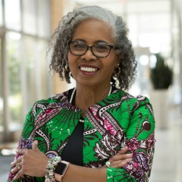
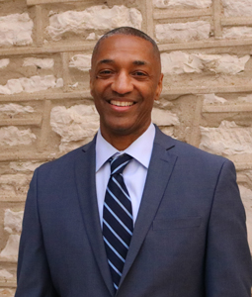
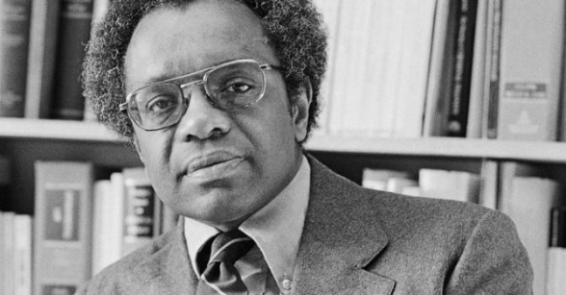
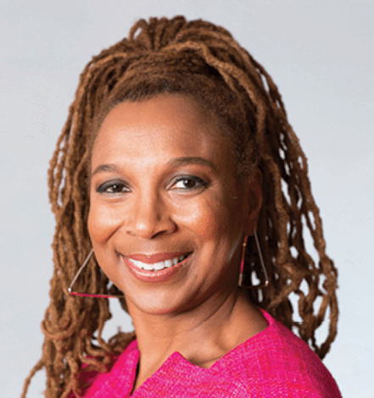
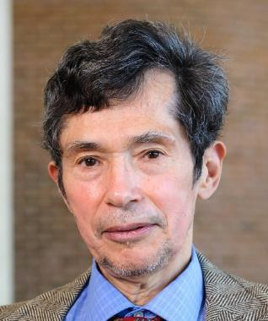
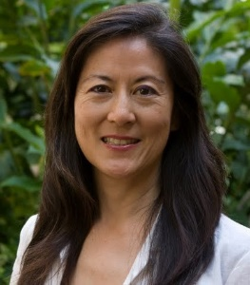
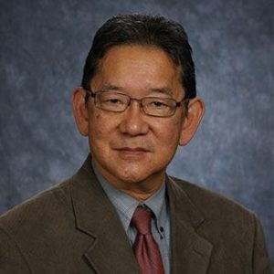
The Origins of Critical Race Theory
Derrick Bell
Gloria Ladson-Billings
William Tate
Kimberle Crenshaw
Richard
Delgado
Mari Matsuda
Neil
Gotanda
1980
1984
1987
1989
1991
1996

Slide 6
Outline
Critical Theory and Critical Race Theory
What is Critical Race Theory?
  Racism is normal
  Racism is concealed
  Lived experience is critical
  Racism is part of interlocking systems of oppression
  Positives of CRT
Problems with Critical Race Theory
Talking about Race
Conclusions and book recommendations

Slide 7
The Core Tenets of CRT
Racism is normal, permanent, and pervasive
Racism is concealed beneath principles like colorblindness, meritocracy, and objectivity
Lived experience is necessary to fully understand racism
Racism is part of interlocking systems of oppression

Slide 8
Outline
Critical Theory and Critical Race Theory
What is Critical Race Theory?
  Racism is normal
  Racism is concealed
  Lived experience is critical
  Racism is part of interlocking systems of oppression
  Positives of CRT
Problems with Critical Race Theory
Talking about Race
Conclusions and book recommendations

Slide 9
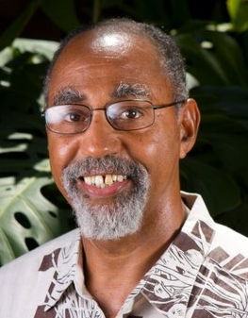
Racism is normal, permanent, and pervasive
“Critical race theory recognizes that racism is endemic to American life… [W]e ask how these traditional interests [like federalism, privacy, traditional values or established property interests] serve as vessels of racial subordination.” – Matsuda et al.
Matsuda, Lawrence, Crenshaw, and Delgado, Words That Wound, 1993, pp. 6-7

Slide 10
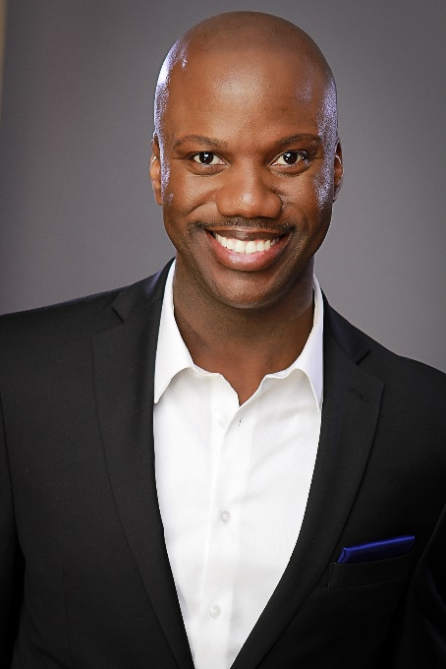
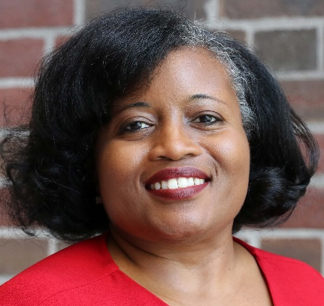
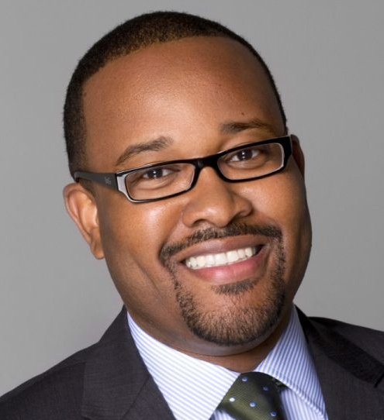
Racism is normal, permanent, and pervasive
“Racism is a normal part of American life, often lacking the ability to be distinctively recognized… A CRT lens unveils the various forms in which racism continually manifests itself, despite espoused institutional values regarding equity and social justice.” – Harper, Patton, and Wooden
Harper, Patton, and Wooden, “Access and Equity for African American Students in Higher Education: A Critical Race Historical Analysis of Policy Efforts,” The Journal of Higher Education, 80(4), 2009, p. 389-414.

Slide 11

Racism is normal, permanent, and pervasive
“Racism is normal, not aberrant, in American society. Because it is an ingrained feature of our landscape, racism looks ordinary and natural to persons in our culture.” – Delgado and Stefancic
Delgado and Stefancic, Critical Race Theory: The Cutting Edge, 3rd edition, p. 2

Slide 12

Racism is normal, permanent, and pervasive
“Race: the characteristics ascribed to a particular race can and will change to fit a dominant group’s interest. In this way, racist behavior is not an aberration in everyday life; it is often normal practice in deeply racialized social systems.” – Kafi Kumasi
Kafi D. Kumasi, “Critical Race Theory and Education: Mapping a Legacy of Activism and Scholarship” in Levinson’s Beyond Critique (p. 209-213).

Slide 13
Outline
Critical Theory and Critical Race Theory
What is Critical Race Theory?
  Racism is normal
  Racism is concealed
  Lived experience is critical
  Racism is part of interlocking systems of oppression
  Positives of CRT
Problems with Critical Race Theory
Talking about Race
Conclusions and book recommendations

Slide 14
Racism is concealed beneath principles like colorblindness, meritocracy, and objectivity
“Critical race theory expresses skepticism toward dominant legal claims of neutrality, objectivity, color blindness, and meritocracy”– Matsuda et al.
Matsuda, Lawrence, Crenshaw, and Delgado, Words That Wound, pp. 6-7

Slide 15
Racism is concealed beneath principles like colorblindness, meritocracy, and objectivity
“liberalism, neutrality, objectivity, colorblindness, and meritocracy… camouflage [how] racial advantage propels the self-interests, power, and privileges of the dominant group.” – Harper, Patton, and Wooden
Harper, Patton, and Wooden, “Access and Equity for African American Students in Higher Education: A Critical Race Historical Analysis of Policy Efforts,” The Journal of Higher Education, 80(4), 2009, p. 389-414.

Slide 16

Racism is concealed beneath principles like colorblindness, meritocracy, and objectivity
“the overall ethos of majority culture promotes and promulgates a notion of ‘color-blindness’ and ‘meritocracy.’ These two notions are mutually intertwined and serve to marginalize certain enclaves of people—predominately people of color.” – Hartlep
Nicholas Hartlep, “Critical Race Theory: An Examination of its Past, Present, and Future Implications,” ERIC Document Reproduction Service No. ED 506 735, 2009

Slide 17
Racism is concealed beneath principles like colorblindness, meritocracy, and objectivity
“critical race scholars are discontented with liberalism… Colorblindness can be admirable… But it can be perverse, for example, when it stands in the way of taking account of differences in order to help people in need… Crits are suspicious of another liberal mainstay, namely, rights. – Delgado and Stefancic
Delgado and Stefancic, Critical Race Theory: An Introduction, p. 27

Slide 18
Outline
Critical Theory and Critical Race Theory
What is Critical Race Theory?
  Racism is normal
  Racism is concealed
  Lived experience is critical
  Racism is part of interlocking systems of oppression
  Positives of CRT
Problems with Critical Race Theory
Talking about Race
Conclusions and book recommendations

Slide 19
Lived experience is critical to fully understand racism
“Critical race theory insists on recognition of the experiential knowledge of people of color…This knowledge is gained from critical reflection on the lived experience of racism…”– Matsuda et al.
Matsuda, Lawrence, Crenshaw, and Delgado, Words That Wound, pp. 6-7

Slide 20
Lived experience is critical to fully understand racism
“CRT gives voice to the unique perspectives and lived experiences of people of color… CRT uses counternarratives as a way to highlight discrimination, offer racially different interpretations of policy, and challenge the universality of assumptions made about people of color.” – Harper, Patton, and Wooden
Harper, Patton, and Wooden, “Access and Equity for African American Students in Higher Education: A Critical Race Historical Analysis of Policy Efforts,” The Journal of Higher Education, 80(4), 2009, p. 389-414.

Slide 21
Lived experience is critical to fully understand racism
“blacks experience the power of second sight from the perspective of antiblack prejudice… A CRT framework recognizes the centrality of experiential knowledge of people of color and views this knowledge as legitimate, appropriate, and critical to understanding, analyzing, and teaching about racial subordination.” – Kafi Kumasi
Kafi D. Kumasi, “Critical Race Theory and Education: Mapping a Legacy of Activism and Scholarship” in Levinson’s Beyond Critique (p. 209-213).

Slide 22
Outline
Critical Theory and Critical Race Theory
What is Critical Race Theory?
  Racism is normal
  Racism is concealed
  Lived experience is critical
  Racism is part of interlocking systems of oppression
  Positives of CRT
Problems with Critical Race Theory
Talking about Race
Conclusions and book recommendations

Slide 23
Racism is part of interlocking systems of oppression
“Critical race theory works toward the end of eliminating racial oppression as part of the broader goal of ending all forms of oppression. Racial oppression is experienced by many in tandem with oppressions on grounds of gender, class, or sexual orientation…The interests of all people of color require not just adjustments within existing hierarchies, but a challenge to hierarchy itself.”– Matsuda et al.
Matsuda, Lawrence, Crenshaw, and Delgado, Words That Wound, pp. 6-7

Slide 24
Racism is part of interlocking systems of oppression
“CRT critiques [claims that]: one can fight racism without paying attention to sexism, homophobia, economic exploitation, and other forms of oppression or injustice.”– Harper, Patton, and Wooden
Harper, Patton, and Wooden, “Access and Equity for African American Students in Higher Education: A Critical Race Historical Analysis of Policy Efforts,” The Journal of Higher Education, 80(4), 2009, p. 389-414.

Slide 25

Racism is part of interlocking systems of oppression
“The Commitment to Social Justice: CRT is committed to social justice and offers a liberatory or transformative response to racial, gender, and class oppression… and works toward the elimination of racism, sexism, and poverty as well as the empowerment of People of Color and other subordinated groups” – Yosso
Tara Yosso, “Whose Culture Has Capital?” Race ethnicity and education, Vol. 8, 2005

Slide 26
Racism is part of interlocking systems of oppression
“CRT scholars are critical of any sociological analyses that focus solely on race without recognizing that racial oppression exists in multiple layers based on gender, class, immigration status, surname, phenotype, accent, and sexuality.” – Kafi Kumasi
Kafi D. Kumasi, “Critical Race Theory and Education: Mapping a Legacy of Activism and Scholarship” in Levinson’s Beyond Critique (p. 209-213).

Slide 27
Outline
Critical Theory and Critical Race Theory
What is Critical Race Theory?
  Racism is normal
  Racism is concealed
  Lived experience is critical
  Racism is part of interlocking systems of oppression
  Positives of CRT
Problems with Critical Race Theory
Talking about Race
Conclusions and book recommendations

Slide 28
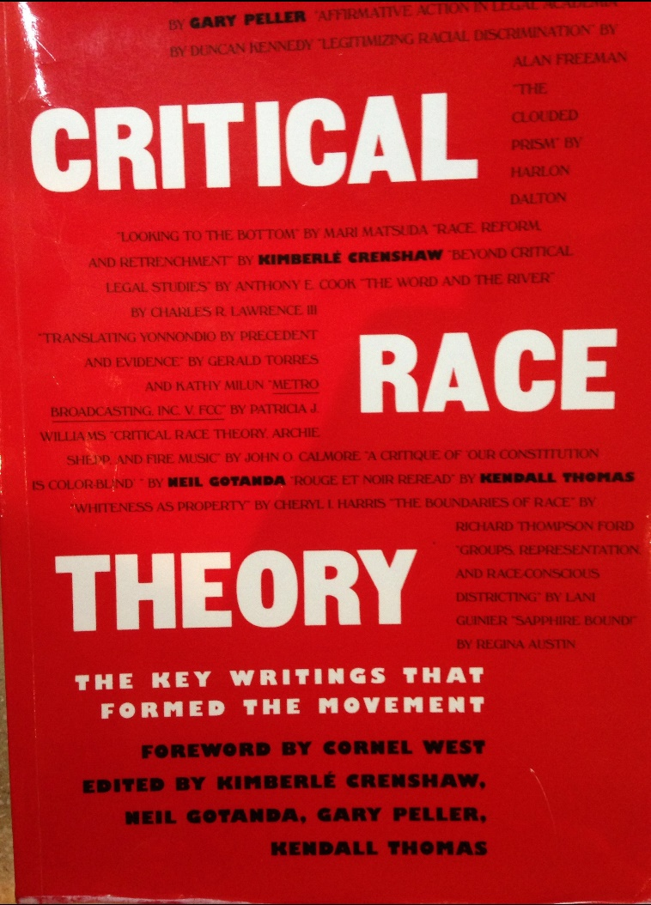
Positives of CRT
Race is a social construct
Racism has shaped our country’s history
Racism can infect systems

Slide 29
Outline
Critical Theory and Critical Race Theory
What is Critical Race Theory?
  Racism is normal
  Racism is concealed
  Lived experience is critical
  Racism is part of interlocking systems of oppression
  Positives of CRT
Problems with Critical Race Theory
Talking about Race
Conclusions and book recommendations

Slide 30
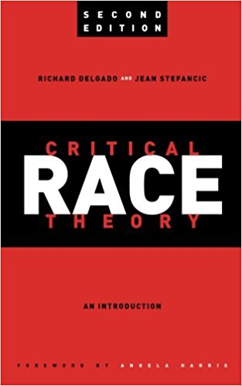
Problems with Critical Race Theory
Racism as primarily sin, not system
Sin, not racism, is pervasive
Identity primarily in Christ, not ethnicity
Truth primarily in Scripture, not experience
Sin as lawlessness, not oppression

Slide 31
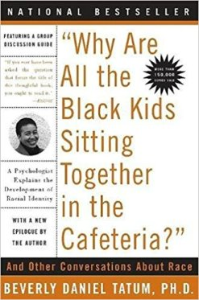
Racism as sin, not system
“People of color are not racist because they do not systematically benefit from racism… Using the same logic, I reserve the word sexist for men” - Tatum
Beverly Daniel Tatum, “Why Are All The Black Kids Sitting Together in the Cafeteria?” p. 10

Slide 32

Racism as sin, not system
“if you are white in a white supremacist society, you are racist. If you are male in a patriarchy, you are sexist. If you are able-bodied, you are ableist. If you are anything above poverty in a capitalist society, you are classist. You can sometimes be all of these things at one.” - Oluo
Ijeoma Oluo, So You Want to Talk About Race? p. 216-217

Slide 33
Problems with Critical Race Theory
Racism as primarily sin, not system
Sin, not racism, is pervasive
Identity primarily in Christ, not ethnicity
Truth primarily in Scripture, not experience
Sin as lawlessness, not oppression

Slide 34

Sin, not racism, is pervasive
“…the question is not ‘Did racism take place?’ but rather, ‘In which ways did racism manifest in this specific context?’”¹
“Cross-racial friendships do not block out the dynamics of racism in the society at large, and these dynamics continue unabated… Racism cannot be absent from your friendship. No person of color whom I’ve met has said that racism isn’t at play in his or her friendships with white people. Some whites are more thoughtful, aware, and receptive to feedback than others, but no cross-racial relationship is free from the dynamics of racism in this society.”²
¹ Schroeder & DiAngelo. (2010). Addressing Whiteness in Nursing Education: The Sociopolitical Climate Project at the University of Washington School of Nursing. Advances in Nursing Science, 33 (3) 244-255.
² Robin DiAngelo, White Fragility, (2018), p. 80-81

Slide 35

Sin, not racism, is pervasive
“Whiteness positions itself as the norm. It refuses to recognize itself for what it is. Its so-called ‘objectivity’ and ‘reason’ is its most potent and insidious tool for maintaining power”
“We need to see racism as structural in order to see its insidiousness. We need to see how it seeps, like a noxious gas, into everything” – Eddo-Lodge
Reni Eddo-Lodge, Why I Am No Longer Talking to White People About Race, p. 169, 222

Slide 36
Problems with Critical Race Theory
Racism as primarily sin, not system
Sin, not racism, is pervasive
Identity primarily in Christ, not ethnicity
Truth primarily in Scripture, not experience
Sin as lawlessness, not oppression

Slide 37
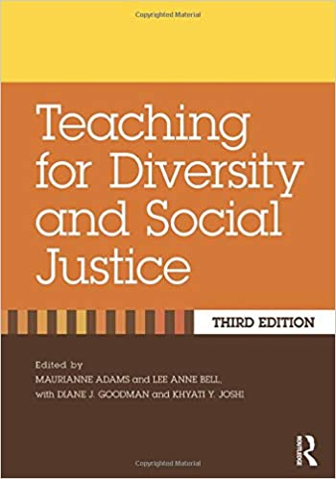
Identity in Christ, not ethnicity
“The binary terms oppressor and oppressed, for example, may raise resistance from participants who cannot reconcile themselves as oppressors… or who resist the term oppressed... On the other hand, we struggle to find other language that doesn’t trivialize the power and harm of the oppressive system” - Adams
Maurianne Adams, Lee Anne Bell, Pat Griffin, Teachings for Diversity and Social Justice, p. xxii, (2007)

Slide 38
Identity in Christ, not ethnicity
“a positive white identity is an impossible goal. White identity is inherently racist; white people do not exist outside the system of white supremacy. This does not mean that we should stop identifying as white and start claiming only to be Italian or Irish. To do so is to deny the reality of racism in the here and now, and this denial would simply be color-blind racism. Rather, I strive to be ‘less white.’ To be less white is to be less racially oppressive. I can build a wide range of authentic and sustained relationships across race and accept that I have racist patterns.” – DiAngelo
Robin DiAngelo, White Fragility, (2018), p. 149-150

Slide 39
Problems with Critical Race Theory
Racism as primarily sin, not system
Sin, not racism, is pervasive
Identity primarily in Christ, not ethnicity
Truth primarily in Scripture, not experience
Sin as lawlessness, not oppression

Slide 40
Truth in Scripture, not experience
“It is about race if a person of color thinks it is about race… whether or not someone is fallible is beside the point. We are, each and every one of us, a collection of our lived experiences…And our experiences are valid.” - Oluo
Ijeoma Oluo, So you want to talk about race, p. 14-15

Slide 41
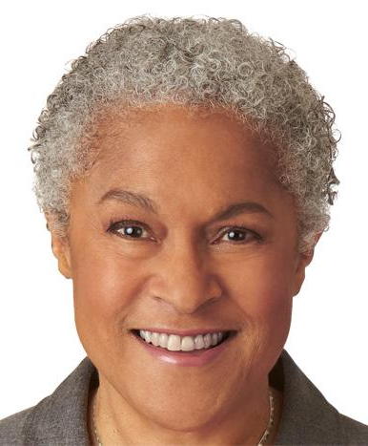
Truth in Scripture, not experience
“Identity politics and standpoint epistemology constitute two important dimensions of epistemic resistance for subordinated groups. Identity politics valorizes the experiences of women, people of color, poor people, LGBTQ people, and similarly subordinated people as a source of epistemic agency. By claiming the authority of experience, standpoint epistemology defends the integrity of individuals and groups in interpreting their own experiences.” - Collins
Patricia Hill Collins, Intersectionality as Critical Social Theory, p. 136

Slide 42
Problems with Critical Race Theory
Racism as primarily sin, not system
Sin, not racism, is pervasive
Identity primarily in Christ, not ethnicity
Truth primarily in Scripture, not experience
Sin as lawlessness, not oppression

Slide 43
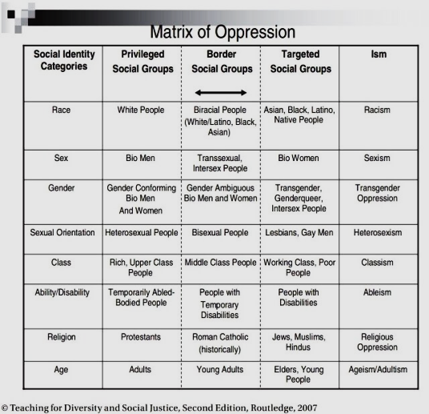

Sin as lawlessness, not oppression
Adams et al, Teaching for Diversity and Social Justice, Appendix C

Slide 44
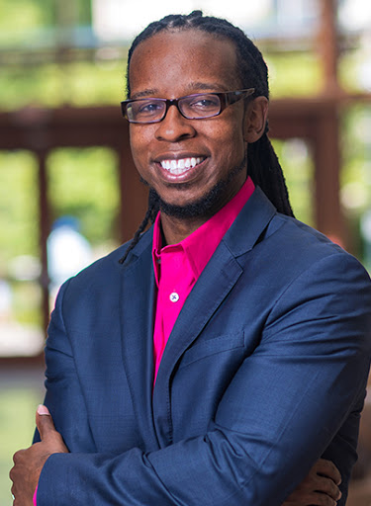
Sin as lawlessness, not oppression
“Antiracist policies cannot eliminate class racism without anticapitalism policies. Anticapitalism cannot eliminate class racism without antiracism.”
“To truly be antiracist is to be feminist. To truly be feminist is to be antiracist”
“We cannot be antiracist if we are homophobic or transphobic… To be queer antiracist is to understand the privileges of my cisgender, of my masculinity, of my heterosexuality, of their intersections” - Kendi
Ibram X. Kendi, How to Be An Antiracist, p. 159 189, 197

Slide 45
Sin as lawlessness, not oppression
“Antiracist policies cannot eliminate class racism without anticapitalism policies. Anticapitalism cannot eliminate class racism without antiracism.”
“To truly be antiracist is to be feminist. To truly be feminist is to be antiracist”
“We cannot be antiracist if we are homophobic or transphobic… To be queer antiracist is to understand the privileges of my cisgender, of my masculinity, of my heterosexuality, of their intersections” - Kendi
Ibram X. Kendi, How to Be An Antiracist, p. 159 189, 197

Slide 46

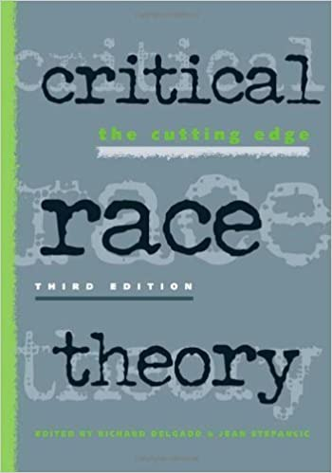
Mixing CRT and Christianity

Slide 47
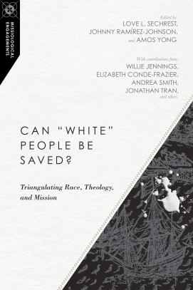
Can ‘White’ People Be Saved?
“the essays in this volume deftly deploy cutting-edge theory in racial and ethnic studies” and draw on “critical theorists [who] advocate for analyses of racism that explore how other communities of color [outside the Black/White binary] experience the effects of racialization” (p. 10-11).
Sechrest, Can ‘White’ People Be Saved, p. 10-11

Slide 48
Can ‘White’ People Be Saved?
“Decolonizing Salvation” - Andrea Smith
“what we presume to be true of the Bible is primarily the result of the history of European interpretation as translated into European languages… we would have a completely different understanding of the Bible if we read it through Indigenous languages translated directly from Greek and Hebrew.” (p. 54)
“According to the European positivist grammar of truth, if proposition p is true, then not-p must be false. Indigenous epistemologies are not beholden to such logic systems. Beliefs, even systems of belief that seem contradictory to European and Euro-American culture–for example, Christianity and Indigenous religions–can coexist in Indigenous culture” (p. 62)

Slide 49
Can ‘White’ People Be Saved?
“The End of ‘Mission’: Christian Witness and the Decentering of White Identity” – Andrew Draper
“whiteness is best understood as a religious system of pagan idol worship that thrives on mutually reinforcing circularity between the image (the ideal or the form) and the social construction of those who worship it…As idolatry, whiteness must be dealt with like any such cultic system: its high places must be torn down and its altars laid low” (p. 177-178)
“If… whiteness is a way of life into which its novitiates are discipled, then a Christian discipleship that entails a deconversion from whiteness is necessary if any true experience of reconciliation with God, others, the creation, and ourselves is to take place. (p. 181)

Slide 50
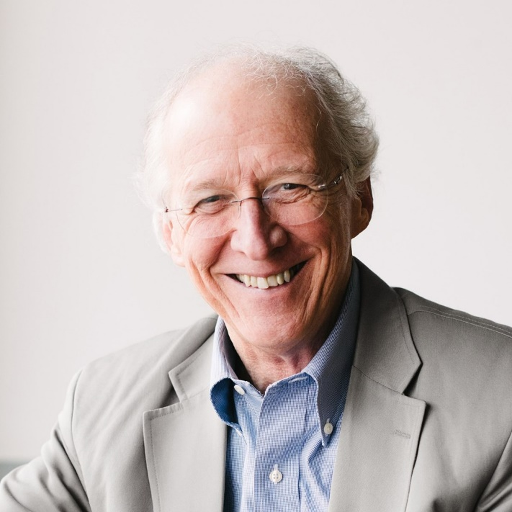
In its core commitments, CRT is incompatible with Christianity
“in its mainstream expression — [critical race theory] is another manifestation of the age-old enslavement of the fallen human heart to self-deification (“I will be my own god”), and self-definition (“I will define my own essential identity”), and self-determination (“I will decide my own truth and my own morality, without deference to any authority outside myself”)…these are the root problems of the mainstream, scholarly, decades-long development of critical race theory, which is why it is being so hotly contested. And in that sense, rightly contested.” – Pastor John Piper

Slide 51
Outline
Critical Theory and Critical Race Theory
What is Critical Race Theory?
  Racism is normal
  Racism is concealed
  Lived experience is critical
  Racism is part of interlocking systems of oppression
  Positives of CRT
Problems with Critical Race Theory
Talking about Race
Conclusions and book recommendations

Slide 52
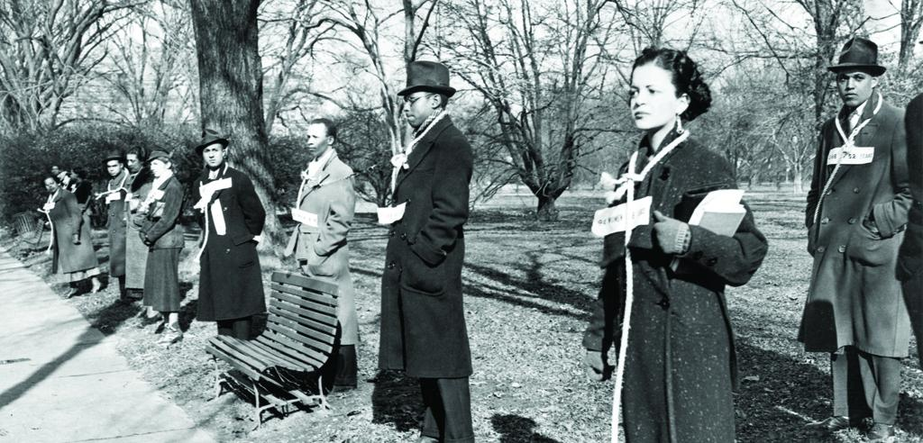
Acknowledge and fight racism

Slide 53
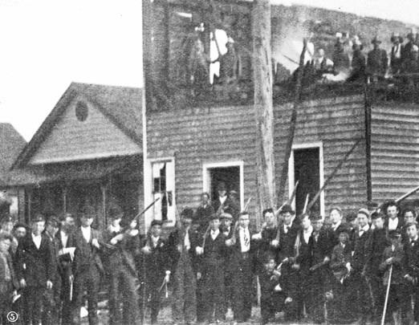
Acknowledge and fight racism

Slide 54
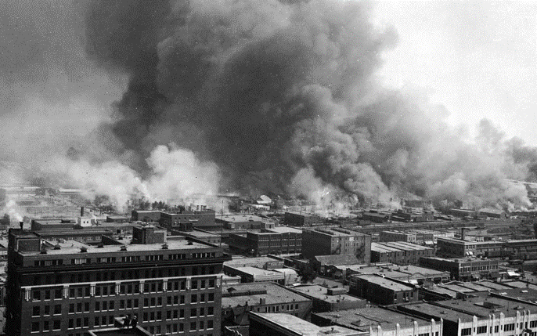
Acknowledge and fight racism

Slide 55
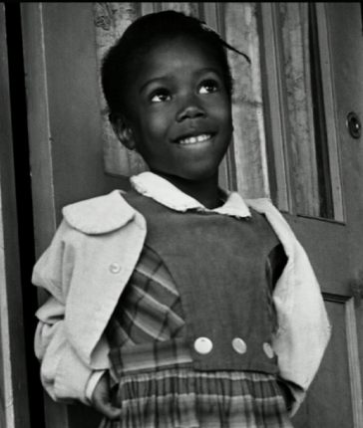

Acknowledge and fight racism

Slide 56
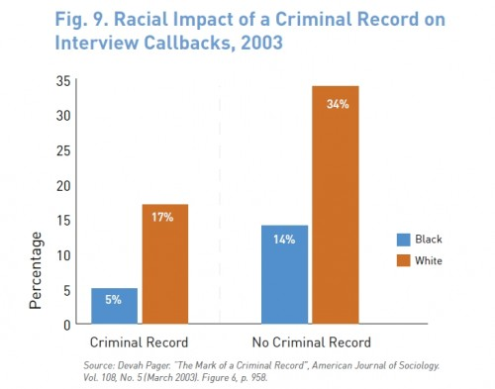
Acknowledge and fight racism
20% higher response rate for whites with criminal record compared to blacks with no criminal record

Slide 57
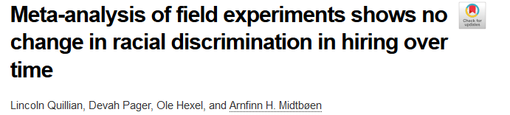
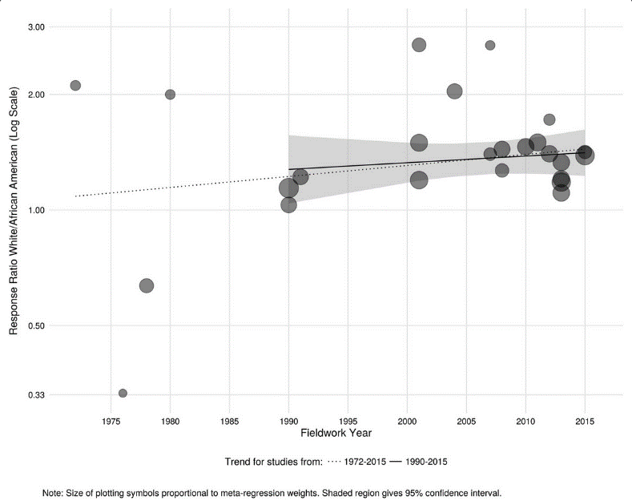
Acknowledge and fight racism
40% higher response rate for whites has not changed in at least three decades

Slide 58
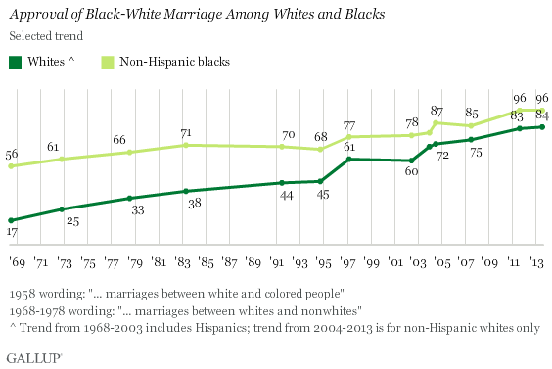
Acknowledge and fight racism
16% of whites do not approve of intermarriage between whites and blacks

Slide 59
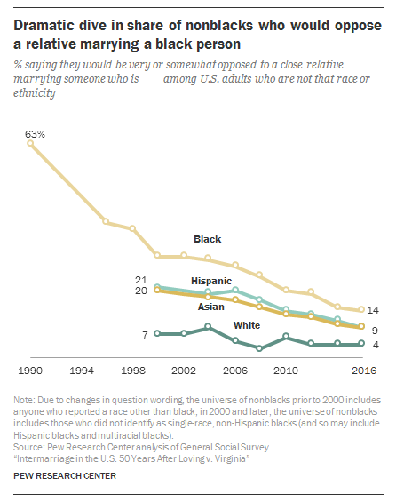
Acknowledge and fight racism
14% of non-blacks would oppose a relative marrying a black person

Slide 60
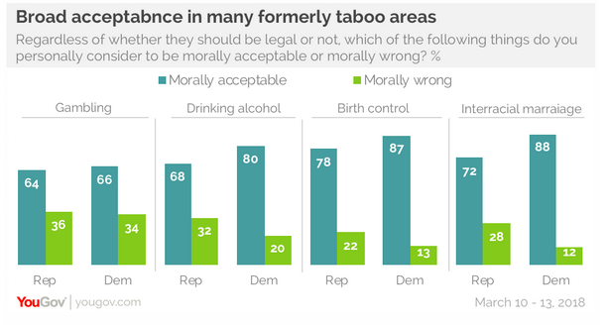
Acknowledge and fight racism
28% of Republicans think interracial marriage is ‘morally wrong’

Slide 61
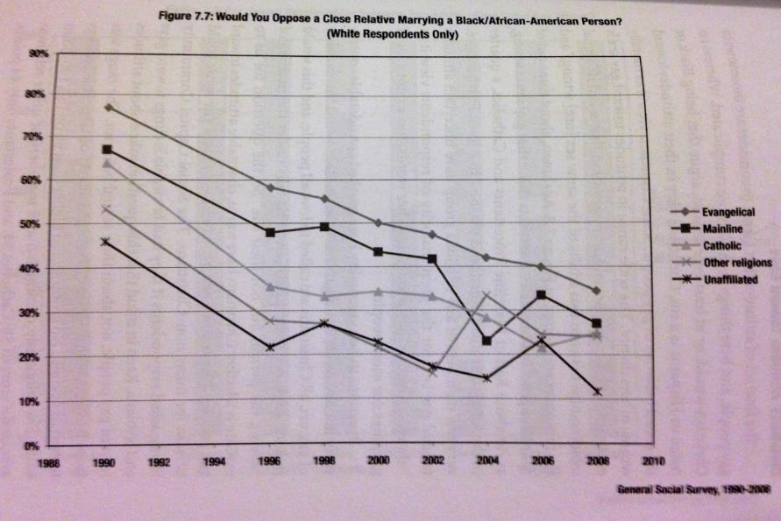
Acknowledge and fight racism
34% of white Evangelicals would oppose a close relative marrying a black person
“Among Evangelicals… we see no evidence of prejudicial attitudes decreasing with church attendance.” – Bradley Wright, Christians Are Hate-Filled Hypocrites… and Other Lies You’ve Been Told, p. 170

Slide 62
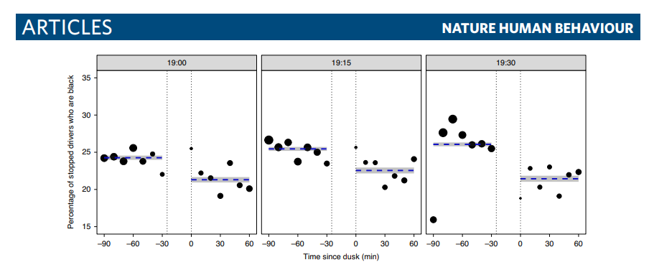
Acknowledge and fight racism
Pierson, E., Simoiu, C., Overgoor, J. et al. A large-scale analysis of racial disparities in police stops across the United States. Nat Hum Behav 4, 736–745 (2020).

Slide 63
Outline
Critical Theory and Critical Race Theory
What is Critical Race Theory?
  Racism is normal
  Racism is concealed
  Lived experience is critical
  Racism is part of interlocking systems of oppression
  Positives of CRT
Problems with Critical Race Theory
Talking about Race
Conclusions and book recommendations

Slide 64

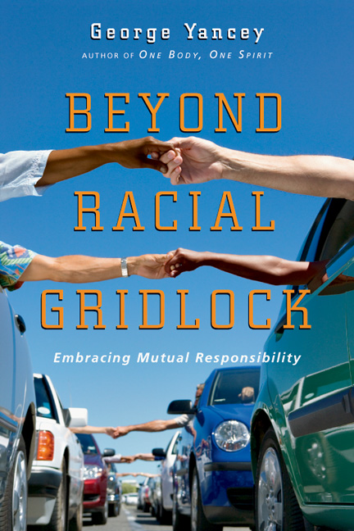
Beyond Racial Gridlock, by Dr. George Yancey

Slide 65
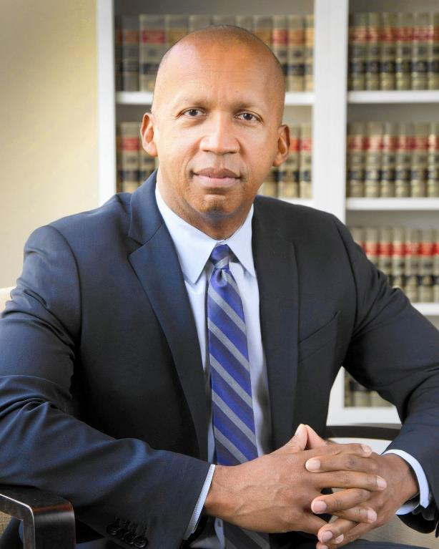
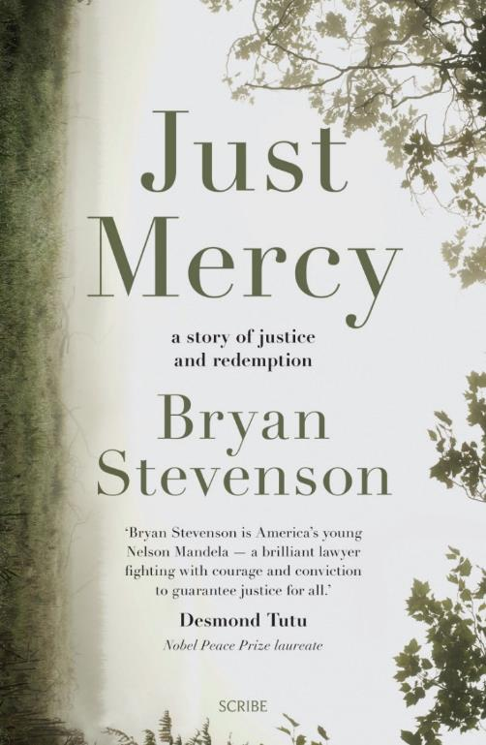
Just Mercy, Bryan Stevenson

Slide 66
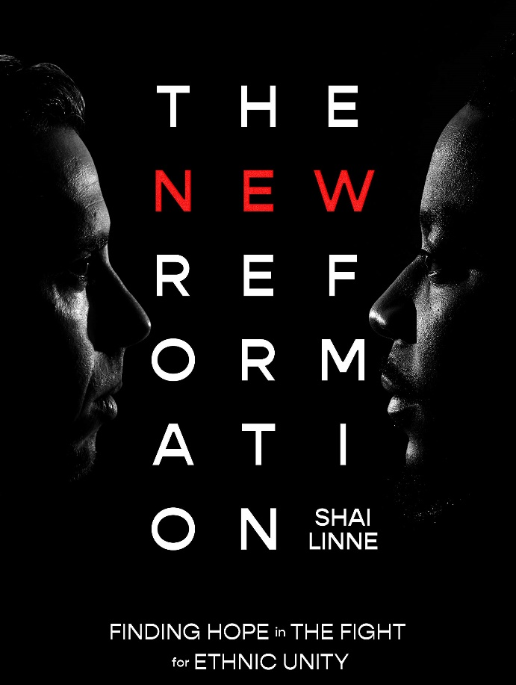
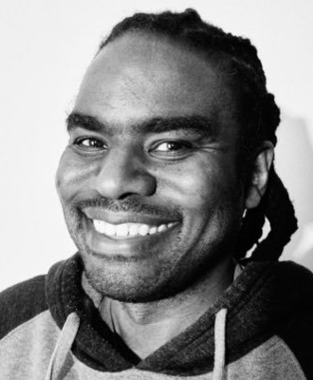
The New Reformation, by Shai Linne

Slide 67
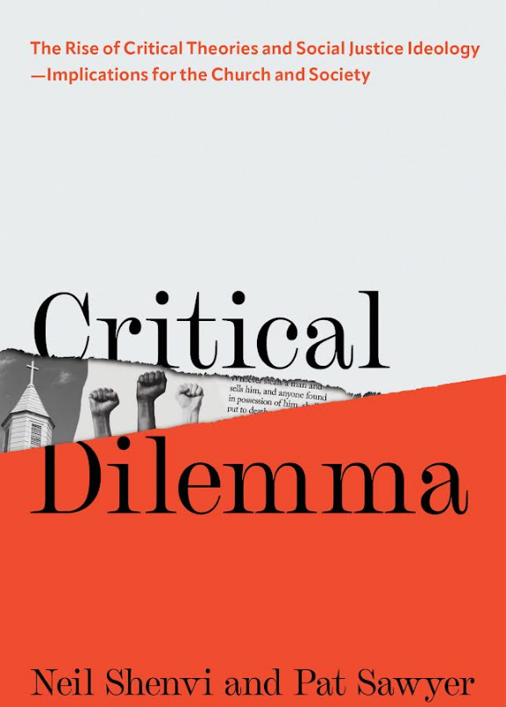


Critical Dilemma by Shenvi and Sawyer (Fall 2023)

Slide 68

Acknowledgements and additional resources
Dr. Christina Shenvi
Dr. Pat Sawyer
“Is Critical Race Theory Biblical? No.” Interview with Pastor Mike Winger
“Is Critical Race Theory compatible with Christianity?” Debate with Pastor Rasool Berry on Unbelievable? With Justin Brierley
“White Fragility: Behind the Worldview” at Ed Stetzer’s The Exchange
shenviapologetics.com/
Twitter @NeilShenvi, @RealPatSawyer

