Slide 1
The New Canon: Assessing Books Like White Fragility and White Awake
Dr. Neil Shenvi
Winter Conference FBCS
March 25-27, 2022

Slide 2
Outline
Review of contemporary critical theory
Review of critical race theory
Secular books about race
  White Fragility
  How to Be An Antiracist
  Also: So You Want to Talk About Race, Why I’m No Longer Talking to White People About Race, Me and White Supremacy
Christian books about race
  White Awake
  Be The Bridge
  Also: Rediscipling the White Church, Reconstructing the Gospel, We Need to Talk About Race, How to Fight Racism, After Whiteness, Can ‘White’ People Be Saved?
Sociology as theology
  Jesus and John Wayne
  Taking America Back for God
  Also: The Rise of Biblical Womanhood, White Evangelical Racism
Conclusions

Slide 3





The central premises of contemporary critical theory?
Premise I: Social binary
Premise II: Oppression through ideology
Premise III: Lived experience
Premise IV: Social justice

Slide 4

Premise #1: Society is divided into oppressed and oppressor groups
Sensoy and DiAngelo, Is Everyone Really Equal, p. 64

Slide 5

Premise #2: Oppression occurs through hegemonic power
Old white men
~15%

Slide 6



Premise #3: ‘Lived experience’ gives oppressed groups privileged access to truth
Oppression and epistemology:
Privilege
Lived
experience
Internalized oppression
Liberatory consciousness

Slide 7

Premise #4: Social justice demands the liberation of oppressed groups
Definition of social justice:
“Prior to celebrating diversity, we must first eliminate intolerance. No matter what form it takes or who does it, we must all take action to stop intolerance when it happens. Working towards a celebration of diversity implies working for social justice – the elimination of all forms of social oppression… Social injustice takes many forms. It can be injustice based on a person’s gender, race, ethnicity, religion, sexual orientation, physical or mental ability, or economic class.” – Mary McClintock, “How to Interrupt Oppressive Behavior,” Readings for Diversity and Social Justice, p. 483

Slide 8
Outline
Review of contemporary critical theory
Review of critical race theory
Secular books about race
  White Fragility
  How to Be An Antiracist
  Also: So You Want to Talk About Race, Why I’m No Longer Talking to White People About Race, Me and White Supremacy
Christian books about race
  White Awake
  Be The Bridge
  Also: Rediscipling the White Church, Reconstructing the Gospel, We Need to Talk About Race, How to Fight Racism, After Whiteness, Can ‘White’ People Be Saved?
Sociology as theology
  Jesus and John Wayne
  Taking America Back for God
  Also: The Rise of Biblical Womanhood, White Evangelical Racism
Conclusions

Slide 9
The Core Tenets of CRT
Racism is normal, permanent, and pervasive
Racism is concealed beneath principles like colorblindness, meritocracy, and objectivity
Lived experience is necessary to fully understand racism
Racism is part of interlocking systems of oppression

Slide 10
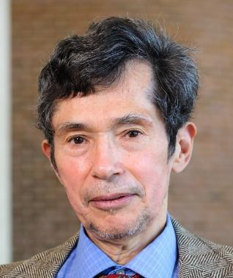

Racism is normal, permanent, and pervasive
“Racism is normal, not aberrant, in American society. Because it is an ingrained feature of our landscape, racism looks ordinary and natural to persons in our culture.” – Delgado and Stefancic
Delgado and Stefancic, Critical Race Theory: The Cutting Edge, 3rd edition, p. 2

Slide 11
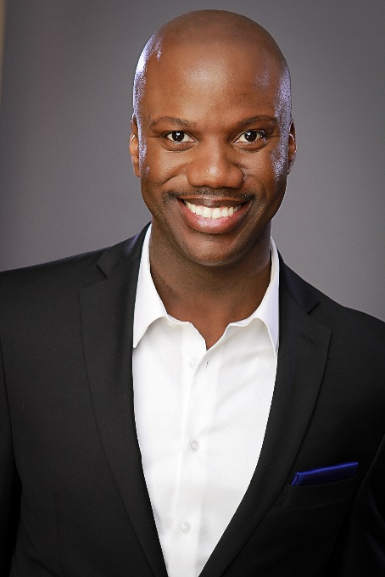
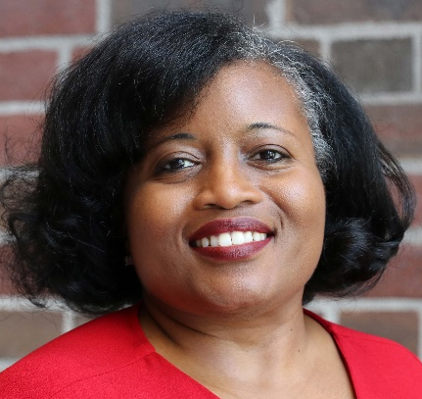
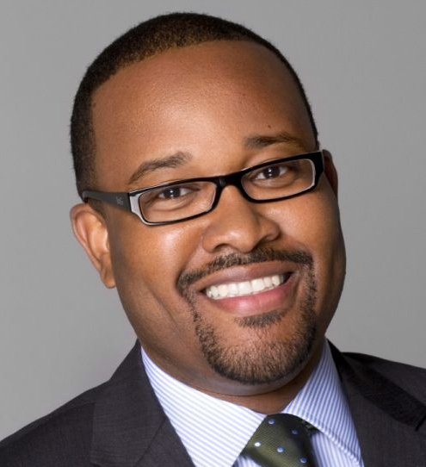
Racism is concealed beneath principles like colorblindness, meritocracy, and objectivity
“liberalism, neutrality, objectivity, colorblindness, and meritocracy… camouflage [how] racial advantage propels the self-interests, power, and privileges of the dominant group.” – Harper, Patton, and Wooden
Harper, Patton, and Wooden, “Access and Equity for African American Students in Higher Education: A Critical Race Historical Analysis of Policy Efforts,” The Journal of Higher Education, 80(4), 2009, p. 389-414.

Slide 12
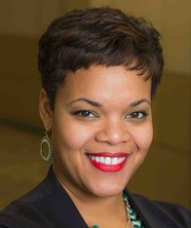
Lived experience is critical to fully understand racism
“blacks experience the power of second sight from the perspective of antiblack prejudice… A CRT framework recognizes the centrality of experiential knowledge of people of color and views this knowledge as legitimate, appropriate, and critical to understanding, analyzing, and teaching about racial subordination.” – Kafi Kumasi
Kafi D. Kumasi, “Critical Race Theory and Education: Mapping a Legacy of Activism and Scholarship” in Levinson’s Beyond Critique (p. 209-213).

Slide 13
Racism is part of interlocking systems of oppression
“CRT critiques [claims that]: one can fight racism without paying attention to sexism, homophobia, economic exploitation, and other forms of oppression or injustice.”– Harper, Patton, and Wooden
Harper, Patton, and Wooden, “Access and Equity for African American Students in Higher Education: A Critical Race Historical Analysis of Policy Efforts,” The Journal of Higher Education, 80(4), 2009, p. 389-414.

Slide 14
Outline
Review of contemporary critical theory
Review of critical race theory
Secular books about race
  White Fragility
  How to Be An Antiracist
  Also: So You Want to Talk About Race, Why I’m No Longer Talking to White People About Race, Me and White Supremacy
Christian books about race
  White Awake
  Be The Bridge
  Also: Rediscipling the White Church, Reconstructing the Gospel, We Need to Talk About Race, How to Fight Racism, After Whiteness, Can ‘White’ People Be Saved?
Sociology as theology
  Jesus and John Wayne
  Taking America Back for God
  Also: The Rise of Biblical Womanhood, White Evangelical Racism
Conclusions

Slide 15

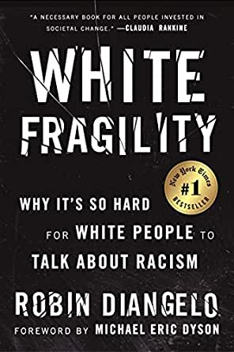
DiAngelo’s White Fragility

Slide 16
DiAngelo’s White Fragility
Positives:
Easy to read
Recognizably insane

Slide 17
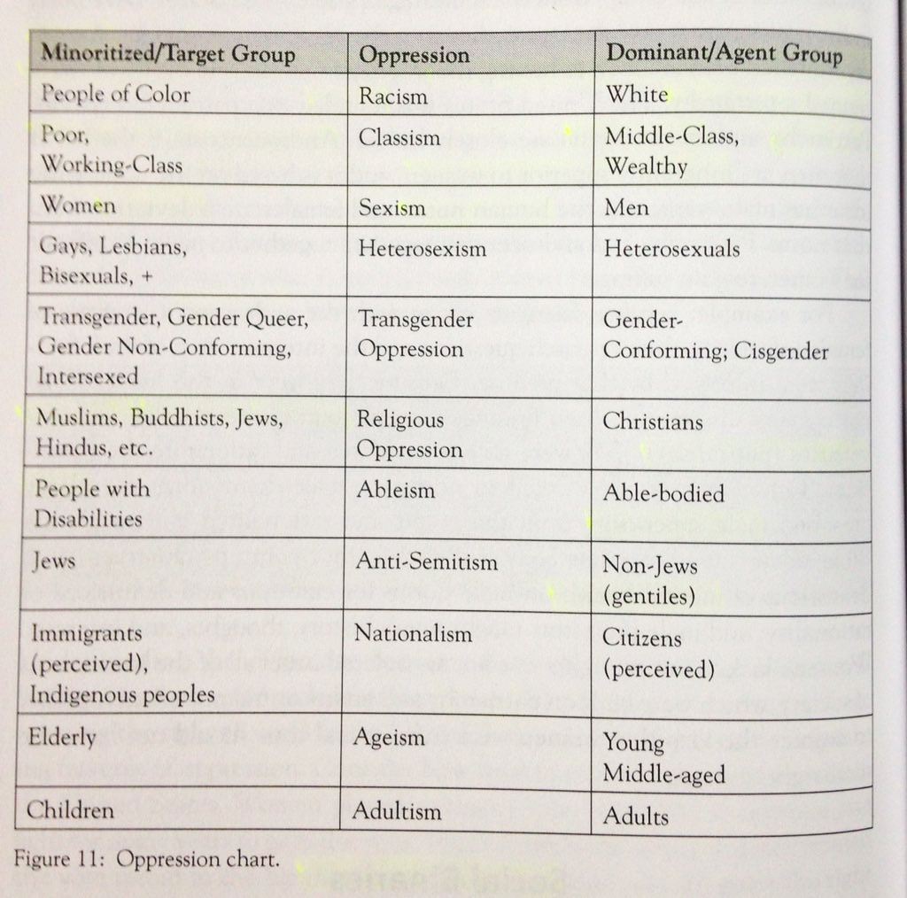
Critical Social Justice
Robin DiAngelo, What Does It Mean to Be White, (2016), p. 64

Slide 18
All whites are racist
“a positive white identity is an impossible goal. White identity is inherently racist; white people do not exist outside the system of white supremacy. This does not mean that we should stop identifying as white and start claiming only to be Italian or Irish. To do so is to deny the reality of racism in the here and now, and this denial would simply be color-blind racism. Rather, I strive to be ‘less white.’ To be less white is to be less racially oppressive. I can build a wide range of authentic and sustained relationships across race and accept that I have racist patterns.”
Robin DiAngelo, White Fragility, (2018), p. 149-150

Slide 19
The white fragility Kafkatrap
White fragility is “a state in which even a minimum amount of racial stress … becomes intolerable, triggering a range of defensive moves” (p. 103). Manifestations of white fragility include:
Feelings:
Singled out
Attacked
Silenced
Guilty
Accused
Judged
Angry
Scared
Behaviors:
Crying
Physically leaving
Emotionally withdrawing
Arguing
Denying
Seeking absolution
Claims:
I already know all this.
You are judging me
You are generalizing
I disagree
Some people find offense where there is none.
Robin DiAngelo, White Fragility, (2018), p. 103

Slide 20
Roadmap to Alienation
“…the question is not ‘Did racism take place?’ but rather, ‘In which ways did racism manifest in this specific context?’”¹
Cross-racial friendships do not block out the dynamics of racism in the society at large, and these dynamics continue unabated… Racism cannot be absent from your friendship. No person of color whom I’ve met has said that racism isn’t at play in his or her friendships with white people. Some whites are more thoughtful, aware, and receptive to feedback than others, but no cross-racial relationship is free from the dynamics of racism in this society.”²
¹ Schroeder & DiAngelo. (2010). Addressing Whiteness in Nursing Education: The Sociopolitical Climate Project at the University of Washington School of Nursing. Advances in Nursing Science, 33 (3) 244-255.
² Robin DiAngelo, White Fragility, (2018), p. 80-81

Slide 21
Outline
Review of contemporary critical theory
Review of critical race theory
Secular books about race
  White Fragility
  How to Be An Antiracist
  Also: So You Want to Talk About Race, Why I’m No Longer Talking to White People About Race, Me and White Supremacy
Christian books about race
  White Awake
  Be The Bridge
  Also: Rediscipling the White Church, Reconstructing the Gospel, We Need to Talk About Race, How to Fight Racism, After Whiteness, Can ‘White’ People Be Saved?
Sociology as theology
  Jesus and John Wayne
  Taking America Back for God
  Also: The Rise of Biblical Womanhood, White Evangelical Racism
Conclusions

Slide 22
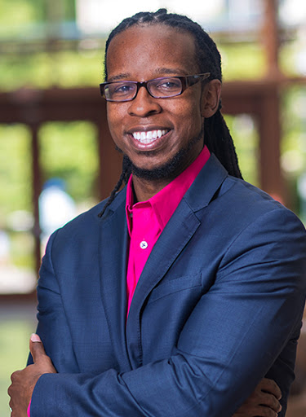
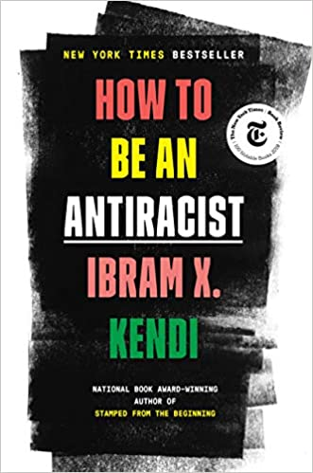
Kendi’s How to Be An Antiracist

Slide 23
Kendi’s How to be An Antiracist
Positives:
Easy to read
Clear definitions
Rejects the idea that “Blacks can’t be racist”

Slide 24
No neutrality
“there is no neutrality in the racism struggle. The opposite of ‘racist’ isn’t ‘not racist.’ It is ‘anti-racist.’ What’s the difference? One endorses either the idea of a racial hierarchy as a racist, or racial equality as an antiracist. One either believes problems are rooted in groups of people as a racist, or locates the roots of problems in power and policies, as an antiracist. One either allows racial inequities to persevere, as a racist, or confronts racial inequities, as an antiracist. There is no in-between safe space of ‘not racist.’…The claim of ‘not racist’ neutrality is a mask for racism… The language of colorblindness –like the langue of ‘not racist’ — is a mask to hide racism.”
Ibram X. Kendi, How to Be An Antiracist, p. 9-10

Slide 25
Antiracism as religion
“At Urbana ’70, Ma and Dad found themselves leaving the civilizing and conserving and racist church they realized they’d been part of. They were saved into Black liberation theology and joined the churchless church of the Black Power movement… My parents now had, separately, arrived at a creed with which to shape their lives, to be the type of Christians that Jesus the revolutionary inspired them to be... This new definition of the Christian life became the creed that grounded my parents’ lives and the lives of their children. I cannot disconnect my parents’ religious strivings to be Christian from my secular striving to be an antiracist.”
Ibram X. Kendi, How to Be An Antiracist, p. 14-17

Slide 26
Interlocking oppressions
“Antiracist policies cannot eliminate class racism without anticapitalism policies. Anticapitalism cannot eliminate class racism without antiracism.”
“To truly be antiracist is to be feminist. To truly be feminist is to be antiracist”
“We cannot be antiracist if we are homophobic or transphobic… To be queer antiracist is to understand the privileges of my cisgender, of my masculinity, of my heterosexuality, of their intersections”
Ibram X. Kendi, How to Be An Antiracist, p. 159, 189, 197

Slide 27
Disparities = discrimination
““A group we can call segregationists has blamed Black people themselves for racial disparities. A group we can call antiracists has pointed to racial discrimination. A group we can call assimilationists has tried to argue for both, saying that Black people and racial discrimination were to blame for racial disparities.”
“racial discrimination is the sole cause of racial disparities in this country and in the world at large… “When you truly believe that the racial groups are equal, then you also believe that racial disparities must be the result of racial discrimination”
Ibram X. Kendi, Stamped from the Beginning, p. 2, 11

Slide 28
Outline
Review of contemporary critical theory
Review of critical race theory
Secular books about race
  White Fragility
  How to Be An Antiracist
  Also: So You Want to Talk About Race, Why I’m No Longer Talking to White People About Race, Me and White Supremacy
Christian books about race
  White Awake
  Be The Bridge
  Also: Rediscipling the White Church, Reconstructing the Gospel, We Need to Talk About Race, How to Fight Racism, After Whiteness, Can ‘White’ People Be Saved?
Sociology as theology
  Jesus and John Wayne
  Taking America Back for God
  Also: The Rise of Biblical Womanhood, White Evangelical Racism
Conclusions

Slide 29


Hill’s White Awake

Slide 30

Hill’s White Awake
Positives:
Evangelical theology
Good motivation
Pastoral tone

Slide 31
Whiteness = blindness
“The greatest problem of all [for whites is] our conditioned blindness… we are blind wanderers who need help to see a world that functions according to a different set of rules than what we’ve been raised with.”
“it’s impossible to be complicit with centuries of traumatizing oppression without becoming traumatized oneself”
“[Whites’] goal must be sight. Our goal must be transformation. Our goal must be a renewed consciousness… we need a revelation from Jesus Christ in order to see what the kingdom of God is… Let’s pray like the blind man: ‘Lord, help me to see.'”
Daniel Hill, White Awake, p. 154, 72, 23

Slide 32
White Fragility
“Denial” is the earliest stage of the racial awakening process for a white person who has encountered racism (p. 67-79)
“it’s impossible to be complicit with centuries of traumatizing oppression without becoming traumatized oneself” - Hill, White Awake, p. 72

Slide 33
Questions
1. How do we handle disagreement?
2. Why only race?
3. How woke is woke enough?
4. What has the ultimate authority?

Slide 34
Outline
Review of contemporary critical theory
Review of critical race theory
Secular books about race
  White Fragility
  How to Be An Antiracist
  Also: So You Want to Talk About Race, Why I’m No Longer Talking to White People About Race, Me and White Supremacy
Christian books about race
  White Awake
  Be The Bridge
  Also: Rediscipling the White Church, Reconstructing the Gospel, We Need to Talk About Race, How to Fight Racism, After Whiteness, Can ‘White’ People Be Saved?
Sociology as theology
  Jesus and John Wayne
  Taking America Back for God
  Also: The Rise of Biblical Womanhood, White Evangelical Racism
Conclusions

Slide 35

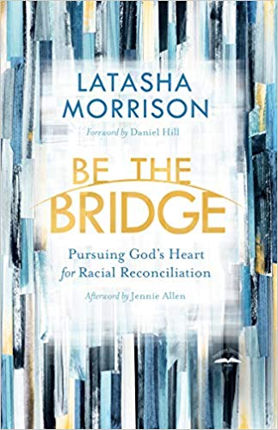
Morrison’s Be the Bridge

Slide 36
Morrison’s Be the Bridge
Positives:
Personal experiences
Good motivation

Slide 37
White Repentance
“shame and guilt often compel majority culture to cover up and whitewash sins”
“Our Western society is highly individualized, and our measure of morality is based on individual guilt or innocence. We’ve all heard the justification: Why should I repent of racism? I never owned slaves. But in the Bible, guilt and shame .. are often communal and point to the need for corporate repentance”
“Dealing with that guilt and shame [of our collective past], really owning it, can be a tear-filled, painful process… We can’t bypass the weight of our guilt and shame if we intend to arrive at true reconciliation and justice”
Latasha Morrison, Be the Bridge, p. 67-69

Slide 38
Unity requires reparations
“If repentance requires turning and walking away from the sins of our past, doesn’t it require walking toward something more reparative? So reparations and repentance are inextricably intertwined, and those who’ve inherited the power and benefits of past wrongs should work to make it right for those who’ve inherited the burdens and oppression of the past.”
“Reparations require sacrifice. But effective bridge builders don’t shy away from Jesus’s call to ‘go and sin no more,’ a call that includes making things right. Like Zacchaeus, effective bridge builders must return what was taken, even if it hurts”
Latasha Morrison, Be the Bridge, p. 155, 164

Slide 39
Be the Bridge in practice
Don’t “whitesplain.” Do not explain racism to a POC. Do not explain how the microaggression they just experienced was actually just someone being nice. Do not explain how a particular injustice is more about class than race. It’s an easy trap to fall into, but you can avoid it by maintaining a posture of active listening.
Don’t equate impact with intent. Yes, we all know your heart was in the right place and you meant well. But your words or behavior had a negative impact on those around you, and that’s what matters. Apologize and do better next time.
Don’t demand proof of a POC’s lived experience or try to counter their narrative with the experience of another POC. The experiences and opinions of POC are as diverse as its people. We can believe their stories. But keep in mind: just because one POC doesn’t feel oppressed, that doesn’t mean systemic, institutional racism isn’t real.
Do not chastise POCs (or dismiss their message) because they express their grief, fear, or anger in ways you deem “inappropriate.” Understand that historically, we white people have silenced voices of dissent and lament with our cultural idol of “niceness.” Provide space for POCs to wail, cuss, or even yell at you. Jesus didn’t hold back when he saw hypocrisy and oppression; POCs shouldn’t have to either.
Don’t get defensive when you are called out for any of the above. When a POC tells you that your words/tone/behavior are racist/oppressive/triggering, you stop. Don’t try to explain yourself (see #6.) Don’t become passive-aggressive or sarcastic. Don’t leave in a huff. (It may be helpful, however, to inconspicuously step outside/go to the restroom and take a deep breath.) Remain cognizant of the dynamics of white fragility, and take note of how it usually shows up in you.
From Whiteness 101 for the Be the Bridge Facebook Group

Slide 40
Outline
Review of contemporary critical theory
Review of critical race theory
Secular books about race
  White Fragility
  How to Be An Antiracist
  Also: So You Want to Talk About Race, Why I’m No Longer Talking to White People About Race, Me and White Supremacy
Christian books about race
  White Awake
  Be The Bridge
  Also: Rediscipling the White Church, Reconstructing the Gospel, We Need to Talk About Race, How to Fight Racism, After Whiteness, Can ‘White’ People Be Saved?
Sociology as theology
  Jesus and John Wayne
  Taking America Back for God
  Also: The Rise of Biblical Womanhood, White Evangelical Racism
Conclusions

Slide 41

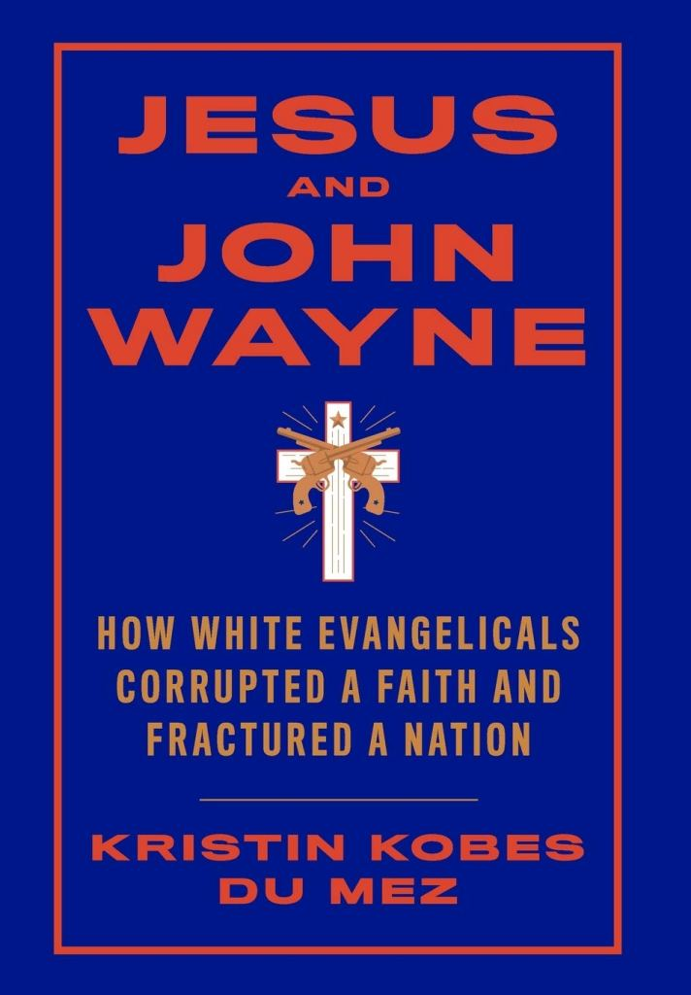
Du Mez’s Jesus and John Wayne

Slide 42

Du Mez’s Jesus and John Wayne
Positives:
Megapastor failures
Sex abuse scandals
“Christian nationalism”

Slide 43
Is Versus Ought
Subtitle: “How White Evangelicals Corrupted a Faith and Fractured a Nation.”
“Doug Wilson, John Piper, Mark Driscoll, James Dobson, Doug Phillips, and John Eldredge all preached a mutually reinforcing vision of Christian masculinity–of patriarchy and submission, sex and power [which] transformed the Jesus of the Gospels into an image of their own making”
“Although the evangelical cult of masculinity stretches back decades, its emergence was never inevitable…Appreciating how this ideology developed over time is… essential for those who wish to dismantle it. What was once done might be undone.”
Du Mez, Jesus and John Wayne, p. 294, 304

Slide 44
Non-egalitarian = patriarchal
“At the center of Dobson’s worldview–and that of many conservative evangelicals–was the strict enforcement of patriarchal authority”
Promise Keepers offered a “patriarchal bargain”
The Council for Biblical Manhood and Womanhood attempts to “fashion a scriptural defense of patriarchy”
The Danvers Statement is “a biblical defense of patriarchy and gender difference”
“CBMW and [Southern Baptist] seminaries [helped] build a network of evangelicals committed to advancing a patriarchal version of Christianity”
Du Mez, Jesus and John Wayne, p. 86, 153, 166, 167, 168

Slide 45
Deconstruction
“the battle over inerrancy was in part a proxy fight over gender”
“Within this expanding [evangelical] network, differences…could be smoothed over in the interest of promoting ‘watershed issues’ like complementarianism, the prohibition of homosexuality, the existence of hell, and substitutionary atonement. Most foundationally, they were united in a mutual commitment to patriarchal power… Over time, a common commitment to patriarchal power began to define the boundaries of the evangelical movement itself, as those who ran afoul of these orthodoxies quickly discovered. Evangelicals who offered competing visions of sexuality, gender, or the existence of hell found themselves excluded from conferences and associations, and their writings banned from popular evangelical bookstores and distribution channels.”
Du Mez, Jesus and John Wayne, p. 108, 204

Slide 46
Outline
Review of contemporary critical theory
Review of critical race theory
Secular books about race
  White Fragility
  How to Be An Antiracist
  Also: So You Want to Talk About Race, Why I’m No Longer Talking to White People About Race, Me and White Supremacy
Christian books about race
  White Awake
  Be The Bridge
  Also: Rediscipling the White Church, Reconstructing the Gospel, We Need to Talk About Race, How to Fight Racism, After Whiteness, Can ‘White’ People Be Saved?
Sociology as theology
  Jesus and John Wayne
  Taking America Back for God
  Also: The Rise of Biblical Womanhood, White Evangelical Racism
Conclusions

Slide 47
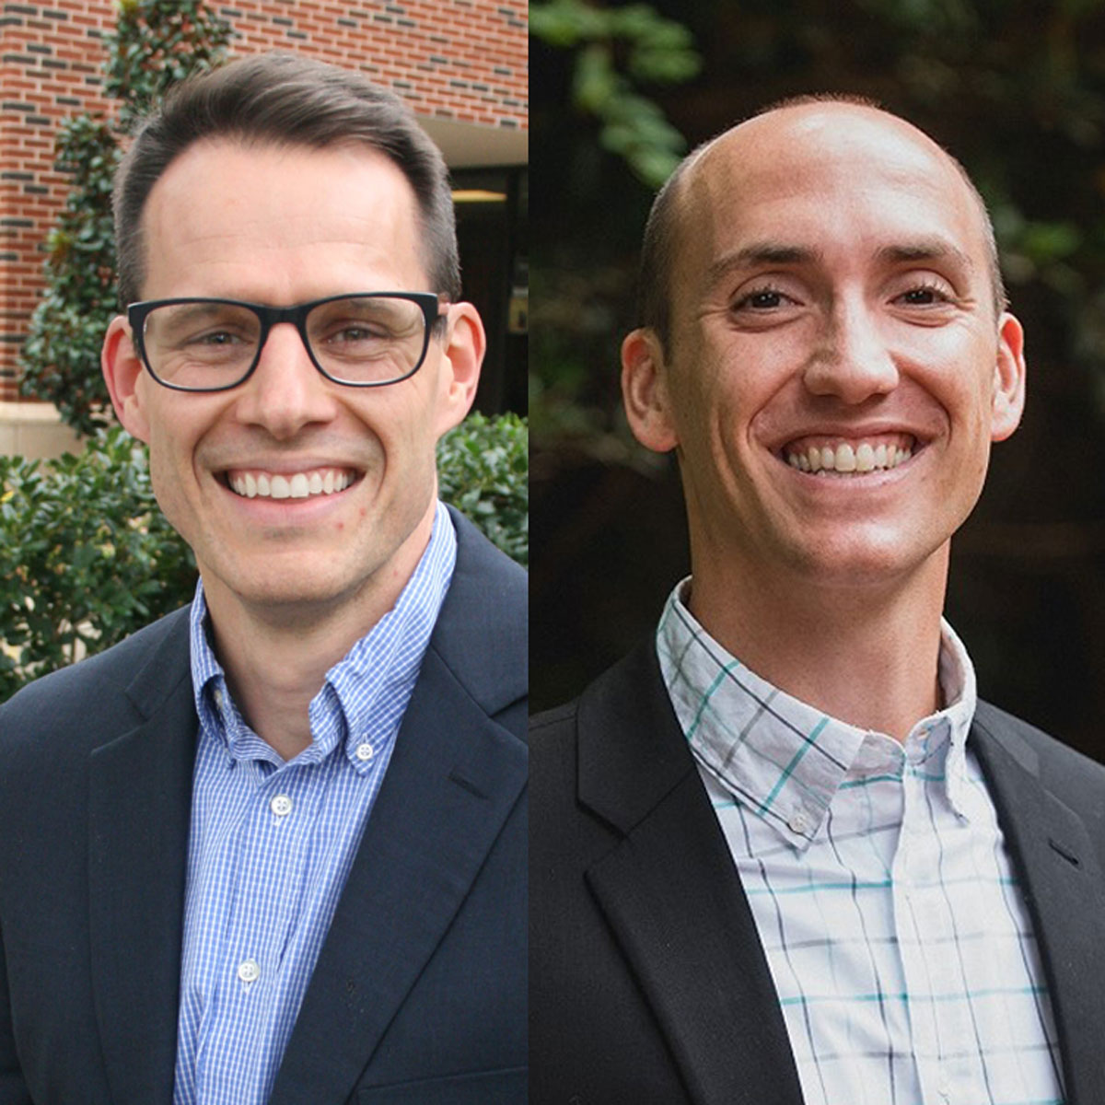

Whitehead’s and Perry’s Taking America Back for God

Slide 48

Whitehead’s and Perry’s Taking America Back for God
Positives:
Empirical data
Real problem: 68.4% of white born-again or evangelical Christians affirmed that “I consider founding documents like the Declaration of Independence and the Constitution to be divinely inspired.”

Slide 49
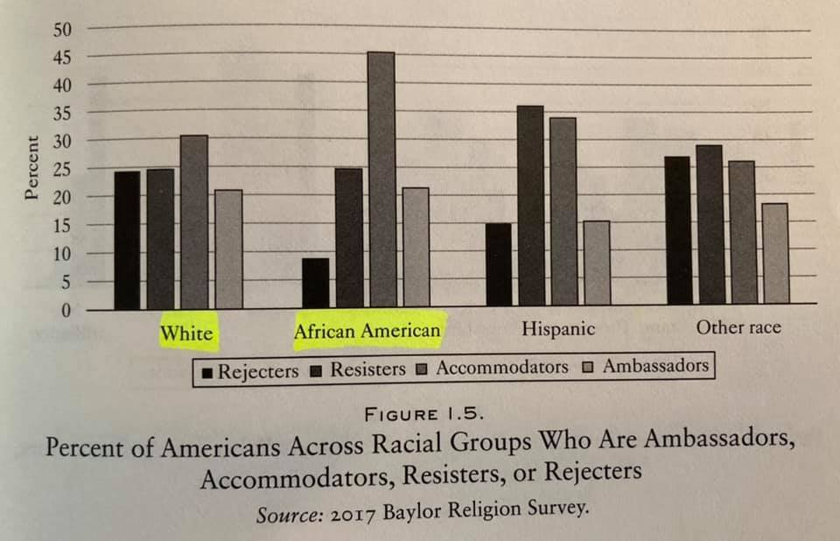
Defining “Christian nationalism”
Whitehead’s and Perry’s methods entail that 38% of Democrats, 67% of Black Protestants, and 21% of Jews are supportive of “Christian Nationalism,” that 38% of people who were supportive of Christian nationalism didn’t vote for Trump, and that Blacks are more supportive of “Christian nationalism” than Whites.

Slide 50
Implicit normative views
“only religious commitment is more predictive of [peoples’] views [on abortion] than Christian nationalism”
Christian nationalism is strongly correlated with opposition to same-sex marriage (p. 133).
Christian nationalism “glorifies the patriarchal, heterosexual family as not only God’s biblical standard, but the cornerstone of all thriving civilizations”
Whitehead and Perry, Taking America Back for God, p. 75, 133, 152

Slide 51
Outline
Review of contemporary critical theory
Review of critical race theory
Secular books about race
  White Fragility
  How to Be An Antiracist
  Also: So You Want to Talk About Race, Why I’m No Longer Talking to White People About Race, Me and White Supremacy
Christian books about race
  White Awake
  Be The Bridge
  Also: Rediscipling the White Church, Reconstructing the Gospel, We Need to Talk About Race, How to Fight Racism, After Whiteness, Can ‘White’ People Be Saved?
Sociology as theology
  Jesus and John Wayne
  Taking America Back for God
  Also: The Rise of Biblical Womanhood, White Evangelical Racism
Conclusions

Slide 52
Conclusions
Contemporary critical theory functions as an all-encompassing worldview
The ideas of critical theory are far more pervasive than most people realize
If Christians aren’t equipped to think biblically about race, gender, and justice, the culture will teach them to think unbiblically
Do not categorize books as “Christian = safe” vs. “non-Christian = unsafe”

Slide 53


Acknowledgements and additional resources
Dr. Christina Shenvi
Dr. Pat Sawyer
Shenviapologetics.com/book-reviews/
Google: “Shenvi” + book title
Twitter @NeilShenvi, @RealPatSawyer

