Slide 1

Social Justice, Critical Theory, and Christianity: Are they Compatible?
Dr. Neil Shenvi
Sept. 17, 2021

Slide 2
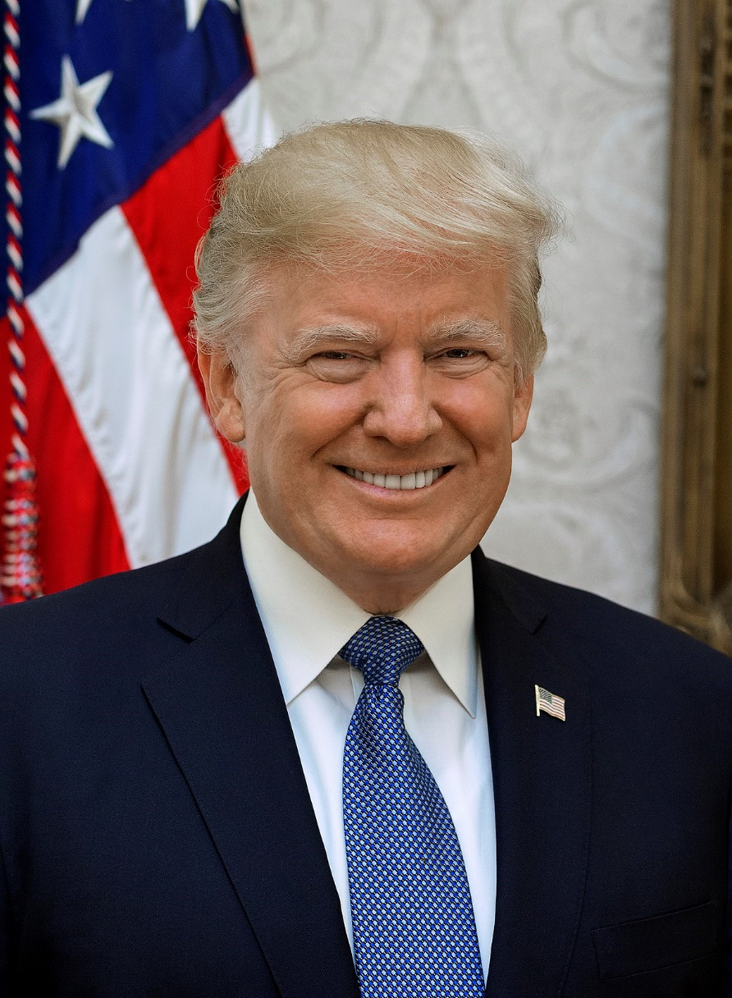
This talk is not about Trump

Slide 3
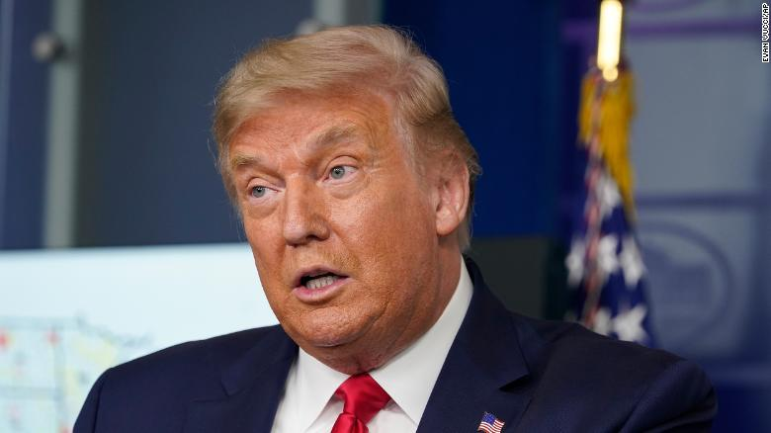
This talk is not about Trump

Slide 4
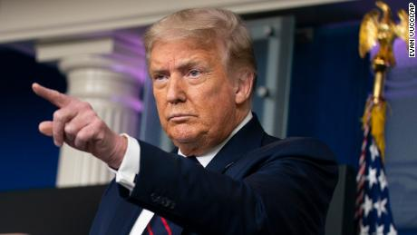



This talk is not about Trump

Slide 5
This talk is not about Trump
This talk is not about Trump
This talk is not about Trump
This talk is not about Trump
This talk is not about Trump
This talk is not about Trump

Slide 6




NYTimes word usage
“Racism”
“Privilege”
“Whiteness”
“Intersectionality”

Slide 7

Smithsonian NMAAHC
“Whiteness and white racialized identity refer to the way that white people, their customs, culture, and beliefs operate as the standard by which all other groups of are compared.”

Slide 8

Black Lives Matter
“We are self-reflexive and do the work required to dismantle cisgender privilege and uplift Black trans folk, especially Black trans women who continue to be disproportionately impacted by trans-antagonistic violence…
We foster a queer‐affirming network. When we gather, we do so with the intention of freeing ourselves from the tight grip of heteronormative thinking, or rather, the belief that all in the world are heterosexual (unless s/he or they disclose otherwise).”

Slide 9
Outline
Why should we care?
What is critical theory?
What are the problems with critical theory?
Logical implications
Conclusions and book recommendations

Slide 10
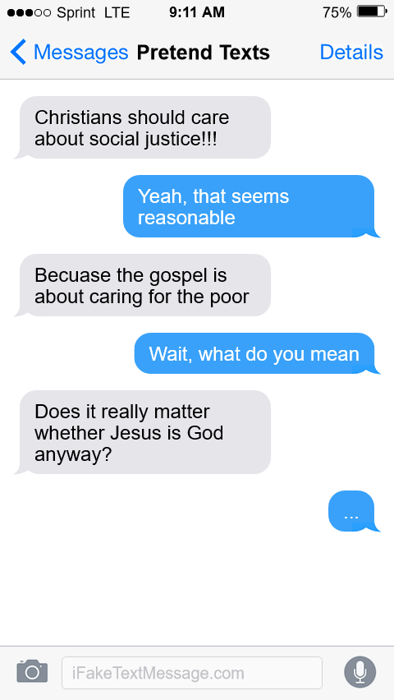
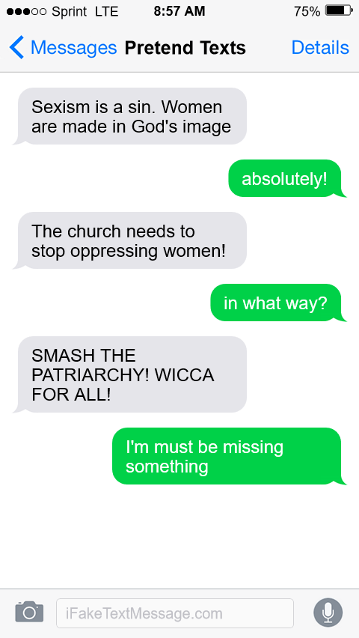
Why should we care?
Warning: fake texts. For pedagogical use only

Slide 11

Why should we care?

Slide 12
Outline
Why should we care?
What is critical theory?
What are the problems with critical theory?
Logical implications
Conclusions and book recommendations

Slide 13

Critical theory and Karl Marx
“Alone among these thinkers [i.e., Horkheimer, Bourdieu, Foucault, etc.], Karl Marx invites consensus as a ‘true’ critical theorist. Indeed, for many, he alone inaugurates the critical tradition” (Levinson et al, Beyond Critique, p. 25-26)
1850
1900
1950
2000

Slide 14




Critical theory and the Frankfurt School
“Critical theory was conceived within the crucible of Marxism” “The Frankfurt School not only contested establishmentarianism view of history, but projected a radical alternative. European radicals applied its ideas to reconfiguring the family, sexuality, and education.” – Bronner, Critical Theory: A Very Short Introduction, p. 2, 7
1850
1900
1950
2000

Slide 15
















Other critical social theorists
Cultural Studies
Postcolonialism
Critical pedagogy
Postmodernism
Bourdieu
Hall
Fanon
Said
Freire
Giroux
Foucault
Derrida
Feminism
Black feminism
Queer theory
Critical Race Theory
de Beauvoir
Friedan
hooks
Lourde
Butler
Rich
Bell
Crenshaw
1850
1900
1950
2000

Slide 16
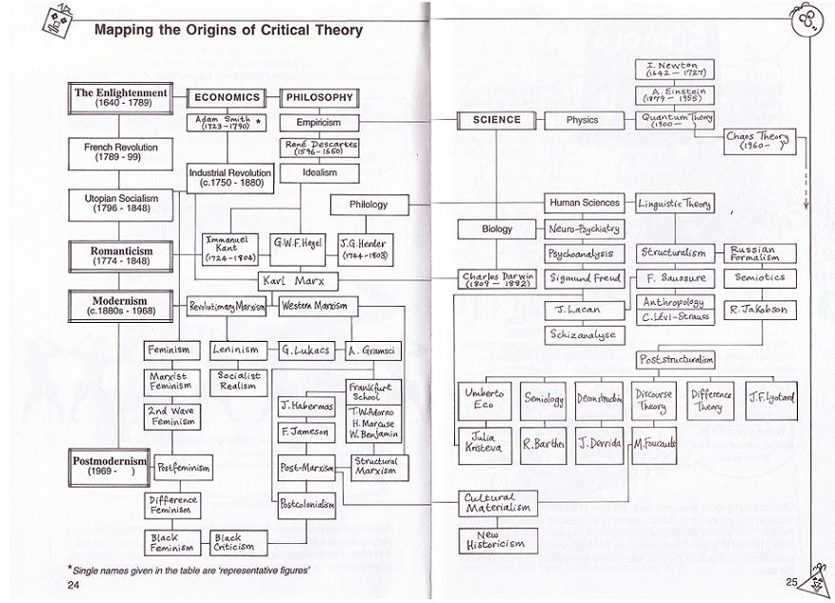
The Taxonomy of Critical Theory
Sim and Van Loon, Introducing Critical Theory, p. 24-25

Slide 17










The Taxonomy of Critical Theory
“critical theory” = critical social theories
“Critical Theory”
= Frankfurt School
Critical theory resists essentialism (it is hard to define!)

Slide 18
What is critical theory?
“intersectionality”
“White privilege”
“White fragility”
“colorblind racism”
“internalized oppression”
“lived experience”
“heteronormativity”
“gender performativity”
“epistemic injustice”
“cisheteropatriarchy”
“compulsory heterosexuality”
“whiteness”

Slide 19
What is critical theory?
“intersectionality”
“White privilege”
“White fragility”
“colorblind racism”
“internalized oppression”
“lived experience”
“heteronormativity”
“gender performativity”
“epistemic injustice”
“cisheteropatriarchy”
“compulsory heterosexuality”
“whiteness”
Kimberlé Crenshaw
Peggy McIntosh
Robin DiAngelo
Eduardo Bonilla-Silva
Patricia Hill Collins
Maurianne Adams
Richard Delgado
Beverly Tatum
etc…

Slide 20
What’s in a name?
“intersectionality”
“White privilege”
“White fragility”
“colorblind racism”
“internalized oppression”
“lived experience”
“heteronormativity”
“gender performativity”
“epistemic injustice”
“cisheteropatriarchy”
“compulsory heterosexuality”
“whiteness”
Cultural Marxism
Identity Politics
Critical Race Theory
Neo-Marxism
Intersectionality
Grievance Studies
Applied postmodernism
Critical Social Justice
“Contemporary critical theory”

Slide 21





The central premises of contemporary critical theory?
Premise I: Social binary
Premise II: Oppression through ideology
Premise III: Lived experience
Premise IV: Social justice

Slide 22
Outline
Why should we care?
What is critical theory?
  Premise 1: Social binary
  Premise 2: Oppression through ideology
  Premise 3: Lived experience
  Premise 4: Social justice
  The strengths of critical theory
What are the problems with critical theory?
Logical implications
Conclusions and book recommendations

Slide 23

Premise #1: Society is divided into oppressed and oppressor groups
Sensoy and DiAngelo, Is Everyone Really Equal, p. 64

Slide 24
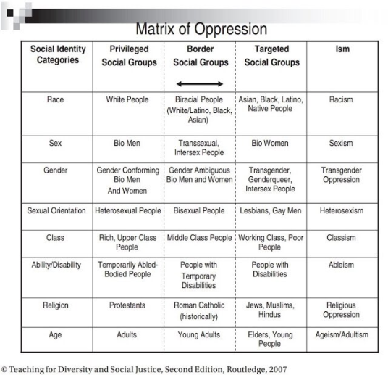
Premise #1: Society is divided into oppressed and oppressor groups
Adams et al, Teaching for Diversity and Social Justice, Appendix C

Slide 25
Outline
Why should we care?
What is critical theory?
  Premise 1: Social binary
  Premise 2: Oppression through ideology
  Premise 3: Lived experience
  Premise 4: Social justice
  The strengths of critical theory
What are the problems with critical theory?
Logical implications
Conclusions and book recommendations

Slide 26

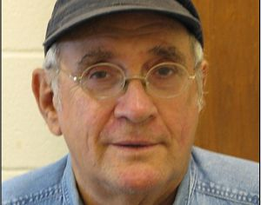
Premise #2: Oppression occurs through hegemonic power
“oppression also traditionally carries a strong connotation of conquest and colonial domination… New left social movements of the 1960s and 1970s, however, shifted the meaning of the concept of oppression. In its new usage, oppression designates the disadvantage and injustice some people suffer not because a tyrannical power coerces them, but because of the everyday practices of a well-intentioned liberal society… Oppression in this sense is structural, rather than the result of a few people’s choices or policies. Its causes are embedded in unquestioned norms, habits, and symbols.” – Iris Young, “Five Faces of Oppression,” Readings for Diversity and Social Justice, p. 36
“Marcuse’s notions of ‘one dimensional thought’…complements the critical theory tradition to better understand how hegemony, as cultural domination, normalizes and sustains the political/economic power of particular historic blocs – the ruling coalition of economic, political and cultural elites” – Lauren Langman, “From Domination to Liberation: Marcuse, Gramsci, and a Critical Theory of Social Mobilization”, p.14, Conference Papers – American Sociological Association.

Slide 27
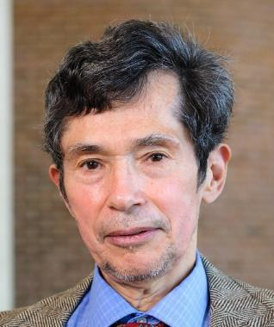
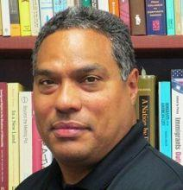
Premise #2: Oppression occurs through hegemonic power
“Ideology – the received wisdom – makes current social arrangements seem fair and natural. Those in power sleep well at night; their conduct does not seem to them like oppression” – Richard Delgado, “Storytelling for Oppositionists and Others”; in Critical Race Theory, pp 71-72
“This new ideology [of color-blind racism] has become a formidable political tool for the maintenance of the racial order… the beauty of this new ideology is that it aids in the maintenance of white privilege without fanfare, without naming those who it subjects and those who it rewards.” Eduardo Bonilla-Silva, Racism Without Racists, p. 3-4

Slide 28

Premise #2: Oppression occurs through hegemonic power
Old white men
~15%

Slide 29
Outline
Why should we care?
What is critical theory?
  Premise 1: Social binary
  Premise 2: Oppression through ideology
  Premise 3: Lived experience
  Premise 4: Social justice
  The strengths of critical theory
What are the problems with critical theory?
Logical implications
Conclusions and book recommendations

Slide 30
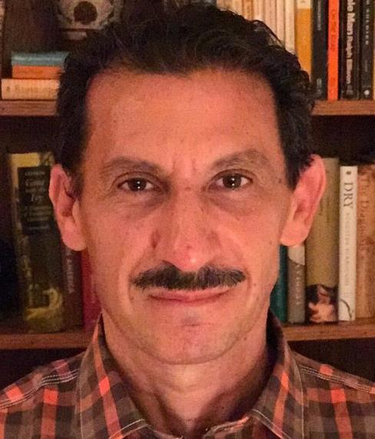
Premise #3: ‘Lived experience’ gives oppressed groups privileged access to truth
“oppressed groups do have a distinctive set of experiences and … are better positioned and better equipped for a particular kind of epistemic subversion… As Mills puts it, ‘Hegemonic [dominant] groups characteristically have experiences that foster illusory perceptions about society’s functioning, whereas subordinate groups characteristically have experiences that (at least potentially) give rise to more adequate conceptualizations’” – Medina, Epistemology of Resistance, p. 46.

Slide 31
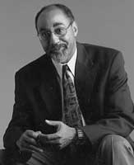
Premise #3: ‘Lived experience’ gives oppressed groups privileged access to truth
“[We] must learn to privilege [our] own perspectives and those of other outsiders, understanding that the dominant legal discourse is premised upon the claim to knowledge of objective truths and the existence of neutral principles. We must free ourselves from the mystification produced by this ideology. We must learn to trust our own senses, feelings, and experiences, and to give them authority, even (or especially) in the face of dominant accounts of social reality that claim universality.” – Charles R. Lawrence III, “The Word and The River: Pedagogy as Scholarship as Struggle,” in Crenshaw’s CRT, p. 338

Slide 32


Premise #3: ‘Lived experience’ gives oppressed groups privileged access to truth
“The idea that objectivity is best reached only through rational thought is a specifically Western and masculine way of thinking – one that we will challenge throughout this book.” – Margaret L. Andersen and Patricia Hill Collins, “Reconstructing Knowledge,” in Anderson and Collins, Race, Class, and Gender, p. 4-5

Slide 33



Premise #3: ‘Lived experience’ gives oppressed groups privileged access to truth
Oppression and epistemology:
Privilege
Lived
experience
Internalized oppression
Liberatory consciousness

Slide 34
Outline
Why should we care?
What is critical theory?
  Premise 1: Social binary
  Premise 2: Oppression through ideology
  Premise 3: Lived experience
  Premise 4: Social justice
  The strengths of critical theory
What are the problems with critical theory?
Logical implications
Conclusions and book recommendations

Slide 35

Premise #4: Social justice demands the liberation of oppressed groups
Definition of social justice:
“Prior to celebrating diversity, we must first eliminate intolerance. No matter what form it takes or who does it, we must all take action to stop intolerance when it happens. Working towards a celebration of diversity implies working for social justice – the elimination of all forms of social oppression… Social injustice takes many forms. It can be injustice based on a person’s gender, race, ethnicity, religion, sexual orientation, physical or mental ability, or economic class.” – Mary McClintock, “How to Interrupt Oppressive Behavior,” Readings for Diversity and Social Justice, p. 483

Slide 36

Unifying themes of critical theory
“the cluster of philosophical approaches to [issues of identity is] known by the umbrella term critical theory. Critical theory is today a diverse phenomenon that draws deeply and variously on strands of Marxist thought, psychoanalysis, feminist theory, postcolonialism, poststructuralism, queer theory, and deconstruction… at the core of the various approaches of critical theorists lies a relatively simple set of convictions: the world is to be divided up between those who have power and those who do not; the dominant Western narrative of truth is really an ideological construct designed to preserve the power structure of the status quo; and the goal of critical theory is therefore to destabilize this power structure by destabilizing the dominant narratives that are used to justify –to ‘naturalize’– it” - Trueman
Trueman, The Rise and Triumph of the Modern Self, p. 225-226

Slide 37
Outline
Why should we care?
What is critical theory?
  Premise 1: Social binary
  Premise 2: Oppression through ideology
  Premise 3: Lived experience
  Premise 4: Social justice
  The strengths of critical theory
What are the problems with critical theory?
Logical implications?
Conclusions and book recommendations

Slide 38

Strength #1. Emphasis on the sinfulness of oppression
“Learn to do good; seek justice, correct oppression; bring justice to the fatherless, plead the widow's cause.” – Is. 1:17
“Do not oppress the widow, the fatherless, the sojourner, or the poor, and let none of you devise evil against another in your heart.” – Zech. 7:20
“Love your neighbor as yourself.” – Mark 12:30
“Listen! The wages of the laborers who mowed your fields which you kept back by fraud, cry out, and the cries of the har­vesters have reached the ears of the Lord of hosts” – James 5:4

Slide 39

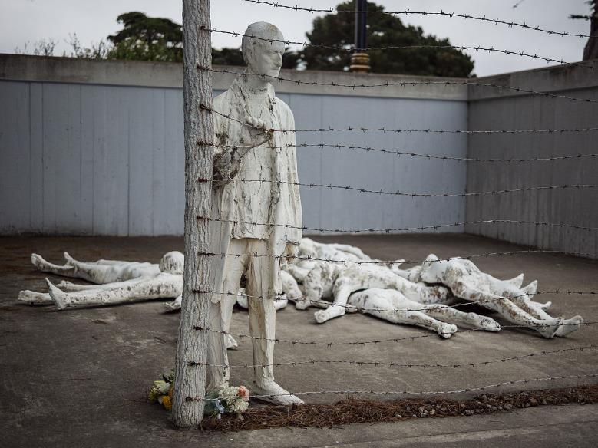
Strength #2. Focus on structures, systems, and norms

Slide 40

Strength #3: Recognition of hegemonic power

Slide 41
Outline
Why should we care?
What is critical theory?
What are the problems with critical theory?
  Worldview
  Epistemology
  Adversarial identities
  Hegemonic power
Logical implications
Conclusions and book recommendations

Slide 42
Worldview questions
Who are we?
What is our fundamental problem as human beings?
What is the solution to our problem?
What is our primary moral duty?
What is our purpose in life?

Slide 43

Christianity and critical theory are competing worldviews
Christianity
-----
OPPRESSION
ACTIVISM
LIBERATION
Patriarchy
White supremacy
Heteronormativity
Toxic masculinity
Classism
Ageism
Ableism
Cisgenderism
Protest
Resistance
Education
Awareness
Equity
Power reversal
Justice
Diversity
Critical theory

Slide 44
Worldview questions
 | Christianity | Critical theory
Who are we? | God’s creatures | Members of various groups
What is our problem? | Sin | Oppression
What is the solution? | Jesus | Liberation
What is our duty? | Loving God | Liberating the oppressed
What is our purpose? | Glorifying God | Working for liberation

Slide 45


Critical theory as worldview
“we now have Social Justice texts--forming a kind of Gospel of Social Justice--that express, with absolute certainty, that all white people are racist, all men are sexist, racism and sexism are systems that can exist and oppress absent even a single person with racist or sexist intentions or beliefs..., sex is not biological and exists on a spectrum, language can be literal violence, denial of gender identity is killing people, the wish to remedy disability and obesity is hateful, and everything needs to be decolonized.
Does this sound like a metanarrative? That's because it is. Social Justice scholarship and its educators and activists see these principles and conclusions as The Truth According to Social Justice--and they treat it as though they have discovered the analogue of the germ theory of disease, but for bigotry and oppression”
-Pluckrose and Lindsay, Cynical Theories, p. 182-183

Slide 46
Outline
Why should we care?
What is critical theory?
What are the problems with critical theory?
  Worldview
  Epistemology
  Adversarial identities
  Hegemonic power
Logical implications
Conclusions and book recommendations

Slide 47
Epistemology
Claim
reason,
logic,
argument
Evidence

Slide 48

Bulverism
psychology,
economics,
politics
Claim
reason,
logic,
argument
Motivation/
hidden agenda
Evidence

Slide 49
Epistemology
psychology,
economics,
politics
Claim
reason,
logic,
argument,
exegesis
“maintaining supremacy”
“internalized oppression”
Scripture

Slide 50
Outline
Why should we care?
What is critical theory?
What are the problems with critical theory?
  Worldview
  Epistemology
  Adversarial identities
  Hegemonic power
Logical implications
Conclusions and book recommendations

Slide 51


Identity and solidarity

Slide 52
Identity and solidarity
Creation
Sin
Redemption

Slide 53
Outline
Why should we care?
What is critical theory?
What are the problems with critical theory?
  Worldview
  Epistemology
  Adversarial identities
  Hegemonic power
Logical implications
Conclusions and book recommendations

Slide 54

Christianity as hegemonic discourse
Religion
Morality
Sexuality
Gender
etc…

Slide 55
Outline
Why should we care?
What is critical theory?
What are the problems with critical theory?
Logical implications
Conclusions and book recommendations

Slide 56

Claim #1: “We should never challenge ‘lived experience’”
“As a woman, I know that our society is deeply sexist.”
“As a black man, I know that our society is deeply racist.”
“As a lesbian, I know that sexual orientation is fixed from birth.”
“As a Sufi Muslim, I know that Islam is true.”
“As a polyamorous man, I know that sex outside of marriage is okay.”
“As a Hindu, I know that all paths lead to God.”

Slide 57

Claim #2: “We need to liberate our theology from privileged groups”
“We need to de-center ‘white theology’ and platform the theology of people of color.”
“We need to de-center ‘Western theology’ and platform non-Western theology.”
“We need to de-center male theology and platform feminist theology.”
“We need to de-center the Eurocentric creeds of the Reformation, and platform liberation theology.”
“We need to de-center the all-male books of the Bible and platform the extra-biblical books written by women.”

Slide 58

Claim #3: “We should dismantle all structures which perpetuate privilege”
“We should dismantle private property, because it perpetuates economic privilege.”
“We should dismantle the institution of marriage, because it perpetuates heterosexual and monogamous privilege.”
“We should dismantle the connection between sex and gender, because it perpetuates cis-privilege.”
“We should dismantle all Christian moral norms, because they perpetuate Christian privilege.”

Slide 59

Claim #4: “We should promote diversity within the church”
“We should promote a diversity of ethnicities within the church.”
“We should promote a diversity of cultures within the church.”
“We should promote a diversity of racist, misogynistic, materialistic, idolatrous cultures within the church ”
“We should promote a diversity of moral behaviors within the church.”
“We should promote a diversity of theological beliefs within the church.”

Slide 60
Positives and negatives
Claim #1: “We should never challenge ‘lived experience’”
Positive: Lived experience can give us valuable insights
Negative: …but must still be subjected to the scrutiny of Scripture and evidence.
Claim #2: “We need to liberate our theology from privileged groups”
Positive: We should constantly reexamine our theology to recognize where our
identity has biased our interpretation
Negative: …but the truth or falsehood of a claim does not depend on the
identity of the person making it.
Claim #3: “We should dismantle all structures which perpetuate privilege”
Positive: Power can be abused and misused
Negative: …but power is not inherently evil and power imbalances are not
necessarily unjust.
Claim #4: “We should promote diversity within the church”
Positive: Some forms of diversity are elements of God’s good creation
Negative: …but others are the result of sin and must be rejected.

Slide 61
Outline
Why should we care?
What is critical theory?
What are the problems with critical theory?
Logical implications
Conclusions and book recommendations

Slide 62
Christianity and critical theory are competing worldviews
Christianity
-----
OPPRESSION
ACTIVISM
LIBERATION
Patriarchy
White supremacy
Heteronormativity
Toxic masculinity
Classism
Ageism
Ableism
Cisgenderism
Protest
Resistance
Education
Awareness
Equality
Power reversal
Justice
Diversity
Critical theory

Slide 63
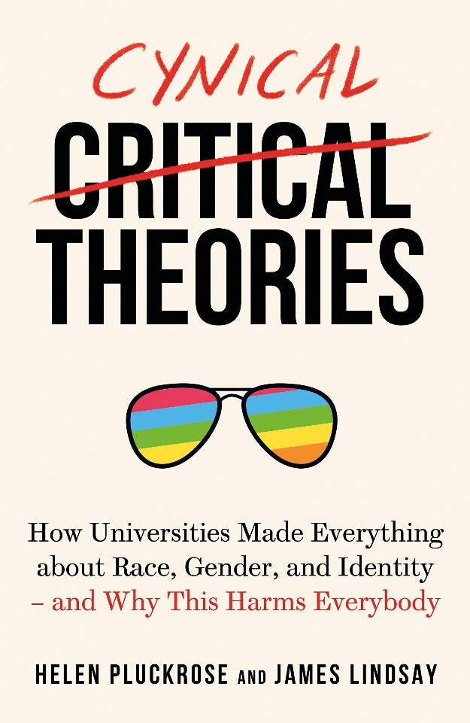
Cynical Theories by Helen Pluckrose and James Lindsay

Slide 64
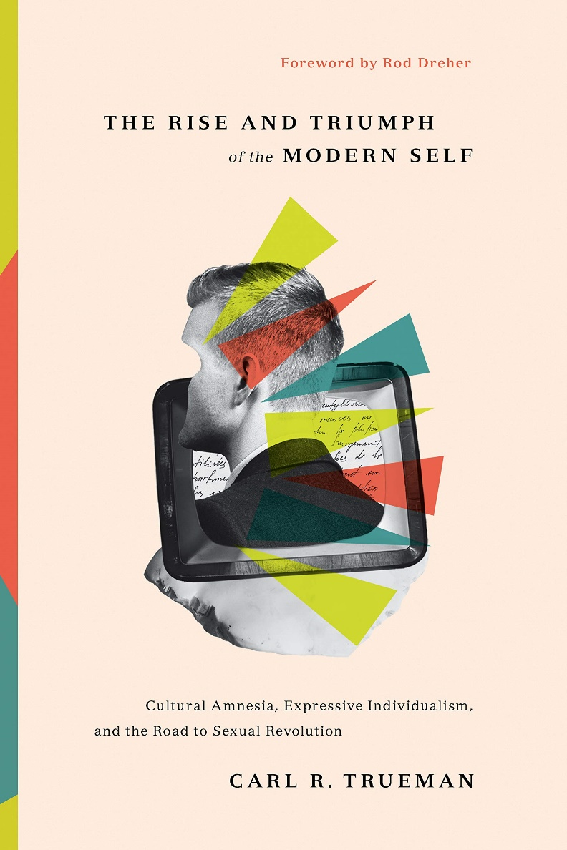
The Rise and Triumph of the Modern Self by Carl Trueman

Slide 65
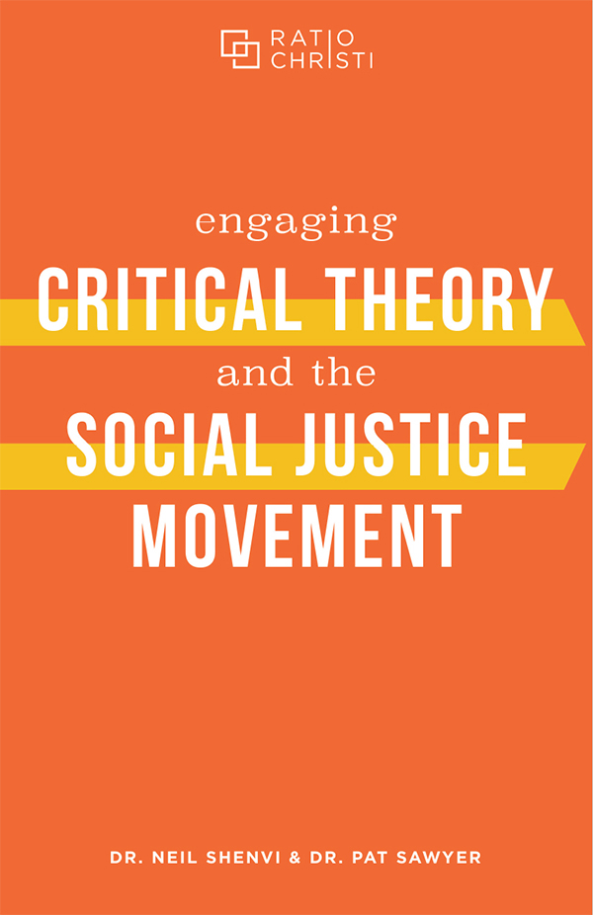


Engaging Critical Theory and the Social Justice Movement by Shenvi and Sawyer

