Slide 1
Christianity and Critical Theory: Are They Compatible?
Dr. Neil Shenvi
Gospel and Social Justice Conference
Ft. Worth, TX
Nov. 9-10, 2018

Slide 2
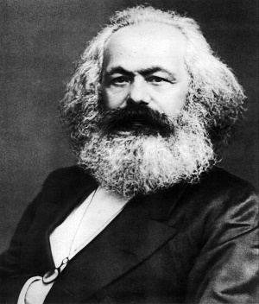
The Origins of Critical Theory

Slide 3
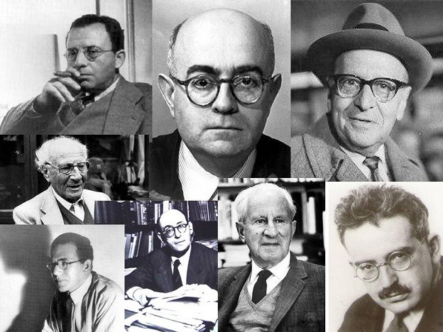
The Dark Origins of Critical Theory

Slide 4

The Dark, Secret Origins of Critical Theory

Slide 5
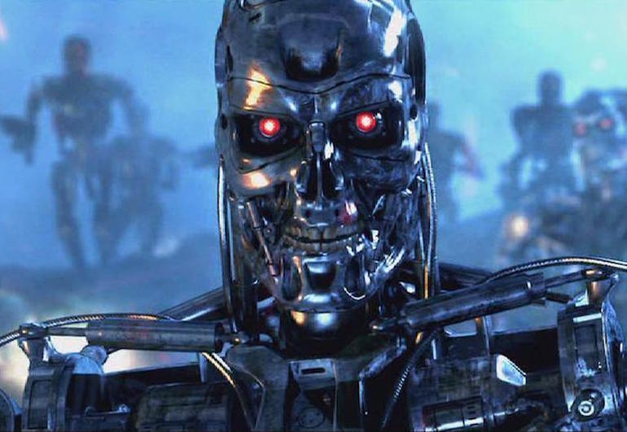

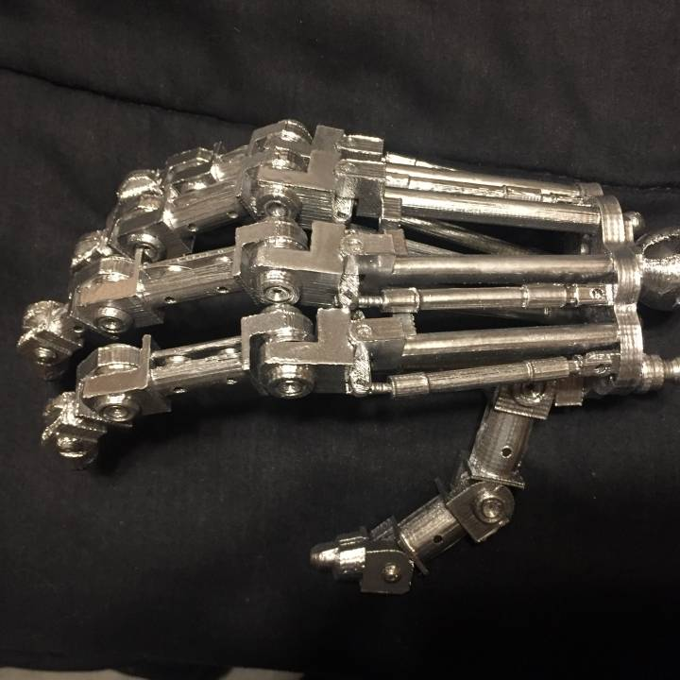
The Dark, Secret, but 100% Legit and Completely Believable Origins of Critical Theory

Slide 6

The Origins of Critical Theory

Slide 7
Outline
Why should we care?
What is critical theory?
Conflicts between critical theory and Christianity
Logical implications
Advice for dialogue

Slide 8
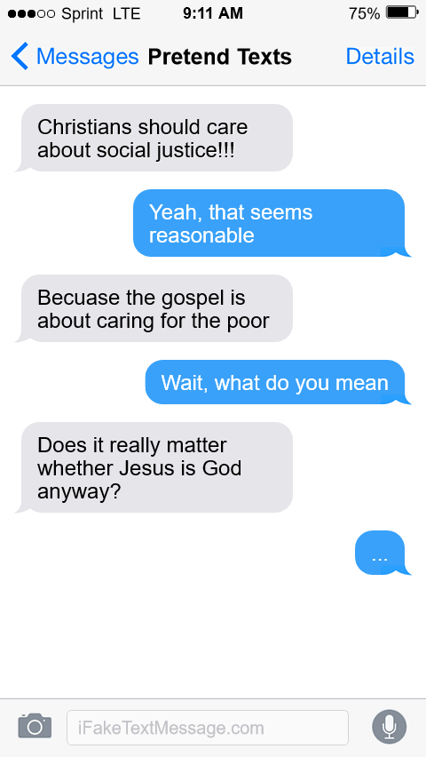
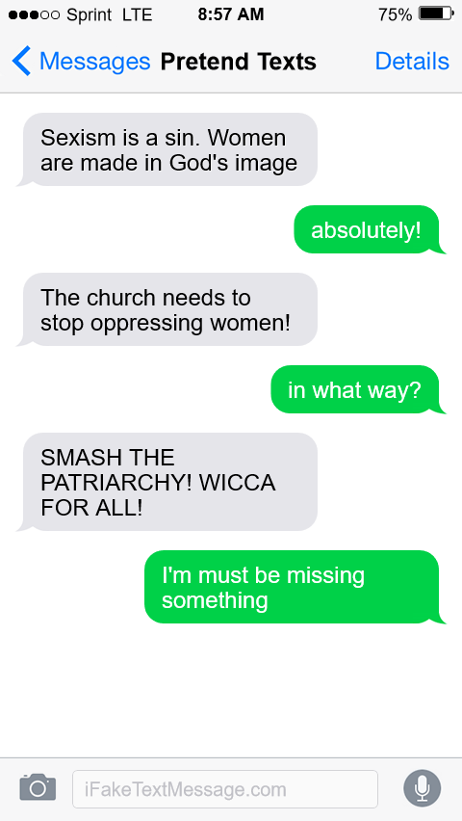
Why should we care?

Slide 9

Why should we care?

Slide 10
Outline
Why should we care?
What is critical theory?
  Premise 1: ‘Oppressed’ vs. ‘oppressor’
  Premise 2: Oppression through hegemonic power
  Premise 3: Solidarity in oppression
  Premise 4: Liberation as moral duty
  Premise 5: ‘Lived experience’ vs. objective evidence
  Premise 6: Guise of objectivity
  Premise 7: Intersectionality
  The strengths of critical theory
Conflicts between critical theory and Christianity
Logical implications
Advice for dialogue

Slide 11
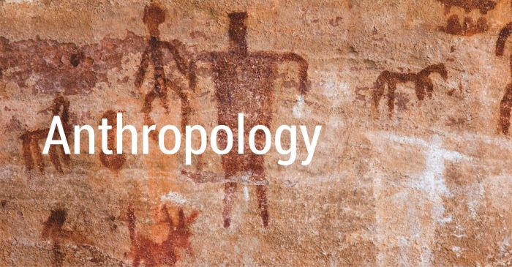



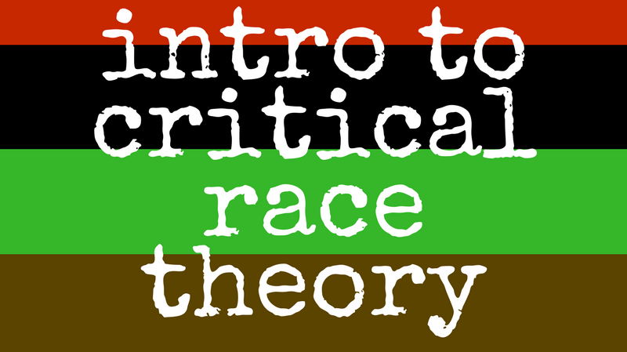
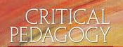

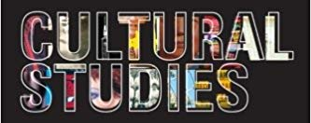
What is critical theory?
CRITICAL THEORY

Slide 12

What is critical theory?
Major premises:
‘Oppressed’ vs. ‘oppressor’
Oppression through hegemonic power
Solidarity in oppression
Liberation as moral duty
Minor premises:
5. ‘Lived experience’ vs. objective evidence
6. Guise of objectivity
7. Intersectionality

Slide 13
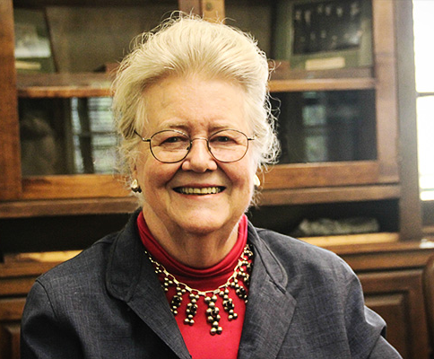
Premise #1: Individual identity is inseparable from group identity as ‘oppressed’ or ‘oppressor’
“My schooling gave me no training in seeing myself as an oppressor… I was taught [wrongly] to see myself as an individual whose moral state depended on her individual moral will” – Peggy McIntosh, “White Privilege and Male Privilege,” in Andersen and Collins, Race, Class, and Gender, p. 72

Slide 14
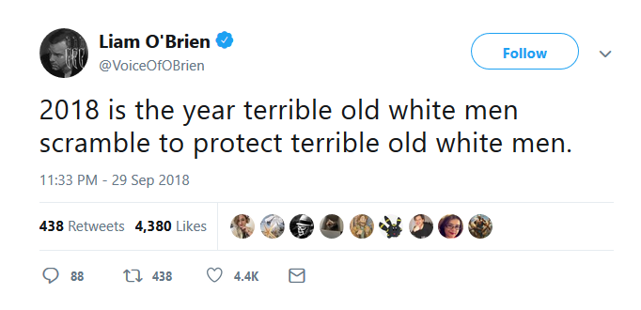
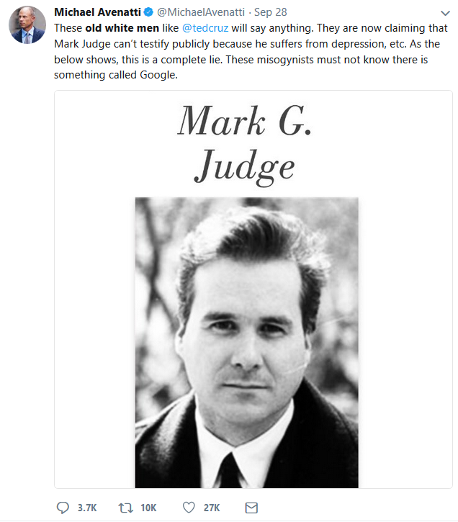
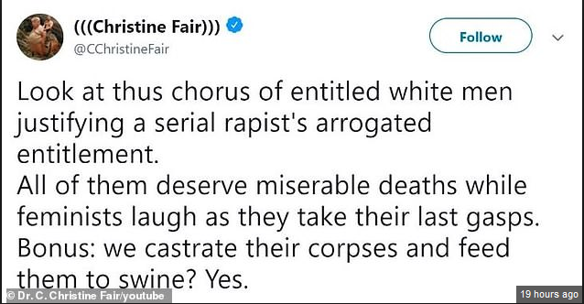
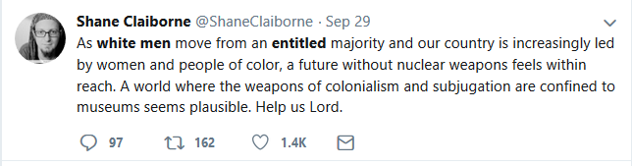
Premise #1: Individual identity is inseparable from group identity as ‘oppressed’ or ‘oppressor’

Slide 15

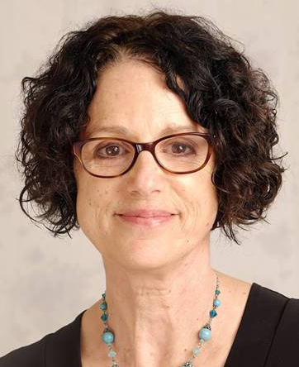
Premise #2: Oppressor groups subjugate oppressed groups through the exercise of hegemonic power
“In any relationship between groups that define one another (men/women, able-bodied/disabled, young/old), the dominant group is the group that is valued more highly. Dominant groups set the norms by which the minoritized group is judged. Dominant groups have greater access to the resources of society and benefit from the existence of the inequality” (p. 25) “Hegemony refers to the control of the ideology of a society. The dominant group maintains power by imposing their ideology on everyone.” (p. 50) – Sensoy and DiAngelo, Is Everyone Really Equal?

Slide 16
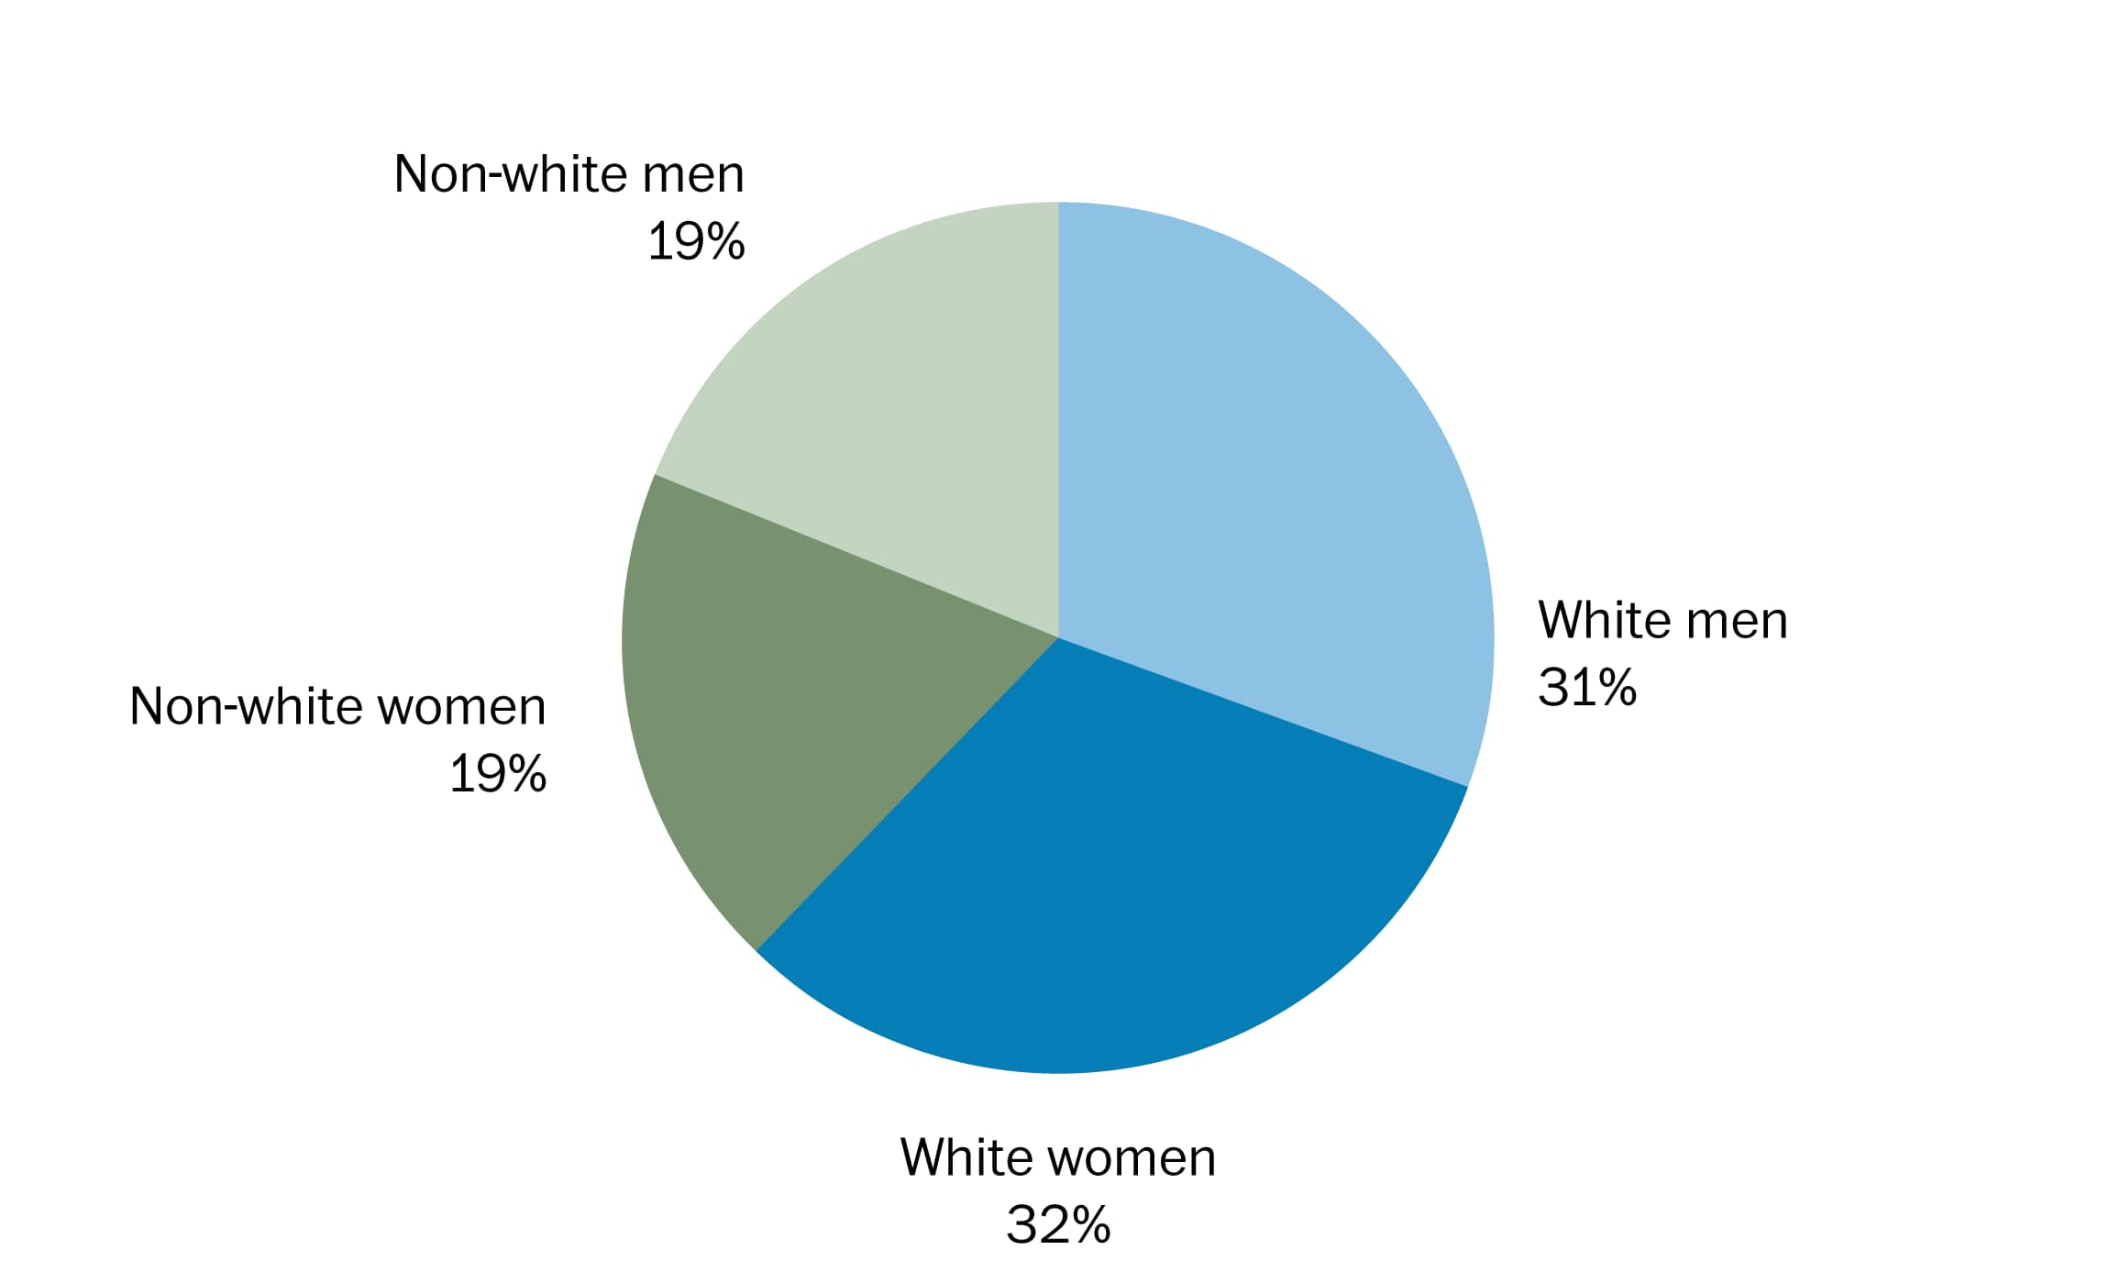
Premise #2: Oppressor groups subjugate oppressed groups through the exercise of hegemonic power
Example: U.S. Demographics

Slide 17
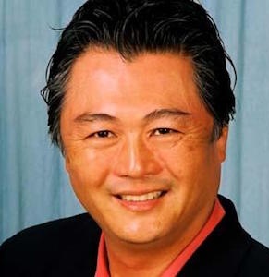

Premise #3: Different oppressed groups find solidarity in the experience of oppression
“I, as a Japanese-American, feel a kinship to both Blacks and Native Americans that I do not feel with white Americans. It… comes from our histories as victims of injustice” – David Mura, in Andersen and Collins, Race, Class, and Gender, p. 14
“I realized I could be beaten on the street for being a [lesbian]. If my sister’s being beaten because she’s Black, it’s pretty much the same principle.. The connection is blatant…” Cherríe Moraga, in Andersen and Collins, Race, Class, and Gender, p. 23

Slide 18
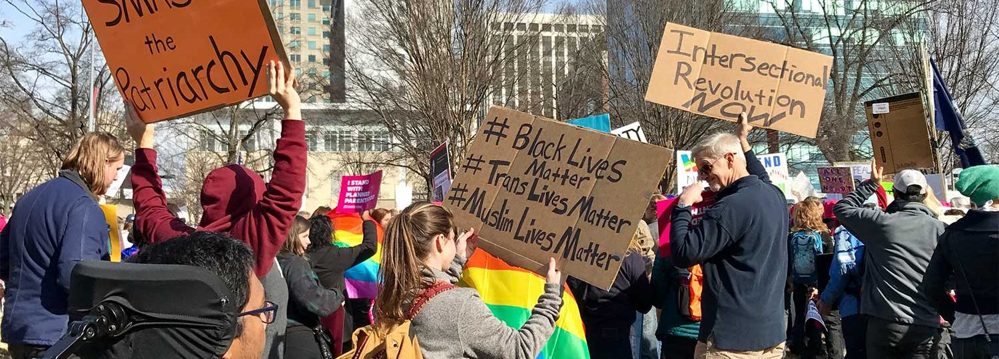
Premise #3: Different oppressed groups find solidarity in the experience of oppression
Example: sustainability.ncsu.edu/

Slide 19
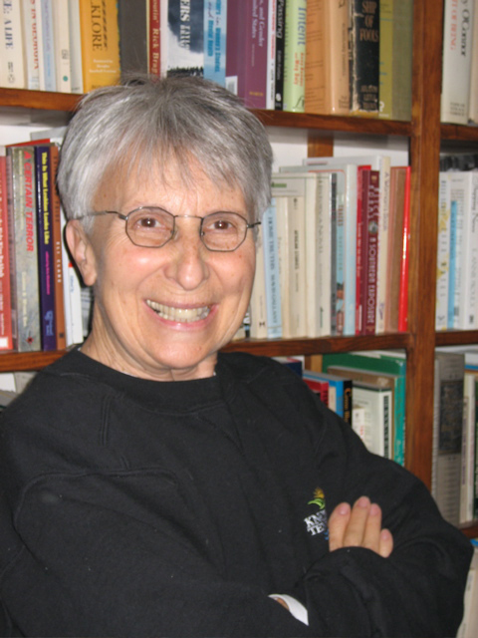
Premise #4: Our fundamental moral duty is freeing groups from oppression
“These political times call for renewed dialogue about and commitment to the politics of liberation…Liberation requires a struggle against discrimination based on race, class, gender, sexual identity, ableism and age” – Suzanne Pharr, “Reflections on Liberation,” in Adams et. al,. Readings for Diversity and Social Justice, p. 450

Slide 20
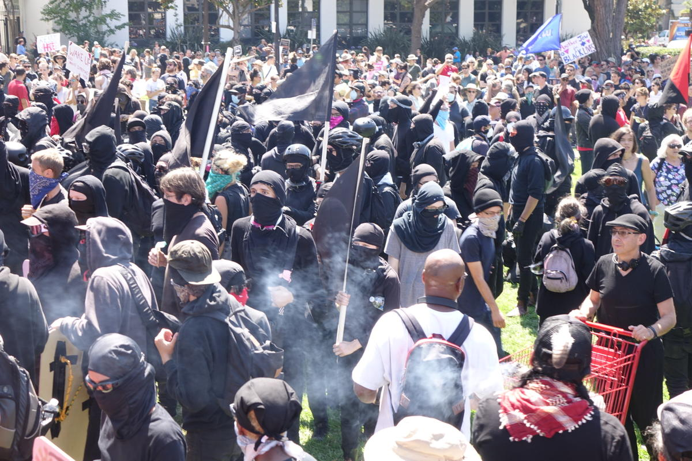
Premise #4: Our fundamental moral duty is freeing groups from oppression

Slide 21
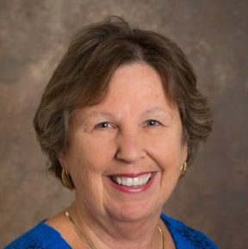
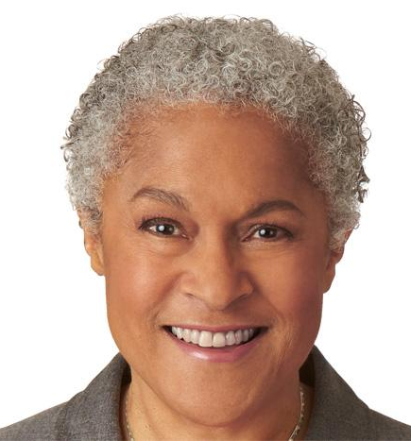
Premise #5: ‘Lived experience’ is more important than objective evidence in understanding oppression
“The idea that objectivity is best reached only through rational thought is a specifically Western and masculine way of thinking – one that we will challenge throughout this book.” – Margaret L. Andersen and Patricia Hill Collins, “Reconstructing Knowledge,” in Anderson and Collins, Race, Class, and Gender, p. 4-5

Slide 22
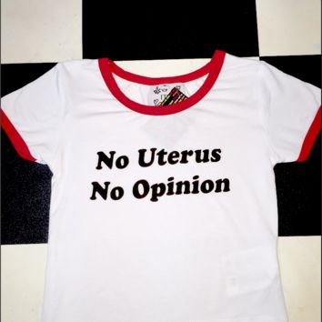
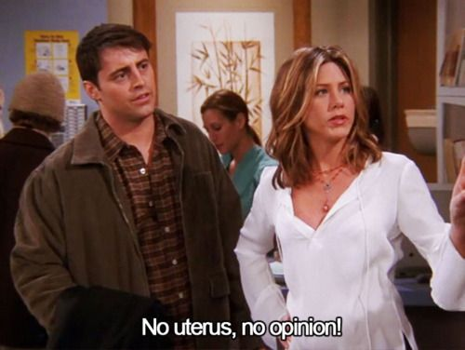

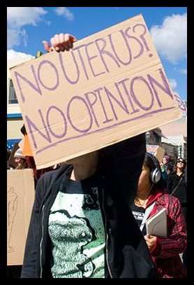
Premise #5: ‘Lived experience’ is more important than objective evidence in understanding oppression

Slide 23
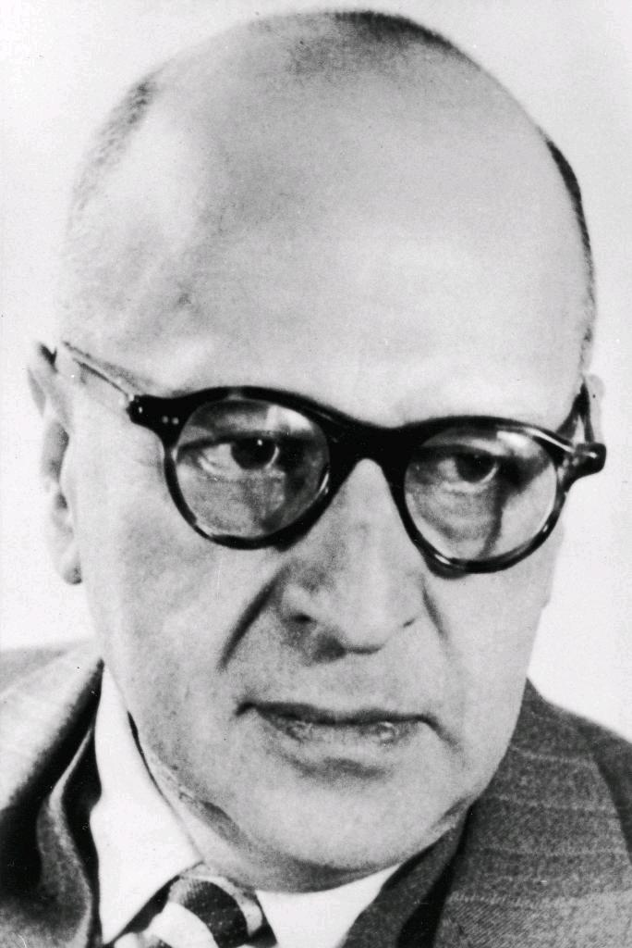
Premise #6: Oppressor groups hide their oppression under the guise of objectivity
“Other [non-critical] forms of thought were seen as affirmative of the existing order in spite of their self-proclaimed neutrality and objectivity… Social interests were hidden within the philosophical discourse.” Stephen Bronner, Critical Theory, p. 23

Slide 24
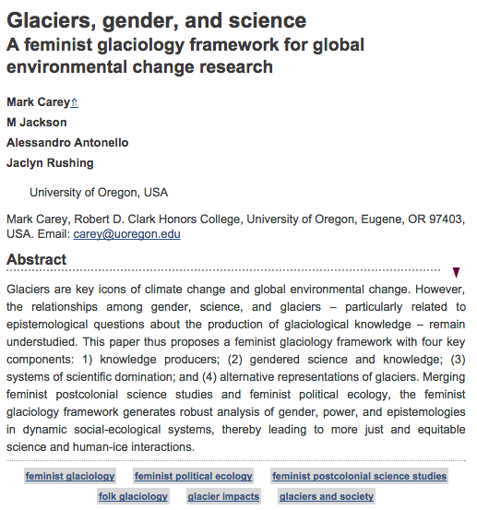
Premise #6: Oppressor groups hide their oppression under the guise of objectivity
…This paper thus proposes a feminist glaciology framework with four key components: 1) knowledge producers; (2) gendered science and knowledge; (3) systems of scientific domination; and (4) alternative representations of glaciers. Merging feminist postcolonial science studies and feminist political ecology, the feminist glaciology framework generates robust analysis of gender, power, and epistemologies in dynamic social-ecological systems, thereby leading to more just and equitable science and human-ice interactions.

Slide 25
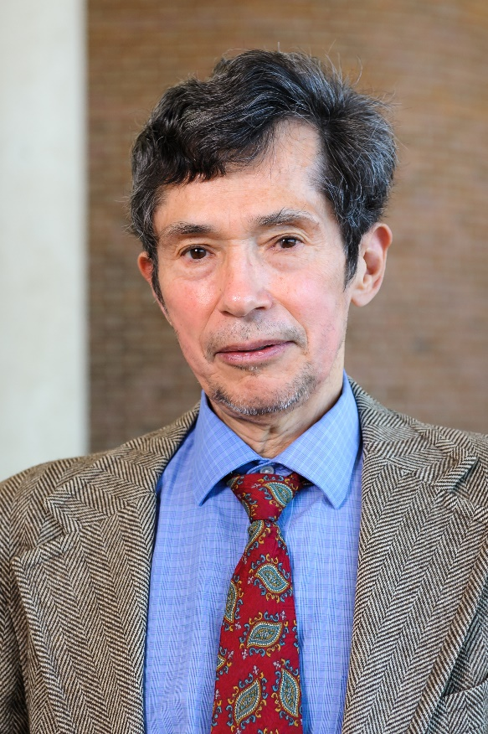

Premise #7: Individuals at the intersection of different oppressed groups experience oppression in a unique way
“Imagine a black woman [who may be] a single working mother… She experiences, potentially, not only multiple forms of oppression but ones unique to her and to others like her.” – Richard Delgado and Jean Stefancic, Critical Race Theory: An Introduction, p. 59

Slide 26
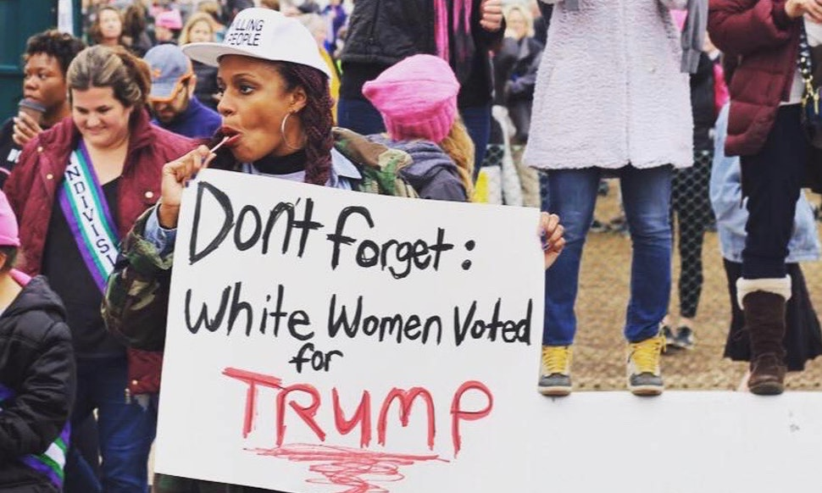
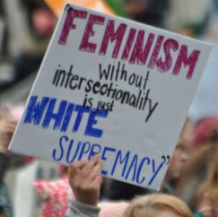
Premise #7: Individuals at the intersection of different oppressed groups experience oppression in a unique way

Slide 27
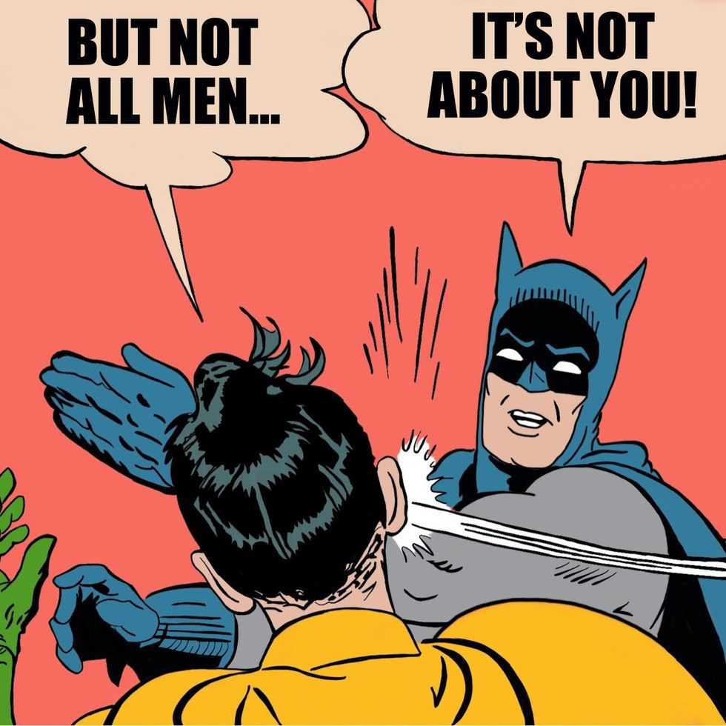

Critical theory is an important and influential ideology in today’s culture

Slide 28
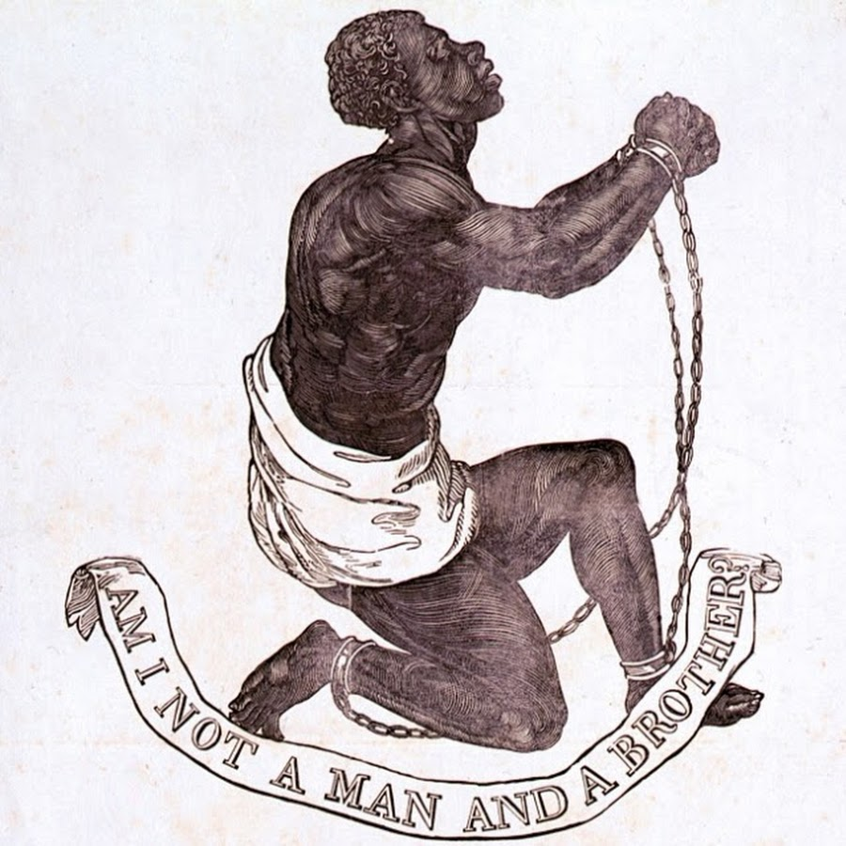


The strengths of critical theory

Slide 29
Strength #1. Emphasis on the sinfulness of oppression
“Learn to do good; seek justice, correct oppression; bring justice to the fatherless, plead the widow's cause.” – Is. 1:17
“Do not oppress the widow, the fatherless, the sojourner, or the poor, and let none of you devise evil against another in your heart.” – Zech. 7:20
“Love your neighbor as yourself.” – Mark 12:30
“Listen! The wages of the laborers who mowed your fields which you kept back by fraud, cry out, and the cries of the har­vesters have reached the ears of the Lord of hosts” – James 5:4

Slide 30
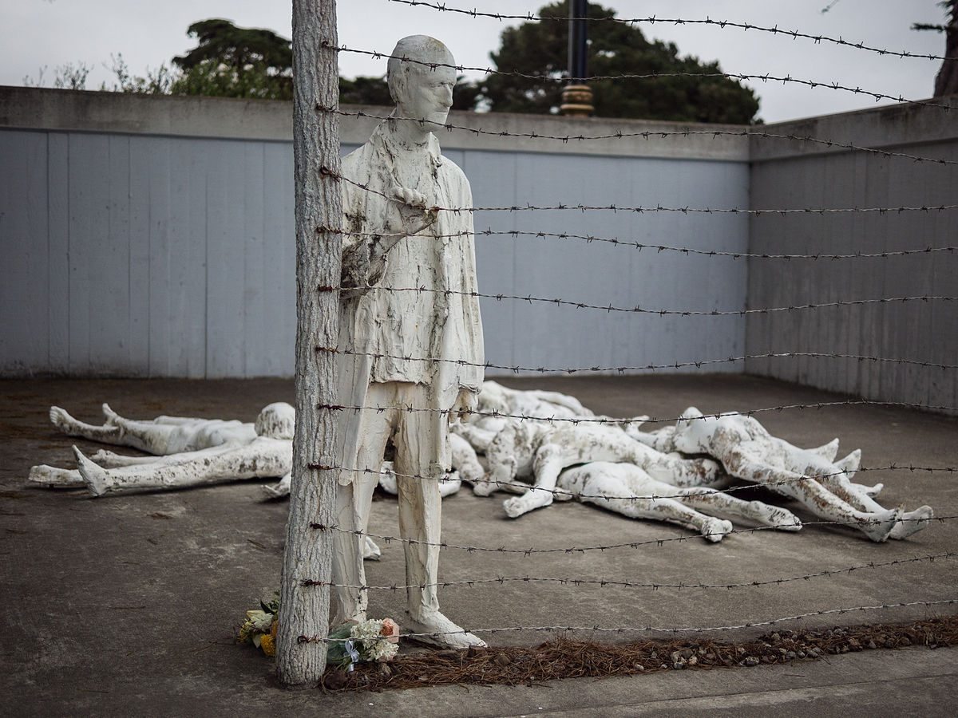
Strength #2. Focus on structures, systems, and norms

Slide 31
Strength #3: Recognition of hegemonic power

Slide 32
Outline
Why should we care?
What is critical theory?
Conflicts between critical theory and Christianity
  Worldview
  Epistemology
  Adversarial identities
  Hegemonic power
  Moral asymmetry
Logical implications
Advice for dialogue

Slide 33
Worldview questions
Who are we?
What is our fundamental problem as human beings?
What is the solution to our problem?
What is our primary moral duty?
What is our purpose in life?

Slide 34
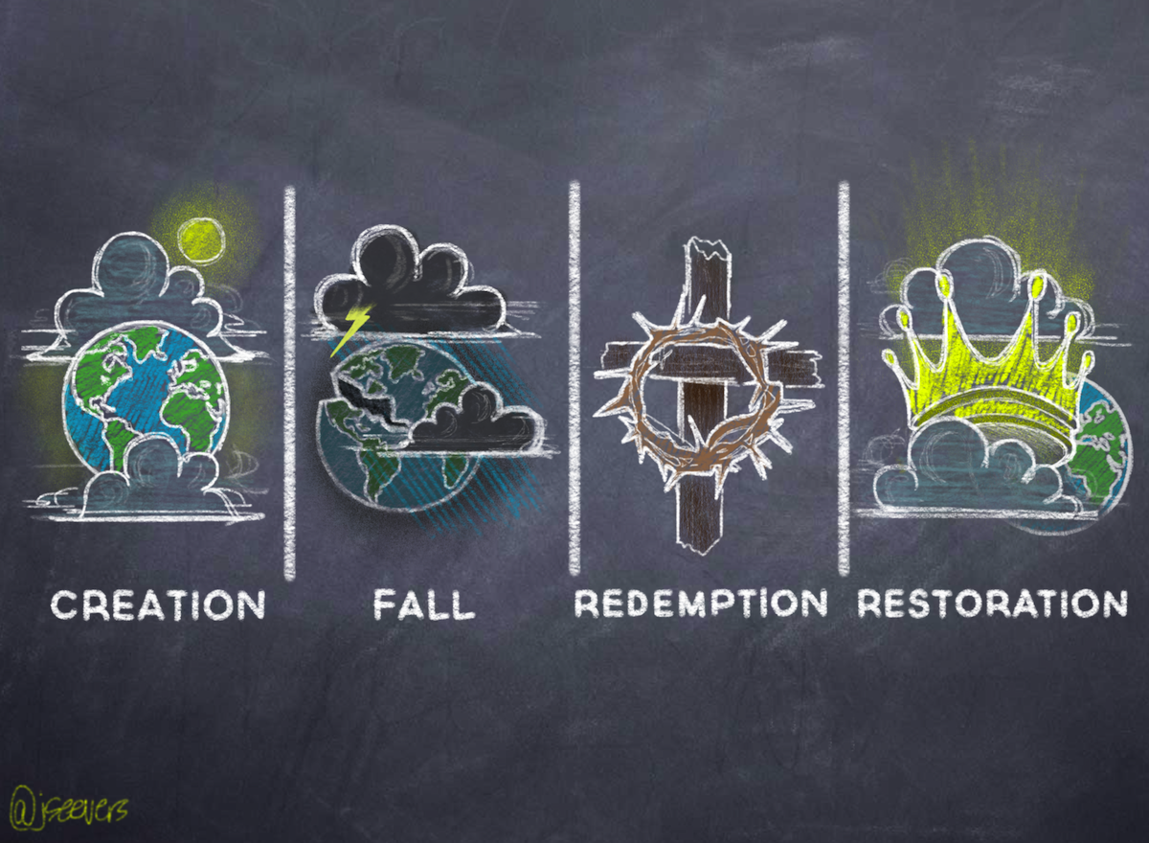
Christianity and critical theory are competing worldviews
Christianity
-----
OPPRESSION
ACTIVISM
LIBERATION
Patriarchy
White supremacy
Heteronormativity
Toxic masculinity
Classism
Ageism
Ableism
Cisgenderism
Protest
Resistance
Education
Awareness
Equality
Power reversal
Justice
Diversity
Critical theory

Slide 35
Worldview questions
 | Christianity | Critical theory
Who are we? | God’s creatures | Members of various groups
What is our problem? | Sin | Oppression
What is the solution? | Jesus | Liberation
What is our duty? | Loving God | Liberating the oppressed
What is our purpose? | Glorifying God | Working for liberation

Slide 36

“In the end, there can be only one”

Slide 37
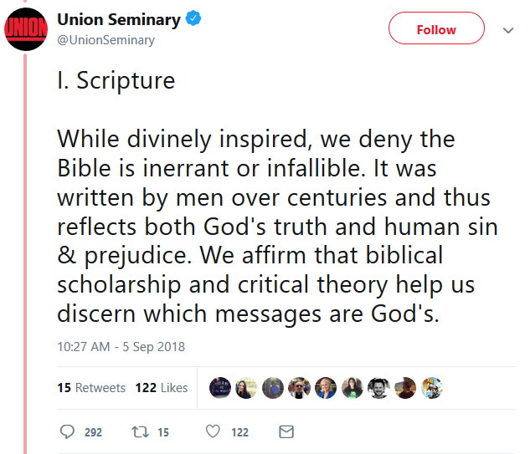
Critical theory as worldview

Slide 38
Outline
Why should we care?
What is critical theory?
Conflicts between critical theory and Christianity
  Worldview
  Epistemology
  Adversarial identities
  Hegemonic power
  Moral asymmetry
Logical implications
Advice for dialogue

Slide 39
Epistemology
Claim
reason,
logic,
argument
Evidence

Slide 40

Epistemology and Bulverism
psychology,
economics,
politics
Claim
reason,
logic,
argument
Motivation
Evidence

Slide 41
Critical theory and Bulverism
psychology,
economics,
politics
Claim
reason,
logic,
argument
“maintaining supremacy”
“internalized oppression”
Evidence

Slide 42
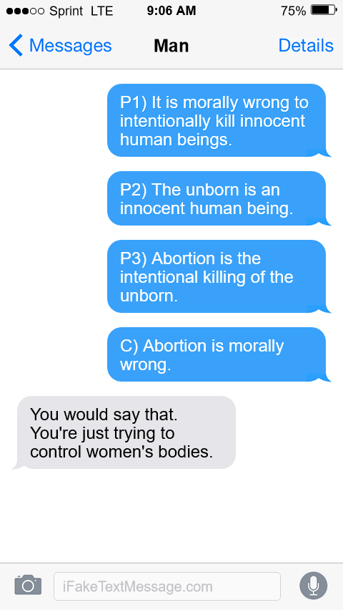
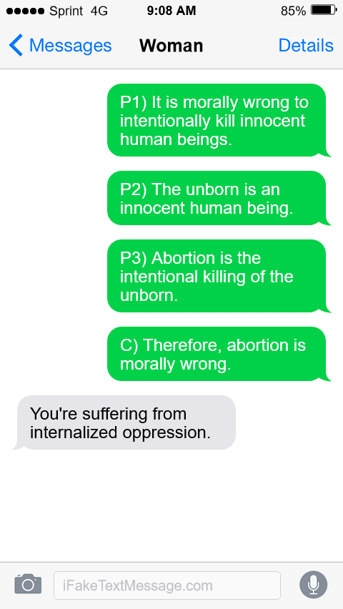
An example from abortion

Slide 43
Critical theory, Bulverism, and the Bible
psychology,
economics,
politics
Claim
reason,
logic,
argument,
exegesis
“maintaining supremacy”
“internalized oppression”
Scripture

Slide 44
Outline
Why should we care?
What is critical theory?
Conflicts between critical theory and Christianity
  Worldview
  Epistemology
  Adversarial identities
  Hegemonic power
  Moral asymmetry
Logical implications
Advice for dialogue

Slide 45


Identity and solidarity

Slide 46
Identity and solidarity
Creation
Sin
Redemption

Slide 47


Sin and human relationships
“assimilation”
“segregation”
Critical theory

Slide 48
Outline
Why should we care?
What is critical theory?
Conflicts between critical theory and Christianity
  Worldview
  Epistemology
  Adversarial identities
  Hegemonic power
  Moral asymmetry
Logical implications
Advice for dialogue

Slide 49

Christianity as hegemonic discourse
Religion
Morality
Sexuality
Gender
etc…

Slide 50
Outline
Why should we care?
What is critical theory?
Conflicts between critical theory and Christianity
  Worldview
  Epistemology
  Adversarial identities
  Hegemonic power
  Moral asymmetry
Logical implications
Advice for dialogue

Slide 51
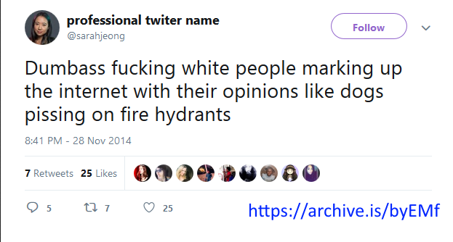
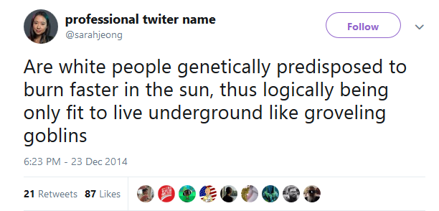

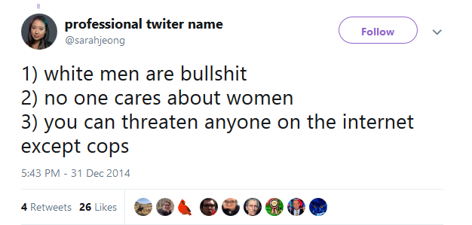
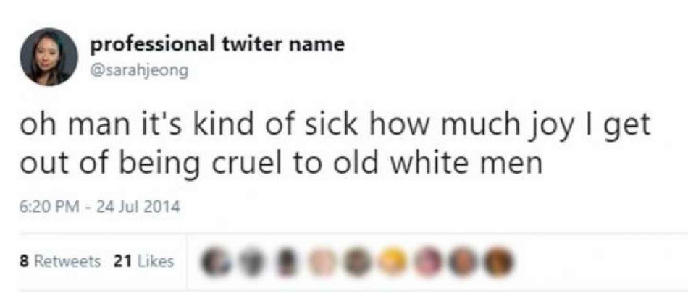
Moral Asymmetry

Slide 52

Moral Asymmetry
“What makes these quasi-satirical generalizations about “white people” different from actual racism is, yes, the underlying power structure in American society. There is no sense of threat associated with Jeong making a joke about how white people have dog-like opinions. But when white people have said the same about minorities, it has historically been a pretext for violence or justification for exclusionary politics.” – Zach Beauchamp, “In Defense of Sarah Jeong” Vox, 8/3/18

Slide 53

Moral Asymmetry
“Privileged people who are committed to listening well will eventually encounter oppressed people who are angry (and rightfully so). Most of the time, this anger will seem directed at the privileged person or at privileged people in general... Now is not the time for privileged folks to be a “prophetic voice” in the lives of oppressed people by speaking hard truth about what (privileged people think) oppressed people should be doing to improve their situation. Privileged people lost their right to the prophetic megaphone when they knowingly or unknowingly participated in societal systems that benefit some people and oppress others. Sorry folks - you can’t be a prophet and an oppressor at the same time.” – Christian professor

Slide 54
Moral Asymmetry
“Don’t chastise POCs (or dismiss their message) because they express their grief, fear, or anger in ways you deem “inappropriate.” Understand that historically, we white people have silenced voices of dissent and lament with our cultural idol of “niceness.” Provide space for POCs to wail, cuss, or even yell at you. Jesus didn’t hold back when he saw hypocrisy and oppression; POCs shouldn’t have to either.” – Christian racial reconciliation group

Slide 55
Biblical commands to particular groups
Never violate God’s universal commands to all Christians
Are based on roles, not on power differentials
Affirm the legitimacy of authority (Rom. 12, Eph. 5:21-6:9, Col. 3:18-4:1, Titus 2:1-10, 1 Pet. 2:18-3:7)
Do not contradict God’s commands to judge impartially (Lev. 19:15, Deut. 1:17, Prov. 20:11)

Slide 56
Christianity and critical theory are competing worldviews
Christianity
-----
OPPRESSION
ACTIVISM
LIBERATION
Patriarchy
White supremacy
Heteronormativity
Toxic masculinity
Classism
Ageism
Ableism
Cisgenderism
Protest
Resistance
Education
Awareness
Equality
Power reversal
Justice
Diversity
Critical theory

Slide 57
Outline
Why should we care?
What is critical theory?
Conflicts between critical theory and Christianity
Logical implications
  “We should never challenge ‘lived experience’.”
  “We need to liberate our theology from privileged groups.”
  “We should dismantle all structures which perpetuate privilege.”
Advice for dialogue

Slide 58
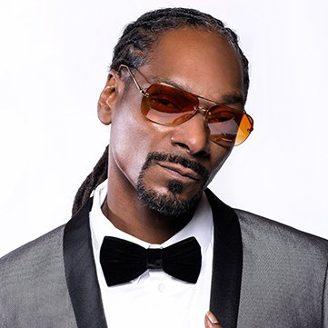
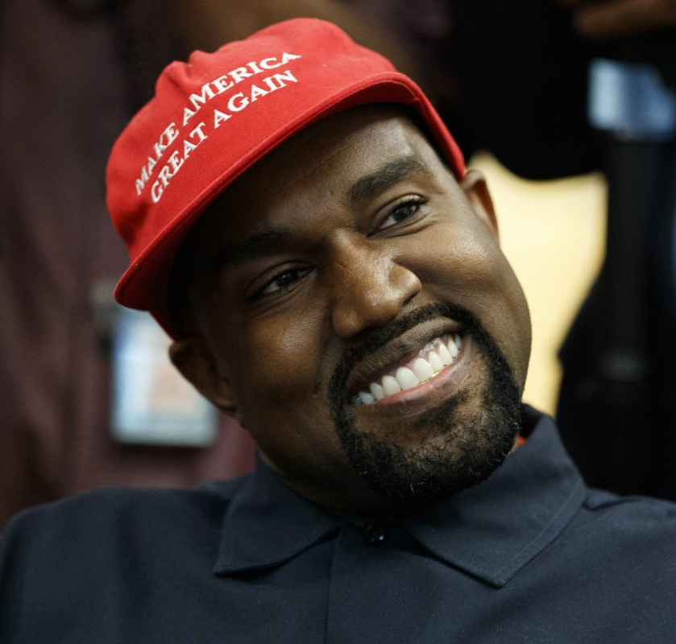
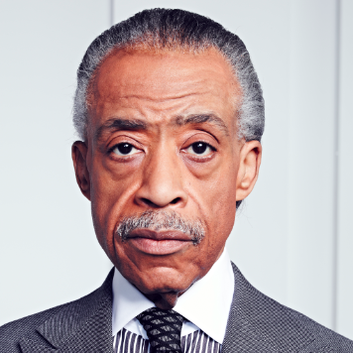
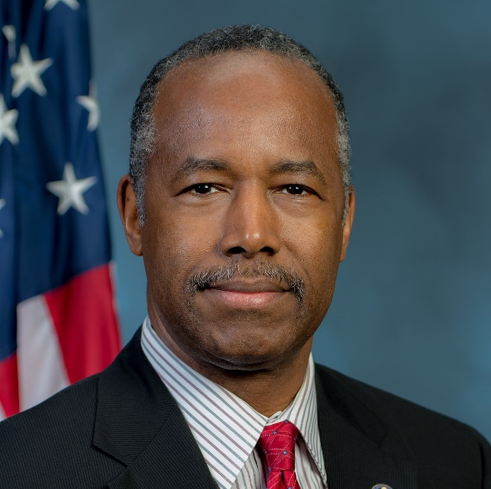
Claim #1: “We should never challenge ‘lived experience’”

Slide 59
Claim #1: “We should never challenge ‘lived experience’”
“As a woman, I know that our society is deeply sexist.”
“As a black man, I know that our society is deeply racist.”
“As a lesbian, I know that sexual orientation is fixed from birth.”
“As a Sufi Muslim, I know that Islam is true.”
“As a polyamorous man, I know that sex outside of marriage is okay.”
“As a Hindu, I’ve had religious experience that show me how all religions are paths to the divine.”
Truth claims must be evaluated on the basis of Scripture and objective evidence.

Slide 60
Outline
Why should we care?
What is critical theory?
Conflicts between critical theory and Christianity
Logical implications
  “We should never challenge ‘lived experience’.”
  “We need to liberate our theology from privileged groups.”
  “We should dismantle all structures which perpetuate privilege.”
Advice for dialogue

Slide 61
Claim #2: “We need to liberate our theology from privileged groups”
“We need to de-center ‘white theology’ and platform the theology of people of color.”
“We need to de-center ‘Western theology’ and platform non-Western theology.”
“We need to de-center male theology and platform feminist theology.”
“We need to de-center the Eurocentric creeds of the Reformation, and platform liberation theology.”
“We need to de-center the all-male books of the Bible and platform the extra-biblical books written by women.”

Slide 62
Outline
Why should we care?
What is critical theory?
Conflicts between critical theory and Christianity
Logical implications
  “We should never challenge ‘lived experience’.”
  “We need to liberate our theology from privileged groups.”
  “We should dismantle all structures which perpetuate privilege.”
Advice for dialogue

Slide 63

Claim #3: “We should dismantle all structures which perpetuate privilege”
“We should dismantle capitalism, because it perpetuates economic privilege.”
“We should dismantle male eldership, because it perpetuates male privilege.”
“We should dismantle the institution of marriage, because it perpetuates heterosexual and monogamous privilege.”
“We should dismantle anti-abortion laws, because they perpetuate male privilege.”
“We should dismantle the connection between sex and gender, because it perpetuates cis-privilege.”
“We should dismantle all Christian moral norms, because they perpetuate Christian privilege.”

Slide 64
Positives and negatives
Claim #1: “We should never challenge ‘lived experience’”
Positive: Lived experience can give us unique insights
Negative: …but must still be subjected to the scrutiny of Scripture and evidence.
Claim #2: “We need to liberate our theology from privileged groups”
Positive: We should constantly reexamine our theology to recognize where our identity has biased our interpretation
Negative: …but the truth or falsehood of a claim does not depend on the identity of the person making it.
Claim #3: “We should dismantle all structures which perpetuate privilege”
Positive: Power can be abused and misused
Negative: …but power is not inherently evil and power imbalances are not necessarily unjust.

Slide 65
Outline
Why should we care?
What is critical theory?
Conflicts between critical theory and Christianity
Logical implications
Advice for dialogue
  Acknowledge and fight racism
  Avoid the M-word
  Read broadly
  Put the gospel first

Slide 66


Advice for dialogue

Slide 67
Outline
Why should we care?
What is critical theory?
Conflicts between critical theory and Christianity
Logical implications
Advice for dialogue
  Acknowledge and fight racism
  Avoid the M-word
  Read broadly
  Put the gospel first

Slide 68
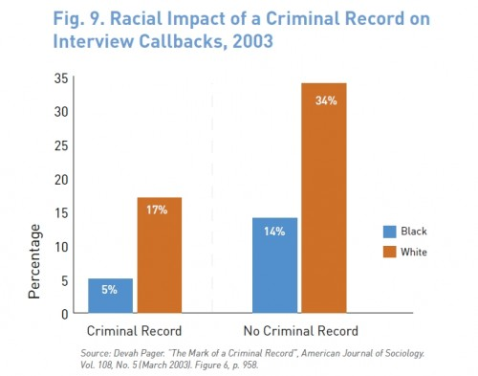
Acknowledge and fight racism
20% higher response rate for whites with criminal record compared to blacks with no criminal record

Slide 69
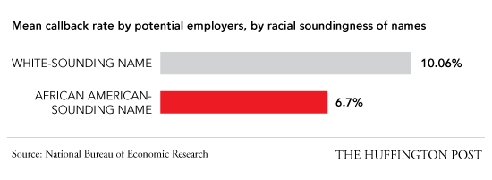
Acknowledge and fight racism
50% higher response rate for whites with identical resumes

Slide 70
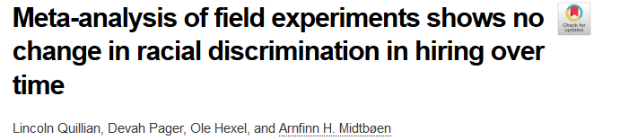
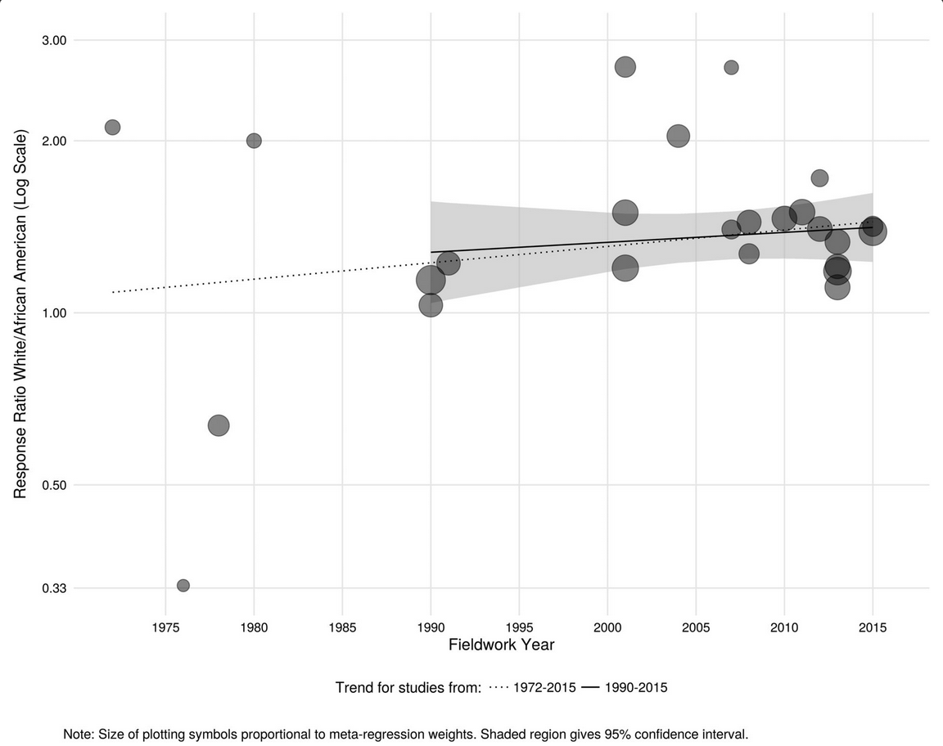
Acknowledge and fight racism
40% higher response rate for whites has not changed in at least three decades

Slide 71

Acknowledge and fight racism
White bus drivers were 2x more likely to give a free ride to white passengers than to black passengers
Mujcic and Frijters, 2013

Slide 72

Acknowledge and fight racism
16% of whites do not approve of intermarriage between whites and blacks

Slide 73

Acknowledge and fight racism
14% of non-blacks would oppose a relative marrying a black person

Slide 74

Acknowledge and fight racism
28% of Republicans think interracial marriage is ‘morally wrong’

Slide 75

Acknowledge and fight racism
34% of white Evangelicals would oppose a close relative marrying a black person
“Among Evangelicals… we see no evidence of prejudicial attitudes decreasing with church attendance.”
– Bradley Wright, Christians Are Hate-Filled Hypocrites… and Other Lies You’ve Been Told, p. 170

Slide 76
Outline
Why should we care?
What is critical theory?
Conflicts between critical theory and Christianity
Logical implications
Advice for dialogue
  Acknowledge and fight racism
  Avoid the M-word
  Read broadly
  Put the gospel first

Slide 77

Don’t be that guy

Slide 78


Avoid labels
I think immigration laws should exist.
AMERICAN EVANGELICALISM is captive to CONSERVATIVE, FASCIST, WHITE SUPREMACIST, NATIONALIST ideologies that have more in common with the philosophy of AYN RAND than the teachings of Jesus!!!!

Slide 79

Avoid labels
I think immigration laws should exist.
AMERICAN EVANGELICALISM is captive to CONSERVATIVE, FASCIST, WHITE SUPREMACIST, NATIONALIST ideologies that have more in common with the philosophy of AYN RAND than the teachings of Jesus!!!!
I think affirmative action laws should exist.
‘WOKE’ EVANGELICALISM is captive to PROGRESSIVE, SOCIALIST, THIRD-WAVE FEMINIST, GLOBALIST ideologies that have more common with the philosophy of KARL MARX than the teachings of Jesus!!!!

Slide 80



Beware of polarization
Critical theory
Biblical orthodoxy
Civil religion
I think Christians should care about justice.
GO PEDDLE YOUR CULTURAL MARXISM SOME PLACE ELSE YOU AVOCADO TOAST-EATING SJW!!!!

Slide 81

Beware of polarization
Critical theory
Biblical orthodoxy
Civil religion
I won

Slide 82
Outline
Why should we care?
What is critical theory?
Conflicts between critical theory and Christianity
Logical implications
Advice for dialogue
  Acknowledge and fight racism
  Avoid the M-word
  Read broadly
  Put the gospel first

Slide 83


Read broadly

Slide 84




Read broadly

Slide 85
Outline
Why should we care?
What is critical theory?
Conflicts between critical theory and Christianity
Logical implications
Advice for dialogue
  Acknowledge and fight racism
  Avoid the M-word
  Read broadly
  Put the gospel first

Slide 86

Put the gospel first

Slide 87
Two crucial questions
Is social justice a Christian imperative? Does God command it? Is it our moral obligation? Is it something we ought to do?
Is the gospel an imperative or a pure indicative? Is it a statement of what we ought to do, or what God has done in Christ?

