Slide 1
Race, Class, and Gender
The Strengths and Weaknesses of the Ideology of the Social Justice Movement
Dr. Neil Shenvi

Slide 2
Acknowledgements
Thanks to my sponsors!
Koch Brothers Industries
Exxon-Mobil
The Knights Templar
The Ayn Rand Center for Intellectualism
100% American Citizen Padminir Vlutin
Southwest Kentucky Small Firearm and Taxidermy Club
Ratio Christi @ NCState

Slide 3
Acknowledgements
Thanks to my sponsors!
Koch Brothers Industries
Exxon-Mobil
The Knights Templar
The Ayn Rand Center for Intellectualism
100% American Citizen Padminir Vlutin
Southwest Kentucky Small Firearm and Taxidermy Club
Ratio Christi @ NCState

Slide 4
Outline
Why study the social justice movement?
What is social justice?
What is ‘critical theory’?
What are the strengths of critical theory?
What are the weaknesses of critical theory?

Slide 5

Why Study the Social Justice Movement?
Political relevance

Slide 6
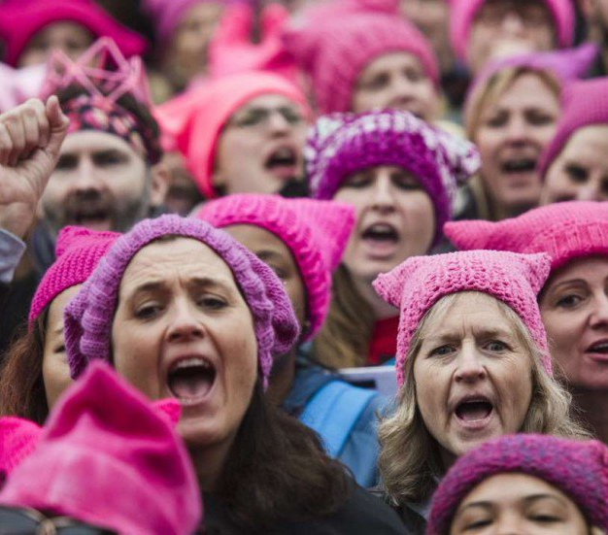
Why Study the Social Justice Movement?
Cultural relevance

Slide 7
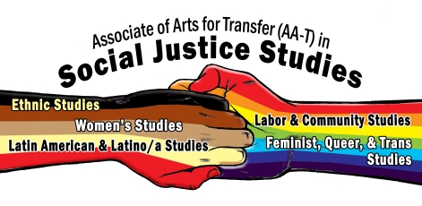
Why Study the Social Justice Movement?
Ideological relevance

Slide 8

Why Study the Social Justice Movement?
Ideological relevance
Reality Studies
Sociology
Astronomy
Jazz
History
Geophysics
French Literature

Slide 9
Why Study the Social Justice Movement?
Ideological relevance
CRITICAL THEORY

Slide 10
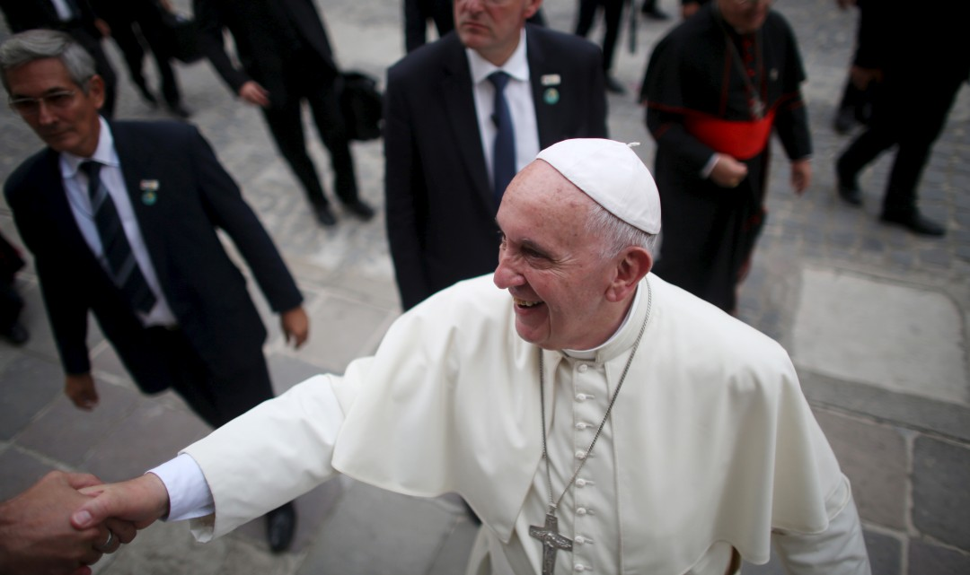
Why Study the Social Justice Movement?
Religious relevance

Slide 11
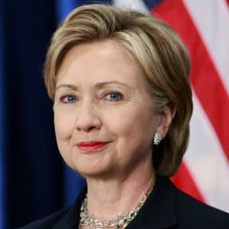

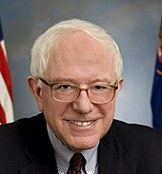
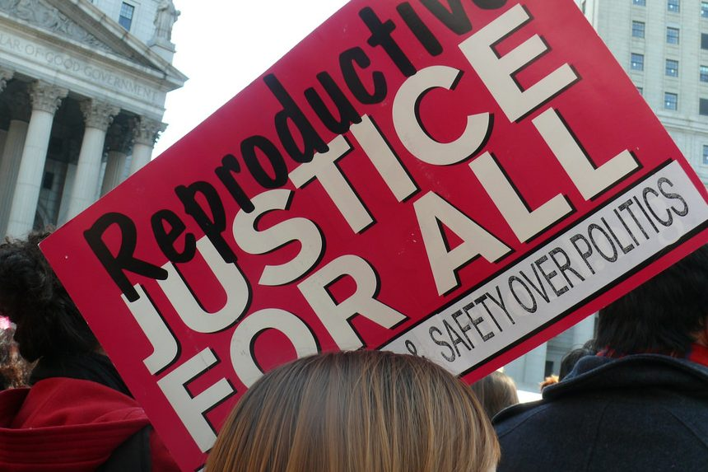
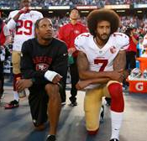
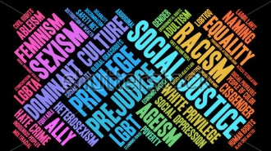
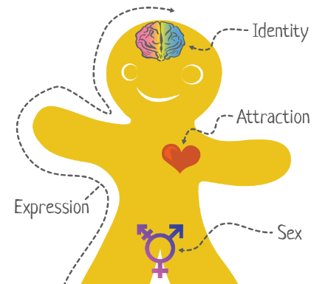
Why Study the Social Justice Movement?
Political
Cultural
Ideological

Slide 12
Outline
Why study the social justice movement?
What is social justice?
What is ‘critical theory’?
What are the strengths of critical theory?
What are the weaknesses of critical theory?

Slide 13
What is ‘social justice’?
Religious social justice
“1943 Society ensures social justice by providing the conditions that allow associations and individuals to obtain their due.
1944 Respect for the human person considers the other "another self." It presupposes respect for the fundamental rights that flow from the dignity intrinsic of the person.
1945 The equality of men concerns their dignity as persons and the rights that flow from it.
1946 The differences among persons belong to God's plan, who wills that we should need one another. These differences should encourage charity.
1947 The equal dignity of human persons requires the effort to reduce excessive social and economic inequalities. It gives urgency to the elimination of sinful inequalities.
1948 Solidarity is an eminently Christian virtue. It practices the sharing of spiritual goods even more than material ones. ”
– Catechism of the Catholic Church

Slide 14

What is ‘social justice’?
Nebulous social justice
“A cry for social justice is usually little more than a call for goodness; “progressive” has become a substitute for “all good things.” But sometimes the word is too vague. So if you press a self-declared progressive to say what it means, he’ll respond, eventually, with something like, “It means fighting for social justice.” If you ask, “What does ‘social justice’ mean?” you are likely to get an exasperated eye roll, because you just don’t get it.” – Jonah Goldberg, National Review

Slide 15

What is ‘social justice’?
Secular social justice
“social justice [is] the elimination of all forms of social oppression” – Mary McClintock, “How to Interrupt Oppressive Behavior,” p. 483
“Heterosexism is the institutionalization of a heterosexual norm or standard, which establishes and perpetuates the notion that all people are or should be heterosexual, thereby privileging heterosexuals and heterosexuality, and excluding the needs, concerns, cultures, and life experiences of LGBT peple.” – Blumenfeld, p. 262
“First, in considering oppression theory, the question ‘what is sexism?’ is addressed through a definition that combines prejudicial attitudes or beliefs with social power. Suzanne Pharr defines sexism as ‘an enforced belief in male dominance and control’ held in place by system of power and control that ultimately keep women subordinate to men. These systems of power and control take place at institutional, cultural, and individual levels.” – Hackman, p. 199
“Like other forms of oppression, ableism operates on individual, cultural, and institutional levels. Ableism affects those with disabilities by inhibiting their access to and power within institutional structures that fulfill basic needs, like health care, housing, government, education, religion, the media, and the legal system.” Castaneda and Peters, p. 320

Slide 16

What is ‘social justice’?
Three influential definitions
Catholic social teaching
“1943. Society ensures social justice by providing the conditions that allow associations and individuals to obtain their due.
1944. Respect for the human person considers the other "another self." It presupposes respect for the fundamental rights that flow from the dignity intrinsic of the person.”
– Catechism of the Catholic Church
“A cry for social justice is usually little more than a call for goodness… If you ask, “What does ‘social justice’ mean?” you are likely to get an exasperated eye roll, because you just don’t get it.” – Jonah Goldberg, National Review
“social justice [is] the elimination of all forms of social oppression” – Mary McClintock, “How to Interrupt Oppressive Behavior” in Adams et al. Readings for Diversity and Social Justice

Slide 17
What is ‘social justice’?
Secular social justice
Catholic social teaching
“social justice [is] the elimination of all forms of social oppression” – Mary McClintock, “How to Interrupt Oppressive Behavior” in Adams et al. Readings for Diversity and Social Justice

Slide 18
What is ‘social justice’?
SOCIAL JUSTICE #3
=
CRITICAL THEORY

Slide 19
Outline
Why study the social justice movement?
What is social justice?
What is ‘critical theory’?
What are the strengths of critical theory?
What are the weaknesses of critical theory?

Slide 20
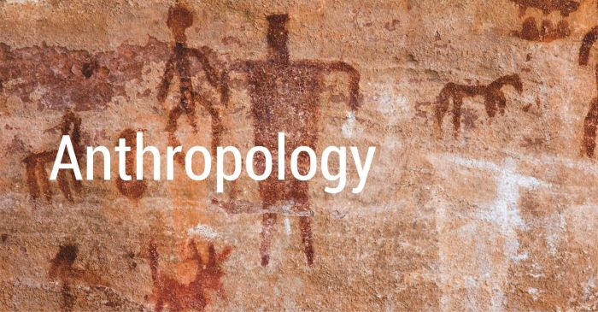



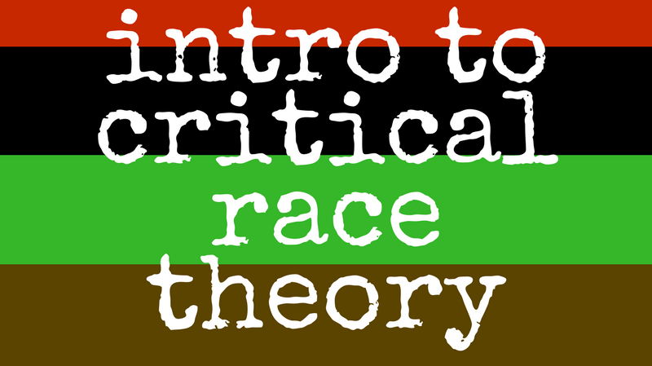
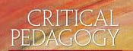
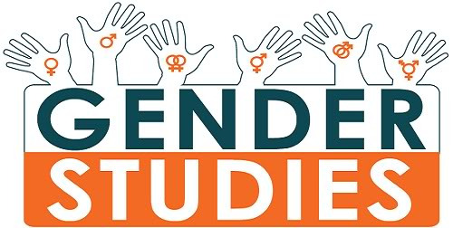
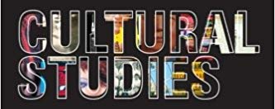
What is critical theory?
CRITICAL THEORY

Slide 21
What is critical theory?
Major premises:
‘Oppressed’ or ‘oppressor’
Oppression through hegemonic power
Solidarity in oppression
Liberation from oppression
Minor premises:
5. ‘Lived experience’
6. Guise of objectivity
7. Intersectionality

Slide 22
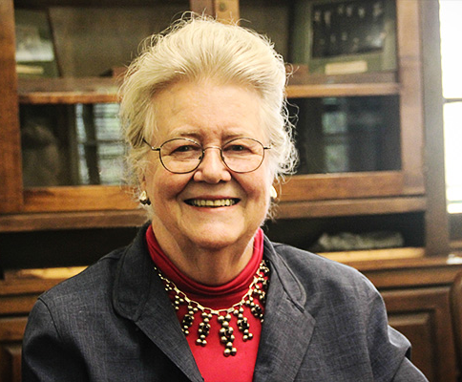
Premise #1: Individual identity is inseparable from group identity as ‘oppressed’ or ‘oppressor’
“My schooling gave me no training in seeing myself as an oppressor… I was taught [wrongly] to see myself as an individual whose moral state depended on her individual moral will” – Peggy McIntosh, “White Privilege and Male Privilege,” in Andersen and Collins, Race, Class, and Gender, p. 72

Slide 23
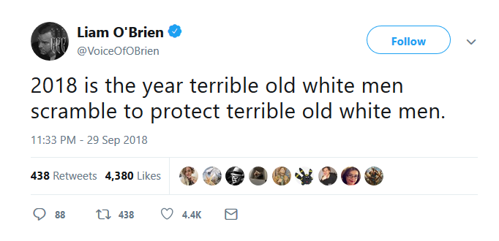
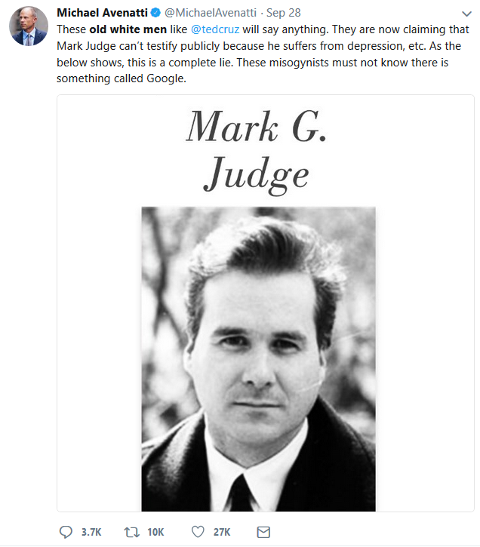
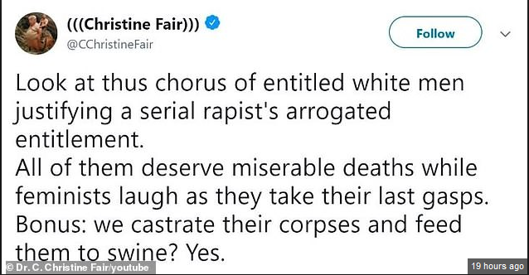
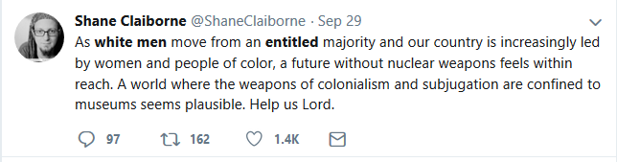
Premise #1: Individual identity is inseparable from group identity as ‘oppressed’ or ‘oppressor’

Slide 24

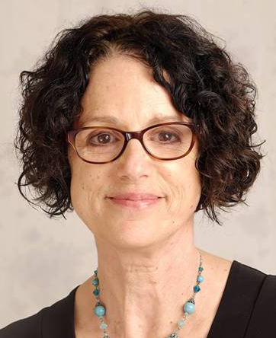
Premise #2: Oppressor groups subjugate oppressed groups through the exercise of hegemonic power
“In any relationship between groups that define one another (men/women, able-bodied/disabled, young/old), the dominant group is the group that is valued more highly. Dominant groups set the norms by which the minoritized group is judged. Dominant groups have greater access to the resources of society and benefit from the existence of the inequality” (p. 25) “Hegemony refers to the control of the ideology of a society. The dominant group maintains power by imposing their ideology on everyone.” (p. 50) – Sensoy and DiAngelo, Is Everyone Really Equal?

Slide 25
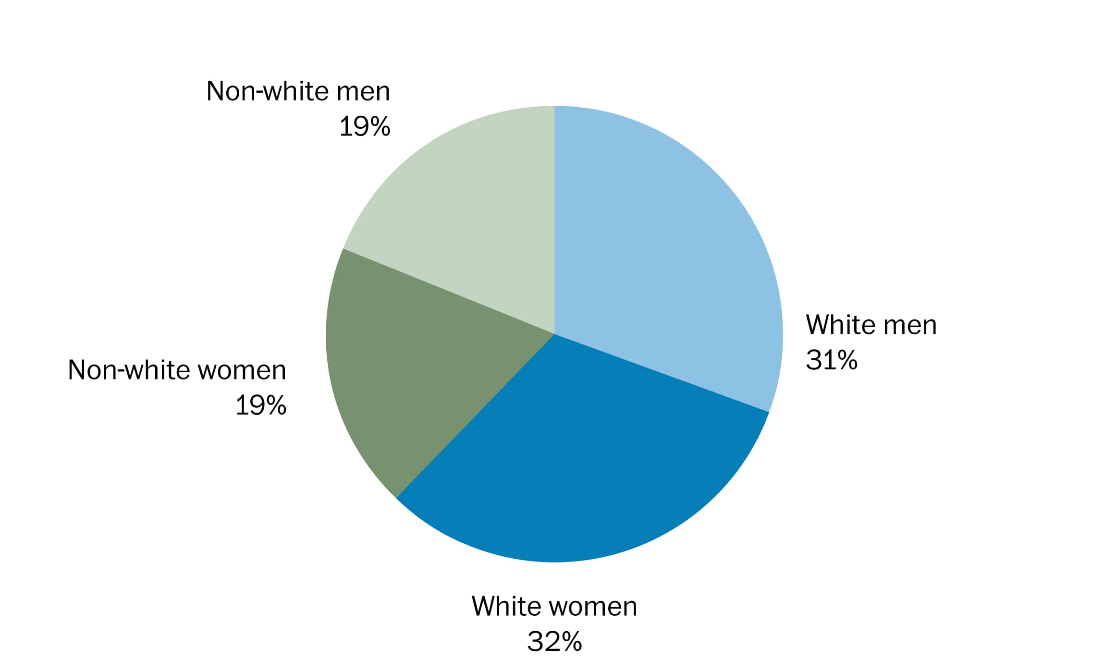
Premise #2: Oppressor groups subjugate oppressed groups through the exercise of hegemonic power
Example: U.S. Demographics

Slide 26
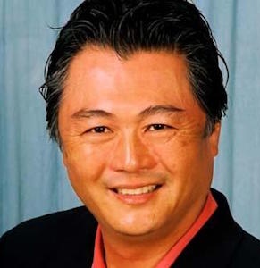
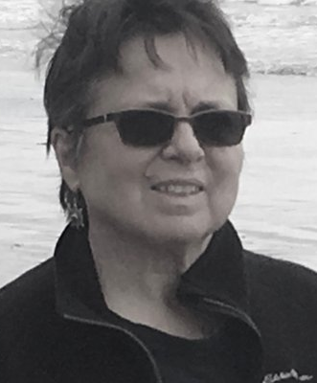
Premise #3: Different oppressed groups find solidarity in the experience of oppression
“I, as a Japanese-American, feel a kinship to both Blacks and Native Americans that I do not feel with white Americans. It… comes from our histories as victims of injustice” – David Mura, in Andersen and Collins, Race, Class, and Gender, p. 14
“I realized I could be beaten on the street for being a [lesbian]. If my sister’s being beaten because she’s Black, it’s pretty much the same principle.. The connection is blatant…” Cherríe Moraga, in Andersen and Collins, Race, Class, and Gender, p. 23

Slide 27
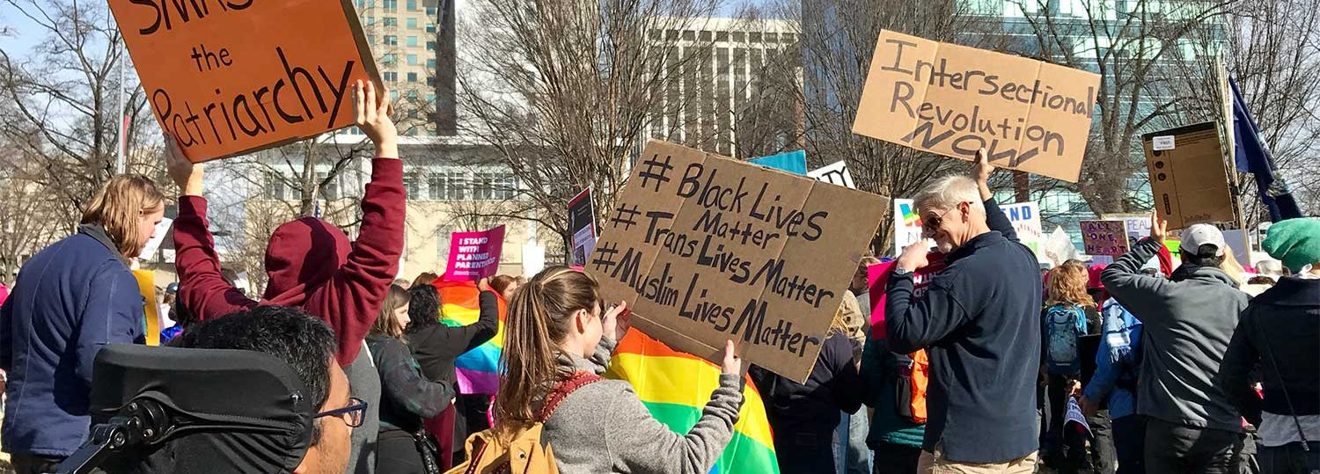
Premise #3: Different oppressed groups find solidarity in the experience of oppression
Example: sustainability.ncsu.edu/

Slide 28
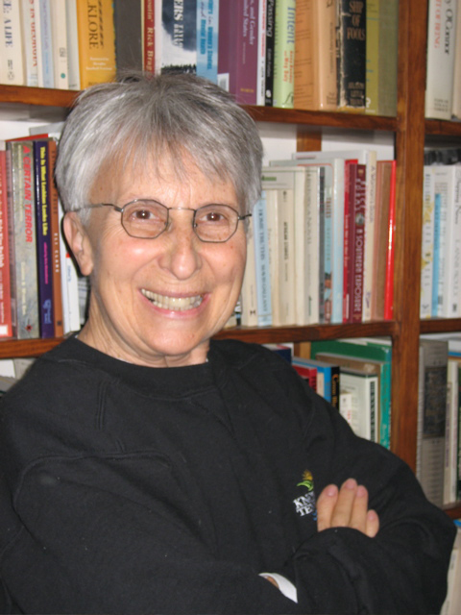
Premise #4: Our fundamental moral duty is freeing groups from oppression
“These political times call for renewed dialogue about and commitment to the politics of liberation…Liberation requires a struggle against discrimination based on race, class, gender, sexual identity, ableism and age” – Suzanne Pharr, “Reflections on Liberation,” in Adams et. al,. Readings for Diversity and Social Justice, p. 450

Slide 29
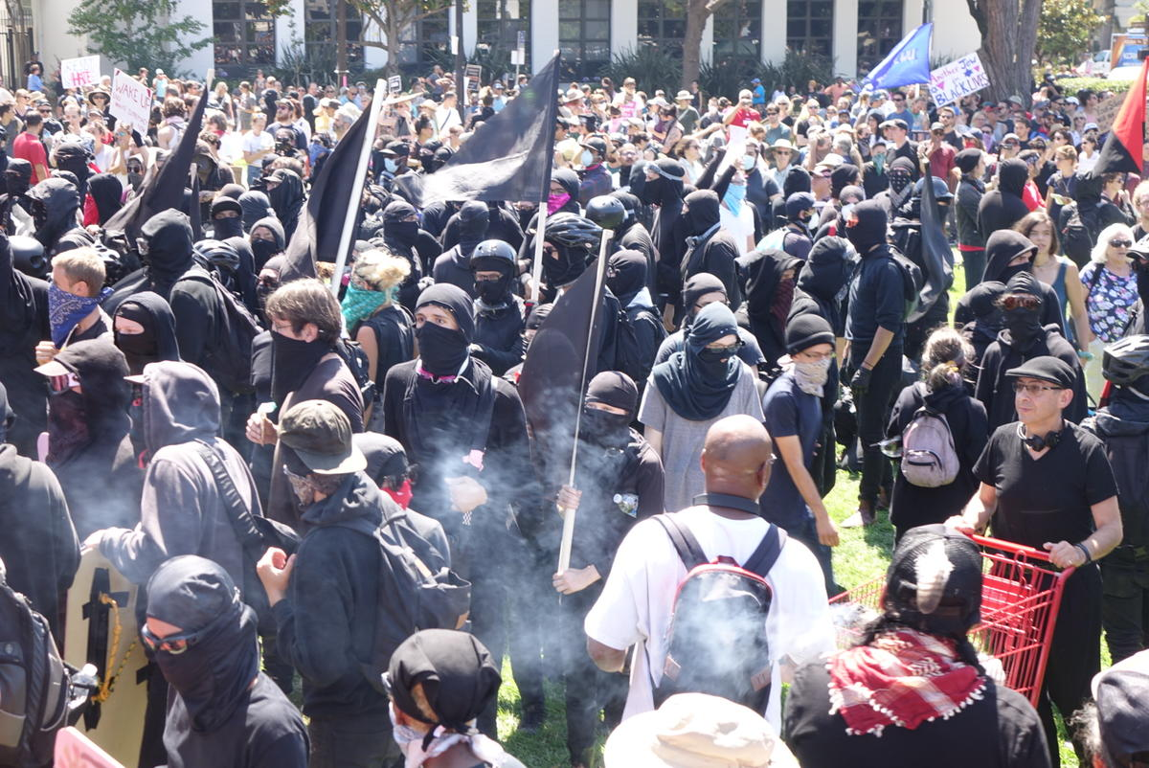
Premise #4: Our fundamental moral duty is freeing groups from oppression

Slide 30
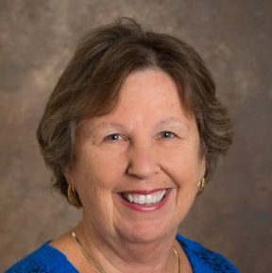
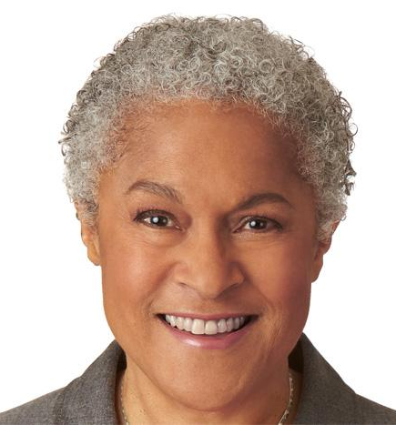
Premise #5: ‘Lived experience’ is more important than objective evidence in understanding oppression
“The idea that objectivity is best reached only through rational thought is a specifically Western and masculine way of thinking – one that we will challenge throughout this book.” – Margaret L. Andersen and Patricia Hill Collins, “Reconstructing Knowledge,” in Anderson and Collins, Race, Class, and Gender, p. 4-5

Slide 31
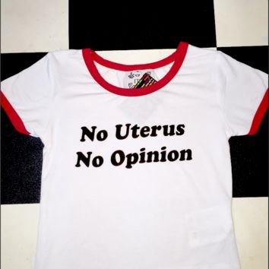
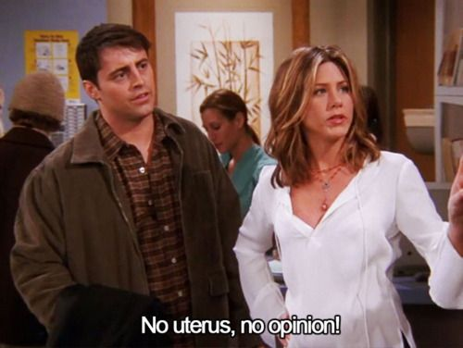

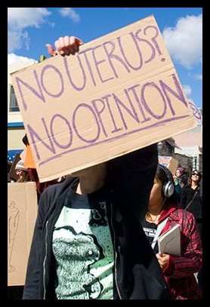
Premise #5: ‘Lived experience’ is more important than objective evidence in understanding oppression

Slide 32
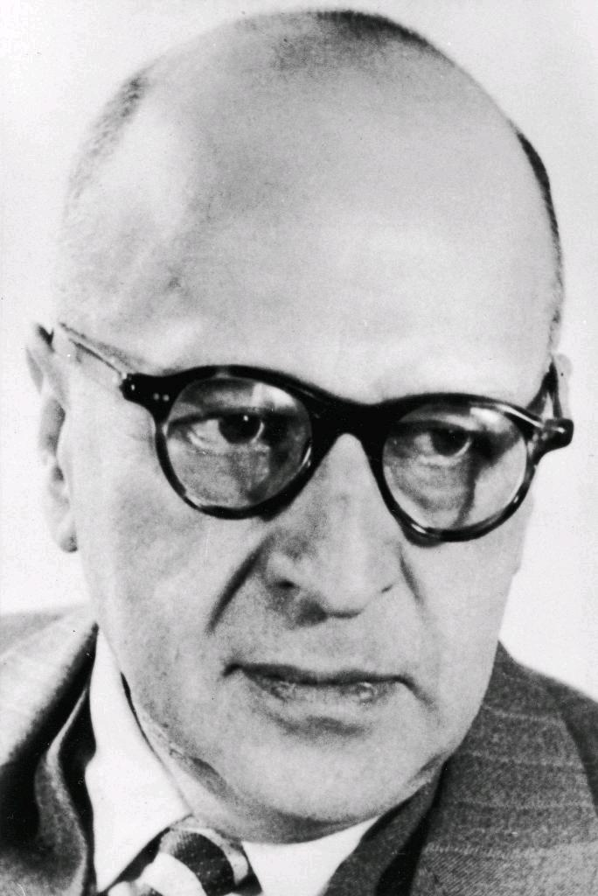
Premise #6: Oppressor groups hide their oppression under the guise of objectivity
“Other [non-critical] forms of thought were seen as affirmative of the existing order in spite of their self-proclaimed neutrality and objectivity… Social interests were hidden within the philosophical discourse.” Stephen Bronner, Critical Theory, p. 23

Slide 33
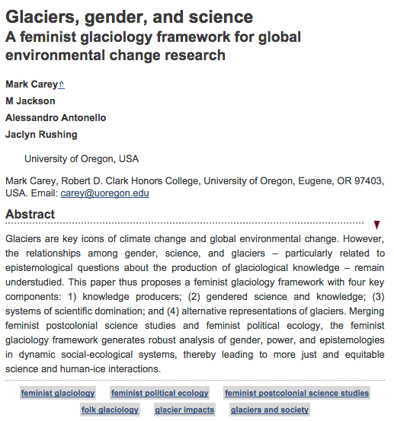
Premise #6: Oppressors groups hide their oppression under the guise of objectivity
…This paper thus proposes a feminist glaciology framework with four key components: 1) knowledge producers; (2) gendered science and knowledge; (3) systems of scientific domination; and (4) alternative representations of glaciers. Merging feminist postcolonial science studies and feminist political ecology, the feminist glaciology framework generates robust analysis of gender, power, and epistemologies in dynamic social-ecological systems, thereby leading to more just and equitable science and human-ice interactions.

Slide 34
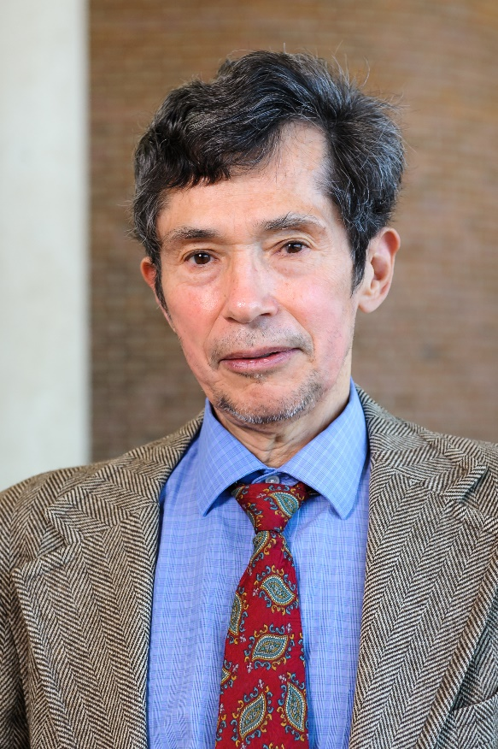

Premise #7: Individuals at the intersection of different oppressed groups experience oppression in a unique way
“Imagine a black woman [who may be] a single working mother… She experiences, potentially, not only multiple forms of oppression but ones unique to her and to others like her.” – Richard Delgado and Jean Stefancic, Critical Race Theory: An Introduction, p. 59

Slide 35
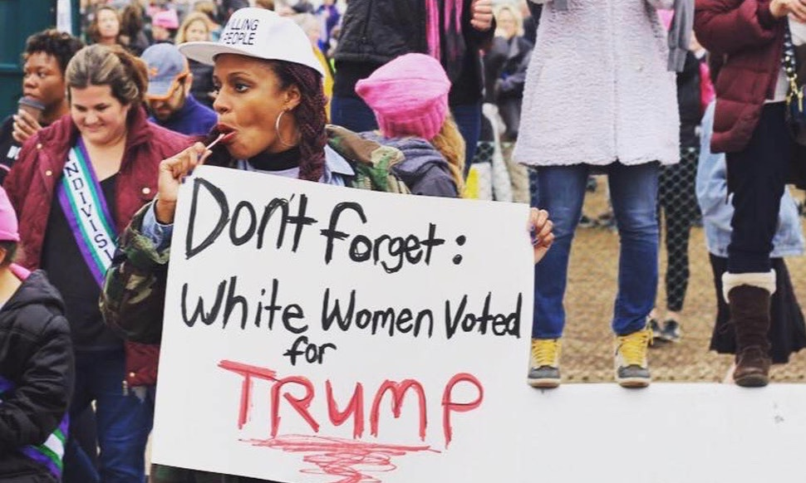
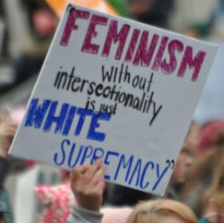
Premise #7: Individuals at the intersection of different oppressed groups experience oppression in a unique way

Slide 36
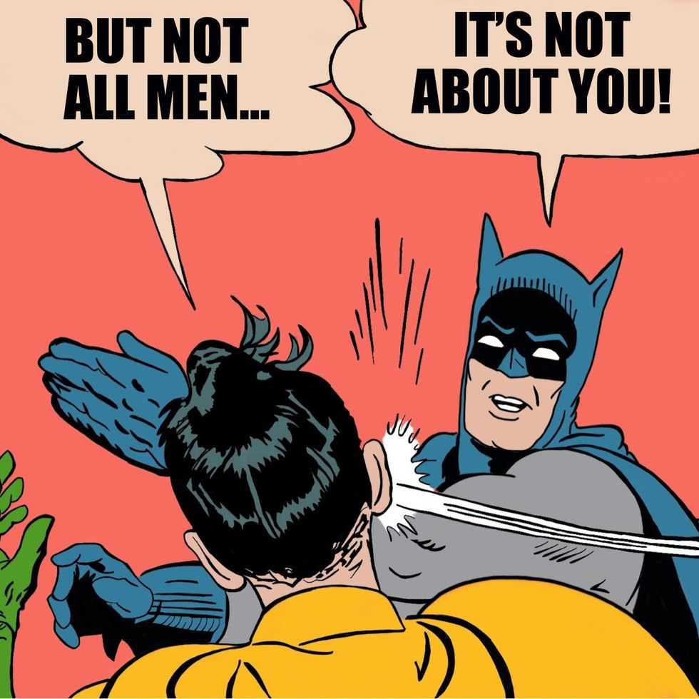

Critical theory is an important and influential ideology in today’s culture

Slide 37
Outline
Why study the social justice movement?
What is social justice?
What is ‘critical theory’?
What are the strengths of critical theory?
What are the weaknesses of critical theory?

Slide 38
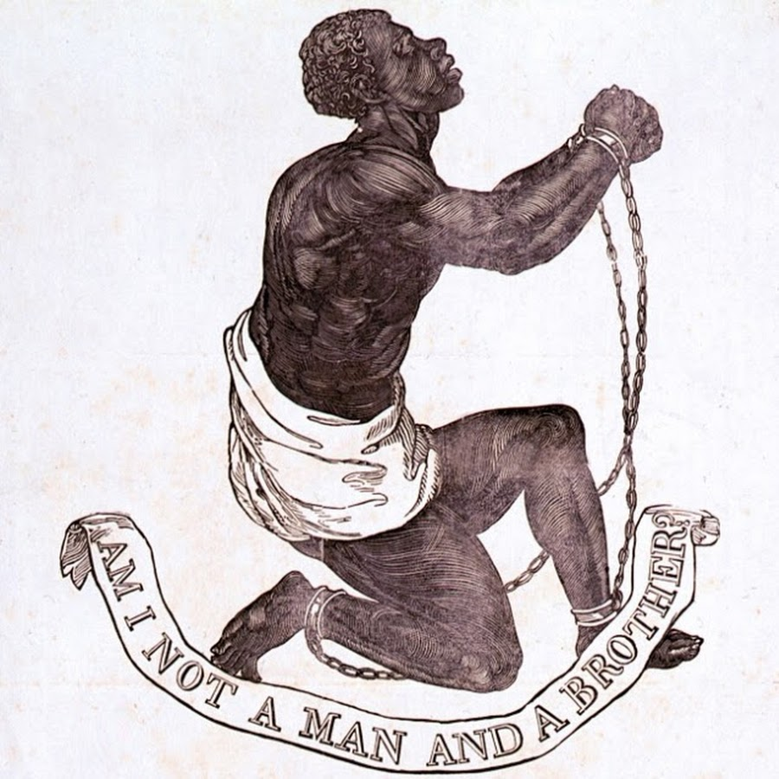
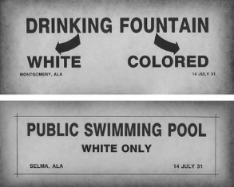
Strength #1. Focus on structures/systems and norms
Systemic racism – unjust systems which harm certain racial groups

Slide 39
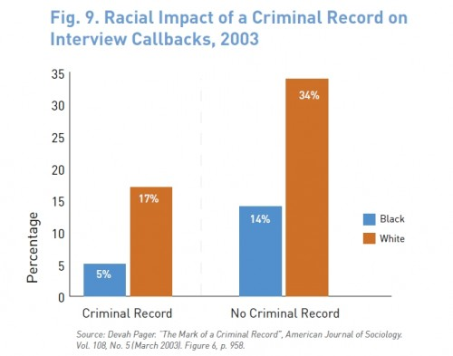
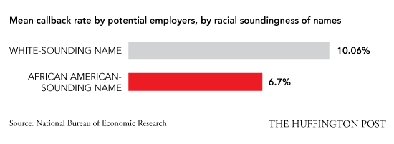
Strength #1. Focus on structures/systems and norms
White privilege – unearned advantages that whites have over people of color, all other things being equal

Slide 40
Strength #1. Focus on structures/systems and norms
WARNING: DEFINITIONS MATTER

Slide 41
Strength #2. Emphasis on the sinfulness of oppression
Old Testament:
“Learn to do good; seek justice, correct oppression; bring justice to the fatherless, plead the widow's cause.” – Is. 1:17
“Do not oppress the widow, the fatherless, the sojourner, or the poor, and let none of you devise evil against another in your heart.” – Zech. 7:20
New Testament:
“Love your neighbor as yourself.” – Mark 12:30
“Listen! The wages of the laborers who mowed your fields which you kept back by fraud, cry out, and the cries of the har­vesters have reached the ears of the Lord of hosts” – James 5:4

Slide 42
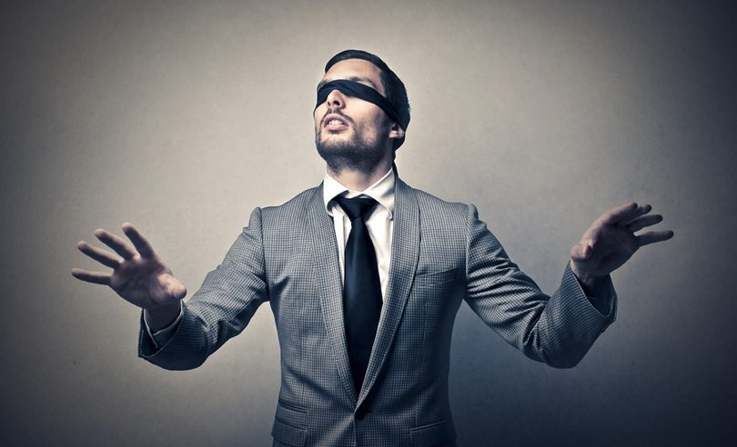
Strength #3. Recognition of the noetic effects of power

Slide 43

Strength #4. Desire to give voice to the marginalized.

Slide 44
Outline
Why study the social justice movement?
What is social justice?
What is ‘critical theory’?
What are the strengths of critical theory?
What are the weaknesses of critical theory?

Slide 45

Weakness #1: Not everything can be reduced to power dynamics
“Christine Delphy (1984), for example, describes marriage as a class relation in which women’s labor benefits men without comparable remuneration” – Young, “Five Faces of Oppression in Adams’ et al. Readings for Diversity and Social Justice, p. 39

Slide 46
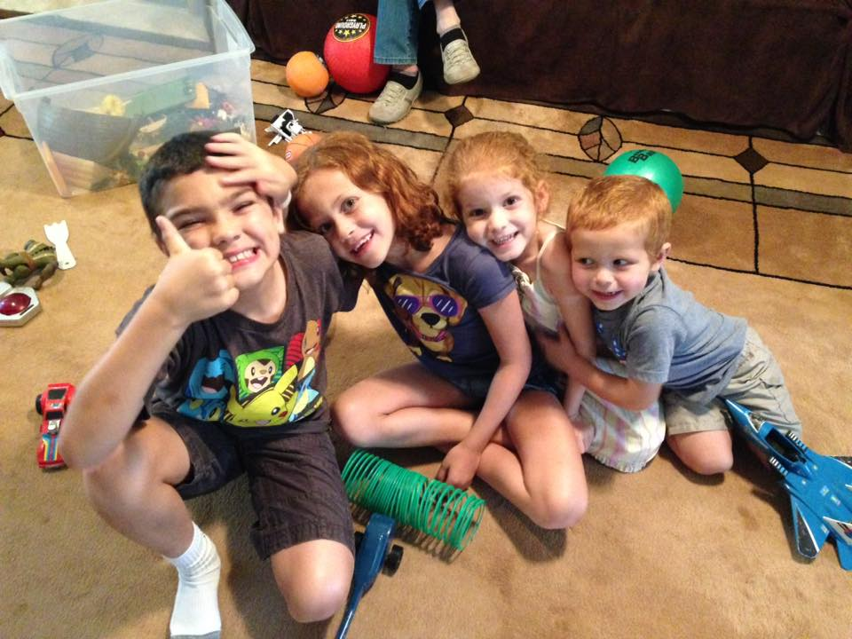
Weakness #1: Not everything can be reduced to power dynamics
“most of us were oppressed as children through the impact of adultism” – Thomson, “Can White Heterosexual Men Understand Oppression?” in Adams’ et al. Readings for Diversity and Social Justice, p. 479
“Children are ... being considered helpless, dependent, and cute - creatures to be cherished and taken are of, but not full human beings to be deeply respected and trusted with significant power. They experience 10-15 years of unpaid labor and brainwashing in our current form of education.”
- Blood, Tuttle, and Lakey in “Understanding and Fighting Sexism: a Call to Men” in Anderson and Collins’ Race, Class, and Gender, p. 139-140

Slide 47
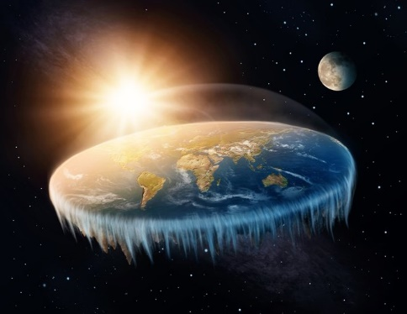
Weakness #1: Not everything can be reduced to power dynamics
Truth is not reducible to power.
Oppressors can make true claims.
An oppressed person can make false claims.

Slide 48
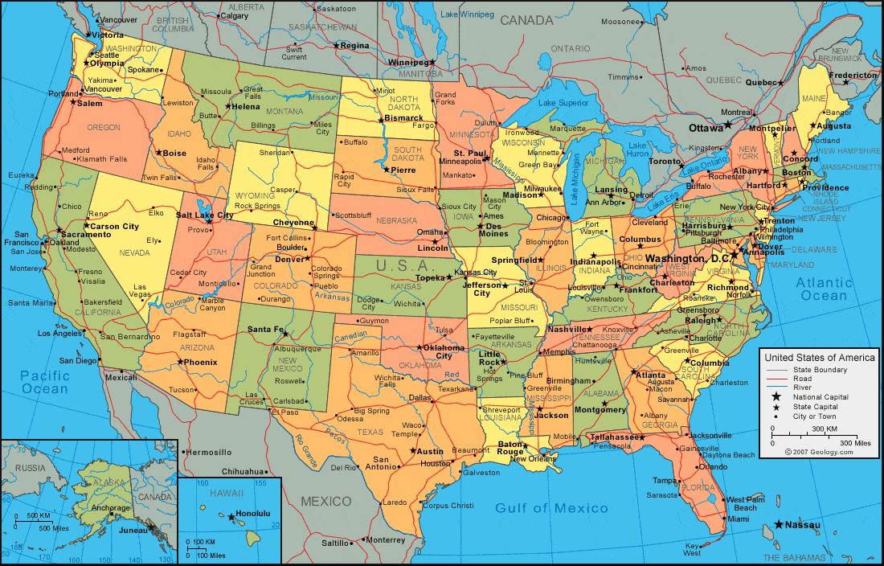
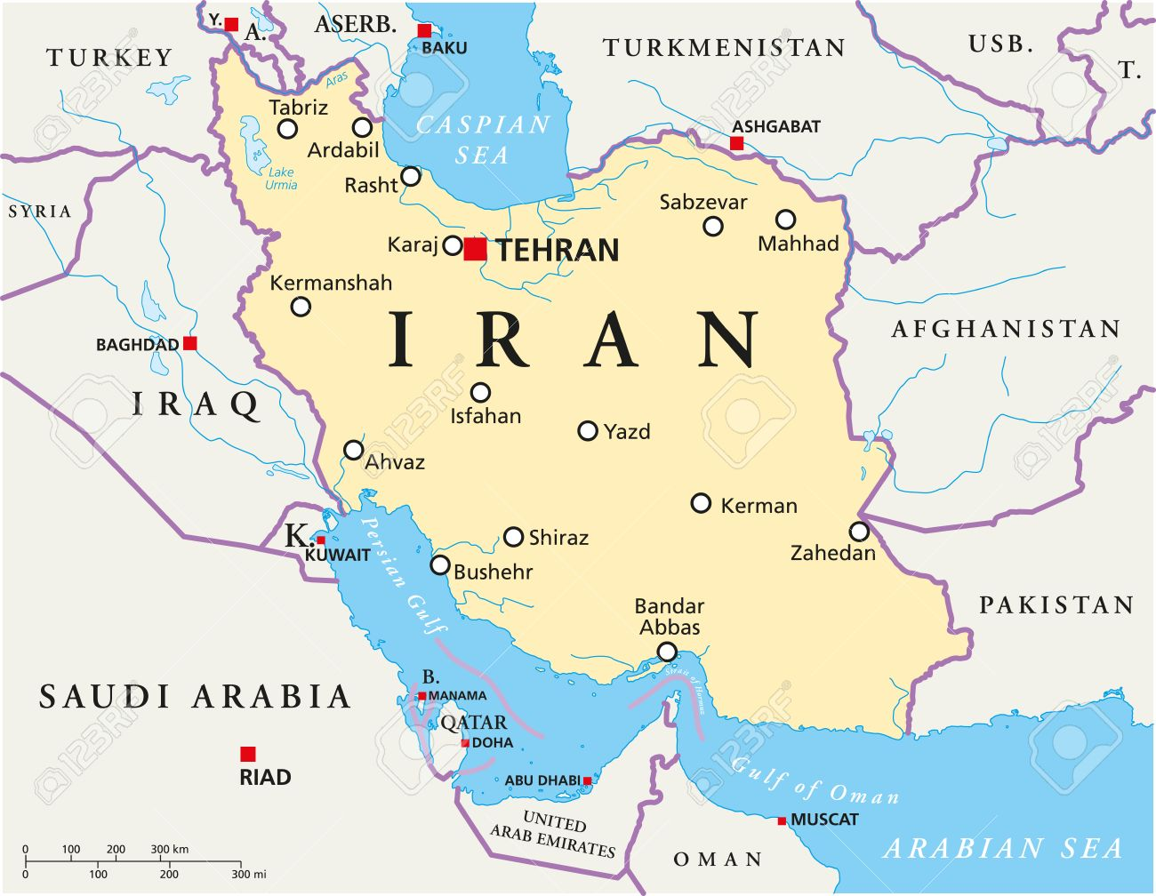
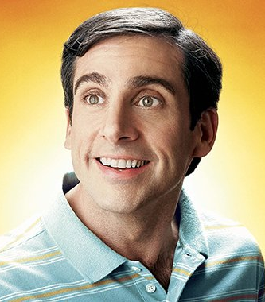
Weakness #2: Power is context-dependent and person-dependent

Slide 49
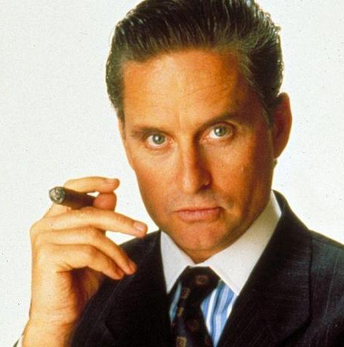

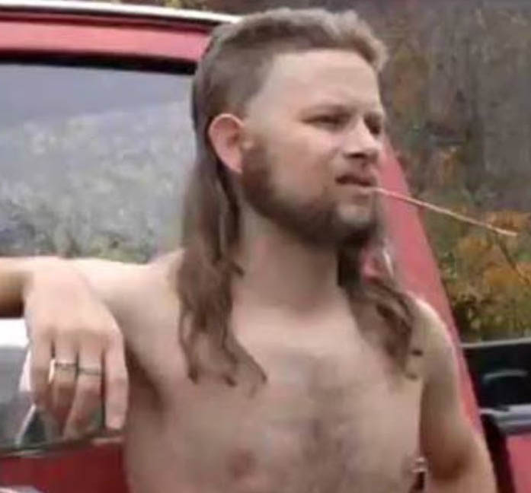
Weakness #2: Power is context- and person-dependent

Slide 50
Weakness #3: ‘Lived experience’ is not always a reliable guide to objective, generalizable truth
“As a woman, I have personally experienced gender discrimination, sexism, and even sexual violence.”
Gender discrimination, sexism, and sexual violence against women are objectively rampant in our culture.
We should dismantle the Patriarchy.

Slide 51
Weakness #3: ‘Lived experience’ is not always a reliable guide to objective, generalizable truth
“As a woman, I have never personally experienced gender discrimination, sexism, or sexual violence.”
Gender discrimination, sexism, and sexual violence against women do not exist in our culture.
We should reject the idea of the Patriarchy.

Slide 52
Weakness #3: ‘Lived experience’ is not always a reliable guide to objective, generalizable truth
“As a mother, I have personally experienced the damage that vaccines did to my child.”
Vaccines are objectively dangerous to children.
We should stop using vaccines.

Slide 53
Weakness #3: ‘Lived experience’ is not always a reliable guide to objective, generalizable truth
“As a cult leader, I have personally experienced the voice of God in my life.”
God is objectively speaking to me.
You should come live in my compound and prepare for Armageddon.

Slide 54
Weakness #3: ‘Lived experience’ is not always a reliable guide to objective, generalizable truth
Personal experience
Interpretation / Extrapolation
Objective truth
Analysis
Prescriptive solution

Slide 55
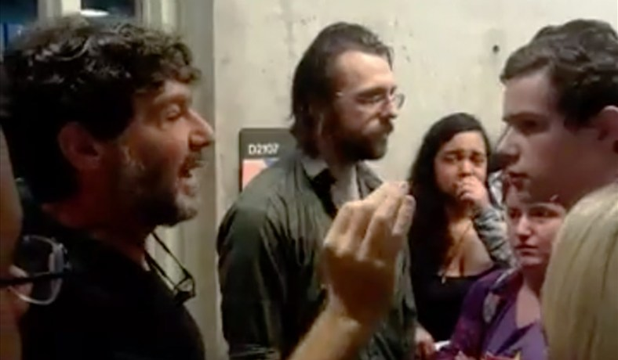
Weakness #4: critical theory is itself a hegemonic discourse that creates power differentials

Slide 56

Weakness #4: critical theory is itself a hegemonic discourse that creates power differentials

Slide 57

Weakness #5: The oppressed and the oppressor both need forgiveness

